Slide 1

Non-linear Regression Analysis with Fitter Software Application
Alexey Pomerantsev
Semenov Institute of Chemical Physics
Russian Chemometrics Society

Slide 2
Agenda
Introduction
TGA Example
NLR Basics
Multicollinearity
Prediction
Testing
Bayesian Estimation
Conclusions

Slide 3

1. Introduction

Slide 4
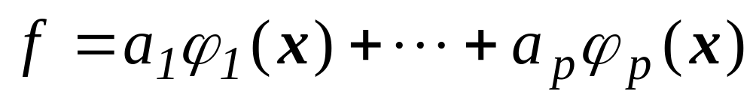
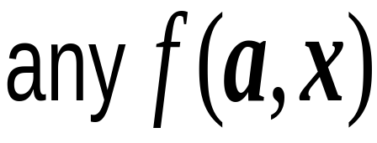
Linear and Non-linear Regressions
2
 | Linear |  |  |  | Non Linear
Formula
Example | f=a exp(-20x) |  |  |  | f=exp(-ax)
Source | Soft |  |  |  |  | Hard
Choice | Easy ? |  |  | Difficult ?
Dimension | Large | Small
Multicollinearity | Excess of parameters |  |  | Lack of data
Interpretation | Well-known |  |  |  |  | Uncommon
Purpose | Interpolation |  | Extrapolation
Soft Tools | Many |  |  |  |  | Few
Close relatives?

Slide 5
2. Thermo Gravimetric Analysis Example
Object |  | PVC Cable Isolation
Goal |  | Service-Life Prediction
Experiment |  | Thermo Gravimetric Method
Tool |  | Non-Linear Regression and Fitter
Let’s see it!

Slide 6
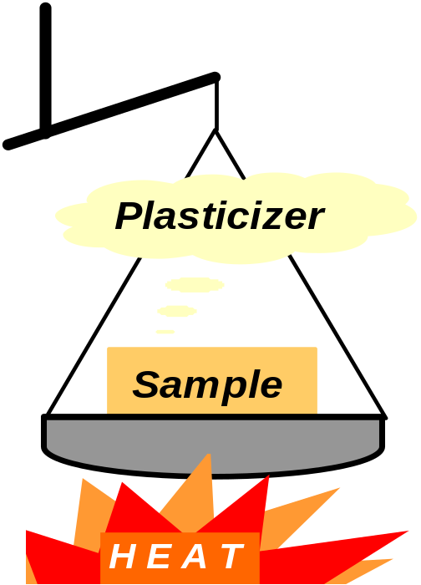
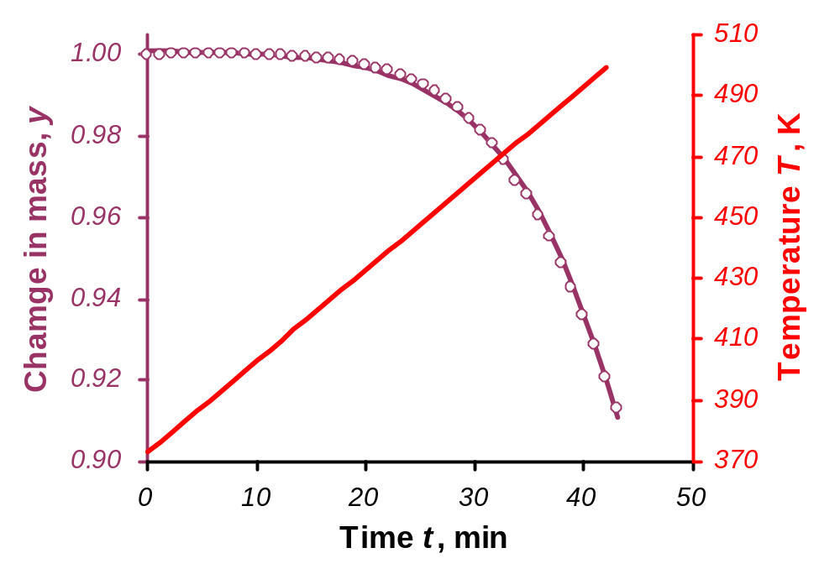
TGA Experiment and Data
TGA Experiment
TGA Data
This is Experiment! Not a Hell of Flame!

Slide 7
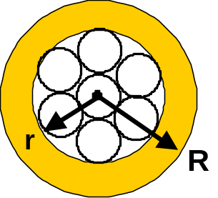
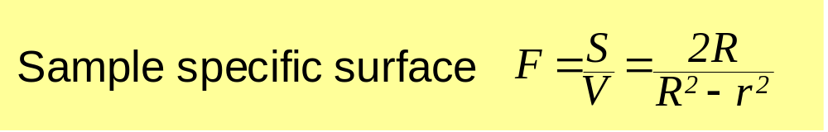
TGA Example Variables
Measured |  |  | Estimated
Response |  |  | Intermediate
y=m/m₀ | Change in mass |  | C | Plasticizer concentration
Predictors |  |  | Parameters
t | Time |  | y₀ | Initial value of y
C₀ | Initial concentration |  | k₀ | Evaporation rate constant
v | Heating rate |  | E | Activation energy
T₀ | Initial temperature
F | Sample specific surface
Small size
problem!

Slide 8
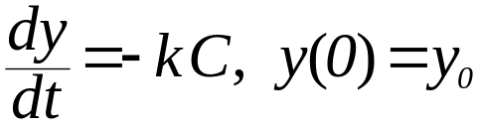
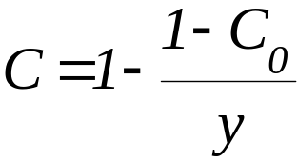
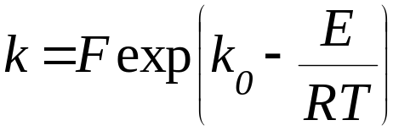
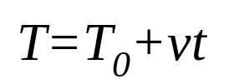
Plasticizer Evaporation Model
Evaporation Law
Volume Change
The Arrhenius law
Temperature growth
Diffusion is
not relevant!

Slide 9
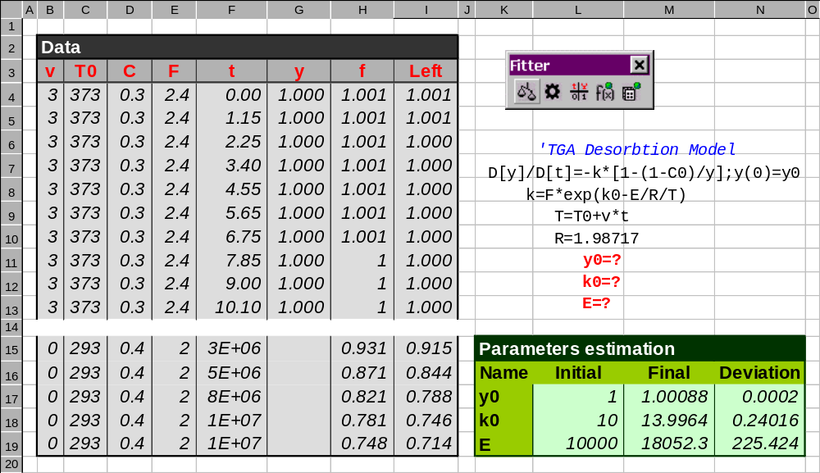

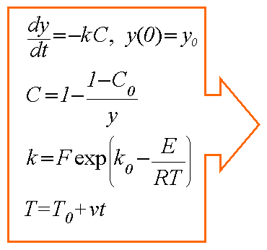
Fitter Worksheet for TGA Example

Slide 10
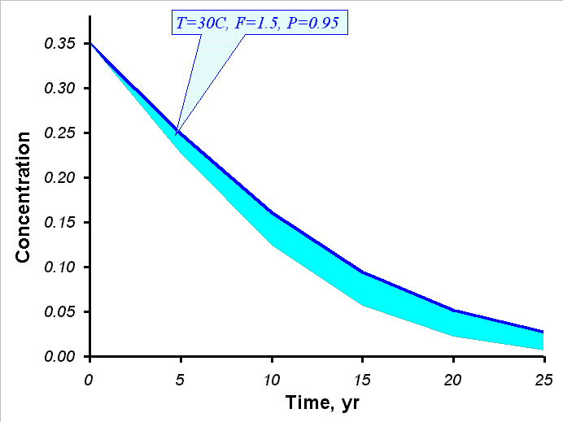
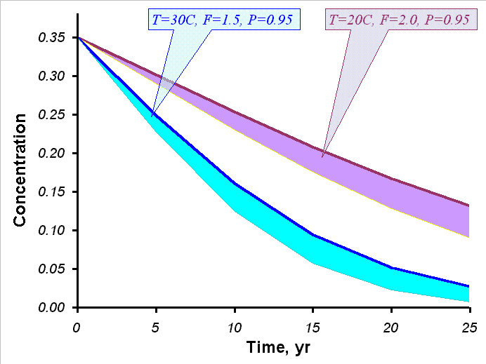
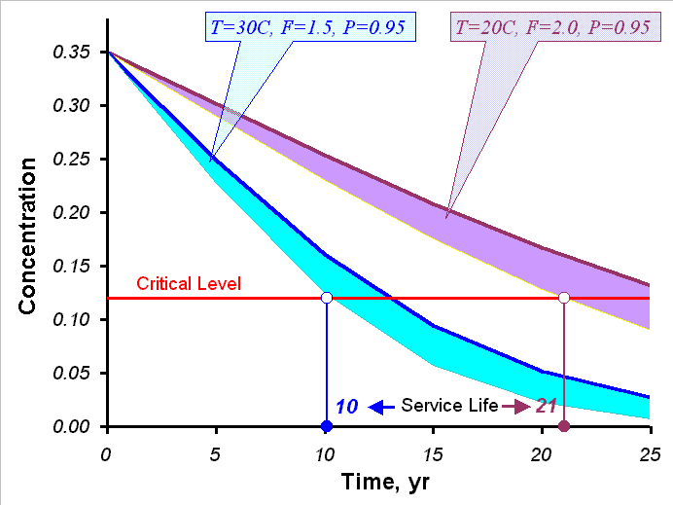


Service Life Prediction by TGA Data

Slide 11

3. NLR Basics
Notes:
.

Slide 12
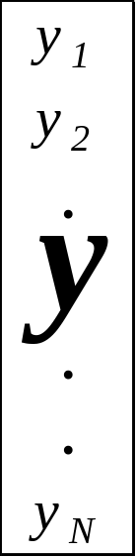
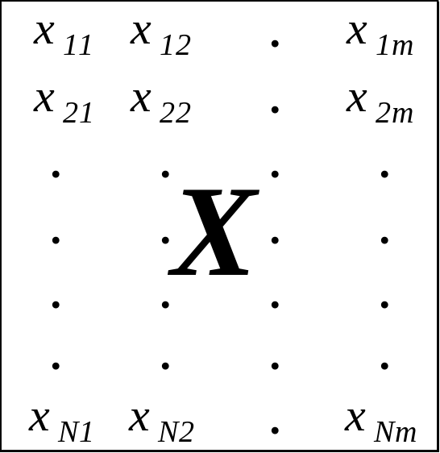
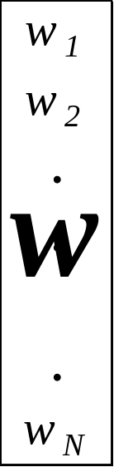
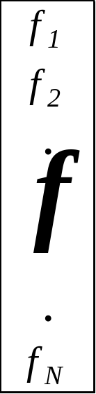
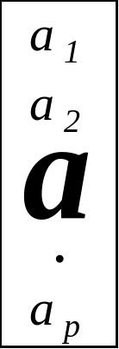


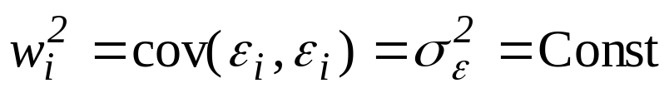
Data and Errors
Response |  | Predictors |  | Weights |  | Parameters |  | Fit
Weight is
an effective
instrument!
Absolute error |  |  |  | Weight and variance
Relative error

Slide 13
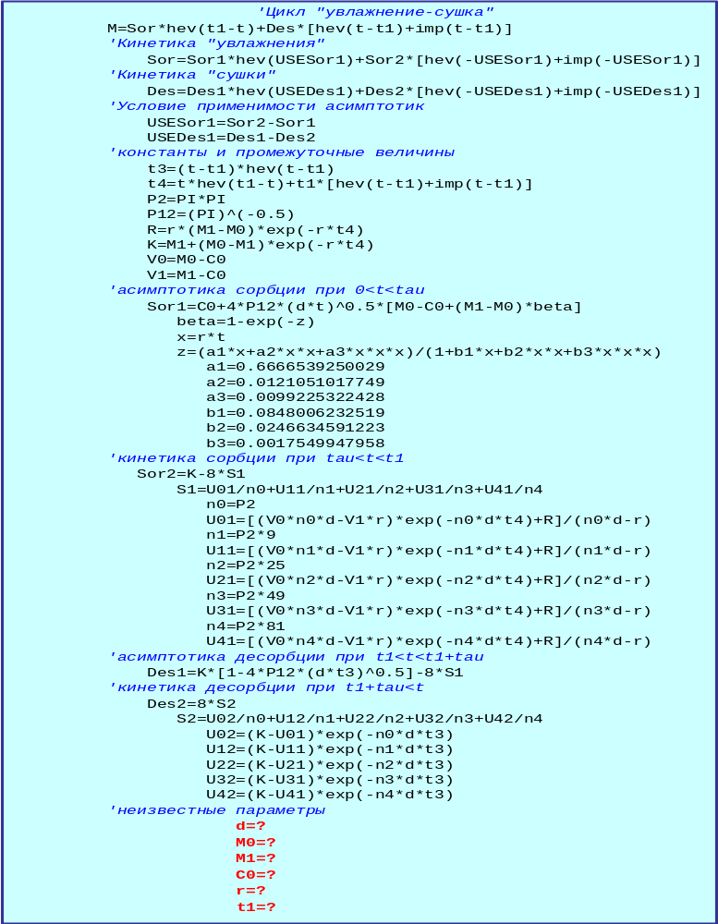
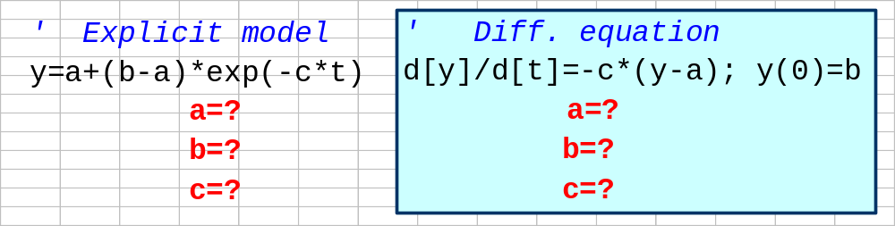
Model f(x,a)
Different shapes of the same model
Explicit model |  | y = a + (b – a)*exp(–c*x)
Implicit model |  | 0 = a + (b – a)*exp(–c*x) – y
Diff. equation |  | d[y]/d[x] = – c*(y –a); y(0) = b
Rather
complex
model!
Presentation at worksheet

Slide 14

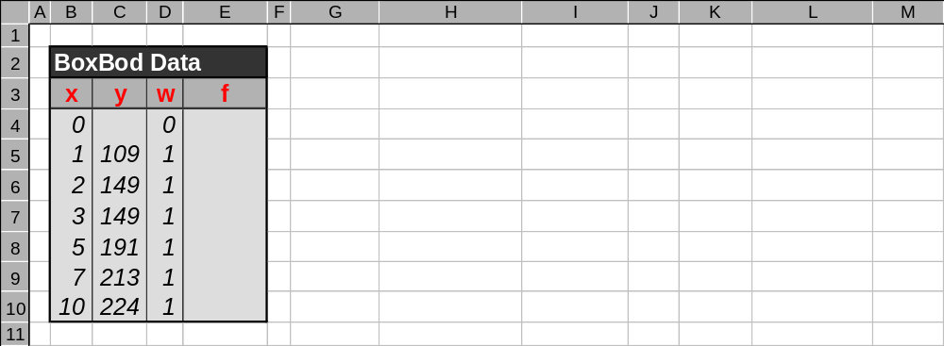
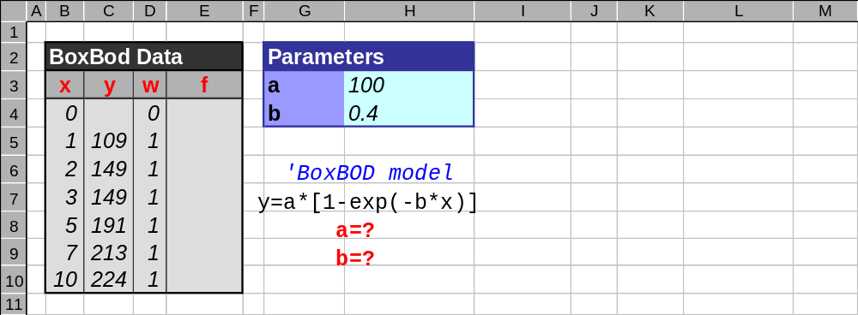
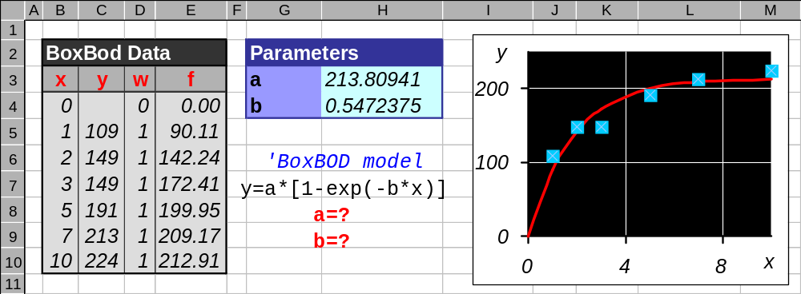
Data & Model Prepared for Fitter
Values
Predictor
Response
Comment
Weight
Apply Fitter!
Fitting
Equation
Parameters

Slide 15
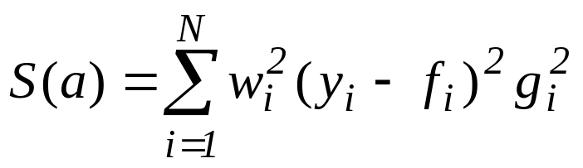
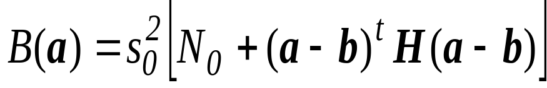

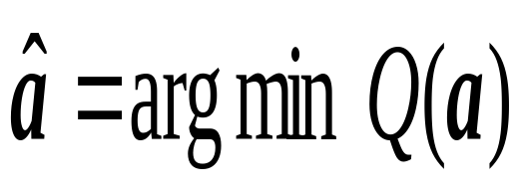
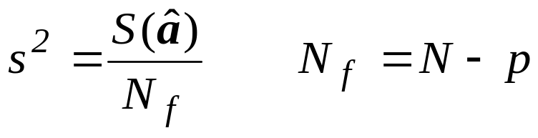
Objective Function Q(a)
Sum of squares
Bayesian term
Objective function
Objective function Q
is a sum of squares
and may be more…
Parameter estimates
Weighted variance estimate

Slide 16
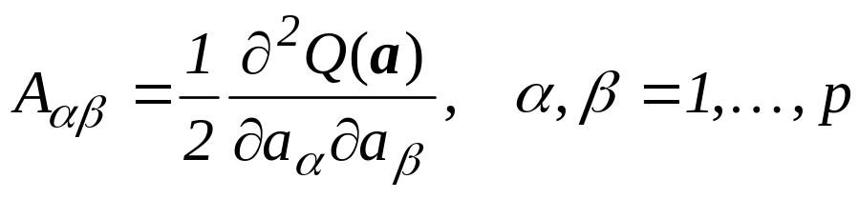
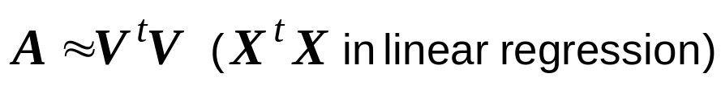
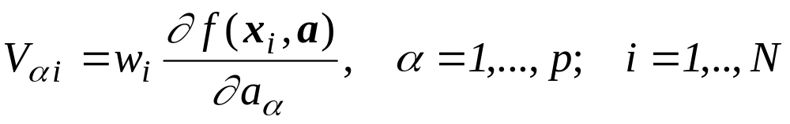


Very Important Matrix A
Hesse’s matrix
Gauss’ approximation
Model derivatives
Covariance matrix
F-matrix
Matrix A is the
cause of troubles..

Slide 17
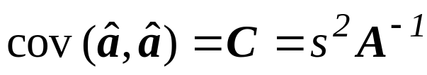
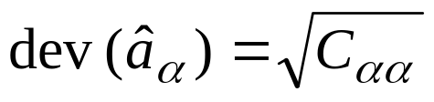
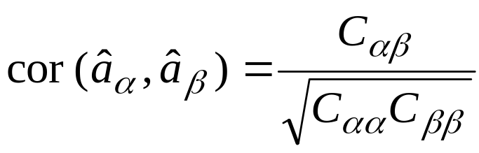


Quality of Estimation
Covariances Matrix
Deviations Vector
Correlations Matrix
Final Objective Value
Error Variance and Number Degrees of Freedom
Matrix A is the
measure of quality!

Slide 18
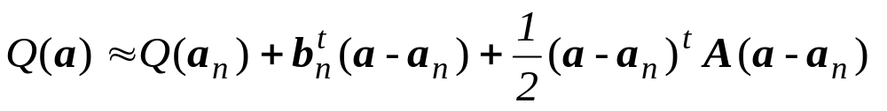
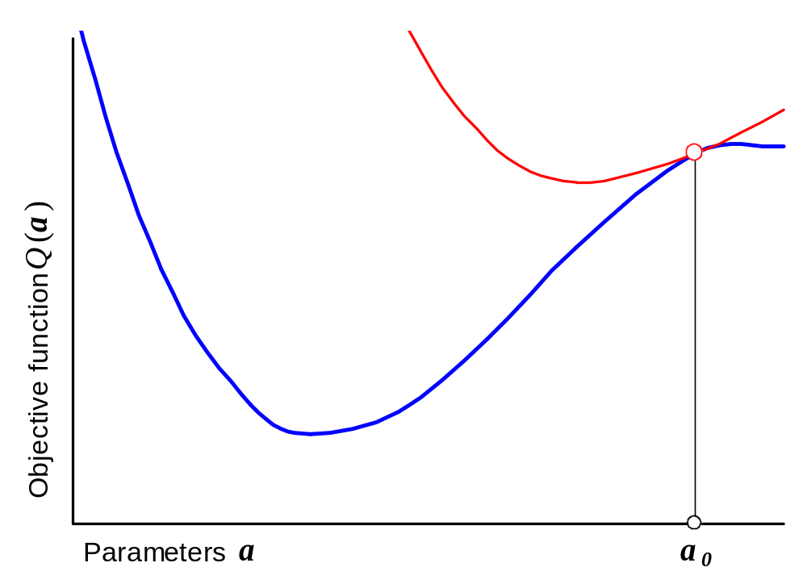
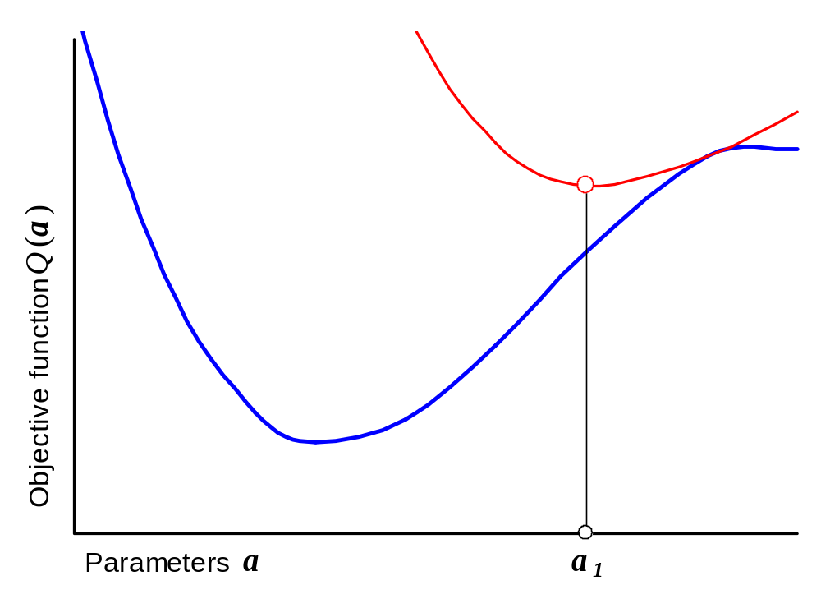
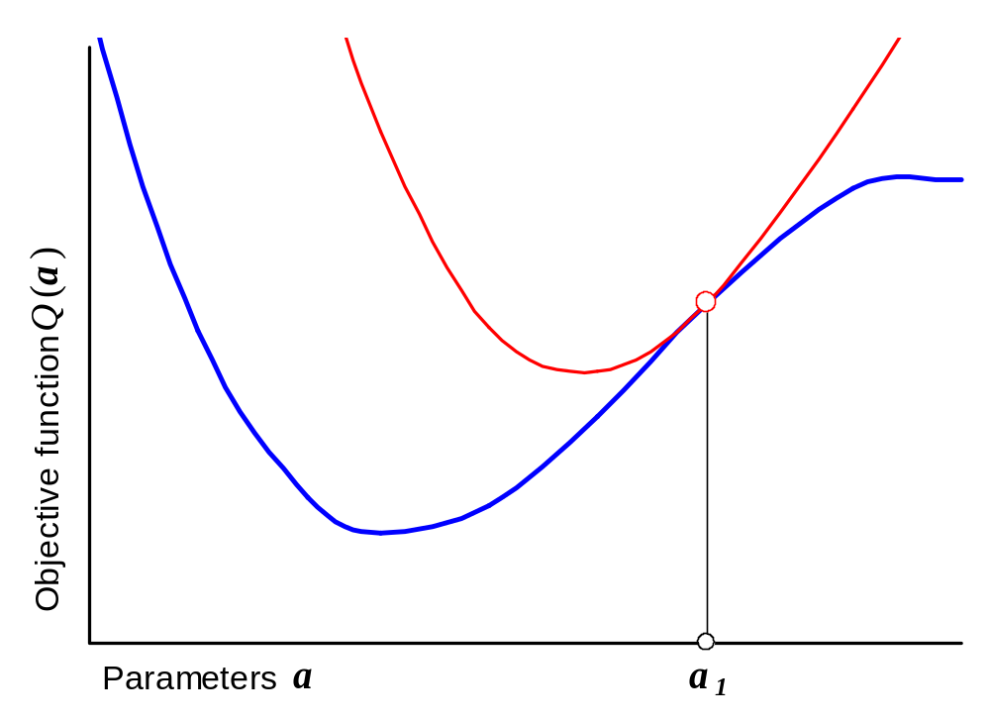
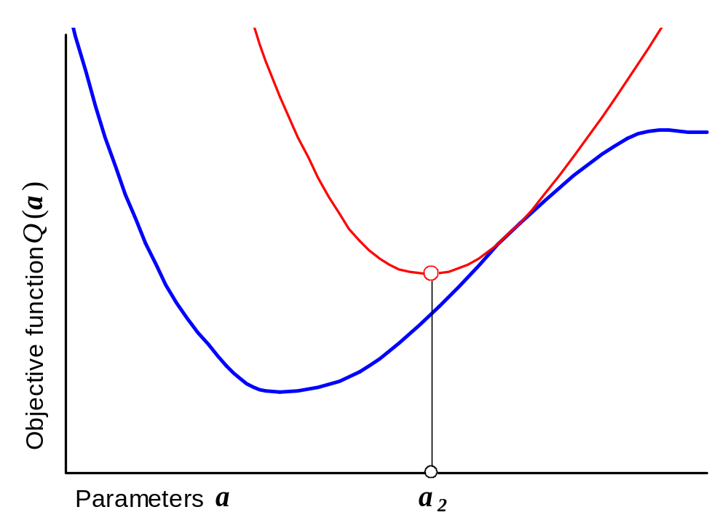
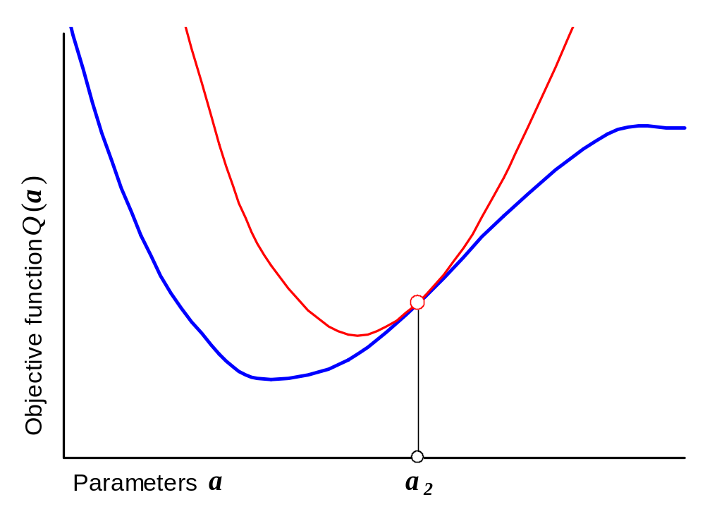
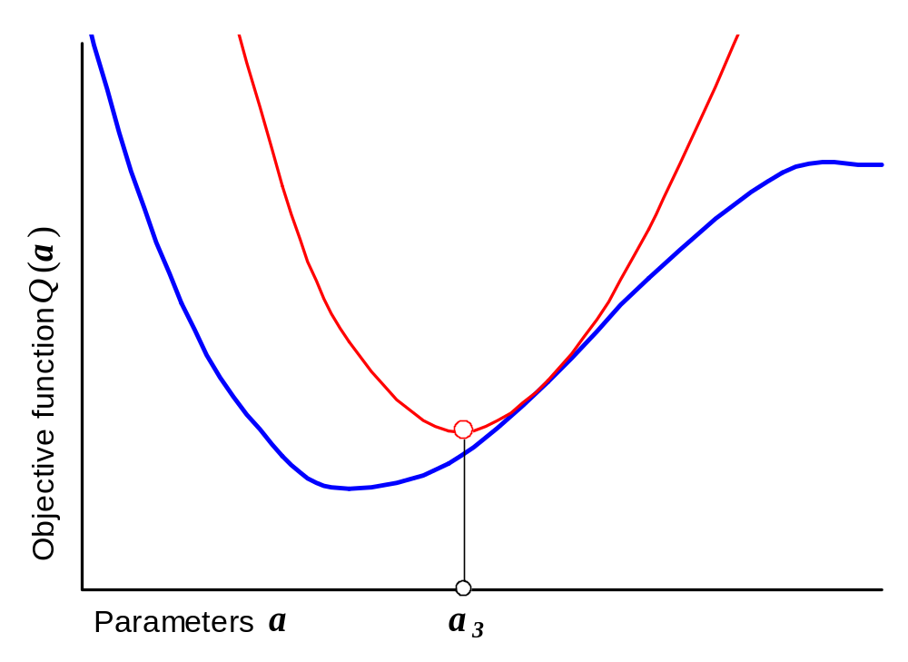
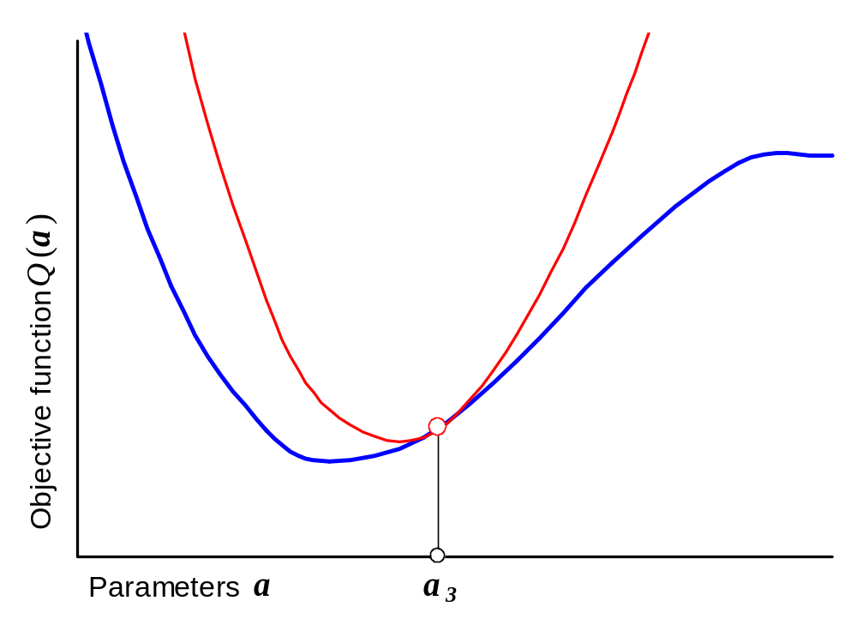
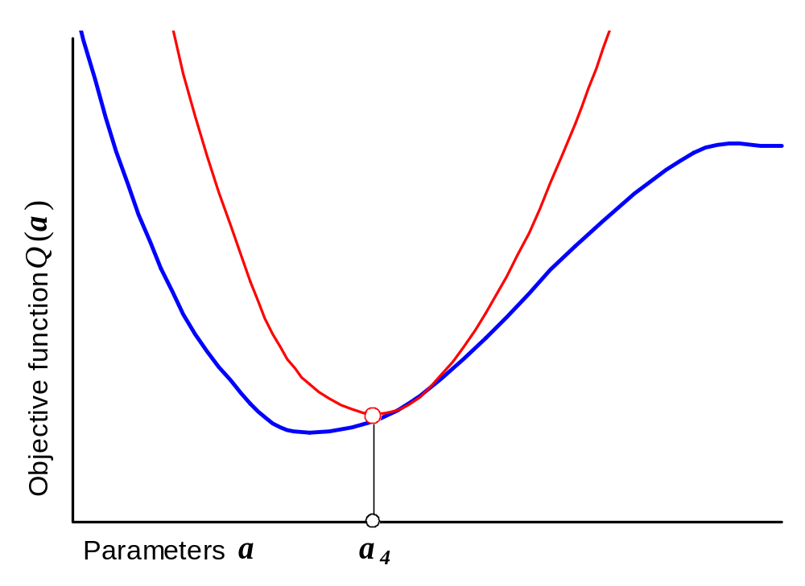
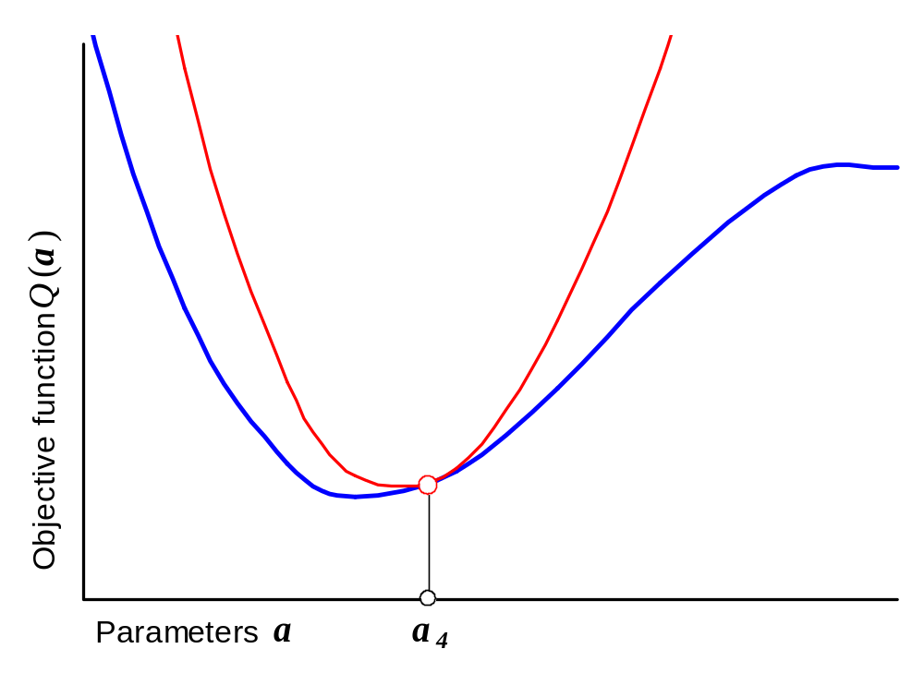
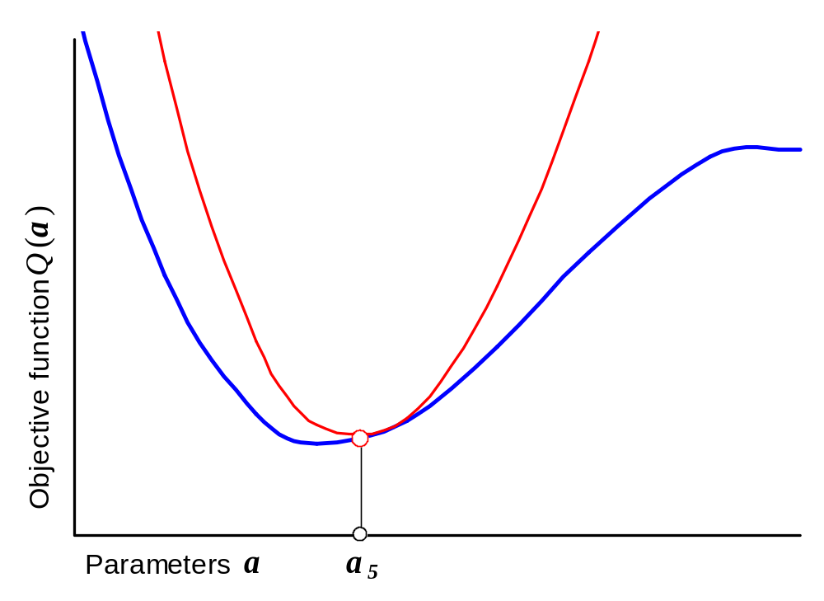
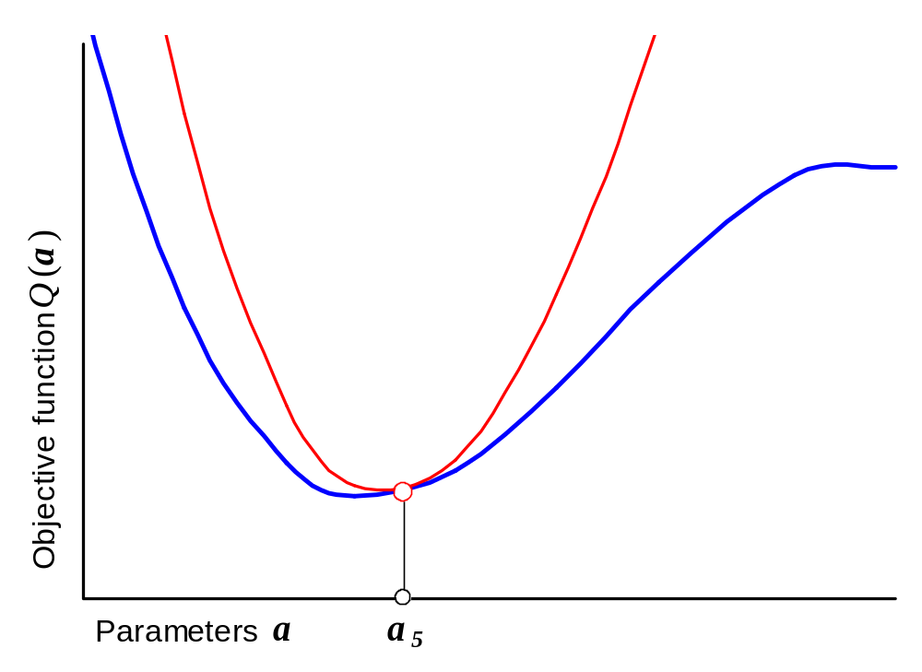
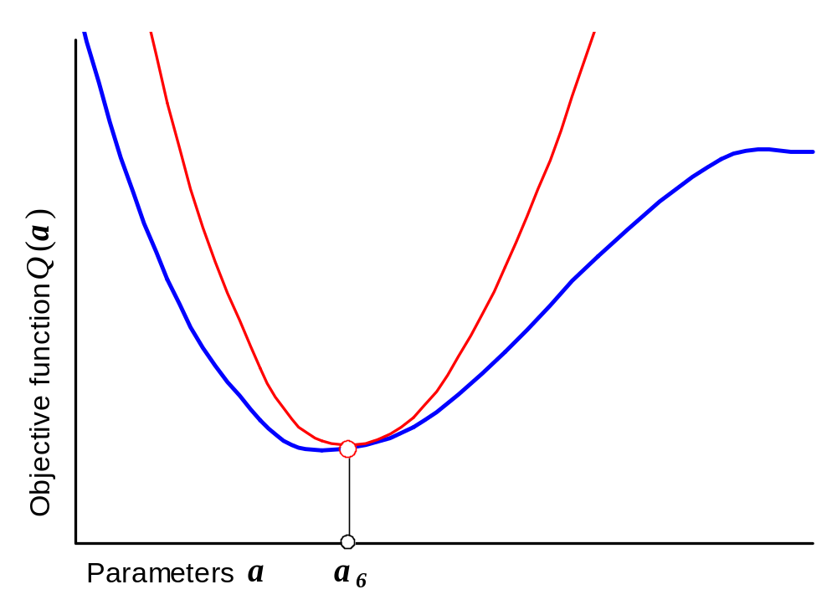
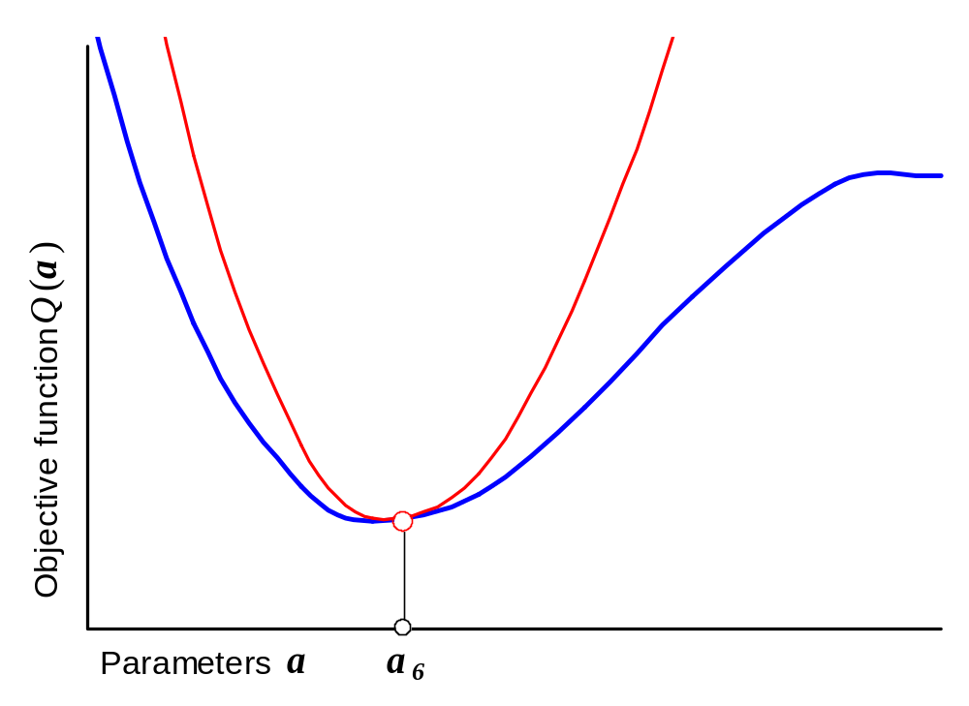






Search by Gradient Method
Matrix A is the
key to search!
Search problems
Initial point a₀
Local minima

Slide 19

4. Multicollinearity

Slide 20








Multicollinearity: View
Multicollinearity is degradation of matrix A
Objective function Q(a)
Spread of eigenvalues
is a measure of degradation
N(A) =
1
2
4
5
6
7

Slide 21







Multicollinearity: Source
“Hard” multicollinearity |  | “Soft” multicollinearity

Slide 22

Data & Model Preprocessing
((a + b) + c) + d ≠ a + (b + (c + d)) as 1+10 ^{–20} = 1
Representation of a number in computer with 64 bits
1 | 0 | 0 | 1 | … | 0 | 1 | 1
Target is to make Hesse matrix A regular and decrease N(A)
M e a n s |  | Data Scaling |  | X → mX
 |  | Data Centering |  | X → X – X₀
 |  | Model Adjusting |  | a → ϕ (a) x → ψ (x) y → χ (y)

Slide 23







Example: The Arrhenius Law
Standard form |  | Adjusted form
Scaling & centering Adjusting
k ≈ 10⁺¹¹ E ≈ 10⁺⁴ |  | a₁ ≈ 1 a₂ ≈ 10
N(A) = 20 |  | N(A) = 2

Slide 24


Derivative Calculation and Precision
N(A) |  | A⁻¹ |  | y=f (a,x) |  | 0=f (y,a,x) |  | dy/dx=f (y,a,x)
6 |  | 6+2=8 |  | 8+0=8 |  | 8+2=10 |  | 10+2=12
10
14+2=16
8
10+2=12
8+2=10
10+0=10
12+0=12
10+2=12
12+2=14
12+2=14
1) Numerical calculation of difference derivatives
2) Auto calculation of analytical derivatives
f=exp(-a*t) | ⇒ | df/da=-t*exp(-a*t)

Slide 25

5. Prediction

Slide 26



Reliable Prediction
Estimate of response
Confidence limits
Linearization
Forecast should
include uncertainties!

Slide 27


Nonlinearity and Simulation
Non-linear models call
for special methods of
reliable prediction!

Slide 28



Prediction: Example
Model of
rubber aging
Accelerated aging tests
Upper confidence limits

Slide 29

6. Testing

Slide 30

Hypotheses Testing
Test statistics ξ is compared with critical value t (α)
From
experiment
Test don’t prove a model!
It just shows that
the hypothesis is
accepted or rejected!
From
theory

Slide 31

Lack-of-Fit and Variances Tests
These hypotheses are based on variances
and they can’t be tested without replicas!
Variances
by
replicas
Replica 1
Replica 2
Lack-of-Fit
is a wily test!

Slide 32

Outlier and Series Tests
These hypotheses are based on residuals
and they can be tested without replicas
Acceptable
deviation
Positive
residual
Series test is
very sensitive!
Negative
residual

Slide 33

7. Bayesian Estimation

Slide 34

Bayesian Estimation
How to eat away
an elephant?
Slice by slice!

Slide 35


Posterior and Prior Information. Type I
Posterior Information |  | Prior Information
Parameter estimates |  | Prior parameter values b
Matrix F |  | Recalculated matrix H
Error variance s² |  | Prior variance value s₀²
NDF N_{f} |  | Prior NDF N₀
Objective Function
The same error in
each portion of data!

Slide 36

Posterior and Prior Information. Type II
Posterior Information |  | Prior Information
Parameter estimates |  | Prior parameter values b
Matrix F |  | Recalculated matrix H
Objective Function
Different errors in
each portion of data!

Slide 37



8. Conclusions
Mysterious Nature
LR Model
NLR Model
Thank
you!

