Slide 1
Simple Interval Calculation bi-linear modelling method.
SIC-method
Rodionova Oxana
rcs@chph.ras.ru
Semenov Institute of Chemical Physics RAS & Russian Chemometric Society

Slide 2
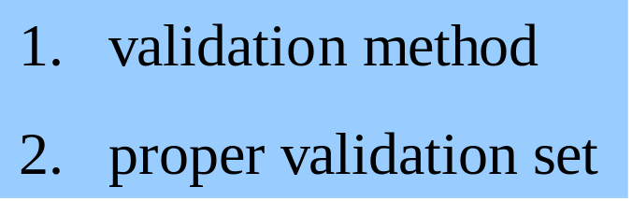
Stages of Multivariate Data Analysis
minimizing the total number of experiments
obtain as much “information” as possible.
Experimental design (DOE)
Modelling
Prediction
Maximally informative model
Validation
accuracy of prediction ?

Slide 3
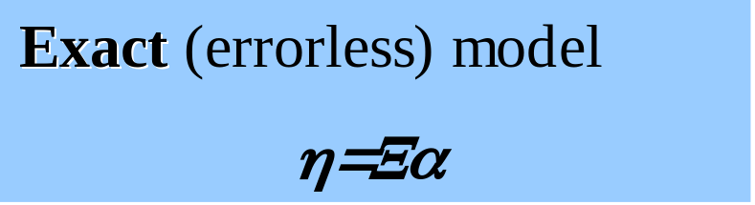
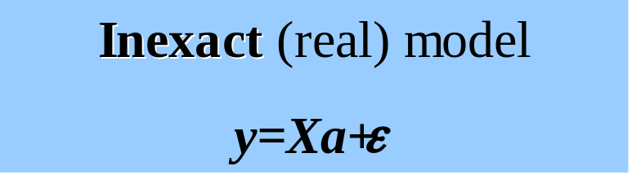
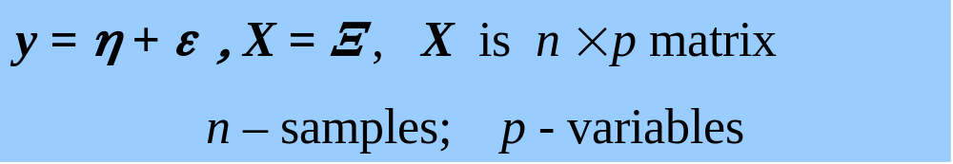
Simple Interval Calculation (SIC)
Interval calculation
Simple
gives the result of the prediction directly in an interval form
1.simple idea lies in the background
2. well-known mathematical methods are used for its implementation.

Slide 4
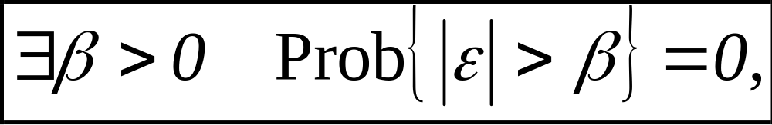
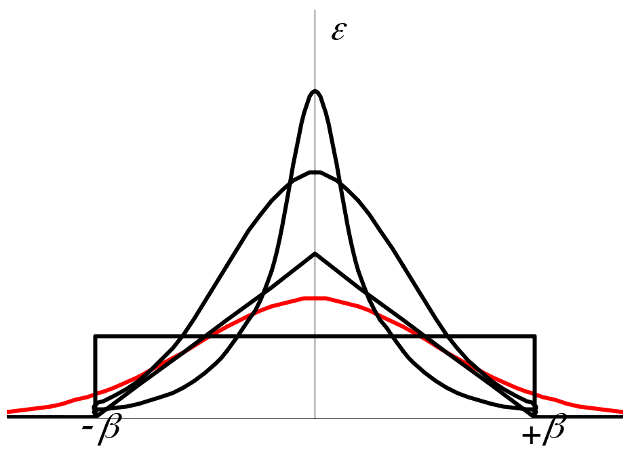
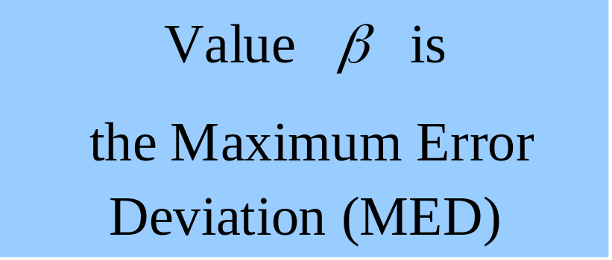
Main Assumption of SIC-method
All errors are limited.
Normal (⇒) distribution
Finite ( ⇒) distributions

Slide 5

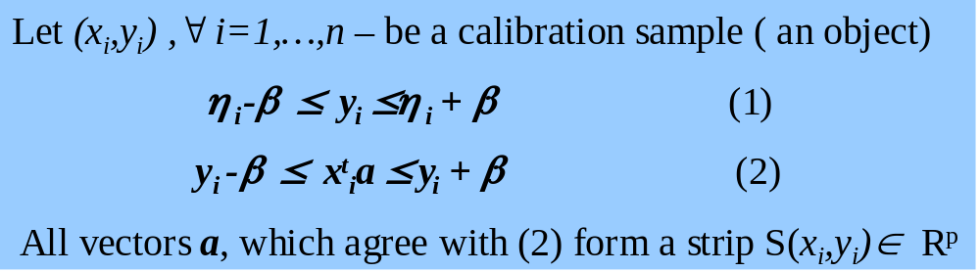
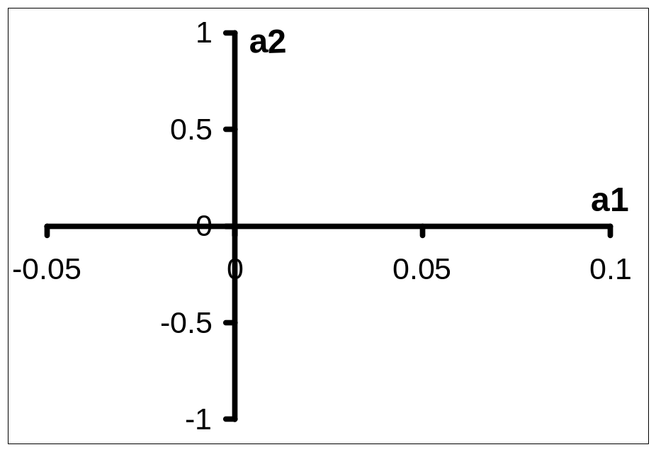
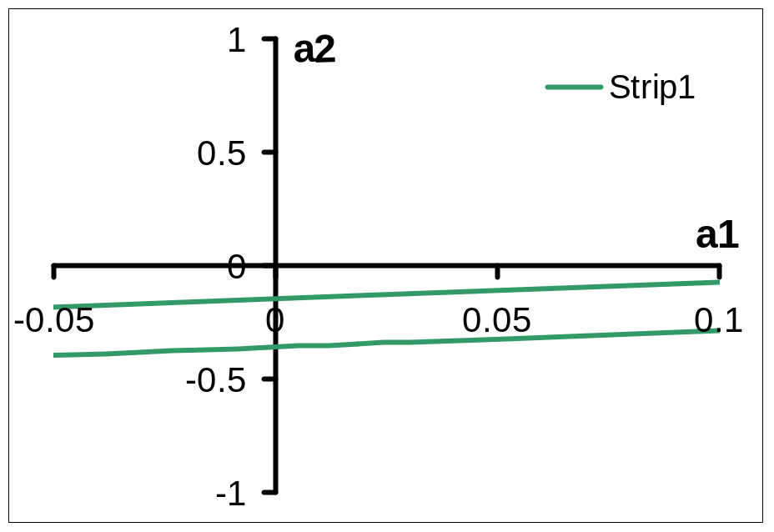
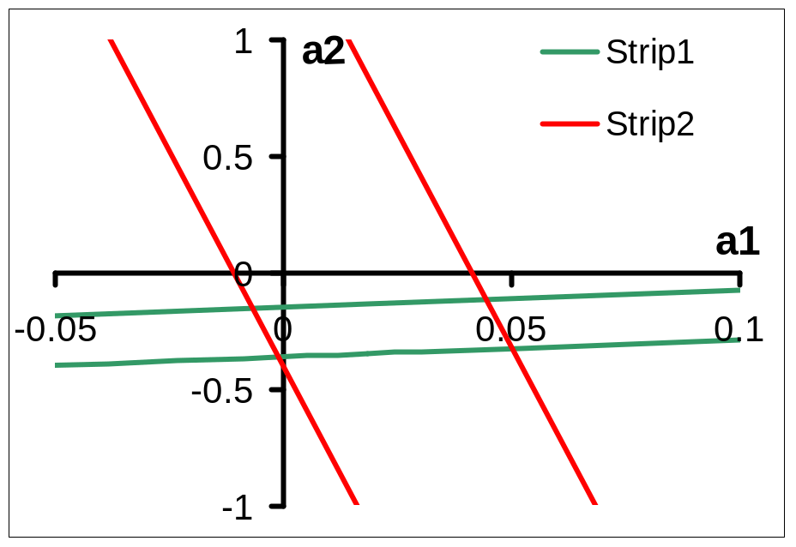
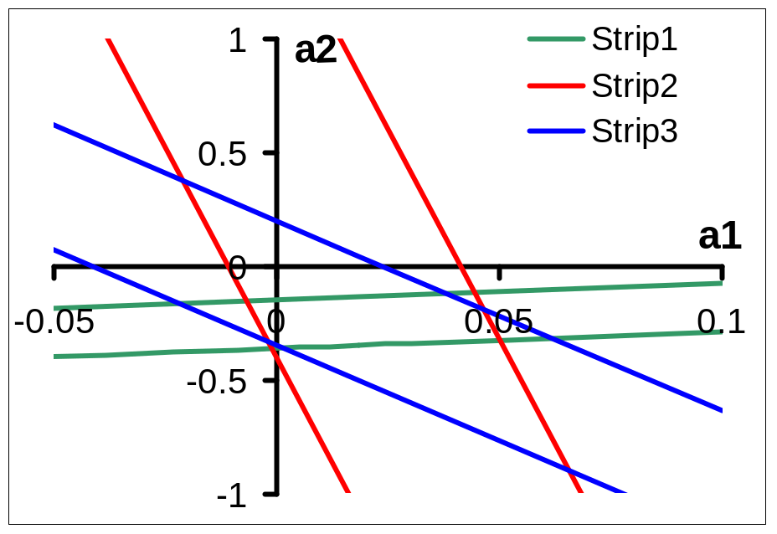
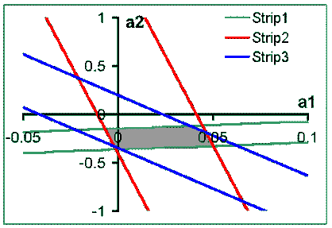
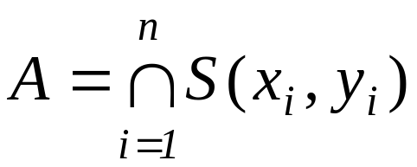
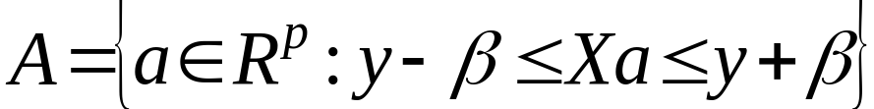
The Region of Possible Values (RPV)

Slide 6
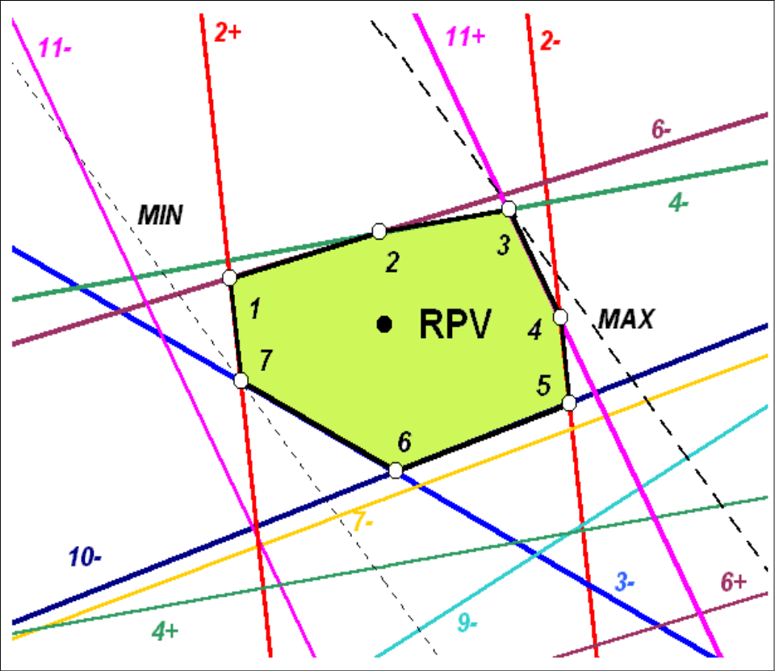
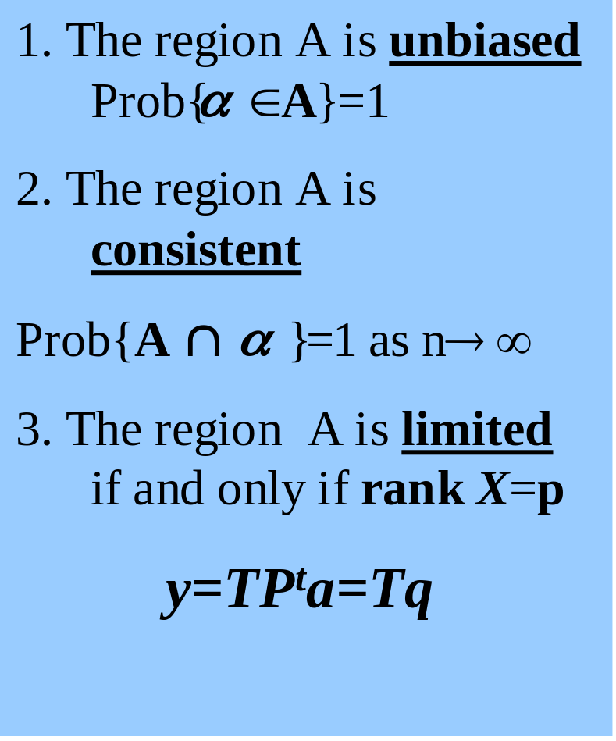
The RPV A Properties
An example of RPV (heptagon) with vertexes 1, 2, ..7

Slide 7
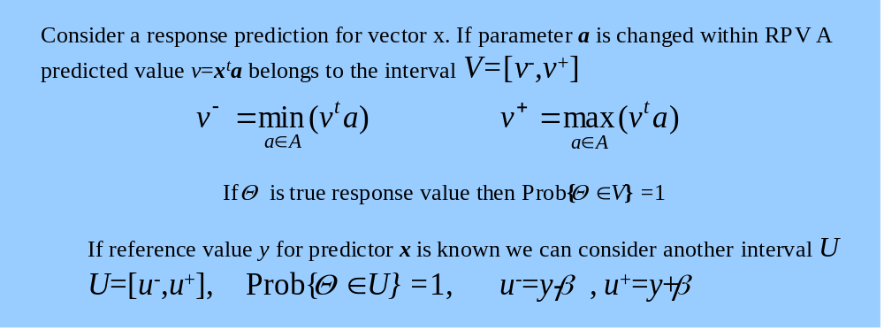
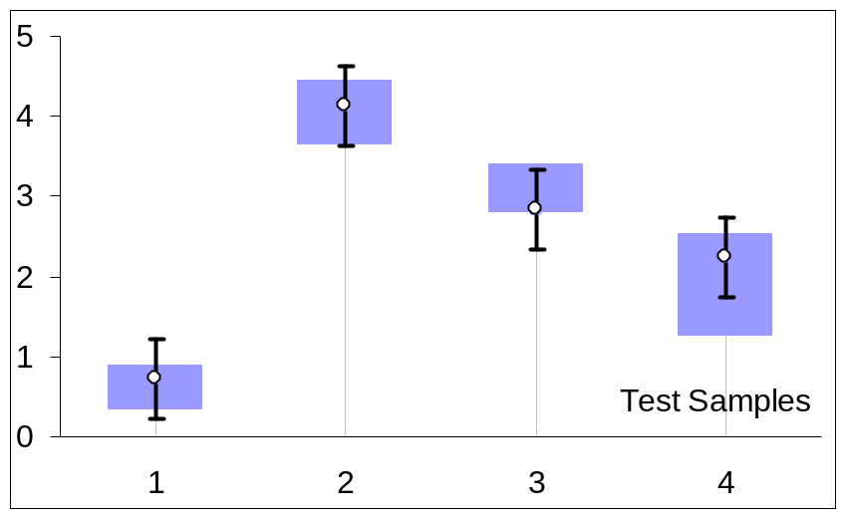
SIC Prediction
V-prediction interval
U-test interval

Slide 8
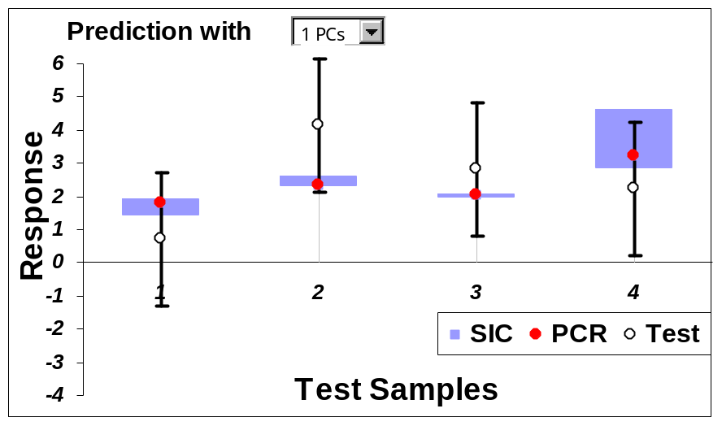
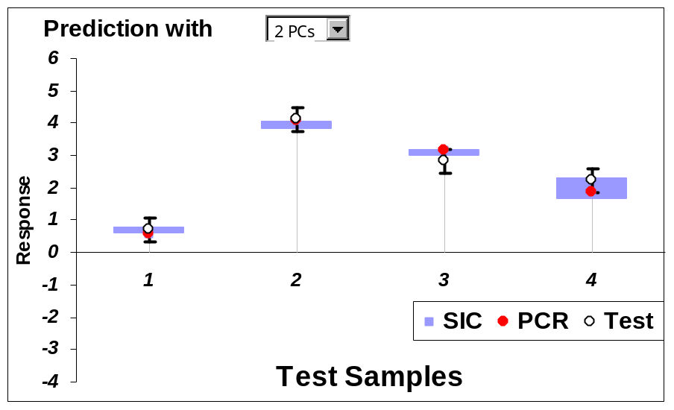
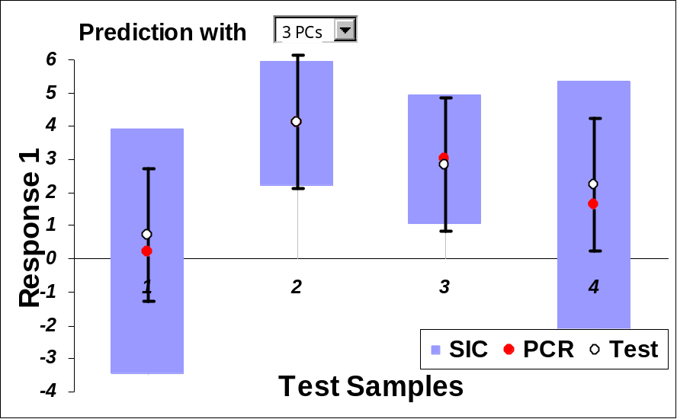
What Can Go Wrong?
“True” values lie outside of the prediction intervals
Prediction intervals are far less than test intervals
Very large prediction intervals

Slide 9
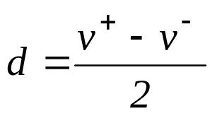
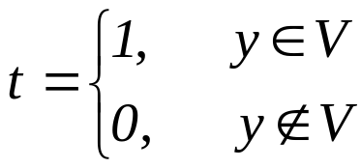
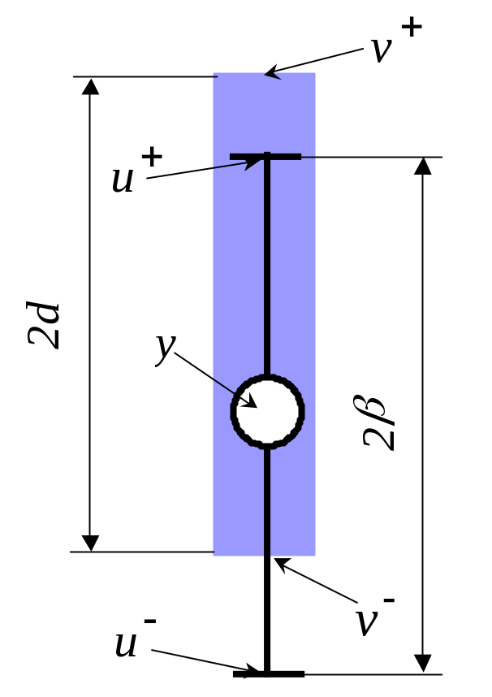
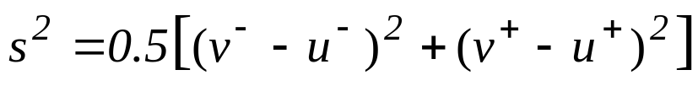
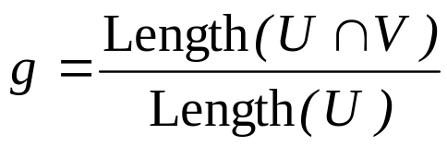
Quality of Prediction
INCLUDE - whether a reference value lies in Prediction Interval
_{(Half)}WIDTH of Prediction Interval
SEPI - Standard Error of Interval Prediction
OVERLAP a fraction of Test interval, within Prediction interval.

Slide 10
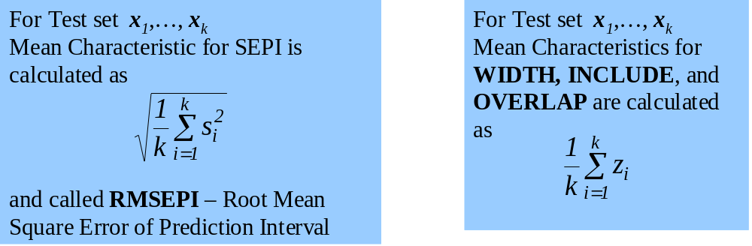
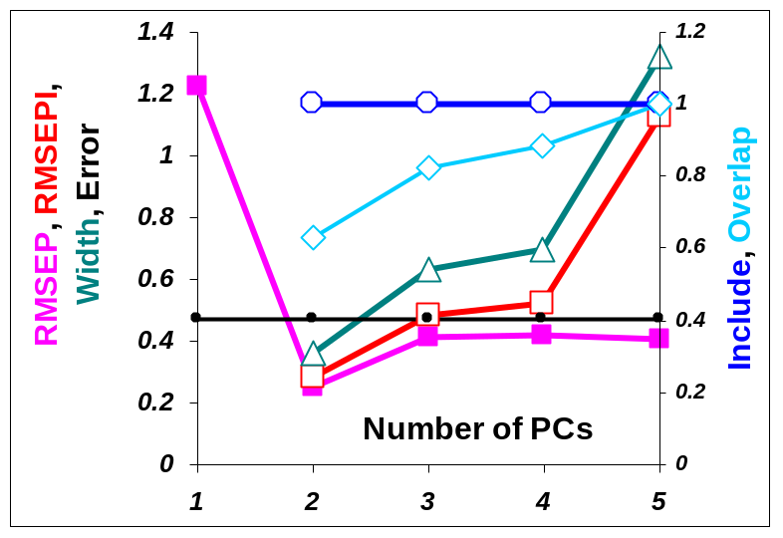
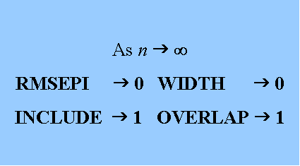
Mean Values

Slide 11
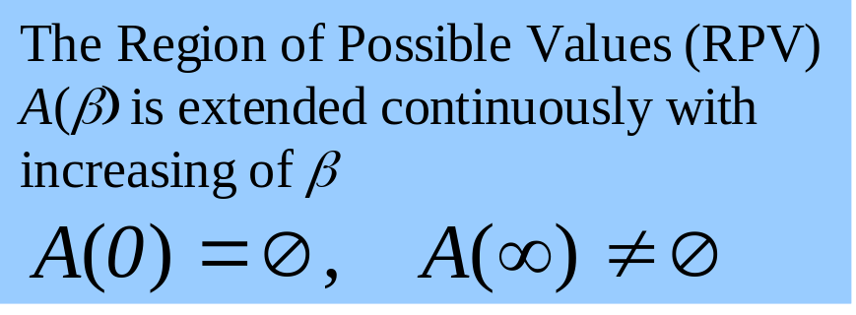
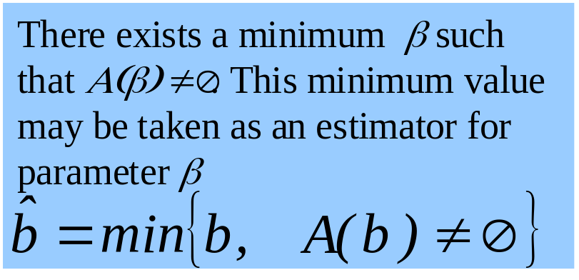
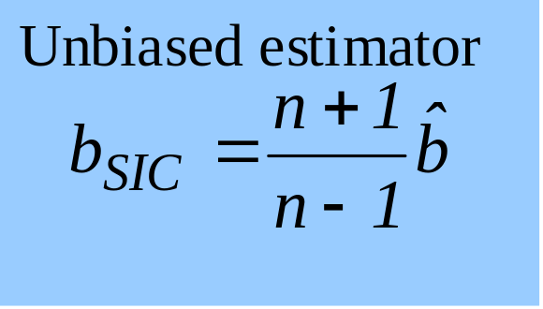
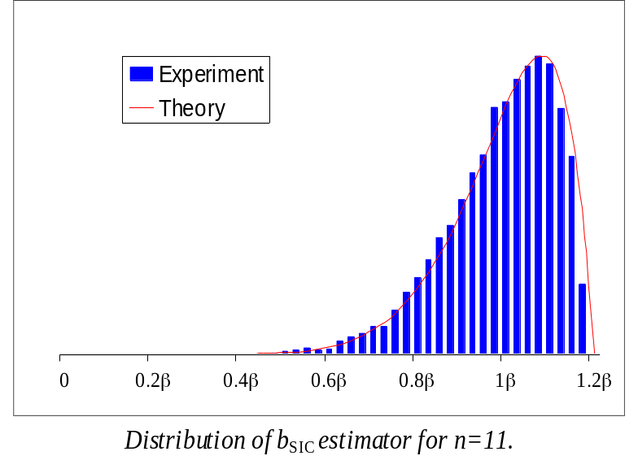
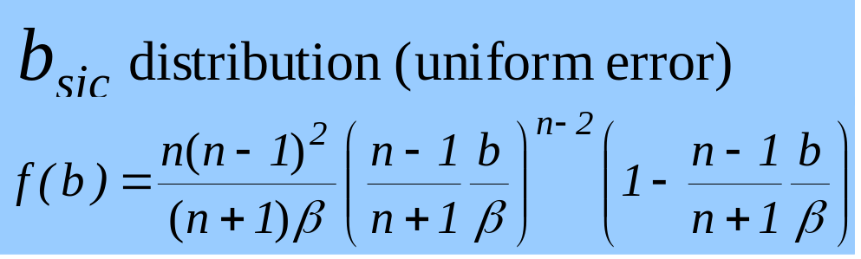
Unknown β. How to Find It?

Slide 12

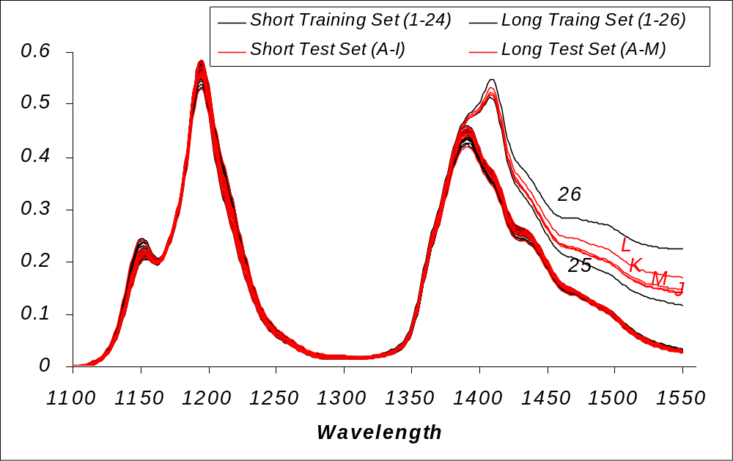
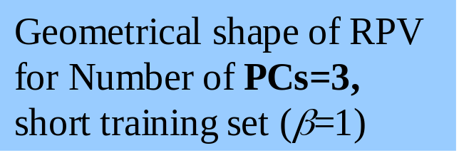
Octane Rating Example
X-predictors are NIR-measurements (absorbance spectra) over 226 wavelengths,
Y –response is reference measurements of octane number.
Training set =26 samples
Test set =13 samples
Spectral dada

Slide 13
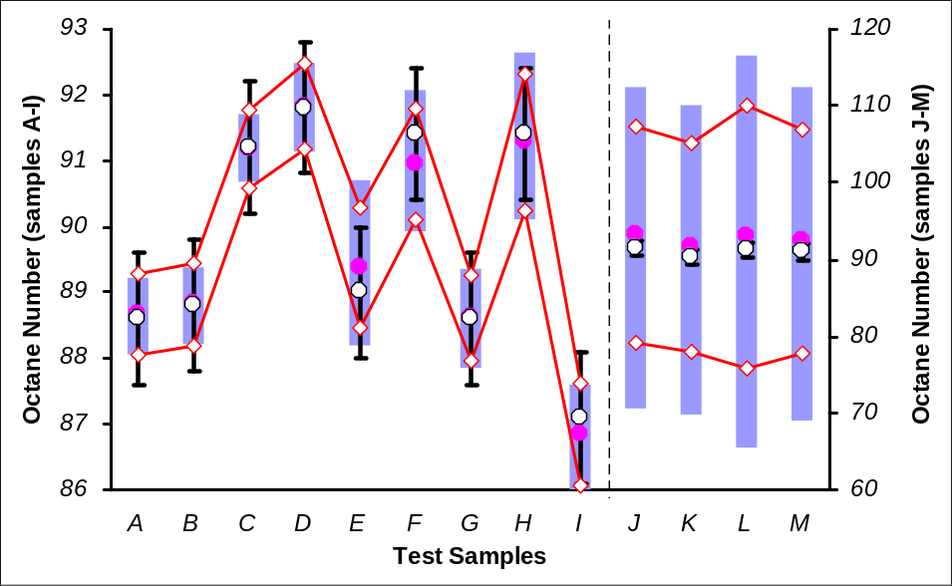
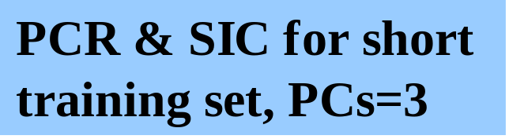
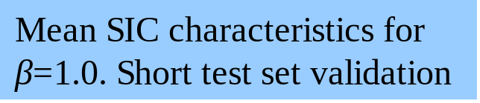
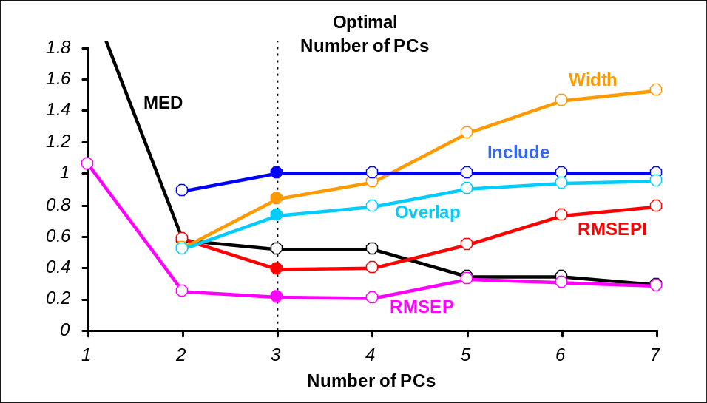
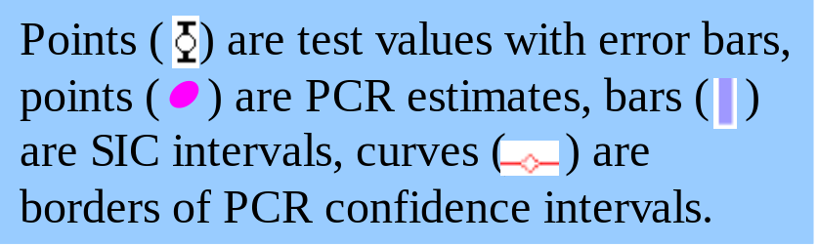
Octane Rating Example

Slide 14
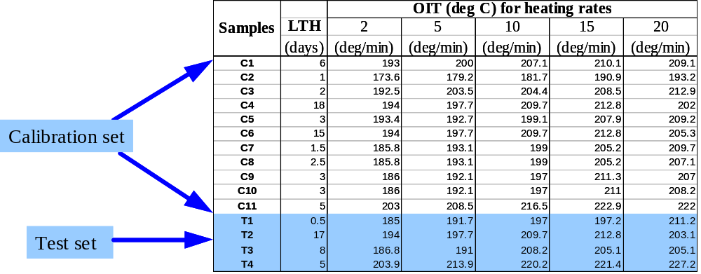
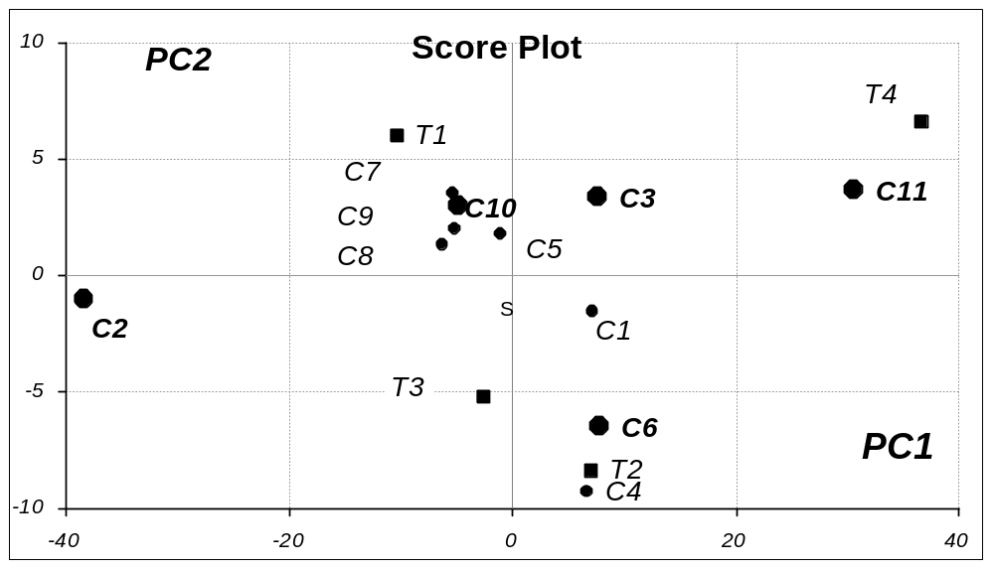
Real-world example
Prediction of antioxidant activity using DSC measurements
Total number of samples (n) =15 Number of variable (p) =5 Calibration set =11 samples Testing set=4 samples

Slide 15
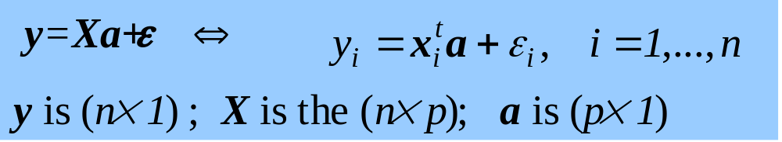
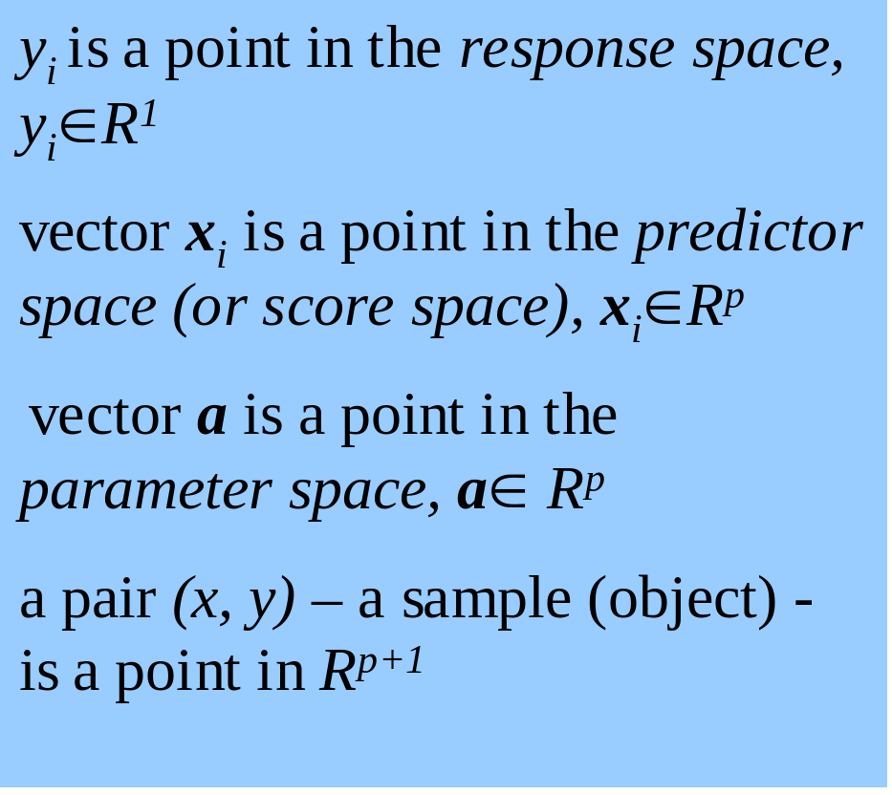
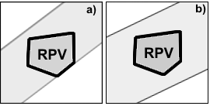
SIC Object Status Theory

Slide 16
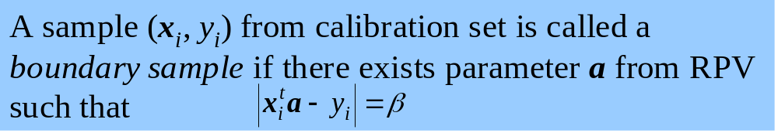
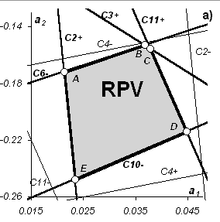
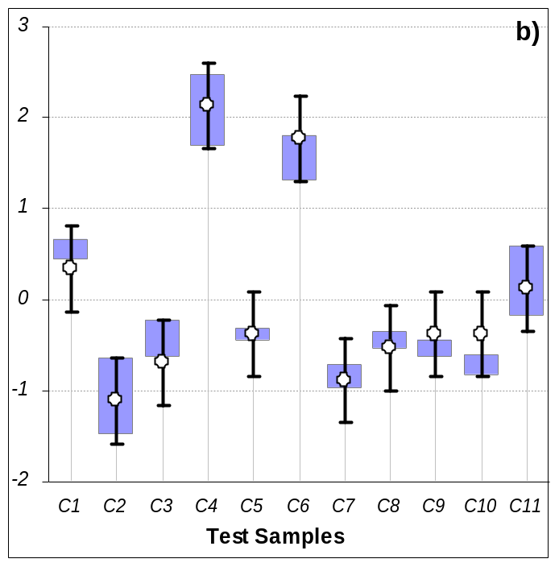
Boundary Sample
RPV and its boundary samples
“Prediction” of the calibration set

Slide 17




Insiders, Outsiders, Outliers

Slide 18



regression line
‘true’ model y=xa
regression 90% conf. interval
insiders , boundary samples , prediction intervals

Slide 19


The region of absolute outsiders
Test samples
Boundary samples (from calibration set)
Calibration samples
The border of absolute outsiders

Slide 20








The Sample Status in the Response Space

Slide 21




SIC– leverage / SIC–residual
Leverage – a measure of how far a data point to the majority
SIC– leverage
Residual – a measure of the variation that is not taken into account by the model
SIC–residual
MED-normalized SIC–residual

Slide 22











SIC Object Status Map

Slide 23
The Main Features of the SIC-method
SIC - METHOD
gives the result of prediction directly in the interval form.
calculates the prediction interval irrespective of sample position regarding the model.
summarizes and processes all errors involved in bi-linear modelling all together and estimates the Maximum Error Deviation for the model
provides wide possibilities for sample classification and outlier detection

