Slide 1
Chemometric Investigation of Polarization Curves:
Initial Attempts
Christopher A. Marks
Center for Electrochemical Science and Engineering
University of Virginia
Charlottesville, VA – USA

Slide 2
Outline
Polarization Curves
  Definition and Terms
  Motivation for Chemometric Approach
  Differences from Spectroscopic Data
Data
Methods
Results
Future Work
Acknowledgements

Slide 3
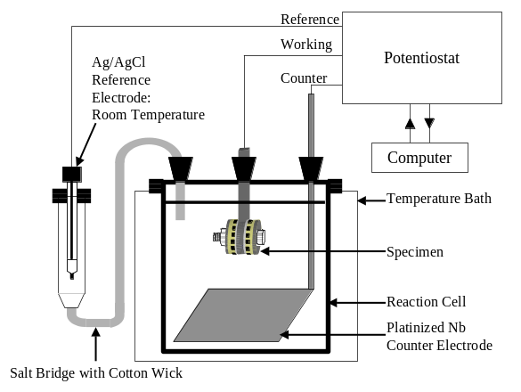
Polarization Curves
Electrochemical measurements of net current density (i (A cm⁻²)) as a function of potential (E (V)) for a given electrolyte and working electrode
Notes:
E versus some reference electrode
Importance of net current
i and log(|i|)

Slide 4
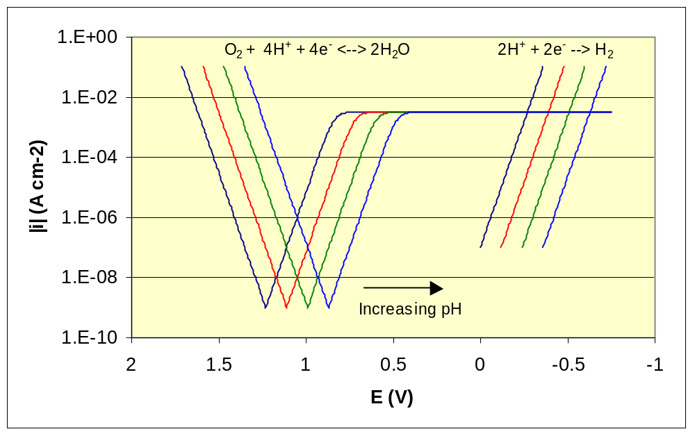
Polarization Curves –
H₂O Reactions
Notes:
E versus some reference electrode
i and log(|i|)
Exchange current density can change
Diffusion limited current density changes as a function of [O₂], pH and stirring, etc.

Slide 5
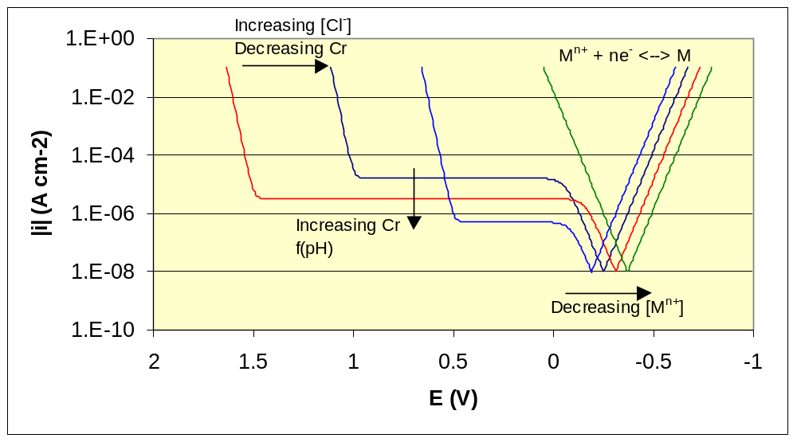
Polarization Curves –
Metal Reactions
Notes:
Exchange current density can be a function of electrolyte
Alloys are more complicated than a pure metal, non-stoichiometric dissolution
Passivity is more complex than indicated

Slide 6
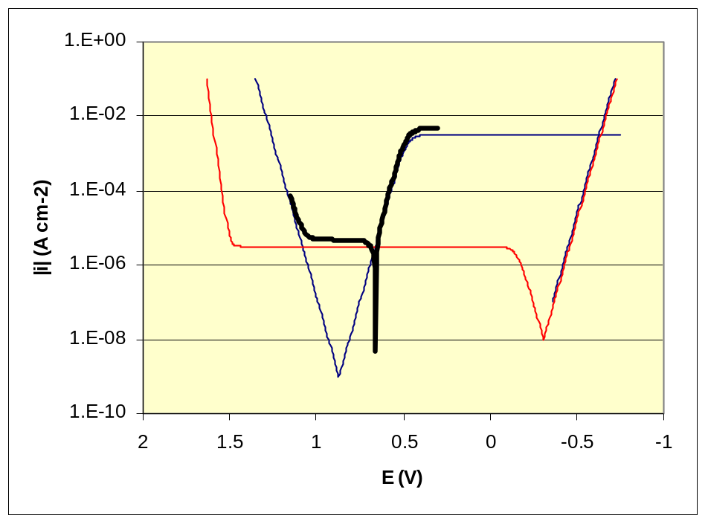
Polarization Curves –
Net Current Measurement
i_{net} = Σi_{anodic} + Σi_{cathodic}
  M → M^{n+} + ne⁻
  2H₂0 → O₂ + 4H⁺ + 4e⁻
  O₂ + 4H⁺ + 4e⁻ → 2H₂O
Only a small fraction
of what is of interest can be measured experimentally
Notes:
Net curve is offset slightly for clarity
E versus some reference electrode
Importance of net current
Define E_{oc}, E_{p}, and i_{pass}

Slide 7
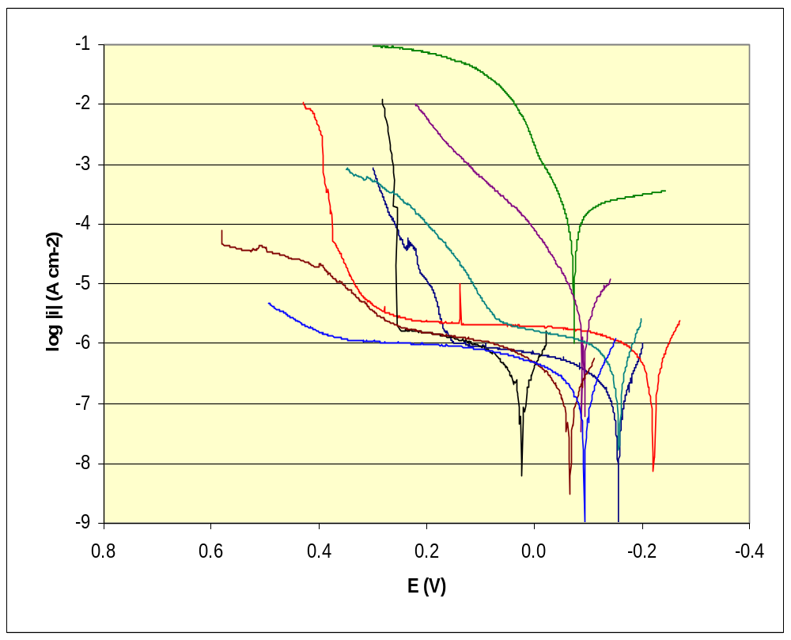
Polarization Curves –
Motivation
Resolve net current data into components which are simple functions of pH, [Cl⁻], [O₂], [M^{n+}], etc. so that the important parameters, E_{oc}, E_{p}, and i_{pass}, can be optimized or interpolated.
Notes:
Compare to anova, etc. of values picked from curves

Slide 8
Polarization Curves –
Different from Spectra
Non-constant domain (non-random missing data)
Variable uncertainty in i, depends on i, not E
How to calculate σ²?
Notes:
Discuss how uncertainty in i is a function of i,

Slide 9
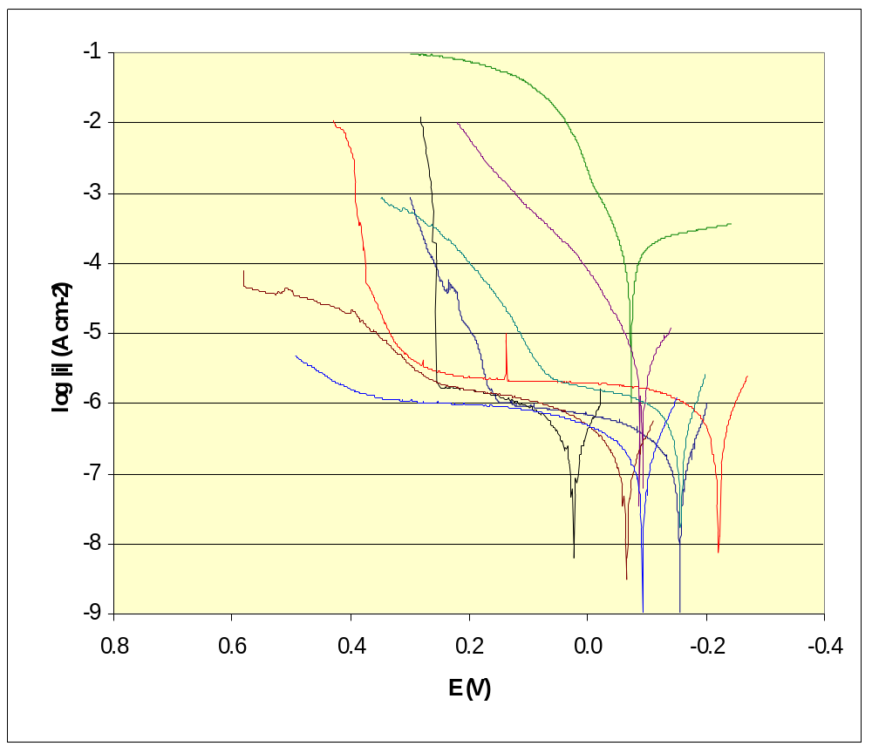
Polarization Data
~ 2 alloys
3 temperatures
2 electrolytes
~ 3 pHs
240 (partial) polarization curves
– 8 shown

Slide 10
Methods
PCA-like approach in Matlab (NIPALS)
No mean-centering or scaling
Missing values replaced by estimates (Xest_{ij}=t_{i}p_{j})
Iteratively re-weighted least squares
  Estimate loadings (p=(t’t)⁻¹t’X)
  Calculate variable weights (v) based on p
  (v_{i} = # obs / (a priori uncertainty for p_{i})²
  Estimate scores (t=Xdiag(v)p’(pdiag(v)p’)⁻¹)
  Go to 1, until convergence
  Orthogonalize p with respect to the previous P

Slide 11
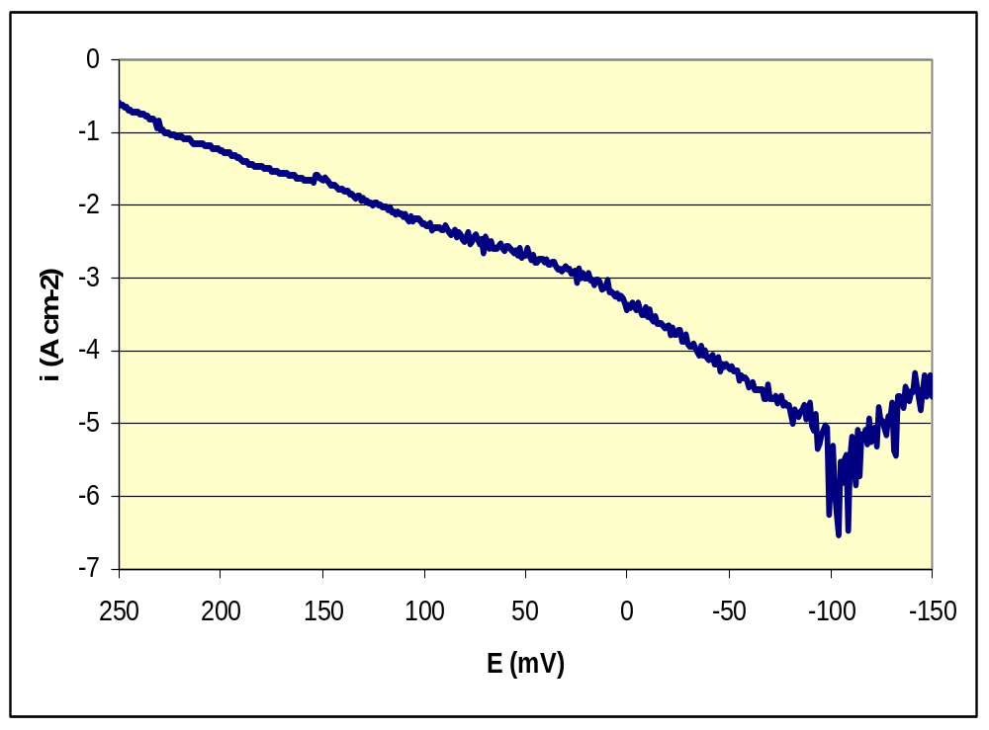
Results
First factor appears fine, others are less compelling
Several outliers identified and removed
Algorithm is slow to converge
Notes:
First factor

Slide 12
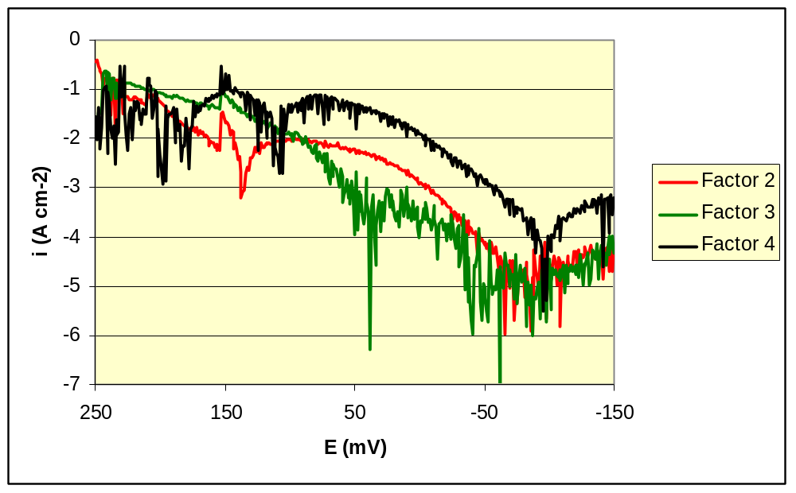
Results
Notes:
Factors 2-4

Slide 13
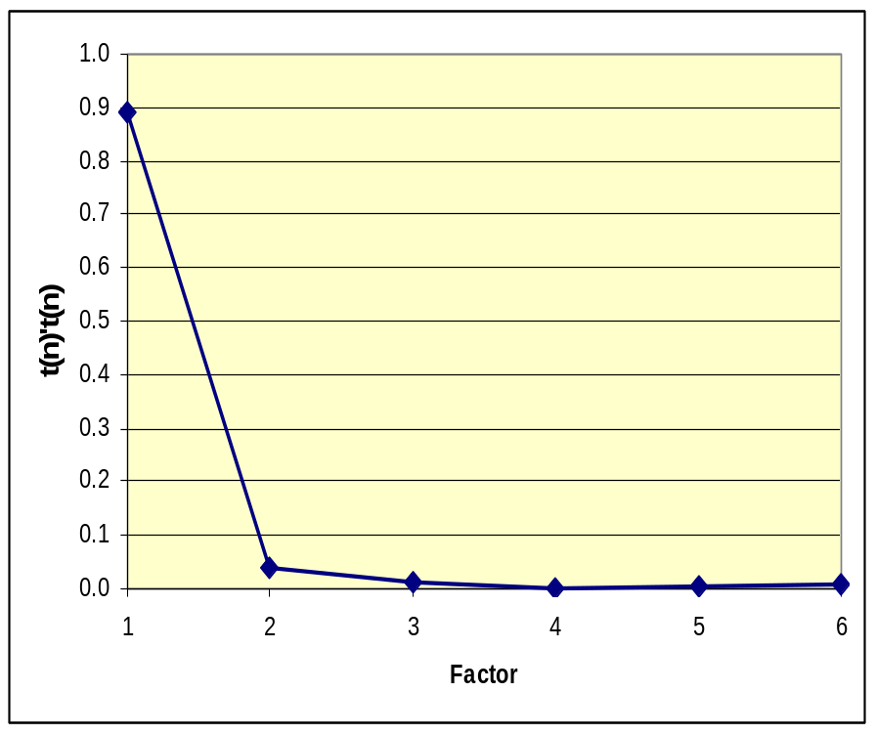
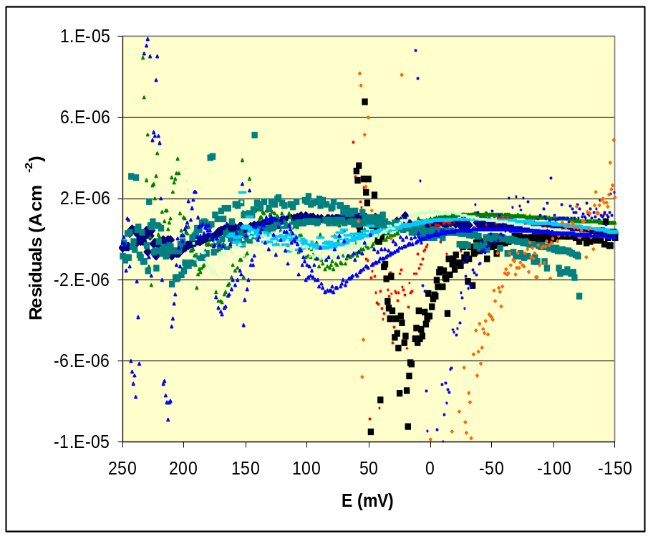
Results
Notes:
6 component residuals are bothersome, not making progress but still large residuals

Slide 14
Future Work
PCA
  Verify target function and weighting
  Non-orthogonal P
  Simulated data
  Smaller/simpler data sets
  Non-negative T (P?) and/or Rotations
PLS and other techniques
Time series
EIS, 3-way?
Spatial electrode arrays

Slide 15
Acknowledgements
Beth Kehler – UVa MS (2001), now at Intel
B.A. Kehler, G.O. Ilevbare, J.R. Scully, "Comparison of the Crevice Corrosion Resistance of Alloys 625 and 22," CORROSION/2000, paper no. 182, NACE, 2000.
B.A. Kehler, Crevice Corrosion Electrochemistry of Alloys 625 And C22, University of Virginia, Charlottesville, January, 2001.
John Scully, Rob Kelly, et al. – CESE
Jack McArdle – UVa Psychology
WSC1 presenters and participants

