Slide 1

PAIRWISE t-TEST AND ANALYSIS OF VARIANCE
Emese Vágó, Sándor Kemény
Budapest University of Technology and Economics

Slide 2
Outline
I. Summary of paired t-test and analysis of variance
II. Similarities and differences in the two procedures
III. Comparison of the models
IV. Comment
IV. Conclusions

Slide 3
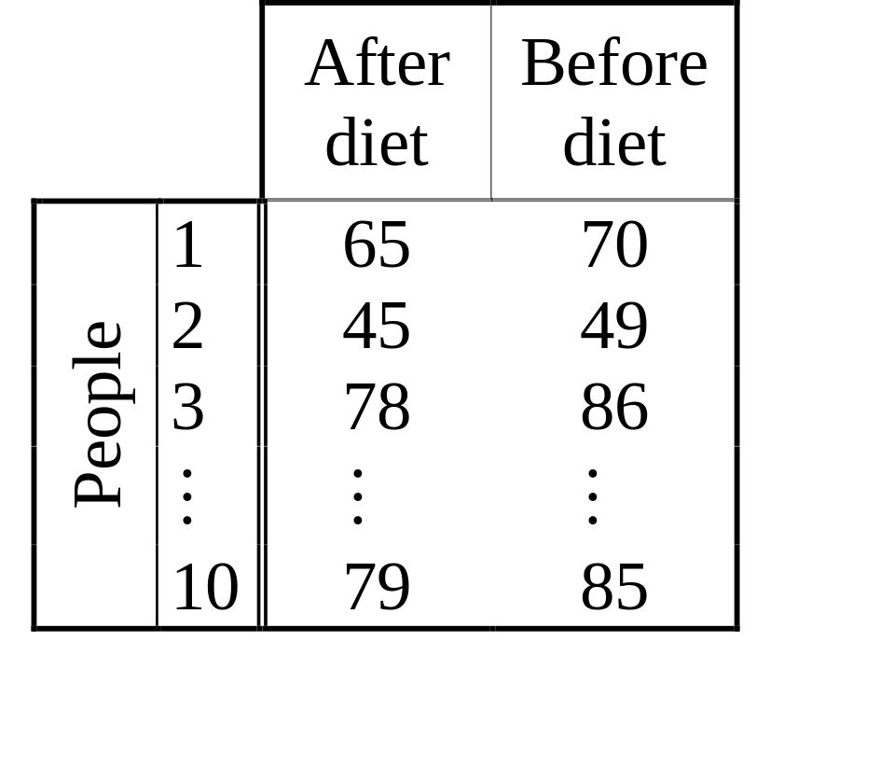
Example
The effect of a diet on weight was investigated using ten people.
Results:

Slide 4
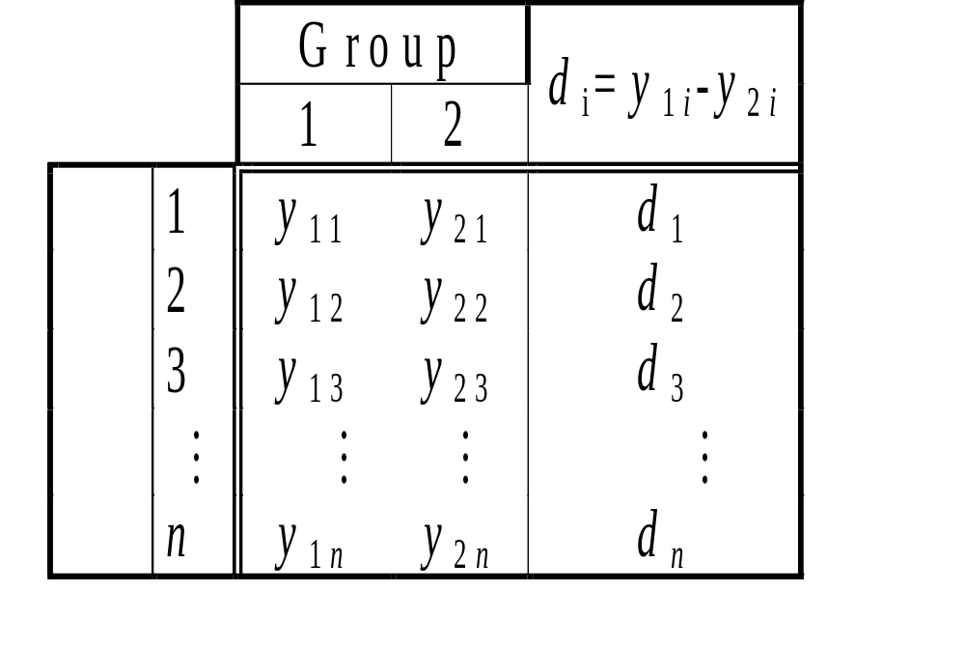
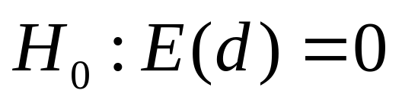
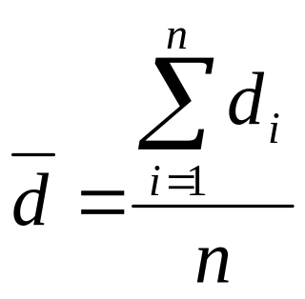
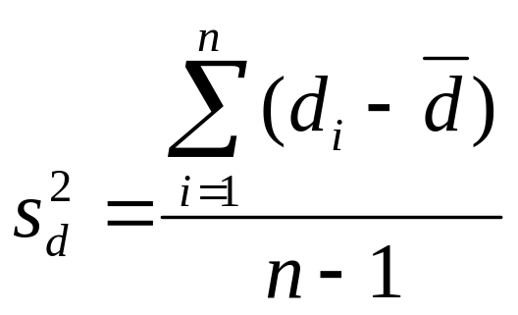
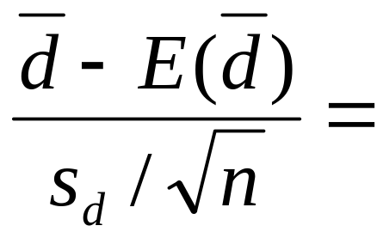
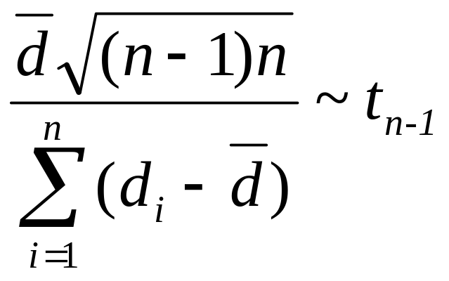
Paired t-test
Pairs

Slide 5
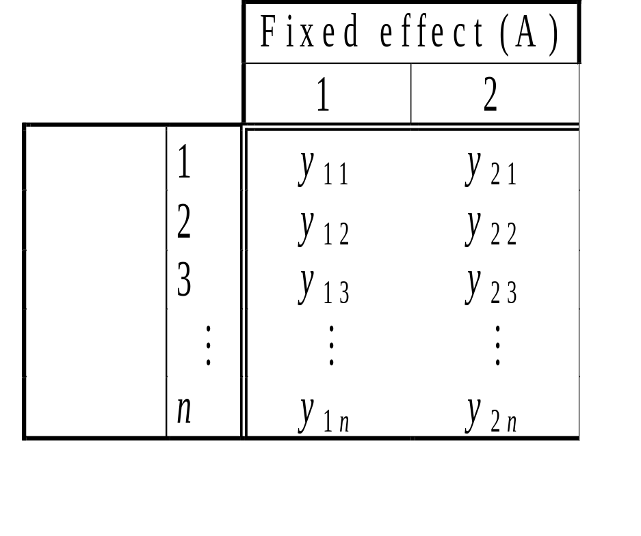
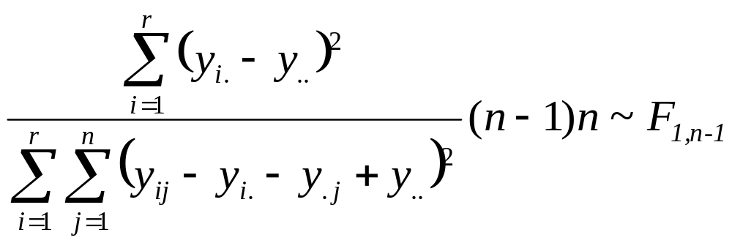
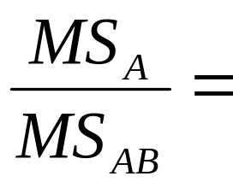
Analysis of variance
y_{ij}: weight of jth men before(i=1)/after(i=2) diet
r: levels of A (2)
Random effect
(B)
n: levels of B (10)

Slide 6
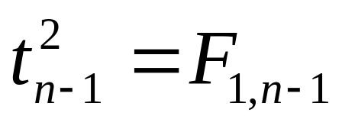
Similarities and differences
Conditions of the two analysis differ in spite of the same statistics. Why is it so?
?
?
Same statistic
Same model

Slide 7
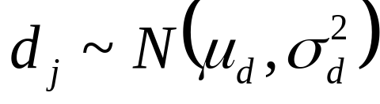
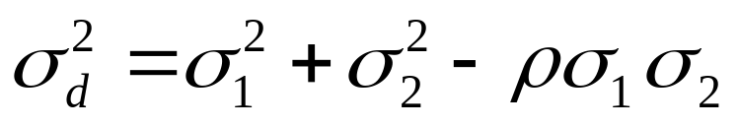
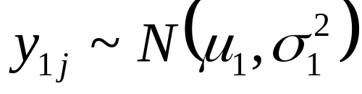
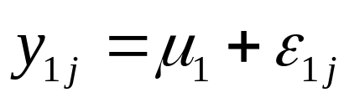
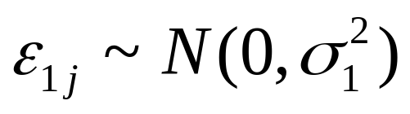
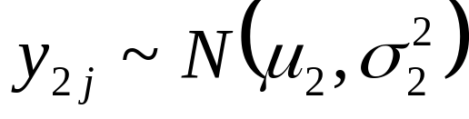
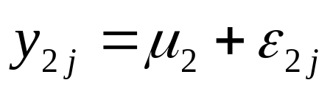
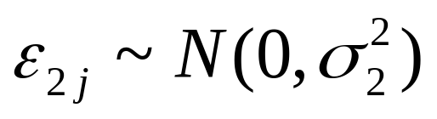
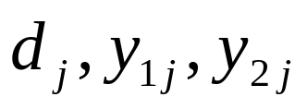
Assumptions - paired t-test
Product moment correlation, can not be estimated
Assumptions of independence for

Slide 8
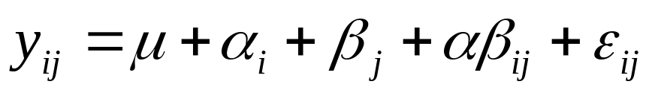
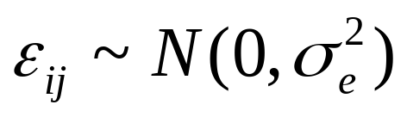
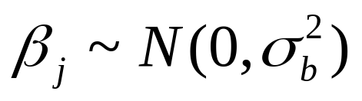
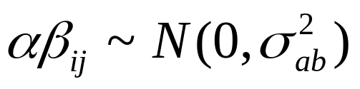
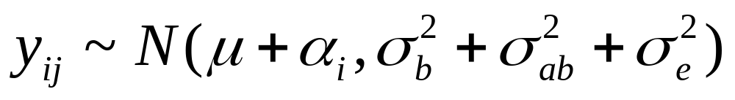
Assumptions - analysis of variance
➢
➢
➢
Assumptions of independence for
- yij
- levels of B

Slide 9
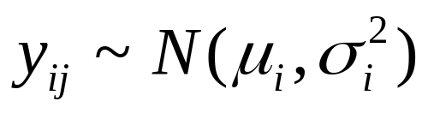
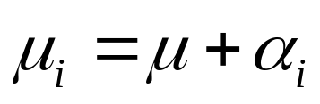
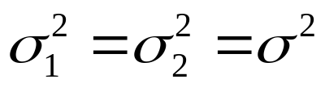
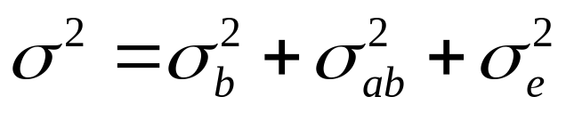
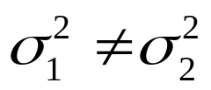
Comparison of assumptions
Paired t-test
Analysis of variance
If
If
the models do not correspond

Slide 10
Comparison of assumptions
ANOVA method may be used with weaker assumptions about homogeneity of variances for:
- one random, and
- one fixed effect (number of levels is two) design
- sample sizes are one
- testing only the effect of fixed factor

Slide 11
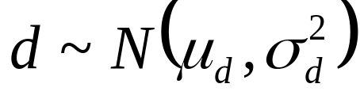
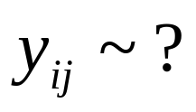
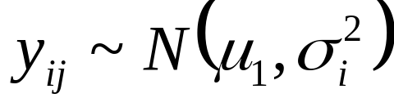
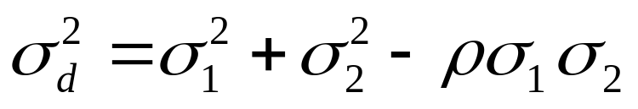
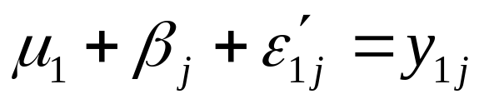
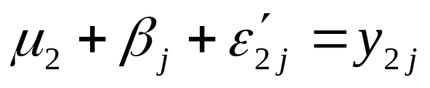

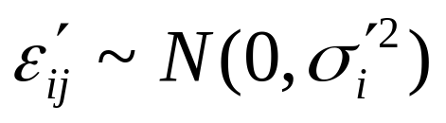
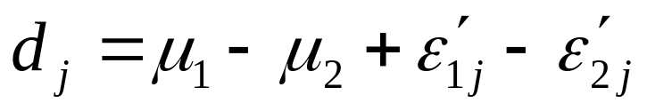
Comment - distribution of the random effect

Slide 12
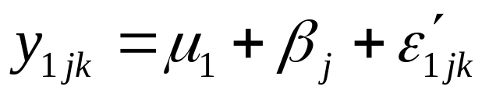
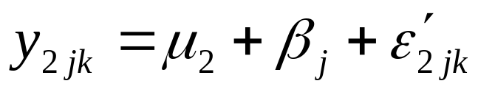
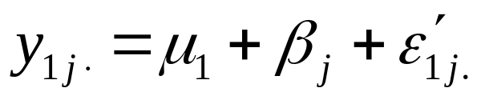
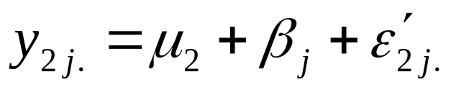
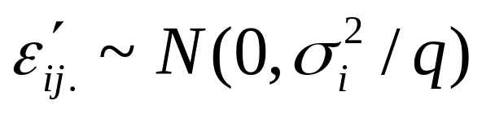
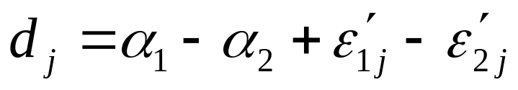
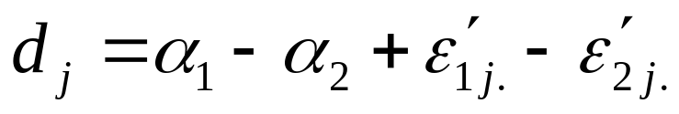
Comment - sample sizes larger then one
Sample size: 1
Sample size: q

Slide 13
Consequence
ANOVA method may be used with weaker assumptions about homogeneity of variances for testing the effect of a 2-level fixed factor, if the other factor is
- random, or fixed and
- sample sizes are one, or larger then one.

Slide 14
THANK YOU FOR YOUR ATTENTION !

