Slide 1



WSC2, Barnaul, March 2003
Applications of Sampling for Theory
Pentti Minkkinen
Lappeenranta University of Technology
e-mail: Pentti.Minkkinen@lut.fi
Sources of sampling error
Correct and incorrect sampling
Estimation of sampling uncertainty
Optimization of sampling procedures
Practical examples

Slide 2
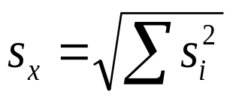
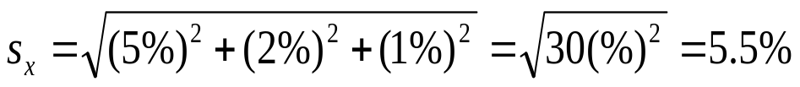
LOT
    μ
(σ)
Primary Secondary Analysis Result
sample sample
s₁ s₂ s₃ s_{x}
x
Propagation of errors:
Example:
GOAL: x = μ
Analytical process usually contains several sampling and
sample preparation steps

Slide 3
SAMPLING
Art of cutting a small portion of material from a large lot and transferring it to the analyzer
Theory of sampling (theoretical) distributions with known properties
SLOGANS
The result is not better than the sample that it is based on
Sample must be representative
Theory that combines both technical and statistical parts
of sampling has been developed by Pierre Gy:
Sampling for Analytical Purposes, Wiley, 1998

Slide 4
PLANNING OF SAMPLING
GATHERING OF INFORMATION
  What are the analytes to be determined?
  What kind of estimates are needed?
    Average (hour, day, shift, batch, shipment, etc.)
    Distribution (heterogeneity) of the determinand in the lot
    Highest or lowest values
  Is there available useful a priory information (variance estimates, unit costs)?
  Is all the necessary personnel and equipment available?
  What is the maximum cost or uncertainty level of the investigation?

Slide 5
PLANNING OF SAMPLING
2. DECISIONS TO BE MADE
  Manual vs. automatic sampling
  Sampling frequency
  Sample sizes
  Sampling locations
  Individual vs. composite samples
  Sampling strategy
    Random selection
    Stratified random selection
    Systematic stratified selection
  Training

Slide 6
Global Estimation Error
GEE
Total Sampling Error
TSE
Total Analytical Error
TAE
Point Materialization Error
PME
Weighting Error
SWE
Increment Delimi-
tation Error
IDE
Increment Extraction
Error
IXE
Increment and Sample
Preparation Error
IPE
Point Selection Error
PSE
Long Range
Point Selection Error
PSE₁
Periodic
Point Selection Error
PSE₂
Fundamental
Sampling Error
FSE
Grouping and
Segregation Error
GSE
GEE=TSE +TAE
TSE= (PSE+FSE+GSE)+(IDE+IXE+IPE)+SWE
Error components of analytical determination according to P.Gy

Slide 7
Sample
Ideal
mixing
0-D
If the lot to be sampled can be mixed before sampling it can be treated
as a 0-dimensional lot. Fundamental sampling error determines the
correct sampling error and can be estimated by using binomial or
Poisson distributions as models, or by using Gy’s fundamental sampling
error equations.

Slide 8
1-D
Samples
2-D
If the lot cannot be mixed before sampling the dimensionality of the lot
depends on how the samples are delimited and cut from the lot. Auto-
correlation has to be taken into account in sampling error estimation

Slide 9
Samples
3-D
Lot is 3-dimensional, if none of the dimensions is completely
included in the sample

Slide 10
Weighting error
Sample
Concentration
Volume
c·V
No.
mg/l
m
3
g
1
6.25
4.58
28.6
2
4.36
3.71
16.2
3
5.58
5.20
28.99
4
4.64
5.71
26.48
5
4.86
4
.54
22.08
6
3.65
6.78
24.75
7
3.73
7.12
26.55
8
5.98
5.81
34.76
9
4.96
5.86
29.05
Mean
4.89
5.479
26.39
Sum
44.01
49.3
237.47
Weighted mean concentration:
∑
c_{i}V_{i}
= 4.86 mg/l
∑
V_{i}
Total emission estimate (unweighted):
M
=
9
⋅
c
⋅
V
=
9
⋅
4
.
89
⋅
g
/
m
3
⋅
5
.
479
⋅
m
3
=
241.13
Total emission estimate (weighted):
M
w
=
9
⋅
c
w
⋅
V
=
9
⋅
4
.
86
⋅
g
/
m
3
⋅
5
.
479
⋅
m
3
=
237.47 g
Weighting error (in concentration): 0.03 mg/l
Weighting error (in total emission): 3.66 g

Slide 11
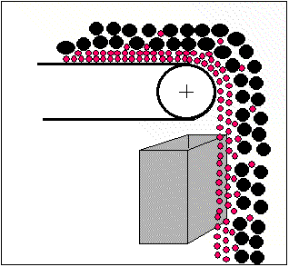
Incorrect sample delimitation

Slide 12
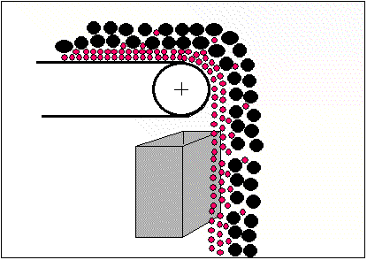
Correct sample delimitation

Slide 13
Correct design for proportional sampler: correct increment extraction
v = constant ≤ 0.6 m/s
if d > 3 mm, b ≥ 3d = b₀
if d < 3 mm, b ≥ 10 mm = b₀
d = diameter of largest particles
b₀ = minimum opening of the
sample cutter
a
v
b
c

Slide 14


Process analyzers often have sample delimitation problems

Slide 15
Incorrect Increment and Sample Preparation Errors
Contamination (extraneous material in sample)
Losses (adsorption, condensation, precipitation, etc.)
Alteration of chemical composition (preservation)
Alteration of physical composition (agglomeration, breaking of particles, moisture, etc.)
Involuntary mistakes (mixed sample numbers, lack of knowledge, negligence)
Deliberate faults (salting of gold ores, deliberate errors in increment delimitation, forgery, etc.)

Slide 16
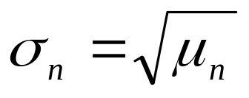
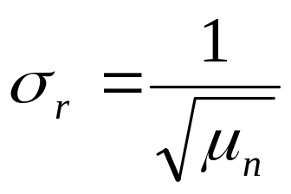
Estimation of Fundamental Sampling Error by Using Poisson Distribution
Poisson distribution is describes the random distribution of rare
events in a given interval.
If μ_{s} is the number of critical particles in sample, the standard
Deviation expressed as the number of particles is
(1)
The relative standard deviation is
(2)

Slide 17
Example
Plant Manager: I am producing fine-ground limestone that is used
in paper mills for coating printing paper. According to their speci-
fication my product must not contain more than 5 particles/tonne
particles larger than 5 μm. How should I sample my product?
Sampling Expert: That is a bit too general a question. Let’s first
define our goal. Would 20 % relative standard deviation for the
coarse particles be sufficient?
Plant Manager: Yes.
Sampling Expert: Well, let’s consider the problem. We could use the
Poisson distribution to estimate the required sample size. Let’s see:

Slide 18
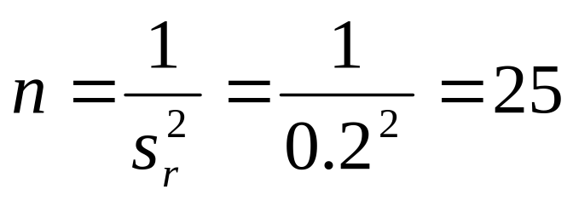
The maximum relative standard deviation s_{r} = 20 % = 0.2. From
equation 2 we can estimate how many coarse particles there should be
in the sample to have this standard deviation
If 1 tonne contains 5 coarse particles this result means that the primary
sample should be 25 tonnes. This is a good example of an impossible
sampling problem. Even though you could take a 25 tonne sample there
is no feasible technology to separate and count the coarse particles from it. You shouldn’t try the traditional analytical approach in con-trolling the quality of your product. Instead, if the specification is really sensible, you forget the particle size analyzers and maintain the quality of your product by process technological means, that is, you take care that all equipment are regularly serviced and their high performance maintained to guarantee the product quality.
Plant Manager: Thank you

Slide 19
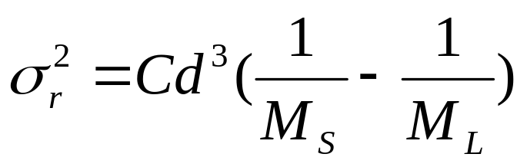
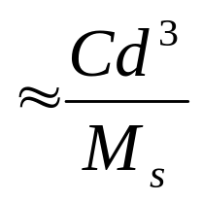
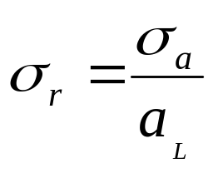
P. Gy’s Fundamental sampling error model
if M_{s} << M_{L}
where
= relative standard deviation
M_{s} = sample size
M_{L} = lot size
d = particle size (95 % top size)
a_{L} = average concentration of the analyte in the lot
C = Sampling constant

Slide 20
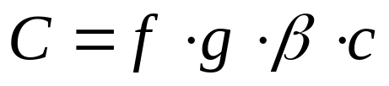
SAMPLING CONSTANT C
composition factor
liberation factor
size distribution factor
shape factor

Slide 21
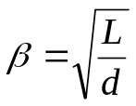


d
d
d
d
f= 1
f= 0,524
f= 0,5
f= 0,1
default in most cases
Estimation of shape factor
d
L = d
L
Estimation of liberation factor for unliberated and
liberated particles

Slide 22
Estimation of size distribution factor, g
Wide size distribution (d/d_{0.05} > 4) default g = 0.25
Medium distribution (d/d_{0.05} = 4...2) g = 0.50
Narrow distribution (1 < d/d_{0.05} < 2) g = 0.75
Identical particles (d/d_{0.05} = 1) g = 1.00

Slide 23
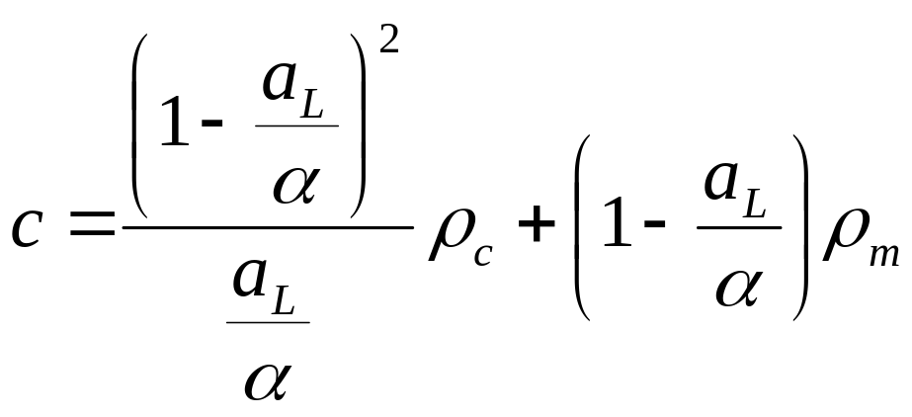
Estimation of constitution factor, c
density of critical particles
average concentration of the lot
density of matrix
concentration of determinand in critical particles

Slide 24
Example:
A chicken feed (density = 0.67 g/cm³) contains as an average 0.05 % of an
enzyme powder that has a density of 1.08 g/cm³. The size distribution of the
enzyme particle size d=1.00 mm and the size range factor g = 0.5 could be
estimated.
Estimate the fundamental sampling error for the following analytical procedure.
First a 500 g sample is taken from a 25 kg bag. This sample is ground to a particle size -0.5 mm. Then the enzyme is extracted from a 2 g sample by
using a proper solvent and the concentration is determined by using liquid
chromatography.
The relative standard deviation of the chromatographic measurement is 5 %.

Slide 25
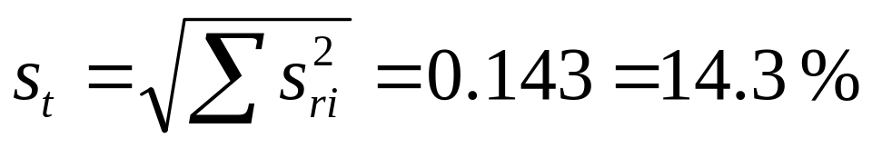
M_{L} =25000 g; d = 1 mm
ρ_{c} = 1.08 g/cm³ ; α = 100 % ; β = 1
ρ_{m} = 0.67 g/cm³ ; a_{L} = 0.05 % ; f = 0.5
c =2160 g/cm³
d ₁= 1 mm; M_{S1} = 500 g ; M_{L1} =25000 g; g ₁ = 0.5;
C ₁= 540 g/cm³
➔ s_{r1} = 0.033 =3.3 % (primary sample)
d ₂= 0.5 mm; M_{S2} =2 g ; M_{L2} =500 g; g ₂ = 0.25;
C ₁= 270 g/cm³
s_{r2} = 0.13 =13 % (secondary sample)
s_{r3} = 0.05 = 5 % (analysis)
Total relative standard deviation:

Slide 26
Analysis of Mineral Mixtures by Using IR Spectrometry
Pentti Minkkinen ^{a)}, Marko Lallo^{a)}, Pekka Sten^{b)}, and Markku J. Lehtinen^{c)}
^{a)} Lappeenranta University of Technology, Department of Chemical Technology, P.O. Box 20,
FIN-53851 Lappeenranta, Finland
^{b)} Technical Research Centre of Finland (VTT), Chemical Technology, Mineral Processing,
P.O. Box 1405, FIN-83501 Outokumpu, Finland
^{c)} Partek Nordkalk Oy Ab, Poikkitie 1, FIN-53500 Lappeenranta, Finland
(Present address: Geological Survey of Finland, R & D Department/Mineralogy and
Applied Mineralogy, P.O.Box 96, FIN-2151 Espoo, Finland)

Slide 27
Content
Introduction
Sampling error estimation and sample preparation
Design of calibration and test sets
Calibration (PLS)
Results

Slide 28
Introduction
In mineral processing it is important to know quanti-tatively the mineral composition of the material to be processed
The methods presently in use time consuming
Only a few reports in literature on use of IR for mineral analysis
Feasibility of FTIR (Nicolet Magna 560) to analyze quantitatively mineral species associated with wollastonite was studied

Slide 29
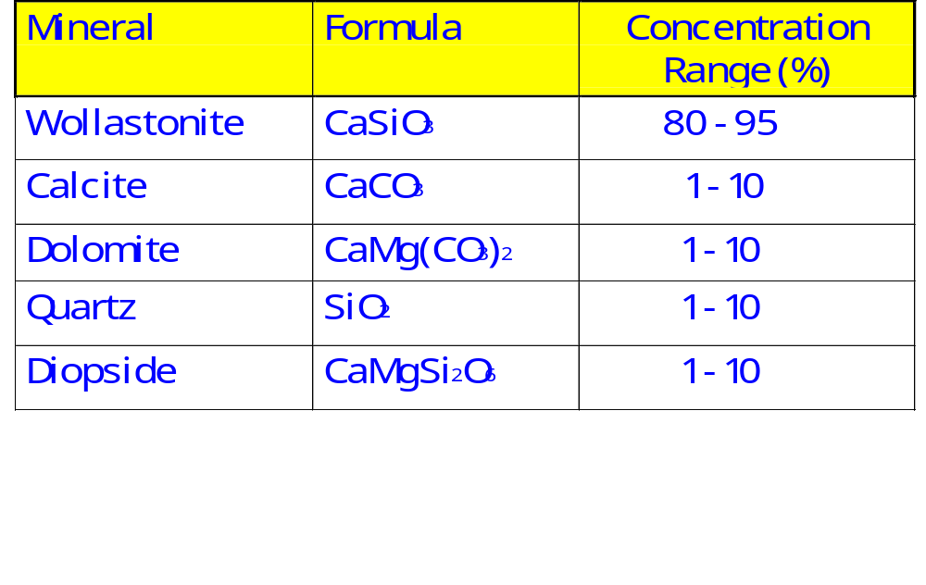
Mineral Mixture Studied

Slide 30
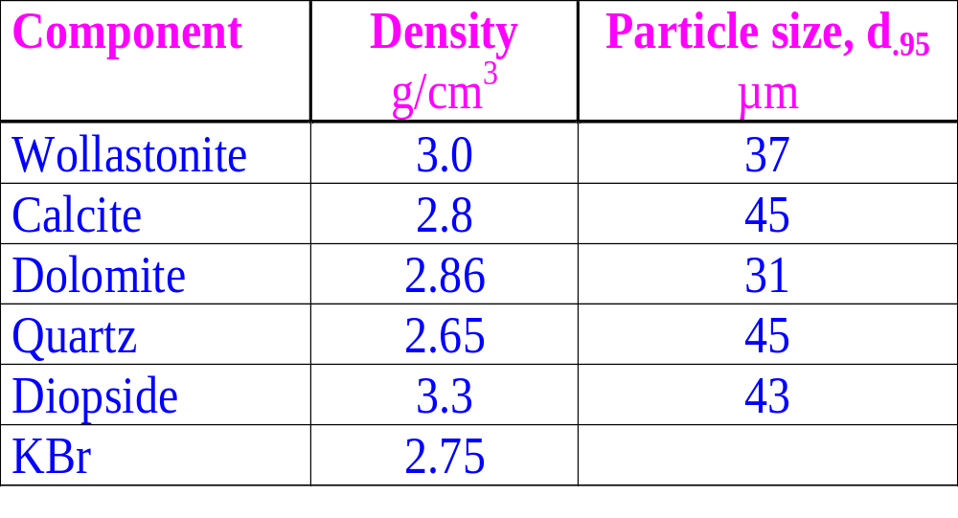
MATERIAL PROPERTIES NEEDED IN SAMPLING ERROR ESTIMATION

Slide 31
Design of calibration set
Mixture design for five components by using XVERT- algorithm (CORNELL, J.A., Experi-ments with Mixtures, 2nd Edition, Wiley, 1990, pp 139-227)
37 calibration and 5 validation standards

Slide 32
Calibration
Spectra recorded with Nicolet Magna 560 FTIR spectrometer
Calibration with PLS1 (model calculated by using TURBOQUANT program)

Slide 33
PREPARATION OF CALIBRATION STANDARDS
Pure minerals (d=1mm) were ground individually 2 min in a swing mill
30 mg - 2.95 g of each mineral were carefully weighted to obtain the designed composition which was carefully mixed 3 min in a Retsch Spectro Mill
20 mg of the mineral mixture was carefully weighted into 4.98 g of KBr and mixed 3 min in a Retsch Spectro Mill
200 mg of the mineral-KBr mixture was pressed into a tablet for the IR measurement

Slide 34
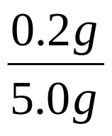
Sampling errors of sample preparation and IR measurement
Dilution factor = = 0.004
Tablet Preparation:
Lot size = M_{L1} = 5 g
Sample size = M_{s1} = 0.2 g
IR Measurement:
Lot size = M_{L2} = 200 mg
Sample size = M_{s2} = 38% of 0.2 g = 76 mg

Slide 35
RESULTS
10
s
8
r1
%
s
6
r2
%
4
s
rt
%
2
0
1
2
3
4
5
6
7
8
9
10
Quartz concentration (%)
FSE of quartz determination

Slide 36
s
0.8
r1
%
s
0.7
r2
%
s
0.6
rt
%
0.5
0.4
80
82
84
86
88
90
92
94
96
Wollastonite concentration (%)
FSE of wollastonite determination

Slide 37
Experimental result (PLS-calibration)
QUARTZ
12
10
8
PREDICTED (%)
6
4
2
0
0
2
4
6
8
10
12
DESIGN (%)
Designed vs. predicted concentration
* = calibration, o = test set

Slide 38
WOLLASTONITE
96
94
92
90
88
PREDICTED (%)
86
84
82
80
78
76
78
80
82
84
86
88
90
92
94
96
DESIGN (%)
Designed vs. predicted concentration
* = calibration, o = test set

Slide 39
Conclusions
FTIR and PLS can be used for mineral analysis
Design and preparation of the calibration set important; pure minerals hard to get and vary in composition from deposit to deposit and also within a deposit
Reproducible sample preparation important both from the spectroscopic point of view and to control the sampling error
Still difficult for a routine laboratory

Slide 40
Uses of Gy’s fundamental sampling error model
s_{r} of a given sample size
Minimum M_{s} for a required s_{r}
Maximum d for given M_{s} and s_{r}
Audit and design of multistep sampling procedures

Slide 41
Estimation of point selection error, PSE
PSE is the error of the mean of a continuous lot estimated by using
discrete samples.
PSEdepends on sample selection strategy, if consecutive values are autocorrelated. Selection options:
random
stratified random
stratified systematic.
Point selection error has two components: PSE = PSE₁ + PSE₂
PSE₁ ... error component caused by random drift
PSE₂ ... error component caused by cyclic drift
Statistics of correlated series is needed to evaluate the sampling
variance.

Slide 42
100
50
Random selection
CONCENTRATION
0
0
5
10
15
20
25
30
TIME
100
50
Stratified selection
CONCENTRATION
0
0
5
10
15
20
25
30
TIME
100
CONCENTRATION
Systematic selection
50
0
0
5
10
15
20
25
30
TIME

Slide 43
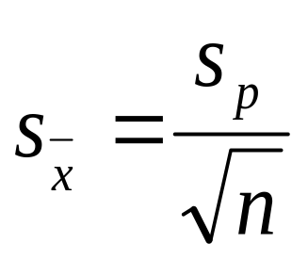
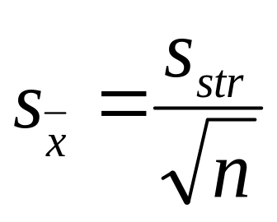
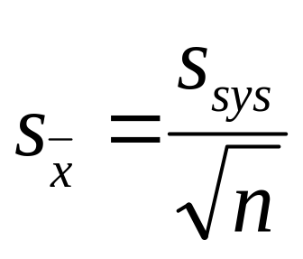
When sampling autocorrelated series the same number of samples gives different uncertainties for the mean depending on selection strategy
Random sampling:
s_{p} is the process standard deviation, s_{str} and s_{sys} standard deviation estimates where the autocor-relation has been taken into account.
Stratified sampling:
Systematic sampling:
Normally s_{p} > s_{str} > s_{sys} ,
except in periodic processes, where s_{sys} may be the largest

Slide 44
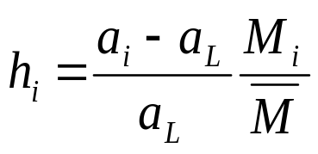

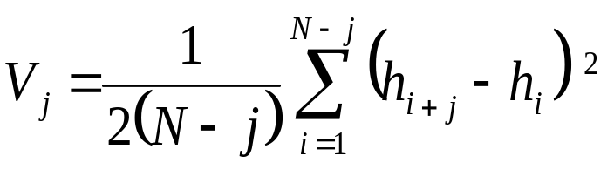
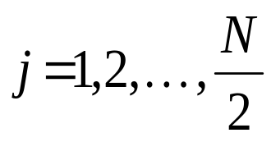
Estimation of PSE by variography
Variogaphic experiment: N samples collected at equal distances
Heterogeneity of the process:
,
Variogram of heterogeneity calculated:
,
To estimate variances the variogram has to be integrated (numerically
in Gy’s method)

Slide 45
0.015
A
V
0.01
0.005
0.04
B
V
0.02
0
0.02
C
V
0.01
0
0.02
D
V
0.01
0
0
5
10
15
20
25
30
35
40
45
50
SAMPLE INTERVAL
Shapes of variograms: A. Random process; B. Process with
non-periodic drift; C. Periodic process; D. Complex process

Slide 46
Estimation of sulfur in wastewater stream
1
0.5
h_{i}
0
0.5
0
5
10
15
20
25
30
DAYS
Heterogeneity of the process, s_{p} = 0.282 =28.2 %

Slide 47
0.15
0.1
V_{i}
0.05
0
0
2
4
6
8
10
12
14
16
Sample interval (d)
Variogram of sulfur in wastewater stream

Slide 48
25
s
str
20
s_{r} (%)
15
s
sys
10
5
0
0
5
10
15
Sample interval (d)
Relative standard deviation estimates, which take auto-
correlation into account

Slide 49
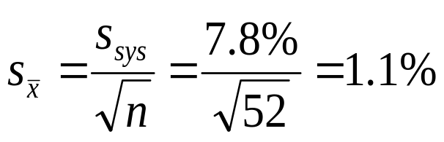
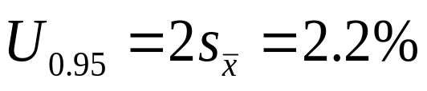
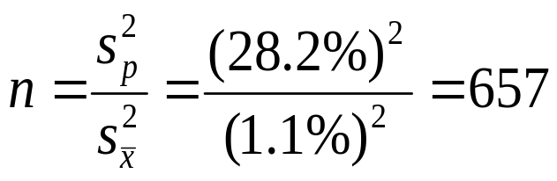
Estimate the uncertainty of the annual mean, if one sample/ week is analyzed by using systematic sample selection
Sampling interval = 7 d ➔ s_{sys} = 7.8 %
Number of samples/y = n =52
Standard deviation of the annual mean =
Expanded uncertainty =
Process standard deviation was 28.2 %. If the number of samples is
estimated by using normal approximation (or samples are selected
completely randomly) the required number of samples is for the same
uncertainty:

Slide 50
CONCLUSIONS
Sampling uncertainty can be, and should be estimated
If the sampling uncertainty is not known it is questionable
whether the sample should be analyzed at all
Sampling nearly always takes a significant part of the
total uncertainty budget
Optimization of sampling and analytical procedures may
result significant savings, or better results, including
scales from laboratory procedures and process sampling
to large national surveys

Slide 51


THANK YOU

