Slide 1

Successive Bayesian Estimation
Alexey Pomerantsev
Semenov Institute of Chemical Physics
Russian Chemometrics Society
Notes:
Hi, everybody!
I am sure that looking at this picture some of you remembers Kostroma and the first Winter school because this is Ipatiev monastery where we have had a pleasant trip. At that conference I presented a lecture about non-linear regression approach. There was a part concerning a new method called successive Bayesian estimation. But it was explained rather briefly so many questions were asked particularly from Chris. That is why I decided to talk more about this technique.
This method is of general nature and it can be applied for the various regression problems. Today I concern with one application that is estimating of reaction rate constants from spectral data. Using it I will demonstrate you how this method works. However, a brief overview of other interesting applications will be done.
I also present you a software (called Fitter). It was developed especially for practical implementation of new NLR algorithms. All calculations were done with this program.

Slide 2
Agenda
Introduction. Bayes Theorem
Successive Bayesian Estimation
Fitter Add-In
Spectral Kinetics Example
New Idea (Method ?)
More Applications of SBE
Conclusions
Notes:
This is our agenda.
Very short introduction just to remember who was Bayes and why his theorem is still in focus.
Then I present the principles and ideas of successive bayesian estimation method.
This will be followed with a short overview of Fitter software, which is our main tool for estimation.
The next part will be rather large example that is estimation of reaction rate constants from spectral data. This is demonstration of SBE method in practice.
Point number 5 is very interesting for me. There I present a new idea (just born) that can be a method for non-linear modeling. Here I expect keen criticism so I intend to stop presentation for discussion.
In other case I will make a quick tour to show you other application of successive Bayesian estimation.
At last there will be some conclusions

Slide 3

1. Introduction
Notes:
Well, here we start introduction

Slide 4

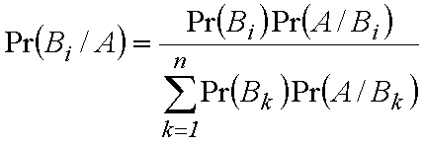
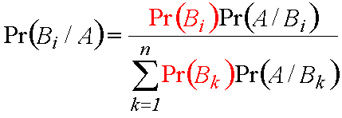
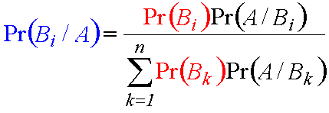
The Bayes Theorem, 1763
Where to take
the prior
probabilities?
Posterior Probability
Prior Probabilities
Thomas Bayes
(1702-1761)
Likelihood Function
L(a,σ ²)=h(a,σ ²)L₀(a,σ ²)
Notes:
This is Thomas Bayes and his famous theorem, which was published only 2 years after his death. I failed to find Bayes portrait so just a symbolic picture is shown. His theorem is very simple indeed. This is just another appearance of well-known law of probability multiplication. The theorem explains how to calculate posterior probability if prior probabilities are know. There is something mysterious in the Bayes theorem, which was in each statistical textbook for 2 hundred years till being uncovered for wide employment in data analysis.
Now we have a lot of works in this field and even a dissent in the statistical community to Bayesians and anti- Bayesians. And the main reason of division is ---
Well, I sought a simple example to explain the Bayes theorem and asked myself – what is the favorite chemometric object, like mouse in biology? What is the favorite chemometric field now, the hot spot of the day? The answers are evident, of course, and I proudly present you….

Slide 5






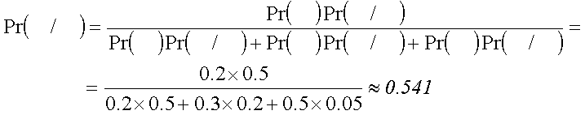
Jam Sampling & Blending Theory
Now we know the origin of
a worm in
the jam!
 |  | 0.20 |  | 0.30 |  | 0.50
 |  | 0.50 |  | 0.20 |  | 0.05
Notes:
Let’s suppose that we are cooking jam using three kinds of berries, which are taken in these proportions. Sometimes worms happen in berries. The probability to meet that unwelcome guy in a berry depends on its kind. This is highest for raspberry and lowest for strawberry. Now, suppose that having breakfast we have found a worm in the jam. Honest scholar has to investigate the origin of this phenomenon. Bayes helps him. Using his theory scientist can calculate the probability that this guy came from raspberry. This is very important that ….

Slide 6


2.Successive Bayesian Estimation (SBE)
Notes:
Now we’ll talk about Successive Bayesian Estimation.

Slide 7
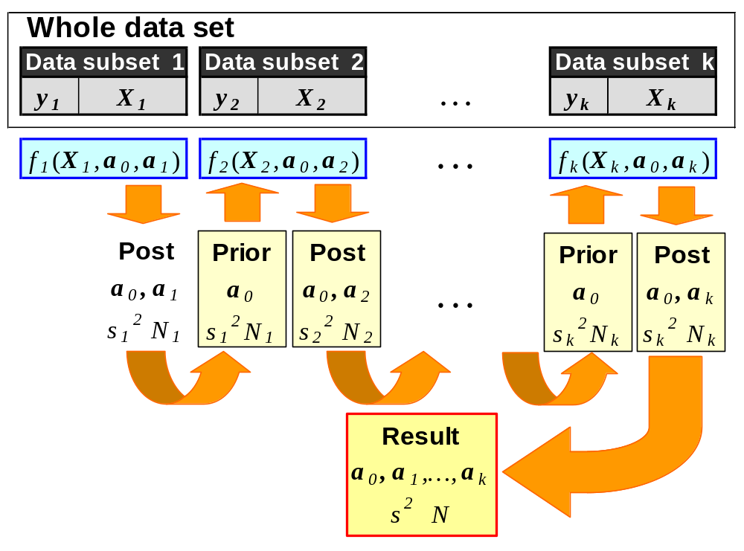
SBE Concept
SBE principles
Split up whole data set
Process each subset alone
Make posterior information
Build prior information
Use it for the next subset
How to eat away
an elephant?
Slice by slice!
Notes:
The main concept of SBE is to split up the whole data set into several parts. Afterward each subset is processed separately. The results obtained on the previous step are used as a priori information (in the Bayesian form) for the next part. During this procedure the sequence of the parameter estimates is produced and its last term is the ultimate estimate.
This method lets us to fit the large (actually – unlimited) data sets with the complex models having the large number of unknown parameters.

Slide 8
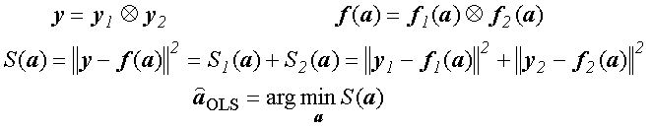
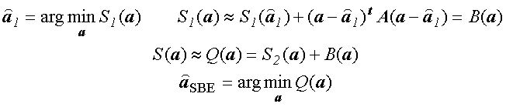
OLS & SBE Methods for Two Subsets
OLS
Quadratic
approximation
near the
minimum!
SBE
Notes:
Let us compare conventional OLS approach with new SBE method. We'll do this for the simple case when initial dataset consists of two subsets.
OLS estimates are obtained as the point where objective function that is the sum of squares has a minimum. Of course this function can be presented as the sum of two sums corresponding to each data subset.
In SBE we start with the first data subset and obtain first-step estimate that minimize the first sum of squares. After that we can expand this sum and build its quadratic approximation near the minimum. This approximation can be treated as the Bayesian information, which is added to the second sum of squares at the next step.
Thus we obtain another SBE objective function, which is close to the OLS objective function i.e. full sum of squares. We can find its minimum and obtain SBE estimate.
Thus main idea is

Slide 9

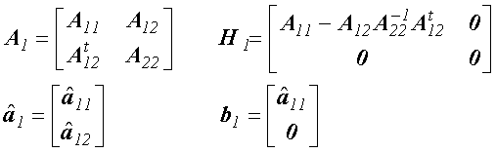

Posterior & Prior Information
Subset 1. Posterior Information
Make Posterior,
rebuild it and
apply as Prior!
Rebuilding (common & partial parameters)
Subset 2. Prior Information
Notes:
Let us consider how Bayesian information is constructed and used.
After some step in the successive procedure we obtain this term that is quadratic approximation of the current objective function. Here N is the number of degrees of freedom, s is variance estimate and A is the Hessian matrix.
Sometimes at the next step fitting the next data subset we use another regression function, which does not depend on some old parameters. In this case we divide matrix A into blocks presenting common parameters, partial parameters and their interference. This matrix should be rebuilt in order to keep the common input and to dismiss the partial input.
At the next step the corrected term is added as the Prior information.
So during the successive algorithm we always ….
So during the successive algorithm we always ….

Slide 10

Prior Information of Type I
Posterior Information |  | Prior Information
Parameter estimates |  | Prior parameter values b
Matrix A |  | Recalculated matrix H
Variance estimate s² |  | Prior variance value s₀²
NDF N_{f} |  | Prior NDF N₀
Objective Function
The same error
variance in the
each subset
of data!
Notes:
This is important that besides vector of regression function parameters, which should be estimated, we have another unknown but scalar value. This is error variance. We have already seen that regression functions and their parameters could be different in the different subsets of data. This requires the recalculation of Bayesian matrix. The error variance can be also similar or dissimilar in each data subsets. This idea impels us to claim that prior information can be of two types. This is of type 1. Here error is the same so we can use posterior variance value and its NDF as a priori information for the next subset. It can be shown that in this case objective function has this form.

Slide 11

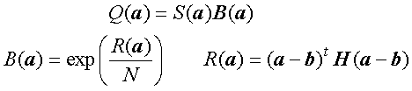
Prior Information of Type II
Different error
variances in the
each subset
of data!
Posterior Information |  | Prior Information
Parameter estimates |  | Prior parameter values b
Matrix A |  | Recalculated matrix H
Objective Function
Notes:
Prior information of Type II is used when error variances are different in the each subset of data. In this case we cannot use posterior variance value so prior information is to be truncated and objective function has the form.

Slide 12


SBE Main Theorem
Different order of subsets processing
SBE
agree with
OLS!
Theorem (Pomerantsev & Maksimova , 1995)
Notes:
To confirm the SBE method we have to answer two main questions.
1) Does the SBE estimate depend on the order of subset processing?
Actually we can start procedure with the first subset and has finished with the last one, but we could do it in the inversed order, i.e. start with the last subset and finish with the first one. Also the whole data set may be split in different (actually unlimited) manner. And each variant produces the SBE estimate.
The second question is
2) Does the SBE estimate agree with the OLS estimate?
This can be proved in general that for linear regression the SBE estimator is equal to the OLS estimator and thus it does not depend on the order of subsets. For nonlinear regression this is fulfilled asymptotically when the number of data points tends to infinity.
Later we will see examples that confirm this result that …

Slide 13

3. Fitter Add-In
Notes:
I’ve introduced Fitter software at our previous meeting so now I just show you some pictures that help you to remember how it works.

Slide 14
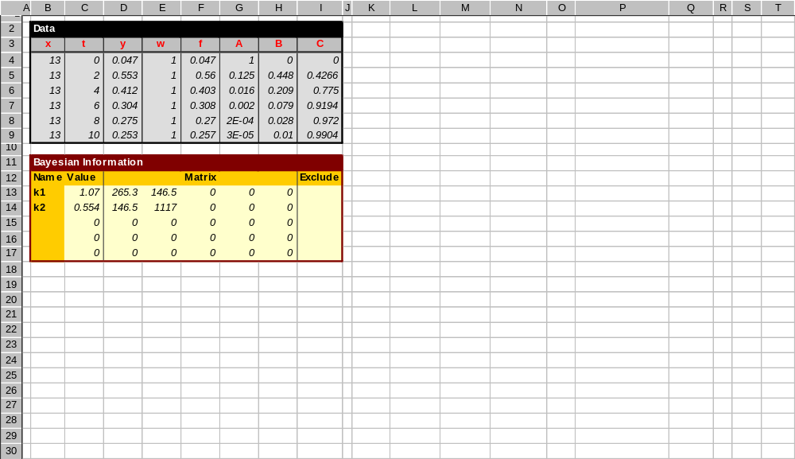
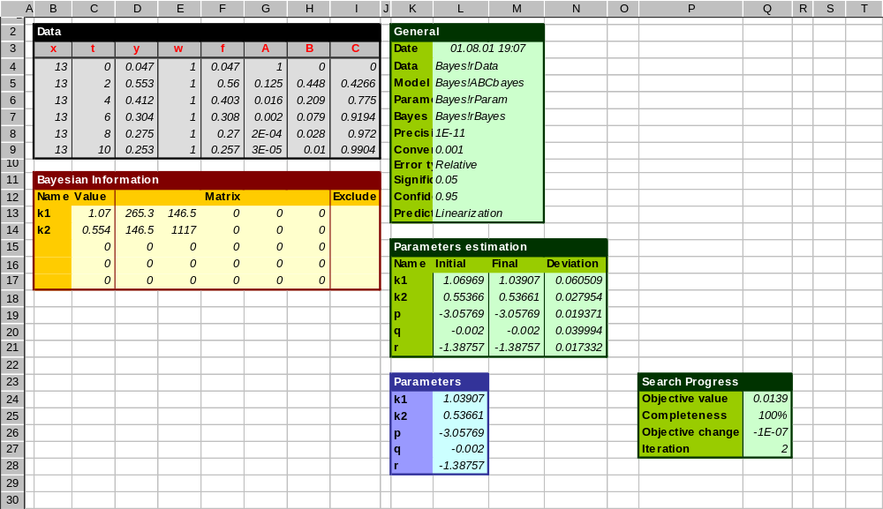
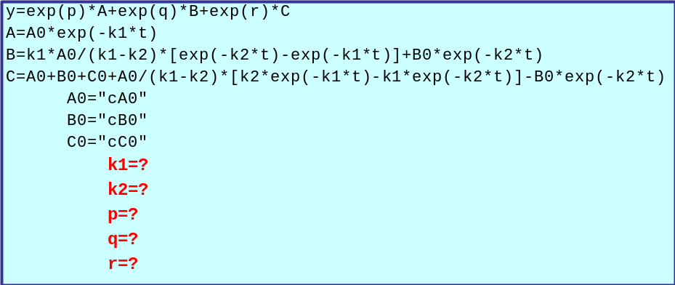
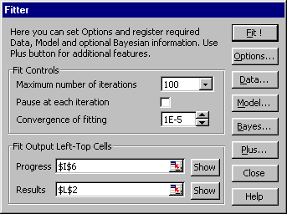
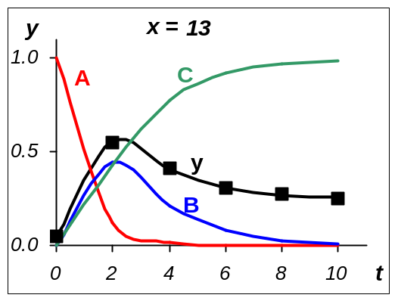
Fitter Workspace
Fitter is a
tool for SBE!
Notes:
The SBE algorithm is carried out with the help of FITTER software, designed for non-linear regression analysis.
Fitter is Add-In for Excel. Using it one can fit data set along with Bayesian information...
... by the model, which can be set and adjust in the interactive manner ...
... applying Fitter menu .
The results are displaying at the worksheet.
So ...

Slide 15

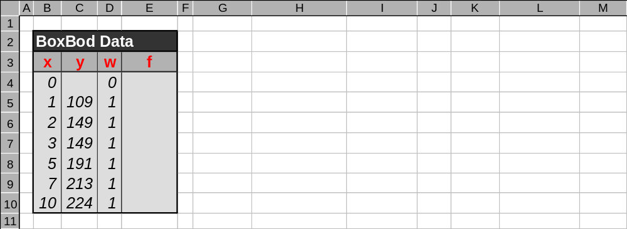
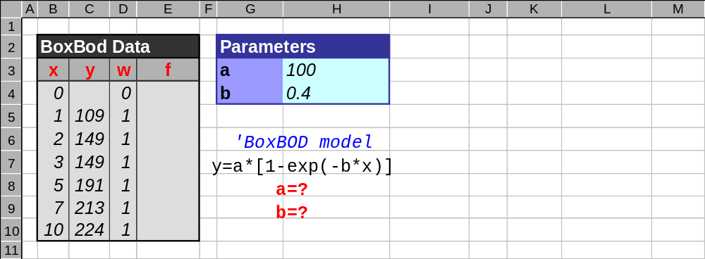
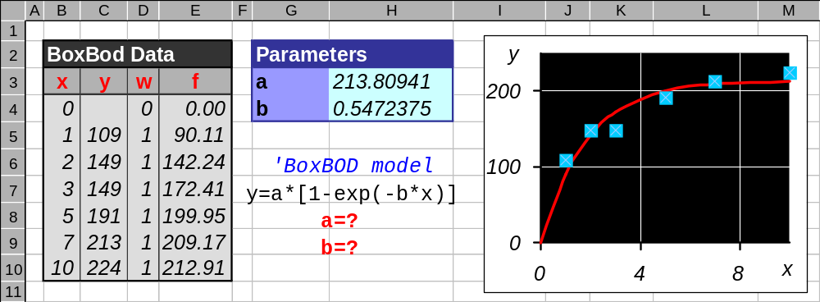
Data & Model Prepared for Fitter
Values
Predictor
Response
Comment
Weight
Apply Fitter!
Fitting
Equation
Parameters
Notes:
At this slide you can see how data and model are prepared for Fitter application.

Slide 16
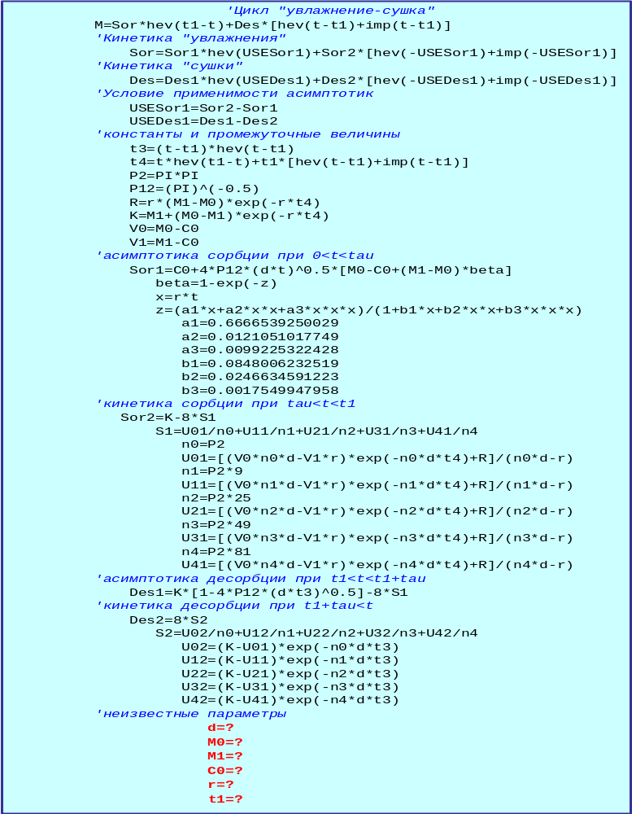
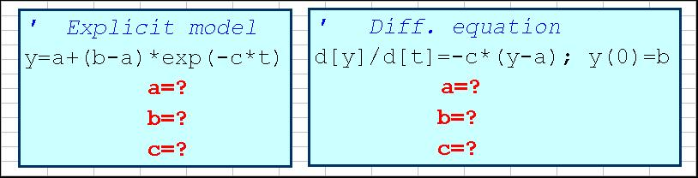
Model f(x,a)
Different shapes of the same model
Explicit model |  | y = a + (b – a)*exp(–c*x)
Implicit model |  | 0 = a + (b – a)*exp(–c*x) – y
Diff. equation |  | d[y]/d[x] = – c*(y –a); y(0) = b
Rather
complex
model!
Presentation at worksheet
Notes:
Here I just want to show you that applying Fitter one can use three main types of model.
This is the same exponential equation presented in different shapes and all are valid.
The model could be very complex and this is an example of big model used for diffusion process evaluation.

Slide 17
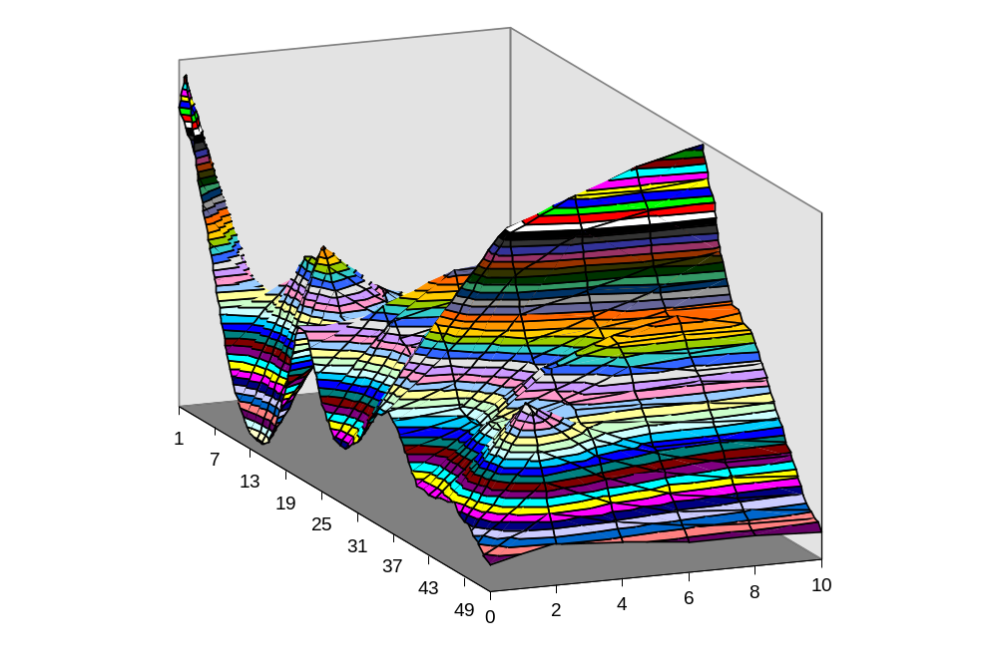
4. Spectral Kinetics Modeling
Notes:
Now we consider an example where spectral kinetics is modeled.

Slide 18
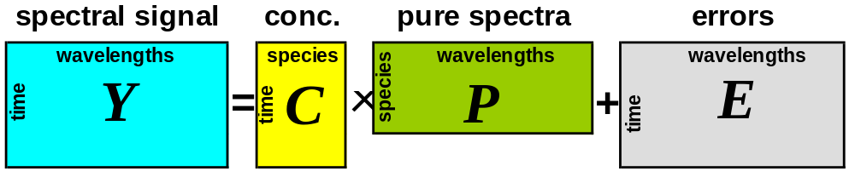
Spectral Kinetic Data
Y(t,x,k)=C(t,k)P(x)+E
This is large
non-linear
regression
problem!
K constants L wavelengths M species N time points
Y is the (N×L) known data matrix
C is the (N×M) known matrix depending on unknown parameters k
P is the (M×L) unknown matrix of pure component spectra
E is the (N×L) unknown error matrix
Notes:
Nowadays spectral data are often used to determine the kinetic parameters. These spectra contain relevant information of the kinetics. However this information is hidden within very complex nonlinear model. Thus this is challenging us to develop advanced methods for obtaining that information.
The model for the kinetics of spectral data may be expressed as a function of time t and wavelength x depending on unknown kinetic rate constants k
Here Y is measured data matrix; C is concentration matrix depending on unknown kinetic parameters, and P is unknown matrix of pure component spectra. Besides, the error matrix E is involved in the model.
Typical dimensions are
10 constants
100 wavelengths
10 species
100 time points
So we can state that …

Slide 19



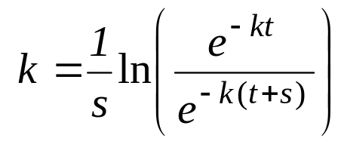
How to Find Parameters k?
Method |  | Idea |  | Dimension |  | Problem
Full OLS (hard) |  |  |  | K+M×L >> 1 |  | Large dimension
Short OLS (hard) |  |  |  | K+M×S ≈ 10 |  | Small precision
WCR (hard&soft) |  |  |  | K ≈ 10 |  | Matrix degradation
GRAM (soft) |  |  |  | K+M×A ≈ 100 |  | Just one model
This is a challenge!
Notes:
Our goal is to find values of parameters k.
“Hard” kinetic models built on the main principles of chemical physics give the strong basement for data analysis. Such methods can be easily applied when spectra of pure components are known. But when they are unknown some essential problems arise.
If we apply Ordinarily Least Squares method using the whole data set, the large number of estimated values leads to multicollinearity. I will show the example.
If we use short OLS method based on the subset of selected wavelengths, the estimation accuracy becomes rather bad. We will see this later.
There are many “soft” methods available to solve this problem where the employed approach consists of performing separate soft calibration between spectra and concentration units. The calibrated concentration values are used further for the parameters' fitting. However these methods can be applied just for some special kinetic models, for example pseudo first order reactions. Sometimes “soft” methods fail to provide the proper accuracy of results. I will show this using real world example. So …

Slide 20

Simulated Example Goals
Compare SBE estimates with ‘true’ values
Compare SBE estimates for different order
Compare SBE estimates with OLS estimates
Notes:
I start with simulated example that let us to achieve the following goals.

Slide 21
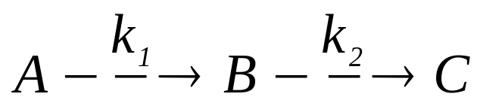
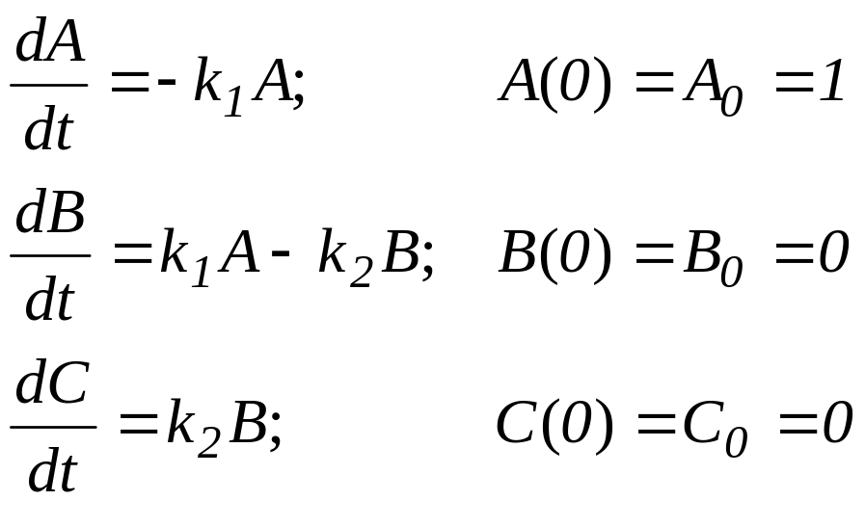
Model. Two Step Kinetics
Standard
‘training’
model
‘True’ parameter values
k₁=1 k₂=0.5
Notes:
In this example we use two-step kinetics of the first order. In this model concentration profiles can be presented in the explicit form. The following true parameter values were applied. This is … for such kind of problem.

Slide 22
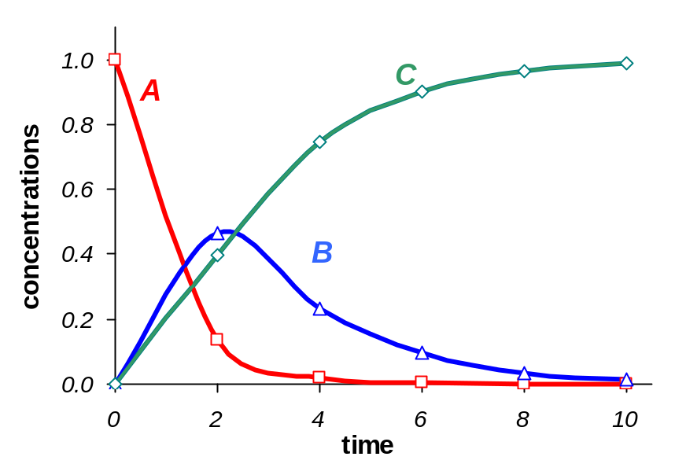
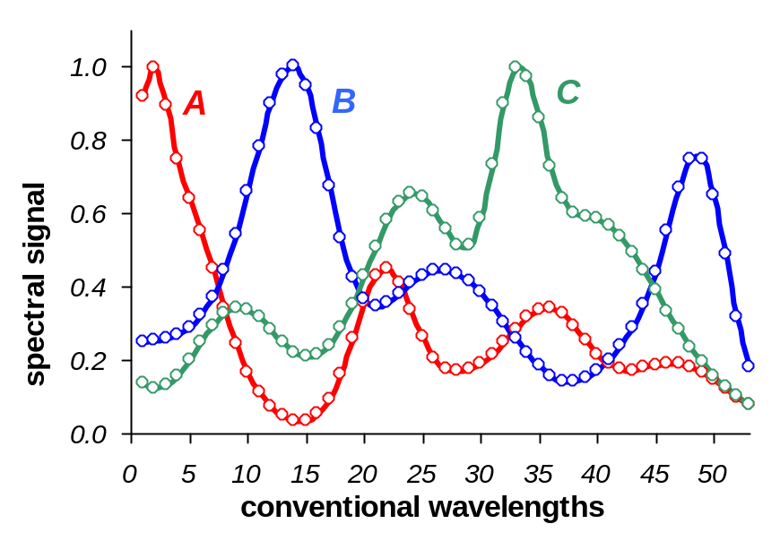
Data Simulation
Usual way of
data simulation
Simulated concentration profiles
Simulated pure component spectra
C₁(t) = [A](t)
C₂(t) = [B](t)
C₃(t) = [C](t)
Y(t,x)=C(t)P(x)(I+E)
STDEV(E)=0.03
P₁(x) = p_{A} (x)
P₂(x) = p_{B} (x)
P₃(x) = p_{C} (x)
Notes:
Concentration matrix C may be obtained as a solution to a kinetic model of two-step kinetics Just 6 time points were used in the data set. Such small number of points is chosen with the intention to produce the maximum troubles in the estimating.
Spectra of all pure components are simulated using Gaussian overlapping spectral peaks. Each spectrum p is normalized as max(p)=1. Here are 53 (m) wavelengths. The actual wavelength values x are never used in the simulated example therefore only conventional wavelength values are denoted. These values are numbers that correspond to the actual wavelength values.
Appling this general formula we obtain the simulated data set.
This is …

Slide 23
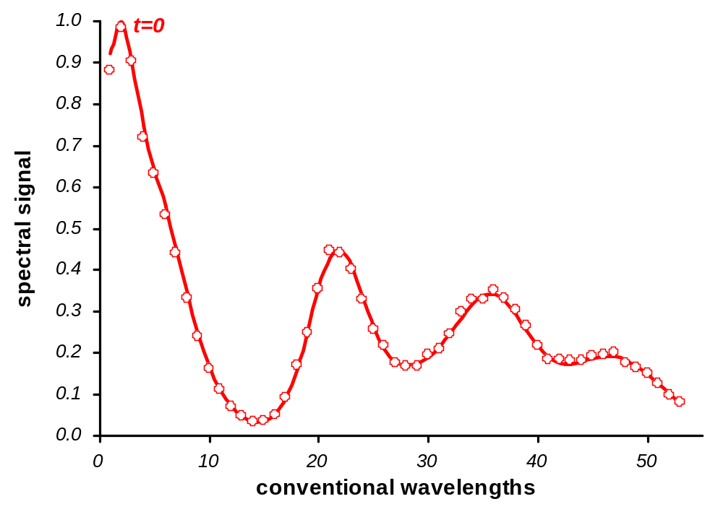
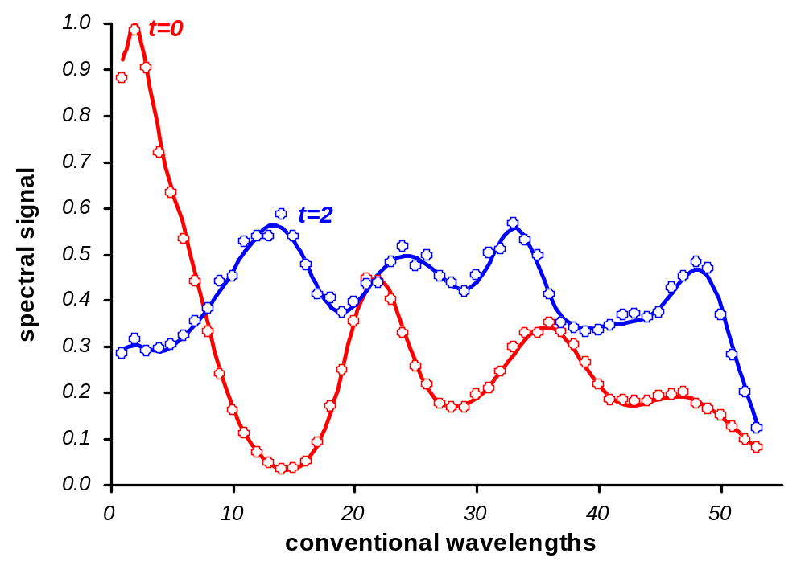
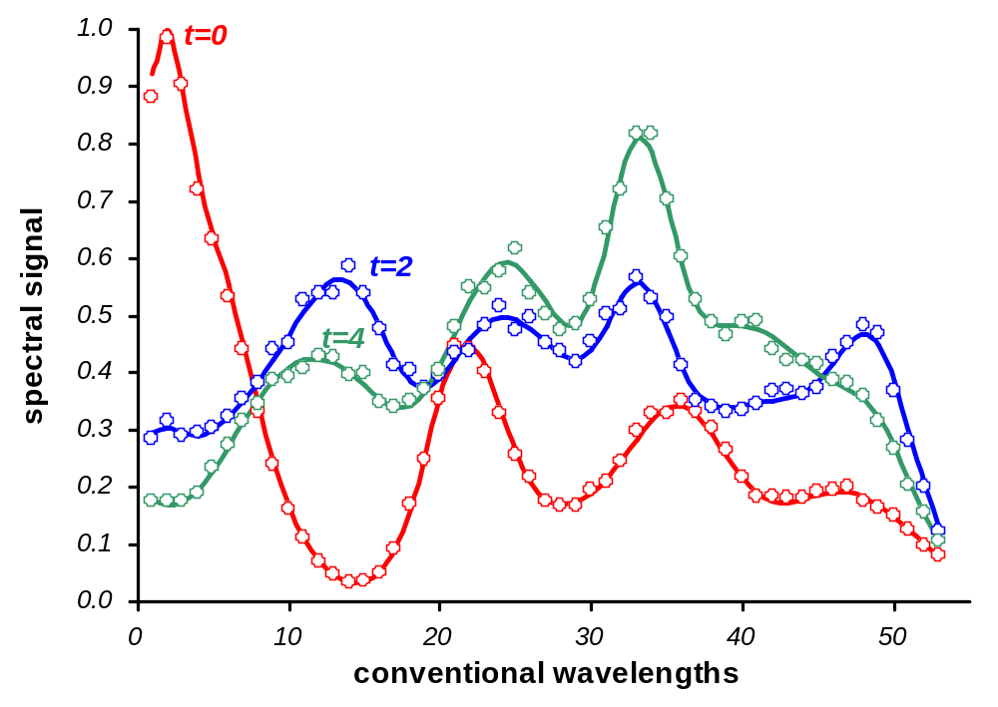
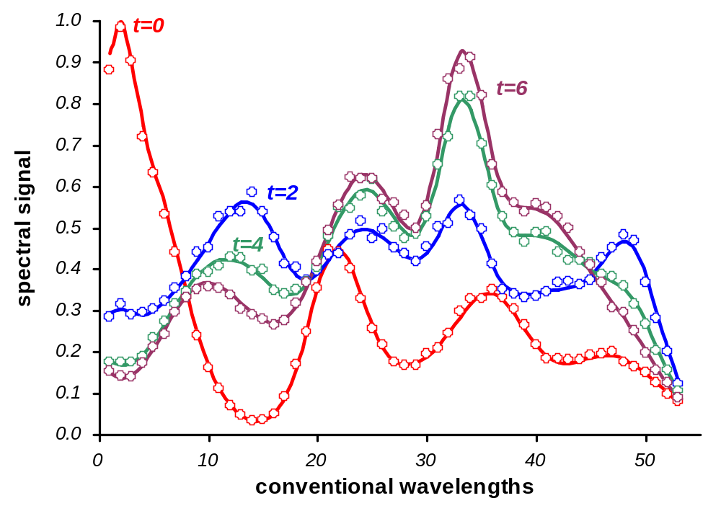
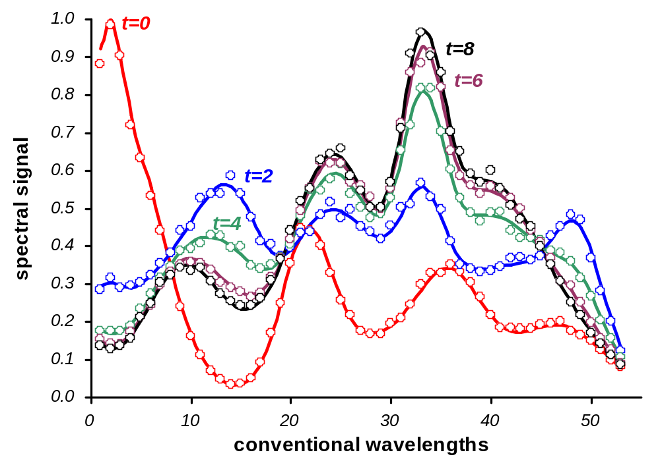
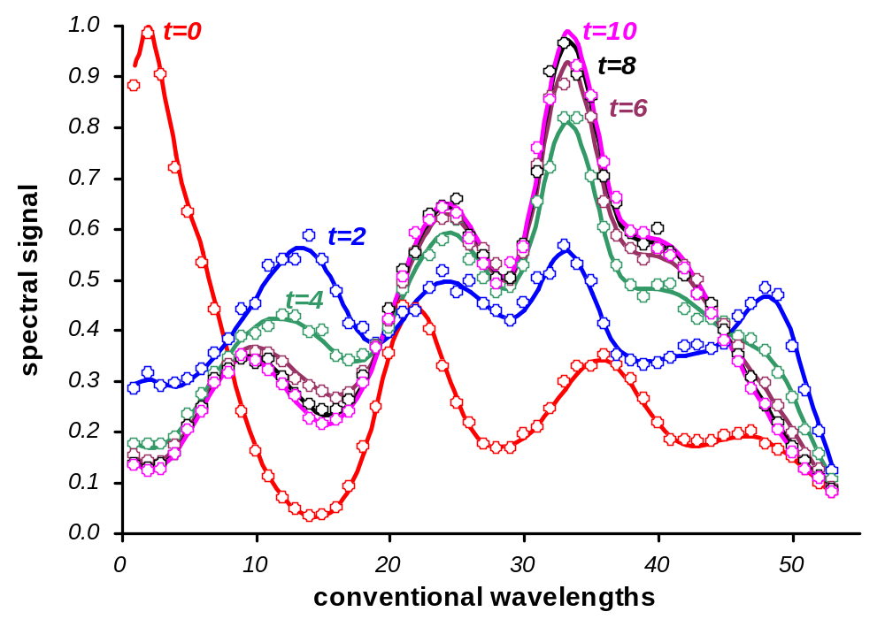
Simulated Data. Spectral View
Spectral
view of data
Notes:
We can look at these data, using wavelength X-axis. Here we can see evolution of 10 spectra along with time.
This is …

Slide 24
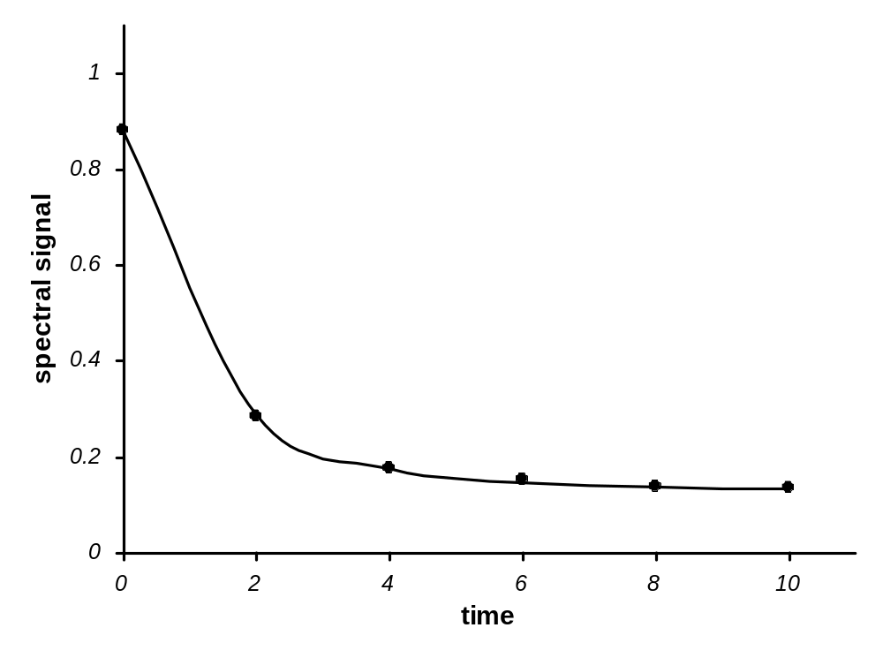
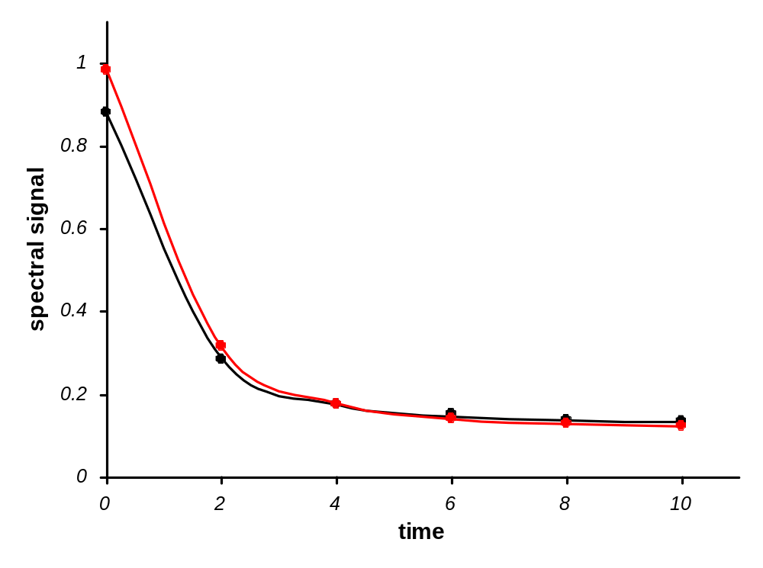
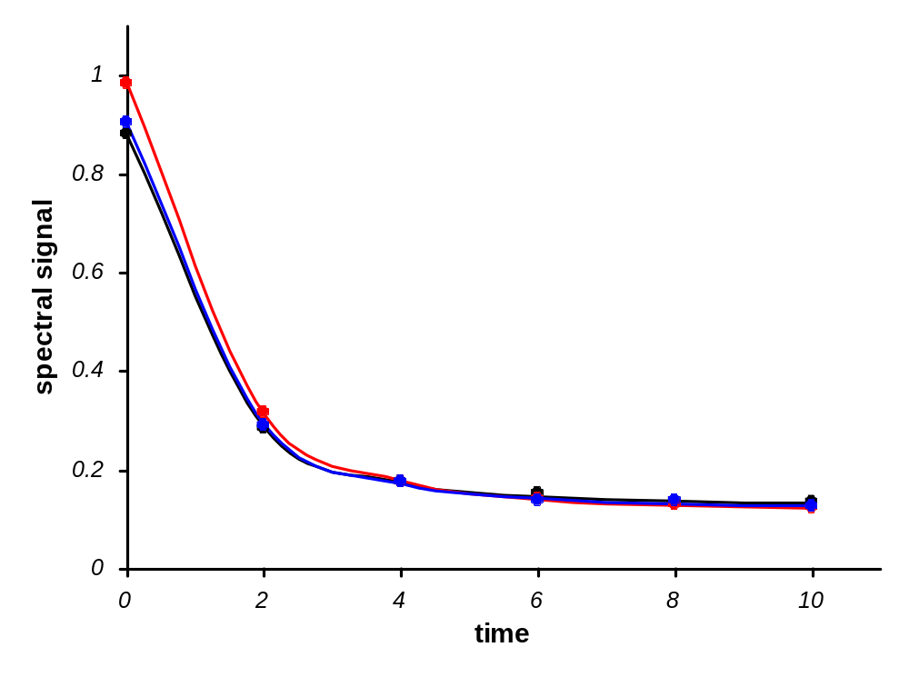
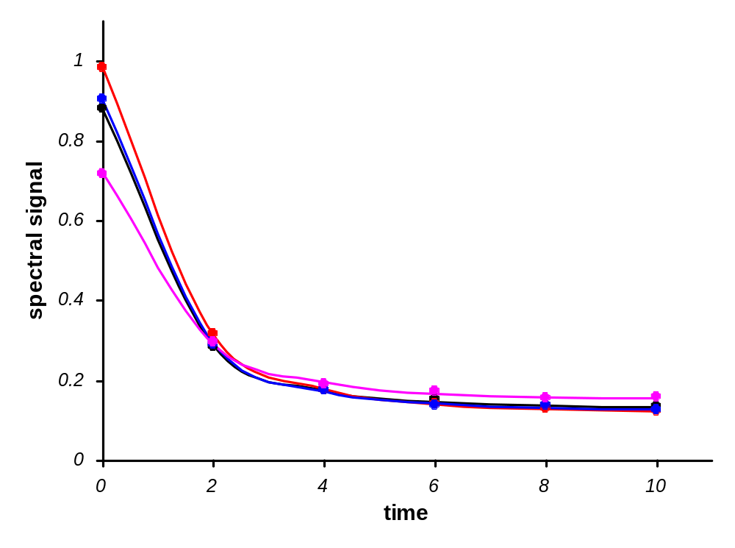
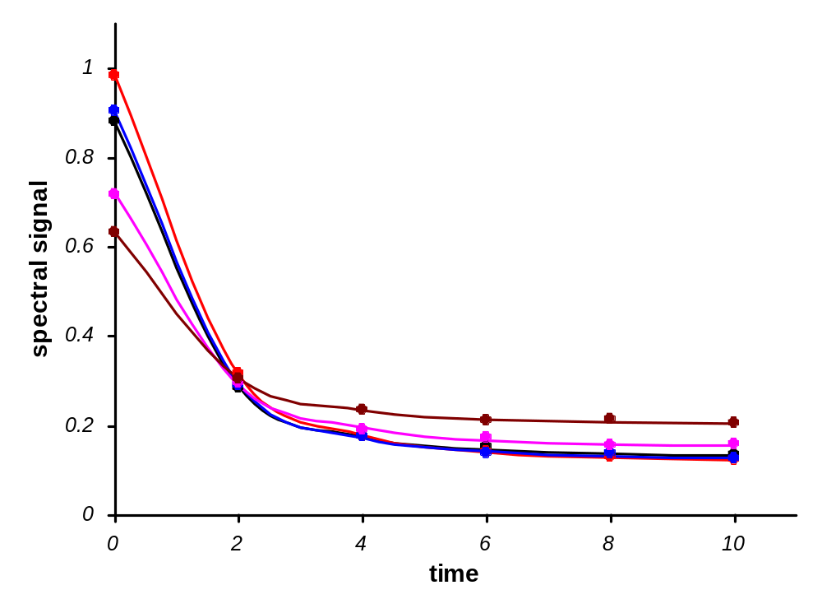
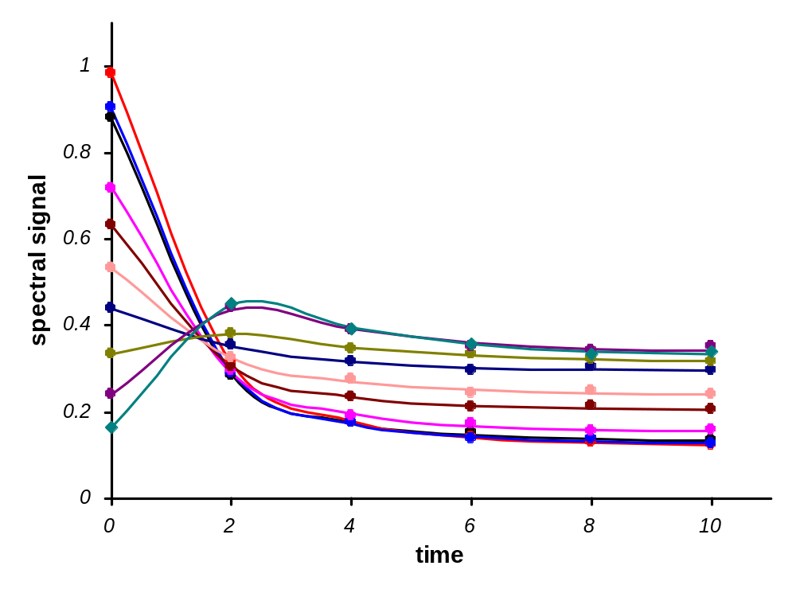
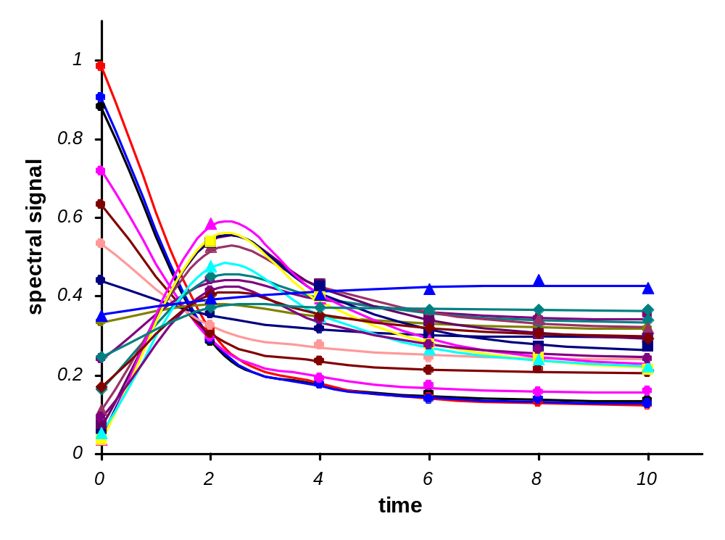
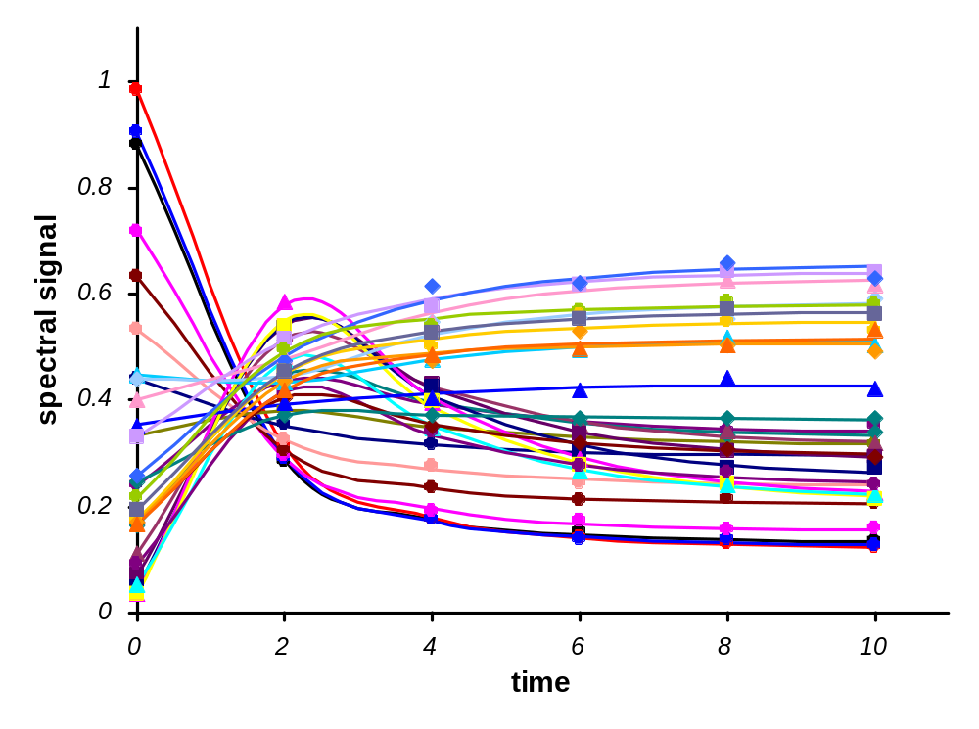
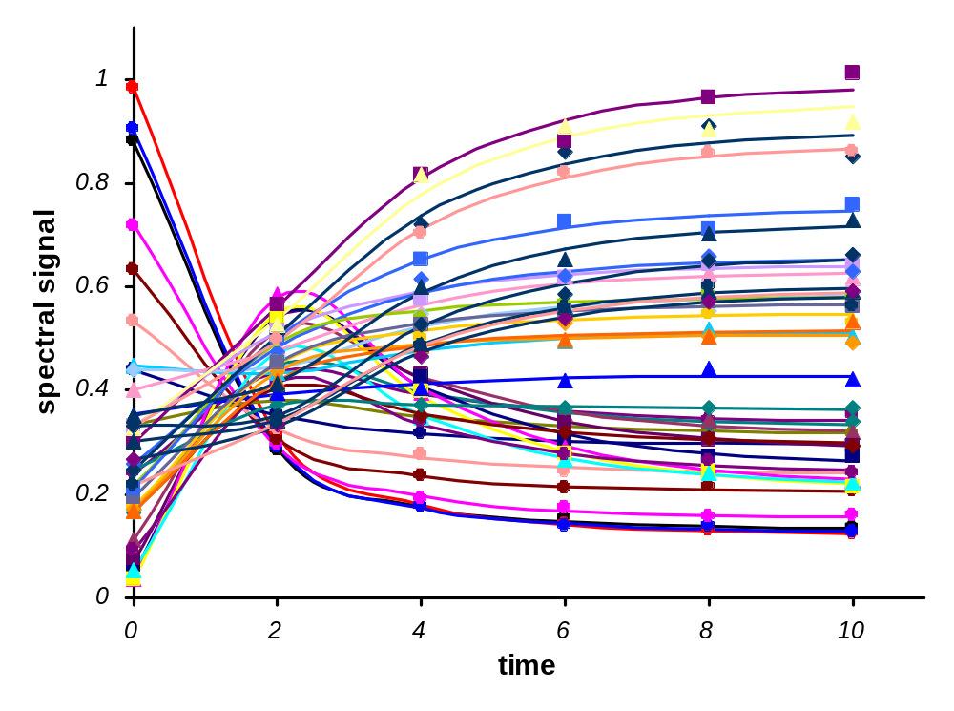
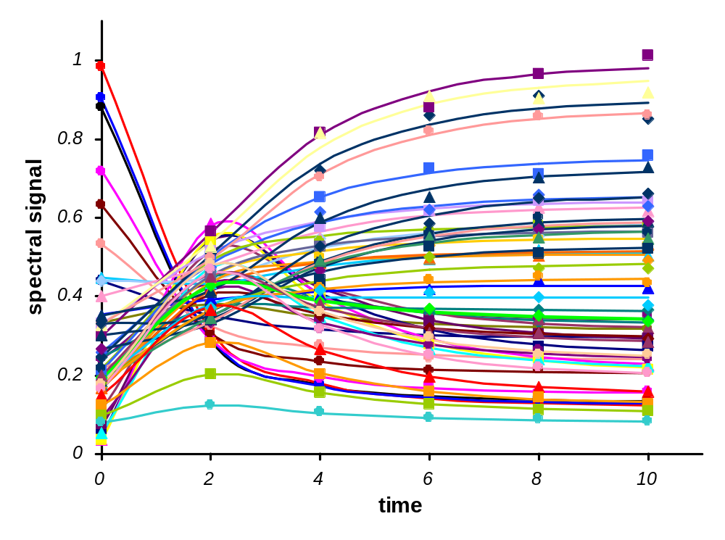
Simulated Data. Kinetic View
Kinetic view
of data
Notes:
This is another view of data. This may be called kinetic view when time is used as X-axis and spectral wavelengths produce kinetic curves. This way to present data is more convenient for SBE application.

Slide 25
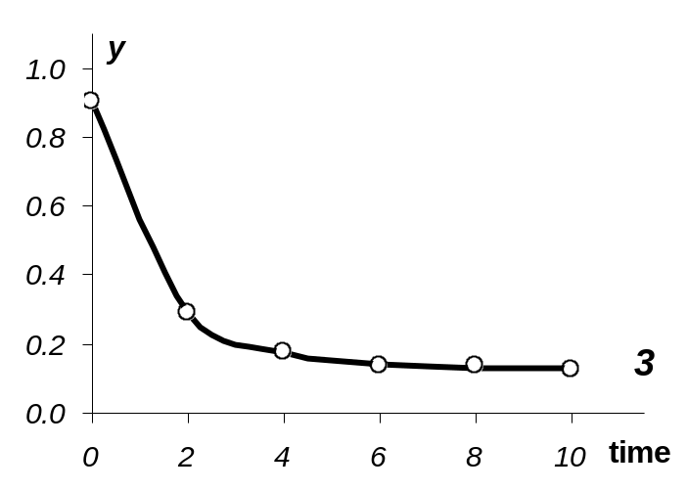
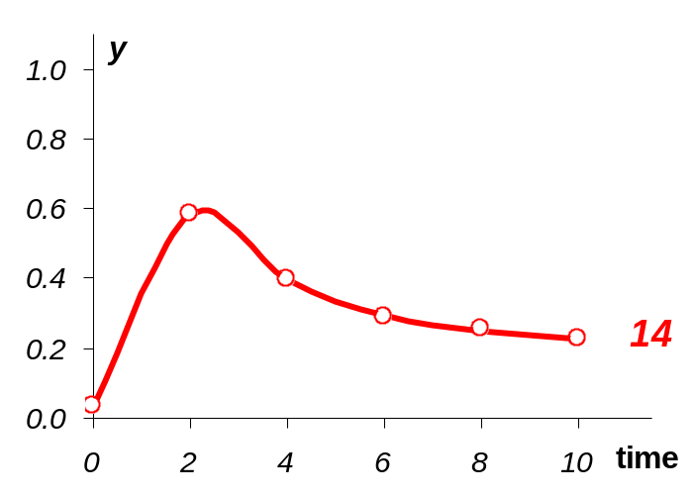
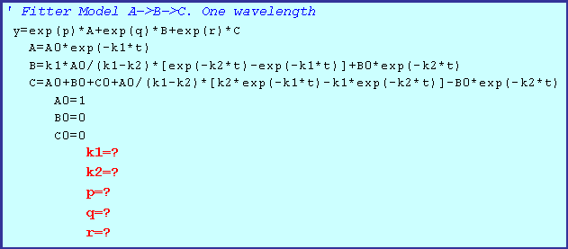
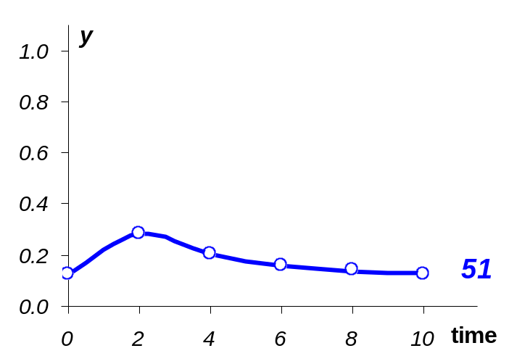
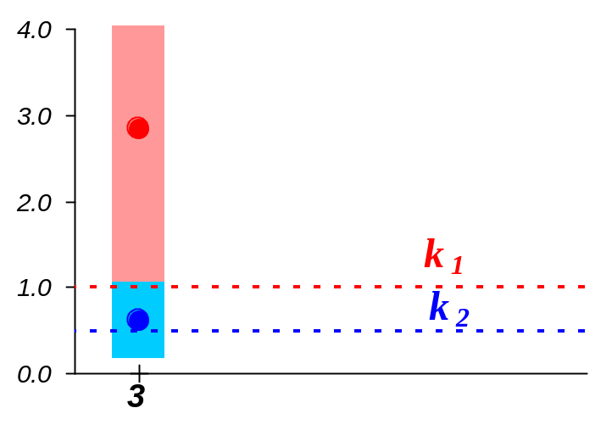
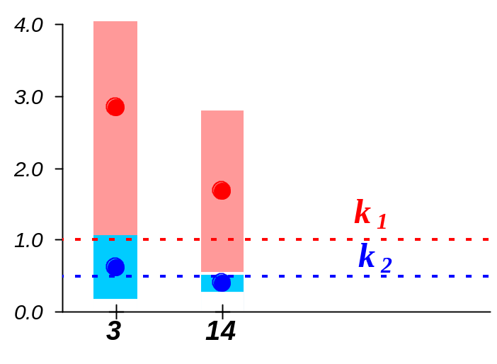
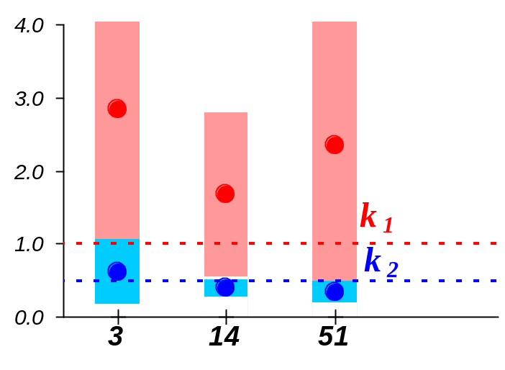
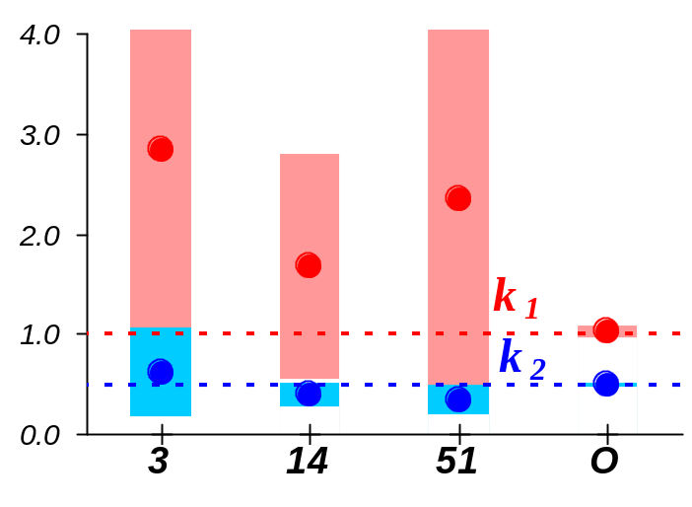
One Wavelength Estimates
Conventional wavelength 3
Conventional wavelength 14
Bad accuracy!
Conventional wavelength 51
Estimates
Notes:
Let us select one wavelength kinetics and try to estimate kinetic constants by the OLS method.
The following Fitter model is applied for fitting.
These plots present initial data and results of estimating. Each constant is shown by the estimated value (point) and by its standard deviation (bar). Also ‘optimal’ estimates calculated by the SBE method are shown.
There we have very …

Slide 26








Four Wavelengths Estimates
Direct order
Inverse order
Bad accuracy,
again!
Random order
Estimates
Notes:
We may aggregate four kinetic curves and process them together. The Fitter model is more complicated.
Here we use left wavelengths from the first to the fourth (di’rect order), there is inverse order with 4 last wavelengths (from the fifty third to the fifth) and there is a random order where wavelengths were selected accidentally.
And comparing the results with the optimal values we can see ….

Slide 27




SBE Estimates at the Different Order
Direct 1, 2, 3, ….
Inverse 53, 52, 51, ….
SBE (practically)
doesn’t depend on
the subsets order!
Random 16, 5, 29, ….
0.95 Confidence Ellipses
Notes:
Now I show the estimates obtained with successive bayesian method. The whole data set is split up the subsets. The first subset includes 4 wavelengths and all other subsets consist of one wavelength data. Here three orders of splitting are shown – direct, inverse and random. At the direct order all wavelengths were processed from left to right, at the inverse order from right to left and at the random order wavelengths were arranged accidentally. Solid curves represent the successive estimates of the kinetic constants and shaded areas show the doubled deviations.
Comparing the trajectories for the different arranges one can see that the intermediate estimates, as well as their uncertainties, really depend on the wavelength order.
The last plot with the 0.95-confidence ellipses of all final estimates demonstrates that they are rather close in spite of the different order of processing. Each ellipse and the mark in its center present the results of SBE with a corresponding order of wavelengths.

Slide 28

SBE Estimates and OLS Estimates
SBE estimates
are close to
OLS estimates!
Notes:
To demonstrate that the SBE method actually agrees with the conventional OLS method, we perform the following ‘validation test’. The simulated data are processed by the OLS method, where 161 parameters are estimated by minimizing the full sum of squares. It was really hard job for Fitter software to find 161 parameters simultaneously. Nevertheless this was done and result is presented here.
The points in the centers of ellipsis show the estimates obtained with the help of the OLS and the SBE methods. They are very close as well as the corresponding confidence regions, which are represented by the ellipses. Thus the test confirms the conclusions of the main Theorem that ...

Slide 29




Pure Spectra Estimating
SBE gives
good spectra
estimates!
Notes:
As soon as common kinetic rate constants k₁ and k₂ have been estimated, it is natural to find partial spectral parameters p, q, and r. It can be done rather easily applying the Bayesian approach again.
Each plot shows the ‘true’ simulated pure component spectrum (solid curve) and its estimate (points). The results are so close that they can be presented only as the difference between the estimated and the ‘true’ spectra (black points). Also the tripled standard deviation regions (thin curves) are shown. These data are plotted to the right Y-axis.

Slide 30
Real World Example Goals
Apply SBE for real world data
Compare SBE with other known methods
Notes:
Now I’ll show how SBE is applied to the real world example.
Using this example we can achieve the following goals.

Slide 31

Data
Bijlsma S, Smilde AK. J.Chemometrics 2000; 14: 541-560
Epoxidation of 2,5-di-tert-butyl-1,4-benzoquinone
SW-NIR spectra
Preprocessed
Data
240 spectra
1200 time points
21 wavelengths
Preprocessing:
Savitzky-Golay filter
Notes:
This example originates from the paper Bijlsma S, Smilde AK. J.Chemometrics 2000; 14: 541-560. The reaction of two-step epoxidation was studied as an example of real experimental process. The data set consists of SW‑NIR spectra of 2,5-di-tert-butyl-1,4-benzoquinone. They are 240 spectra with wavelength range 800‑1100 nm and interval 1.0 nm. Total reaction time is 1200 sec. The raw spectral data are preprocessed in accordance with a described procedure. The fourth spectrum is used as blank and is subtracted from all other spectra. The second derivative spectra are calculated applying a Savitzky-Golay filter with 15 data points’ window. The small wavelength range 860‑880 nm is used for data processing.

Slide 32



Progress in SBE Estimates
SBE works
with the real
world data!
Notes:
We perform data processing with the direct successive procedure when wavelengths are arranged from left to right.
The results are presented in the plot, where the successive estimates of the rate constants are plotted versus wavelengths.
Solid curves represent the successive estimates of the kinetic constants and shaded areas show the doubled deviations

Slide 33





SBE and the Other Methods
SBE gives the
lowest deviations
and correlation!
Notes:
To compare the successive method with other known approaches to kinetic constants estimating, we present the following plot, where the results with different methods are shown. Weighted curve resolution (WCR) is a combination of a ‘soft’ method using singular value decomposition of data matrix Y and a ‘hard’ presentation of concentration matrix C.
The generalized rank annihilation method (GRAM) is a ‘soft’ approach that utilizes a simple equation
The Levenberg-Marquardt algorithm and alternating least squares steps of the PARAFAC model (LM-PAR) is a ‘soft’ method using iterative procedure that enhances GRAM estimates.
Each method is shown by its 0.95‑confidence ellipse. From the plot it can be seen that the SBE ellipse has the smallest size and roundest shape. This means that the successive algorithm yields minimum deviations and correlation among the observed methods.

Slide 34

5. New Idea
Notes:
Now I wish to present you a new idea in data modeling.
It is well known that our data are multicollinear. That’s why simple methods like OLS cannot find optimal solution. I will not discuss this issue because this is a commonplace in chemometrics. And of course everybody knows what can be done in this case – apply advanced methods like PCR or PLS. That is fine till our models are linear or like linear. But sometimes you know that your system is not linear and attempt to use any bi-linear method confirms this sad verity. What can be done? There are some ideas (I can not say methods) how to extend the PLS approach for the non-linear models. For example you can cut your scores space into several areas and build separate linear models for each area.
Let us stop at this place and think a little about SBE. Could this help us in non-linear modeling of deficient data? My answer is yes if we combine SBE with very old and naive regression instrument that is Step Wise Regression.

Slide 35












Bayesian Step Wise Regression
Ordinarily Step Wise Regression
Bayesian Step Wise Regression
y=a₁x₁+a₂x₂+a₃x₃
BSWR accounts
correlations of
variables in step
wise estimation
Objective function
Notes:
At this slide I’ll explain you the principle of Bayesian Step Wise Regression using this simple 3D model. You will see that the technique may be easily extended to the multivariate and even to the non-linear model. For beginning let us remember what ordinarily SWR is. At the first step we find only one parameter using this objective function. At the next step we fix first parameter equals its estimate and find the second parameter using that objective function. At the last step (our model is 3D) we fix two parameters and find the third estimate. Objective function is here. Of course you know that this is rather poor approach. In particularly this does not take into account the correlations and interactions between variables.
Now look at the BSWR. The first step is the same. Just one parameter and the same OF. The second step is something new. We do not fix the first parameter but tie it to its estimate with Bayesian information present in the OF. This means that parameter a₁ can vary near its prior value that is a (hat) inside this gray strip. In the result we obtain two parameters and the estimate of a₁ is changed. At the next step we apply the new Bayesian Information. This permits to vary parameters a₁ and a₂ around their estimates. At last we obtain final result that is estimates of all parameters. Pay attention that old estimated values were changed again. Thus we claim that BSWR give more freedom in estimation and that

Slide 36




BSW Regression & Ridge Regression
BSWR is RR with
a moving center
and non-Euclidean
metric
Notes:
We could look at BSWR from the Tikhonov point of view. Let this point presents some OLS-estimate. That point shows Ridge estimate that in fact minimizes the Euclidean distance between 0 point and OLS point. And that point presents BSWR estimate that minimizes the distance between previous estimate a1(hat) and OLS point. It is important that here the distance is measured with the matrix like Mahalanobis measure. That is why we can say that …

Slide 37




Example. RMSEC & RMSEP
BSWR gives
typical U-shape of
the RMSEP curve
Notes:
Here you can see an example. This is simple simulated linear model. Each plot shows RMSE of calibration (blue) and prediction (pink) for PLS, PCR, SWR and BSWR. Looking at BSWR picture we can see that

Slide 38

Linear Model. RMSEC & RMSEP
BSWR is not
worse then
PLS or PCR
and better
then SWR
y=a₁x₁+a₂x₂+a₃x₃+a₄x₄+a₅x₅
Notes:
Here the final results of modeling are presented. You can see RMSE of C and of P, which corresponds to the optimal number of factor (PCs) in each method. They are 2 for PLS and PCR and 3 for SWR and BSWR. I think you agree that …

Slide 39



Non-Linear Model. RMSEC & RMSEP
For non-linear
model BSWR is
better then
PLS or PCR
Notes:
Now you see the results that were obtained for non-linear model. Here we have 5 variables and 10 parameters. These results demonstrate the typical picture where calibration error is much less then prediction. This is so but BSWR result. These values are OK. You can compare them with the results for linear model. They look very similar and this is normal because both data sets were simulated with the same noise level.
This example shows that ….

Slide 40

Variable selection
BSWR is just
an idea, not
the method so
any criticism is
welcomed now!
Notes:
This picture illustrates the method of variable selection. At the first step we try all variables and select the one that gives the lowest value of RMSEC. Of course this rule has some exceptions, e.g. this point.

Slide 41

6. More Practical Applications of SBE
Notes:
In this section I show some other applications of SBE.

Slide 42



Antioxidants Activity by DSC
DSC Data
Oxidation Initial Temperature (OIT)
To test
antioxidants!
Notes:
This example shows how SBE approach was applied to develop the fast and inexpensive method for antioxidants testing. We use DSC instrument and process data with the help of Fitter software.

Slide 43



Network Density of Shrinkable PE by TMA
TMA Data
Network density
To solve
technological
problem!
Notes:
In this example the SBE approach helps to solve technological problems with production of shrinkable PE. Here we use data of Thermo mechanical analysis and SBE to estimate the dose, which produces proper network density.

Slide 44



PVC Isolation Service Life by TGA
TGA Data
Service life prediction
To predict
durability!
Notes:
This example demonstrate how we predict the durability of PVC cable isolation.

Slide 45




Tire Rubber Storage
Elongation at break
Tensile strength
To predict
reliability!
Notes:
And this is example where SBE is used to to find the shelf time of tire rubbers.

Slide 46
7. Conclusions
Thanks!
1 |  | SBE is of general nature and it can be used for any model
2 |  | SBE agrees with OLS
3 |  | SBE gives small deviations and correlations
4 |  | SBE uses no subjective a priori information
5 |  | SBE may be useful for non-linear modeling (BWSR?)
Notes:
Here we show the conclusions that follow from the presented lecture. All of them are evident but the last item is so important that I should emphasize once more.
The SBE method is Bayesian only in its form but not in its concept. This means that no subjective a priori data are actually used. Each a priori information element yields from the experimental data processed at the previous step and only the way of its application is dictated by the Bayes theorem. No extra assumptions (number of PCs, a time-shift, pseudo first-order) are needed for this method implementation.

