Slide 1

The Pandemic Blockchain
A Decentralized App
Which Has a React Client with Web3 and a Ethereum Smart Contract
SEVAL CAPRAZ
PhD at Hacettepe University, Ankara, Türkiye

Slide 2
Content
Welcome to The Pandemic Blockchain installation guide.
This guide is designed to introduce how to install The Pandemic Blockchain with Web3, blockchain technology, and ipfs as a decentralized application (dApps).
In this guide, you will install a fully functioning Web3 application, and will learn about:
Tools like Ganache, Remix, VSCode
Connecting with wallets like Metamask
Developing Smart Contracts on Ethereum
Storing media on decentralized file storage on IPFS

Slide 3
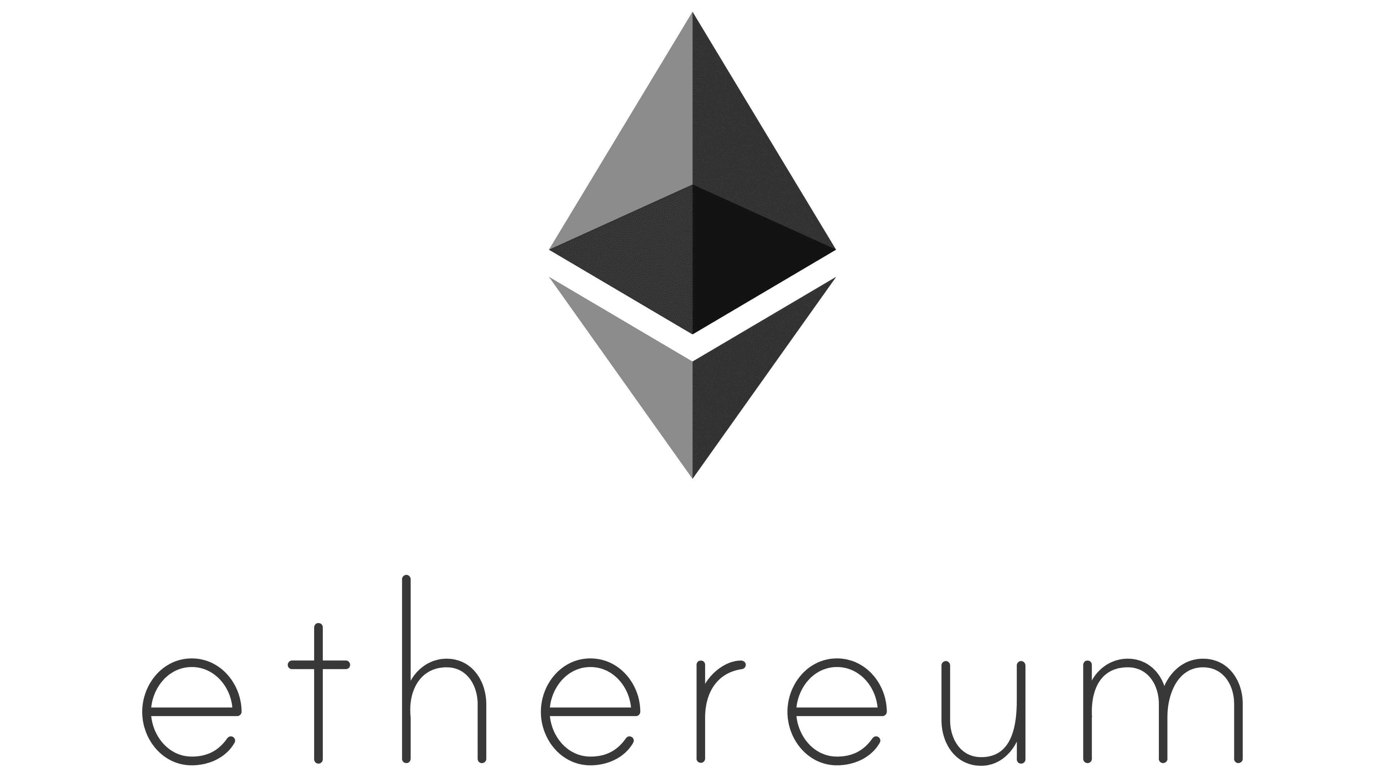
Let's get to know the tools

Slide 4
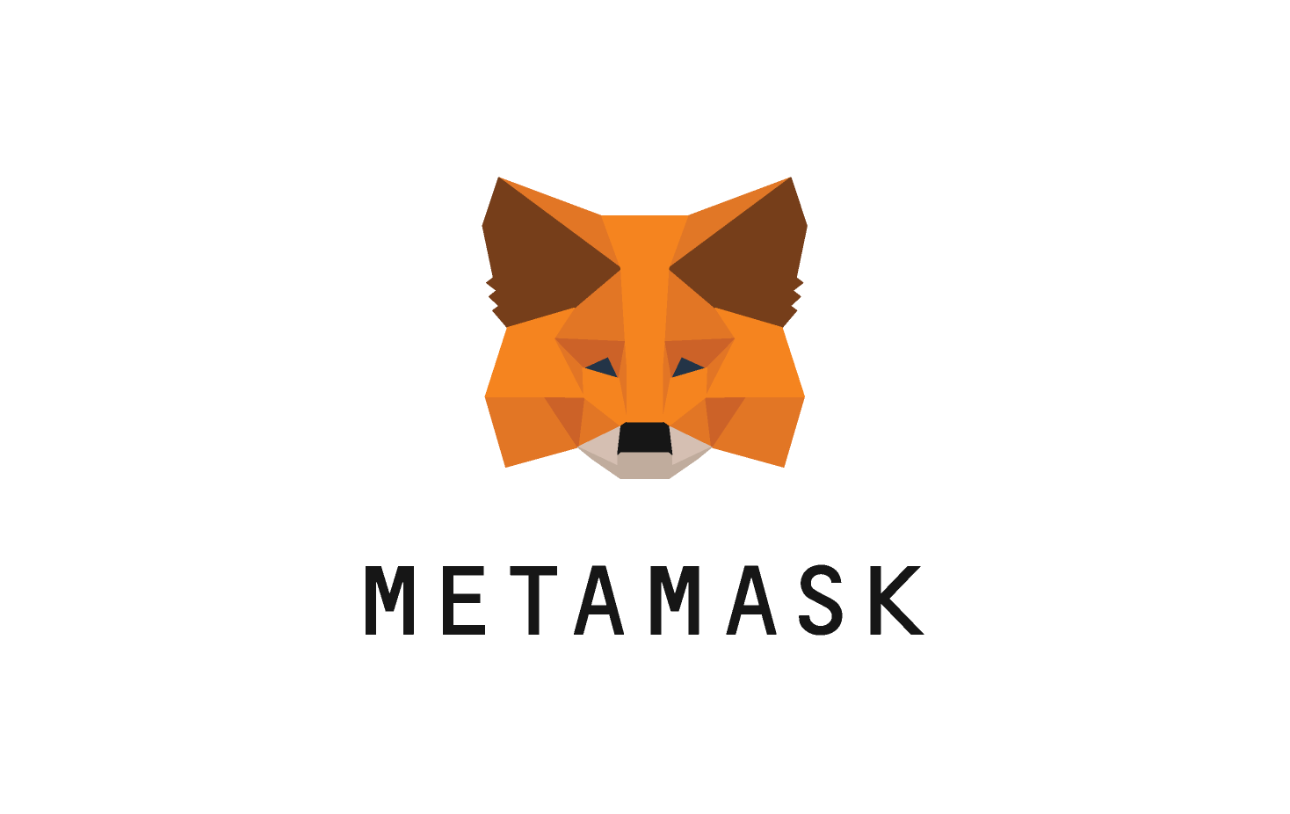
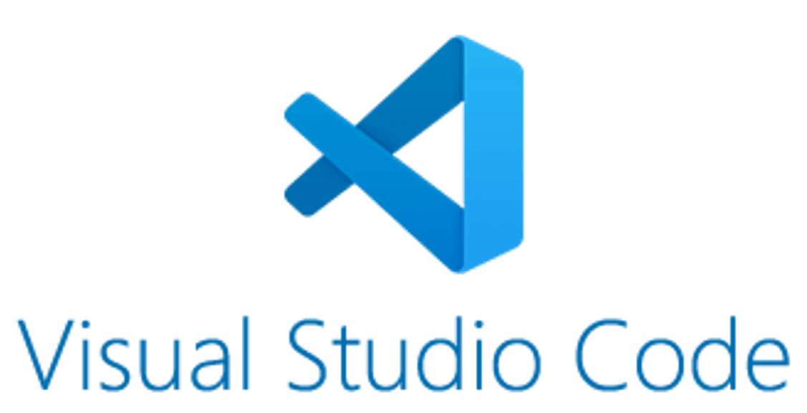

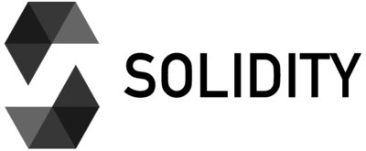
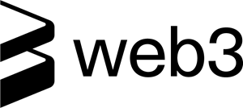

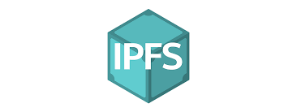
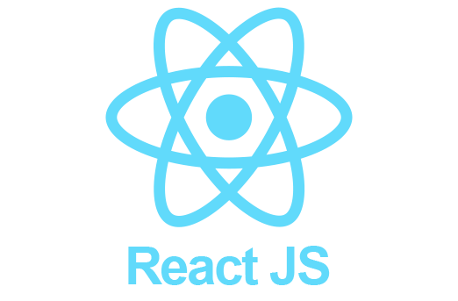
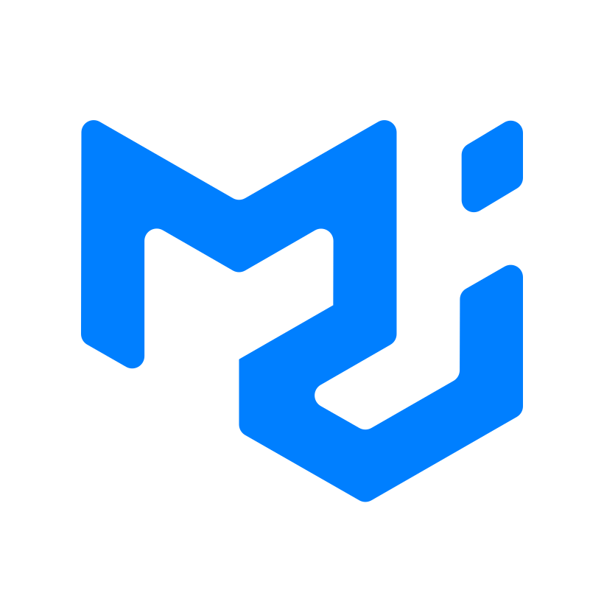
Technologies Used
REMIX
Material UI

Slide 5
Technologies Used
Local Blockchain
Wallet
React App
Deploy
Smart Contract
Infura
REMIX
Material UI

Slide 6
Implementation details
Develop and deploy Solidity smart contract on Remix.
Interact with smart contract in React using web3.js.
Run local blockchain network Ganache.
Implement interaction with IPFS in React using Infura and ipfs-http-client.
Implement intraction with Metamask to handle user private keys. We will use private keys for system login/logout, saving users and saving user medical data.
Configure webpack to deal with resolving fallback, plugins, etc.

Slide 7
Let's get to know the tools
You must write a contract with Solidity and communicate with the contract via JavaScript or console. In general, the working principle is like this. Remix is an IDE to write Solidity smart contract.
Truffle can be used as a contract development tool, and if you want, it can also support the Ethereum network. You can also upload the contract to the ETH network in Ganache or Truffle. Afterwards, you can interact by sending a transaction with the uploaded contract ID, wallet information, etc.
In summary; Ganache raises the ETH network with simple steps. You can easily deploy the contract you developed with Remix here. You can also interact with this contract using the Remix console.
We can write a client application which uses Web3 in VSCode. VSCode is an IDE to write Java and Javascript.

Slide 8
Installed required softwares for Ethereum:
Ubuntu v20.04 x64 or Windows10 or MAC OS
Node.js v15.14.0 and NPM v7.7.6
NVM https://sourceforge.net/projects/nvm-for-windows.mirror/
After installation NVM, on cmd termimal run these commands:
nvm install 15.14.0
nvm use 15.14.0
Ganache v2.7.1 (version can be latest)
https://archive.trufflesuite.com/ganache/
VSCode 1.87.2 (version can be latest)
https://code.visualstudio.com/download
Not necessary:
JDK 11.0.9 x64
https://www.oracle.com/tr/java/technologies/javase/jdk11-archive-downloads.html
Python v3.12.1

Slide 9
Requirements and Installation
You need to have NPM installed in your system.(Details on previous slide)
You also need Metamask extension installed in your Chrome browser(PC). https://metamask.io/download/
Download the Pandemic Blockchain Project from Github:
https://github.com/svlzx/PandemicBlockchain
Download zip and unzip to C:\Users\Seval\PandemicBlockchain-master
Use these commands in downloaded project on cmd terminal:
npm install to create node_modules folder.
npm start to test the project in your localhost.

Slide 10
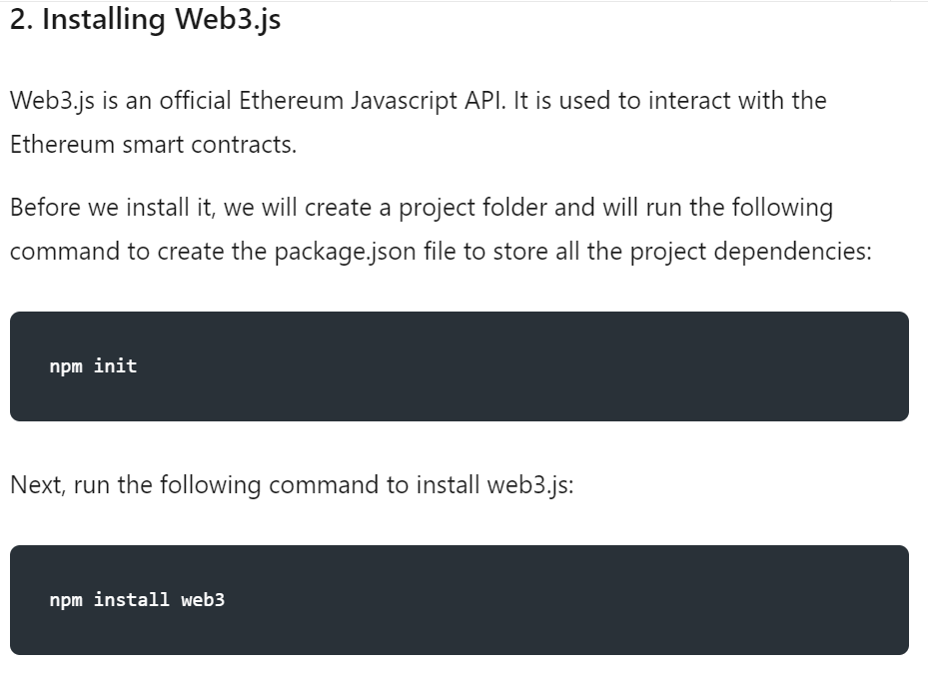
For information only:
To start your own WEB3 application, you can use:
npm init
npm install web3
We will use a Project which has already installed web3. So we don’t need these 2 commands in The Pandemic Blockchain.
Go to address to find more: Create Your First DApp

Slide 11
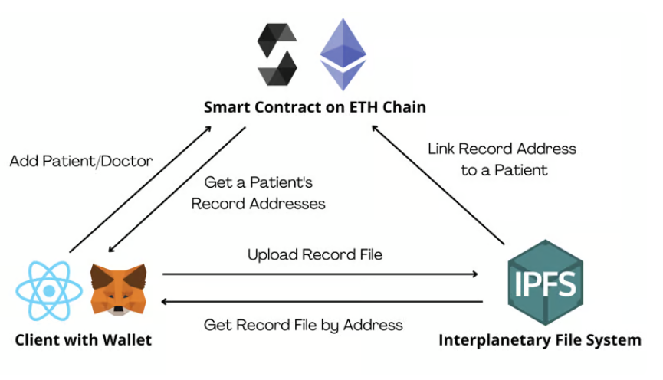
How It Works?

Slide 12
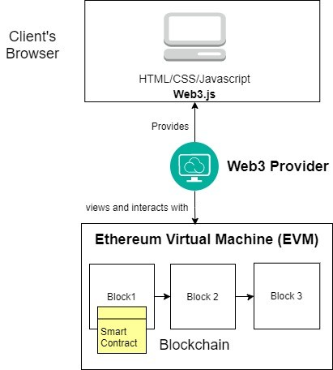
How The React Client App Works?
Go to Project folder.
Open cmd.
Run the command:
npm start
We will configure all tools and config.js in client app before starting.
After configuration, we will start the client app.
So continue to next slide.

Slide 13
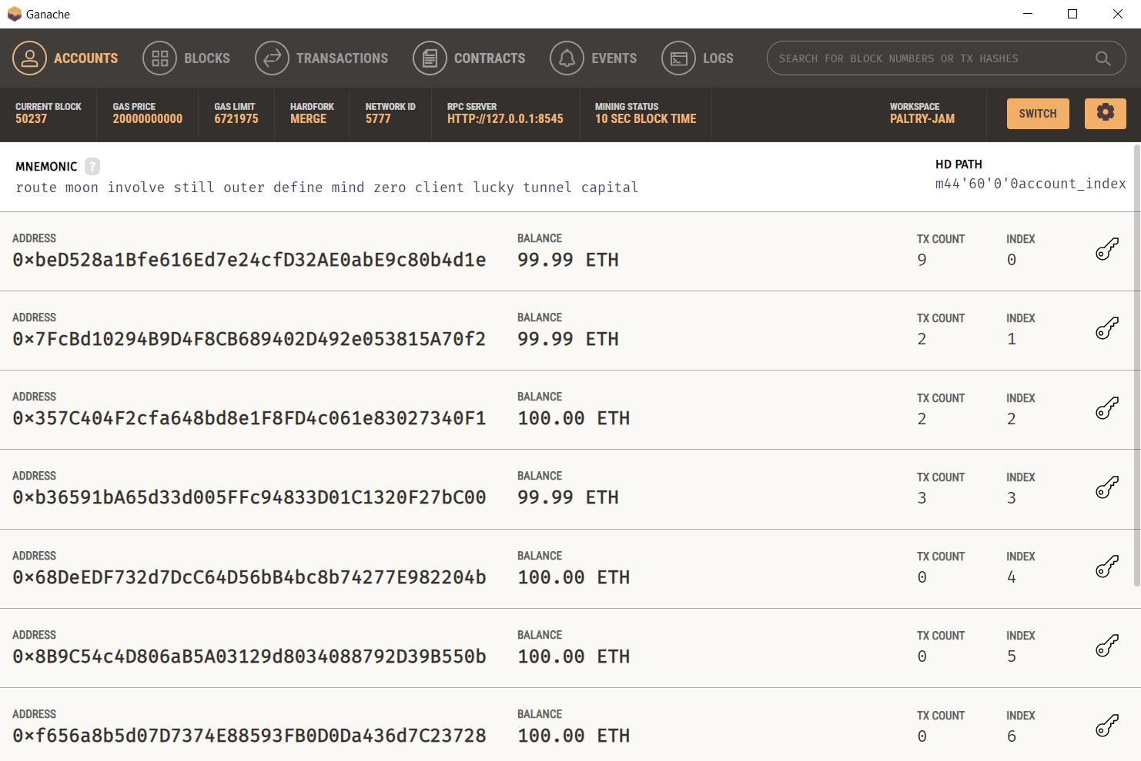
Configuring Ganache
After installation,
Open Ganache
With Ethereum Wizard.
It will create 10 dummy users for system testing.
Open Private Key and
Copy it for MetaMask

Slide 14
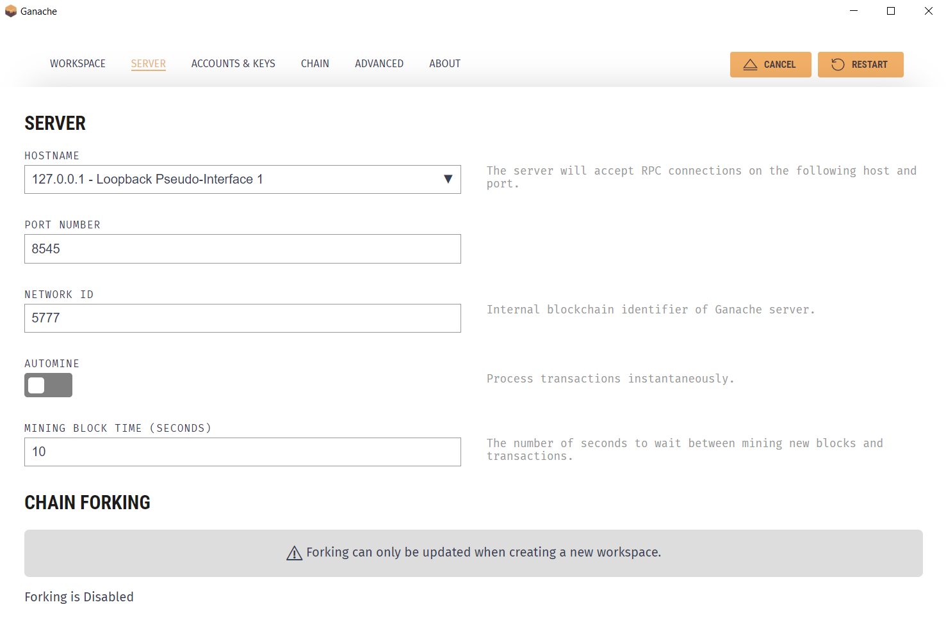
Configure Ganache

Slide 15
Open Remix from your browser
You can access the Remix IDE using the following URL:
https://remix.ethereum.org/
Copy solidity code from C:\Users\Seval\PandemicBlockchain-master\contracts\SmartContract.sol
Create a new contract on Remix and paste copied contract.

Slide 16
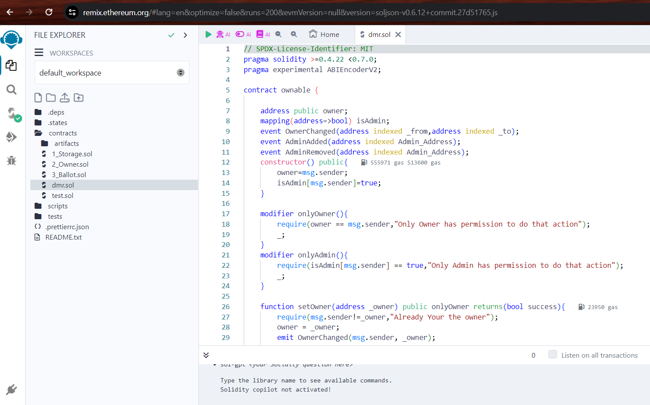

Slide 17

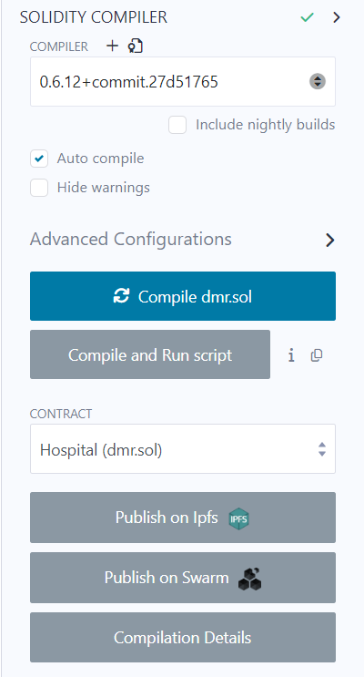
Configure Remix
For compiling select 0.6.12 compiler and compile contract.

Slide 18

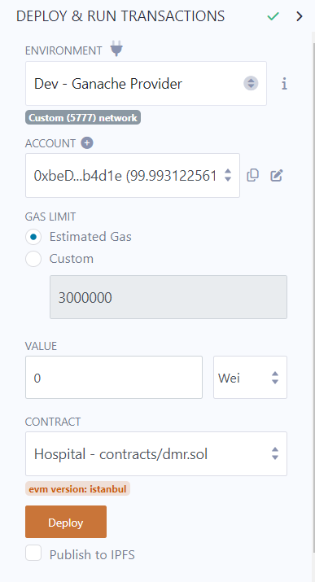
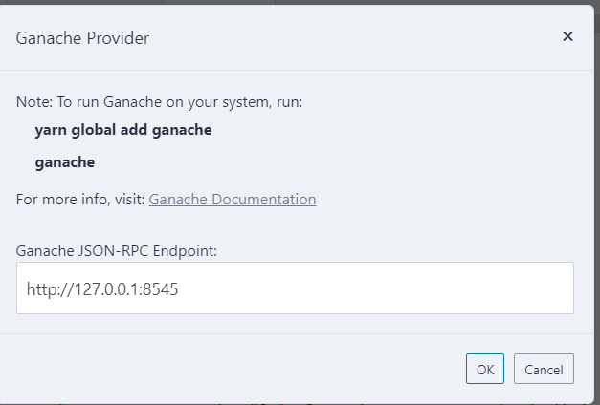
Configure Remix
For testing the smart contract, we had selected the environment as 'Javascript VM', we need to change it to ‘Dev – Ganache Provider' and then we can give the URL of our test environment (defaults to http://127.0.0.1:8545) that we had created using ganache-cli.

Slide 19
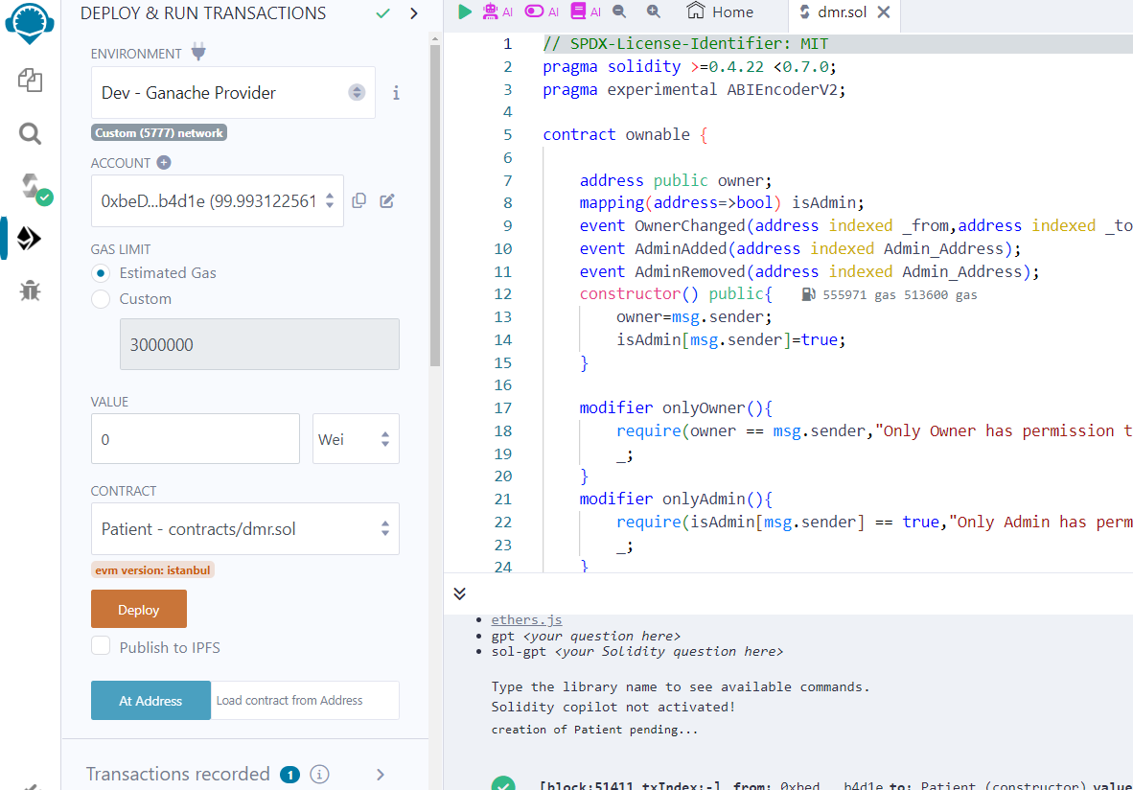
REMIX
Select Account from Ganache accounts.
This account will be the owner of smart contract.

Slide 20
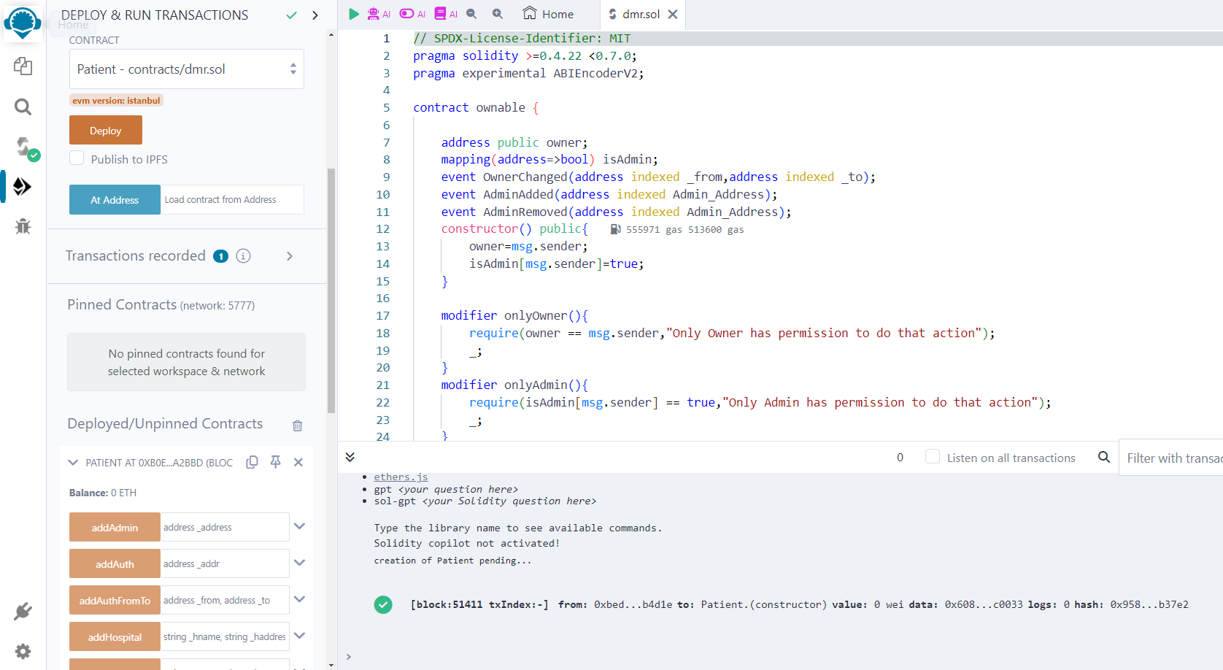
REMIX
Select Patient Contract
Deploy Smart Contract
Copy Contract Address

Slide 21
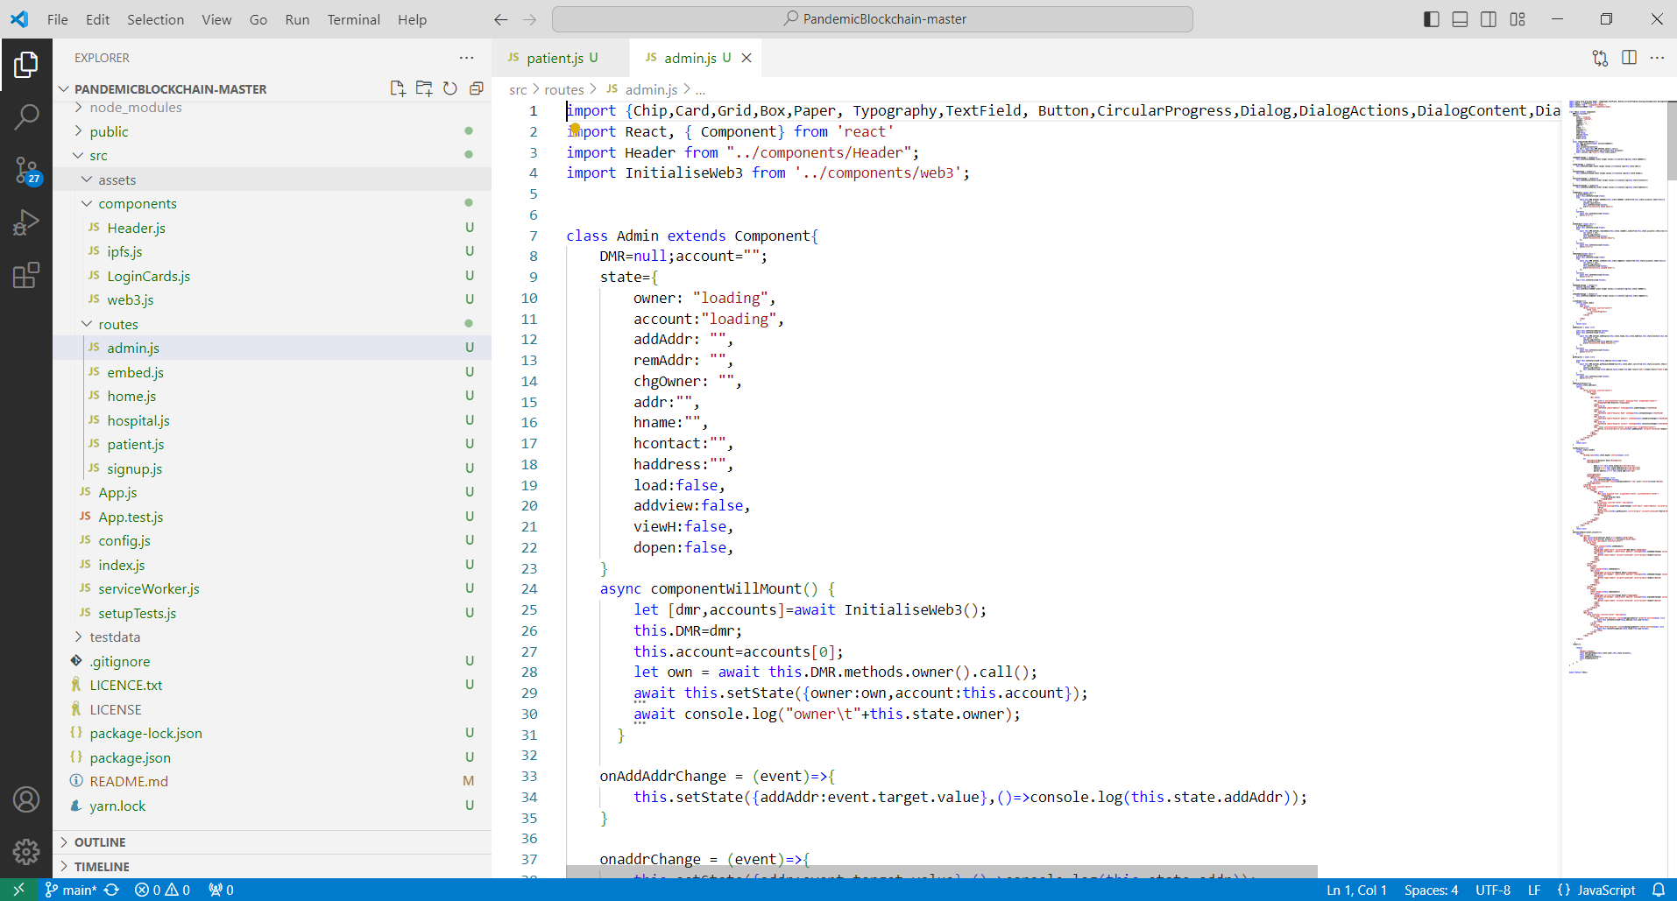
Open Project Folder With VS Code

Slide 22
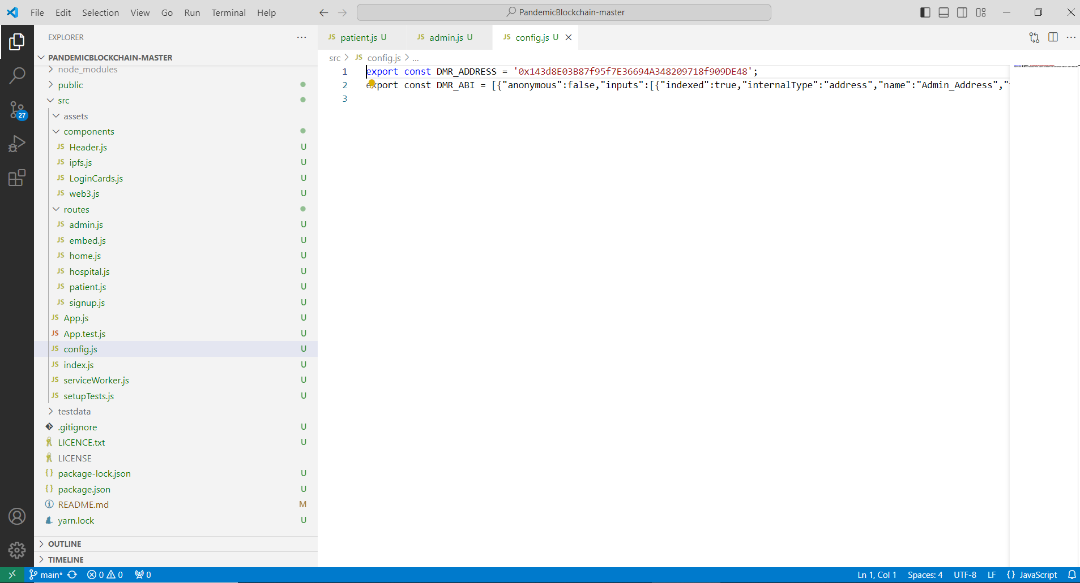
Paste Contract Address to config.js

Slide 23
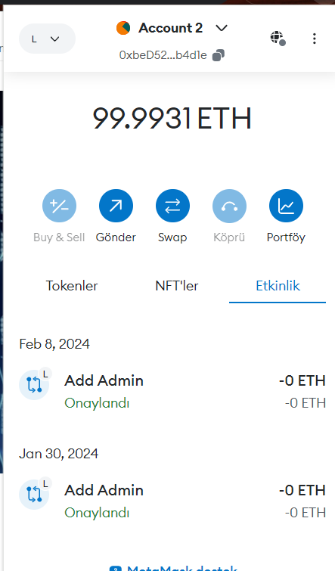
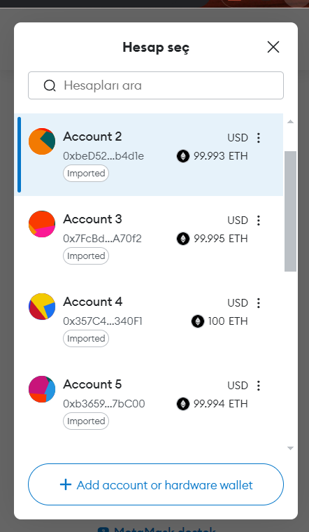
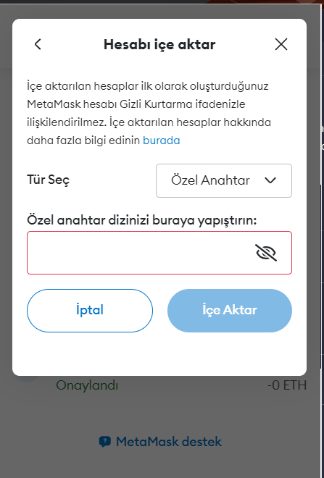
Open Chrome Metamask
Configure Metamask
Import Ganache User Addresses
Paste copied private key from Ganache

Slide 24
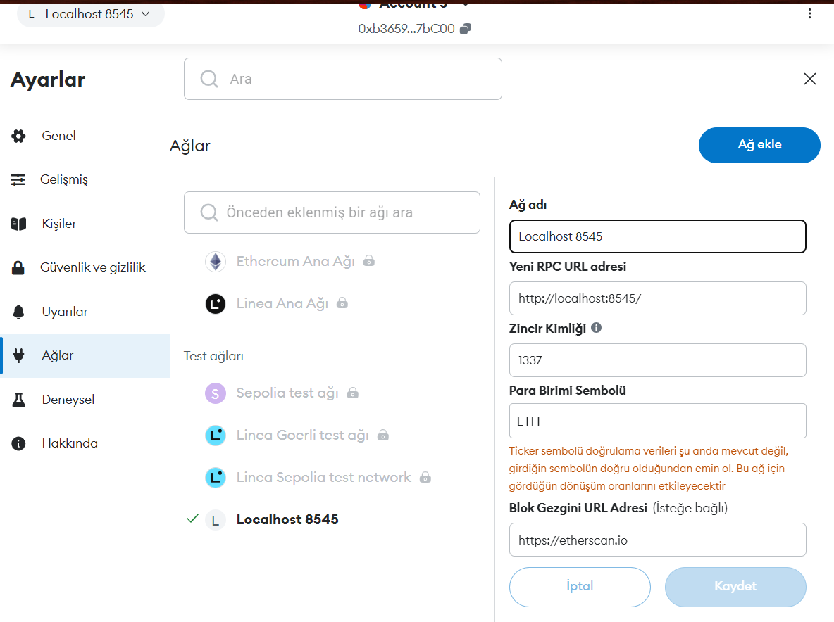
Configure Metamask
Add New Network to MetaMask

Slide 25
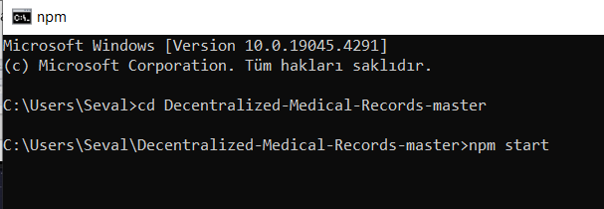
Now Run Reach App
Go to project forder with cmd and run the command:
npm start

Slide 26
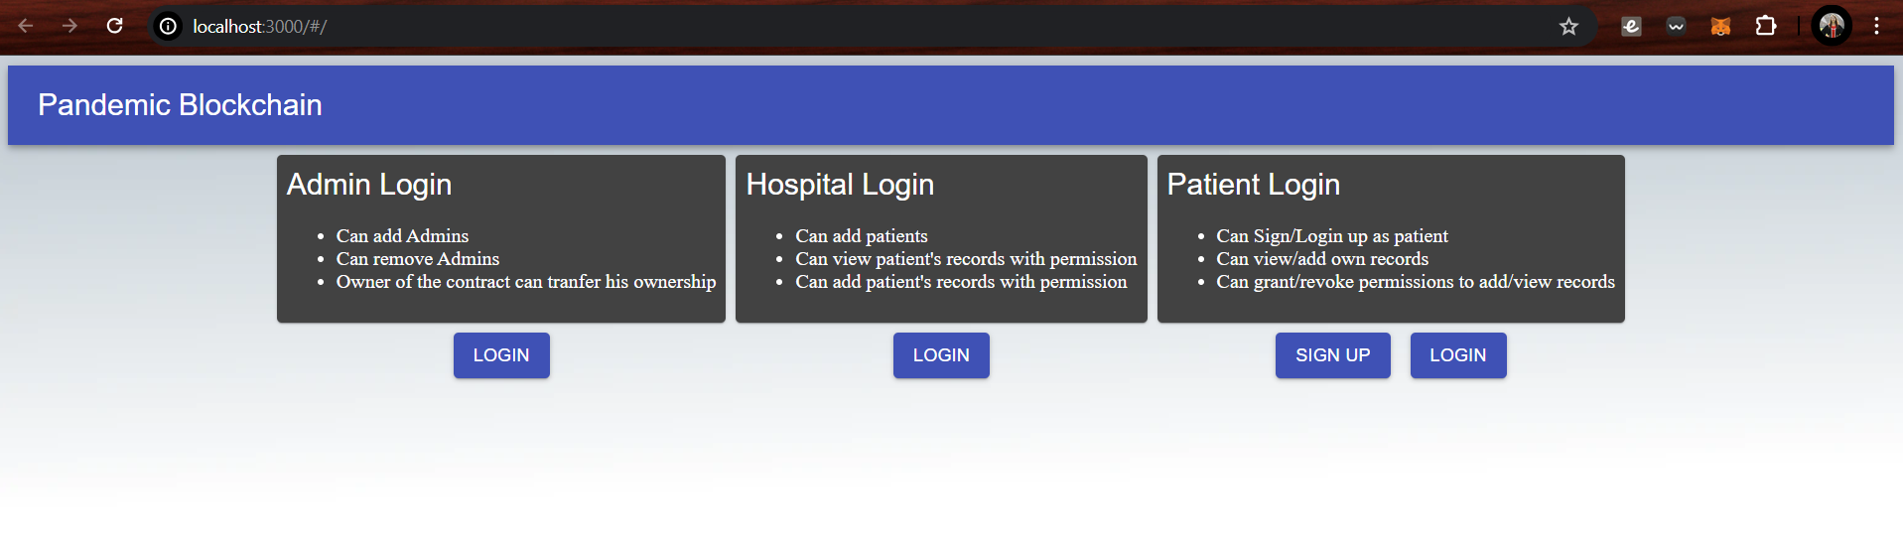
Try adding admin, hospital and patients by changing MetaMask user

Slide 27
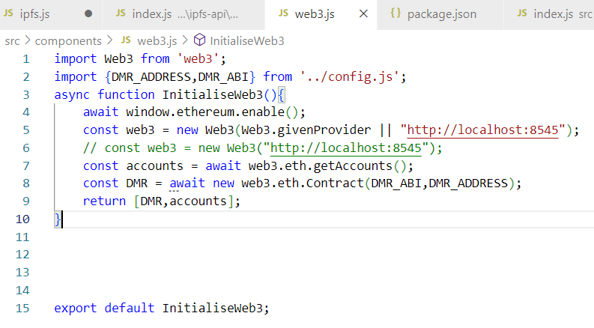
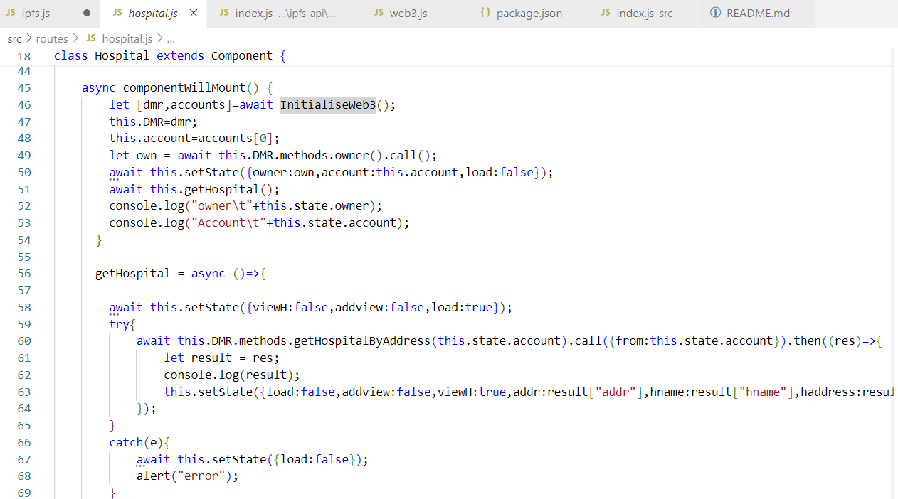
Open VS Code and inspect the codes to connect Web3.

Slide 28
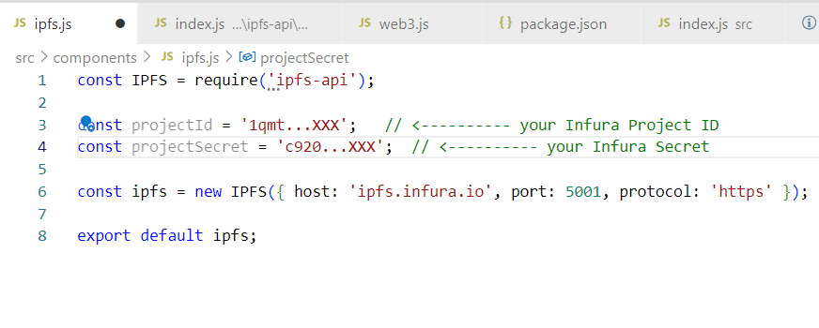
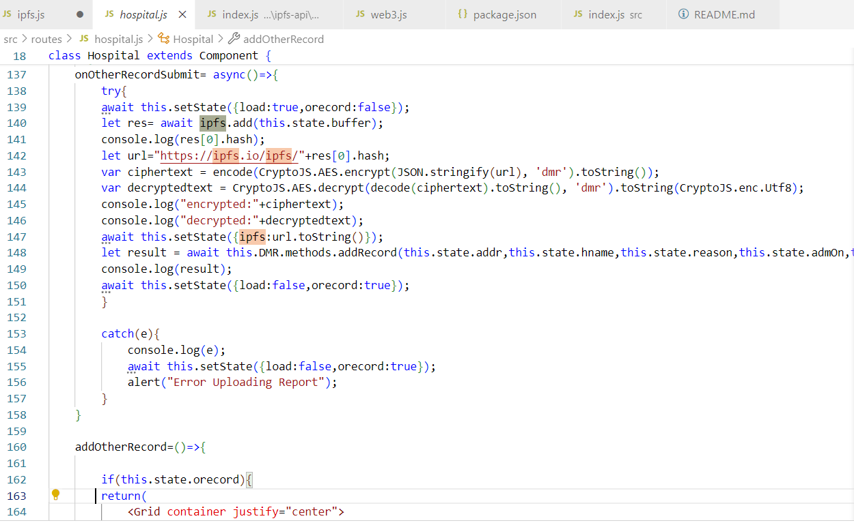
Open VS Code and inspect the codes to upload documents/images to IPFS.

Slide 29
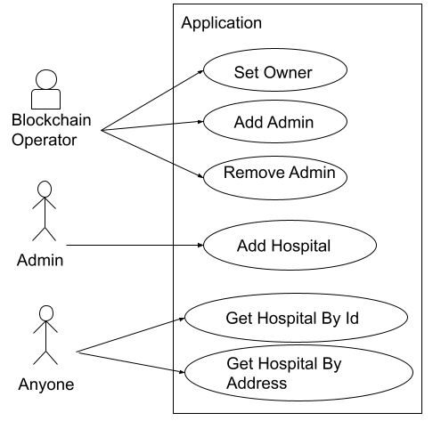
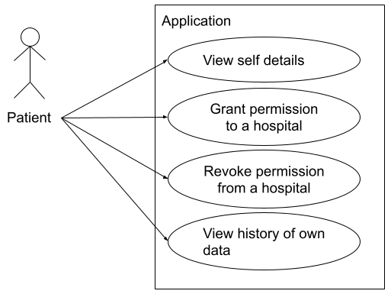
System Use Cases

Slide 30
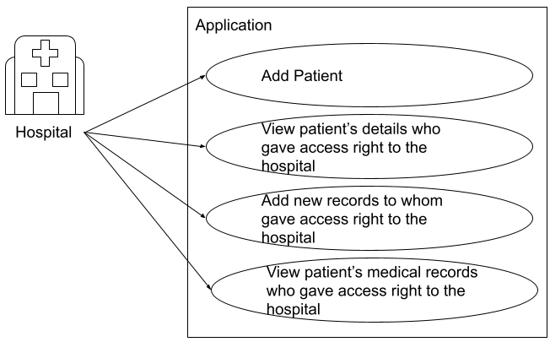
System Use Cases

Slide 31
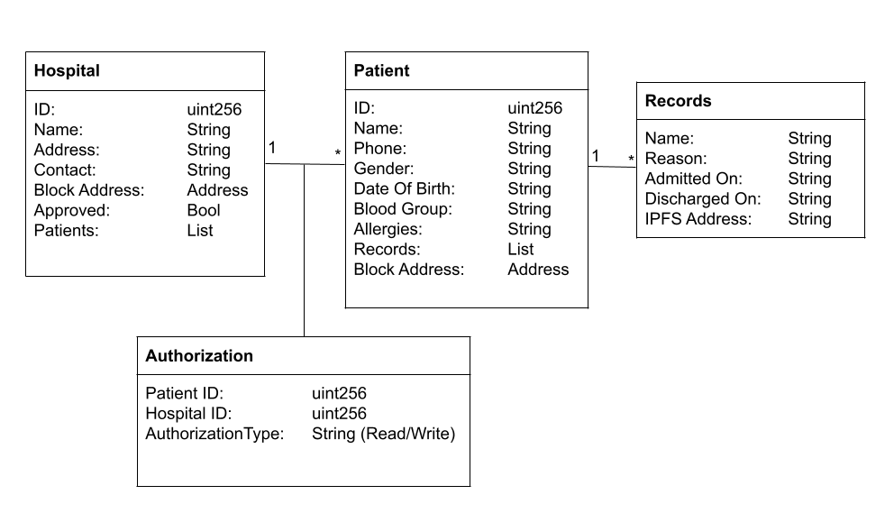
UML Diagram Of The Smart Contract Objects

Slide 32
Thank you.
Contact with me via email:
seval.capraz@hacettepe.edu.tr

