Slide 1

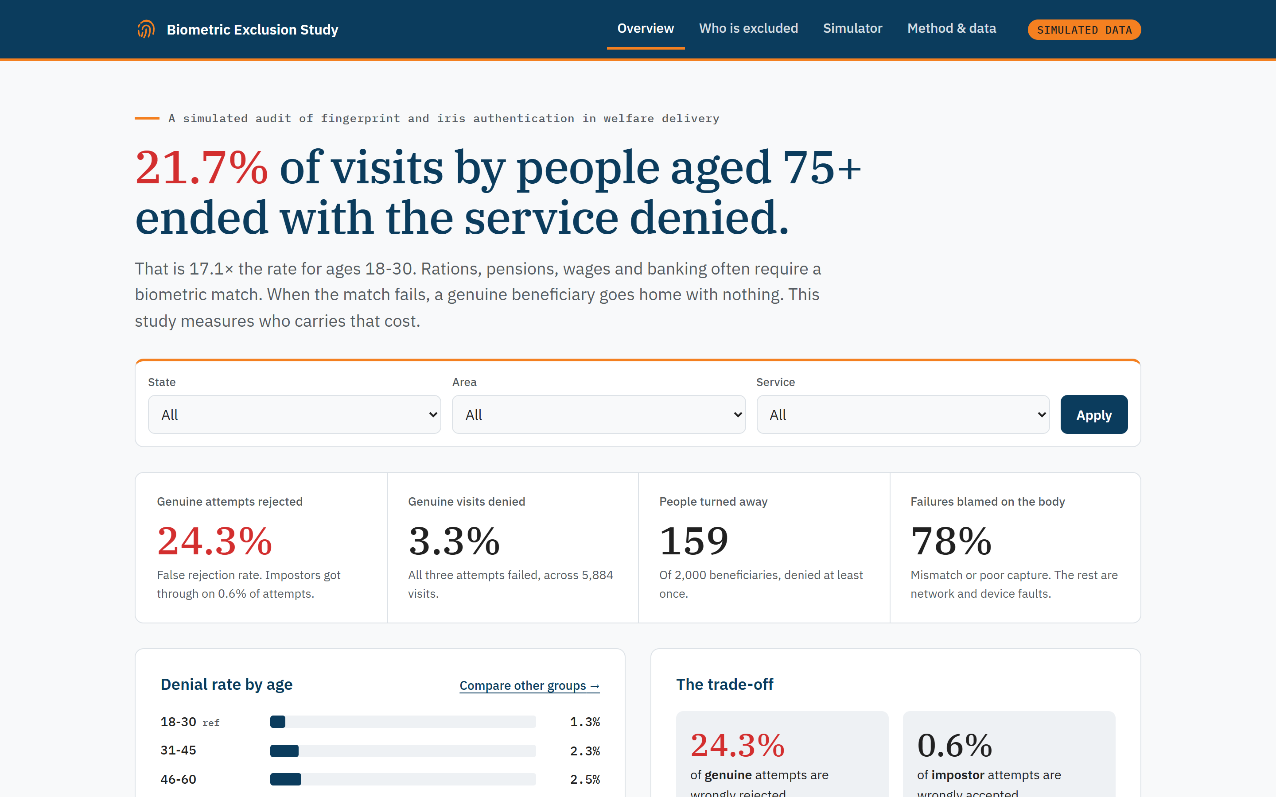
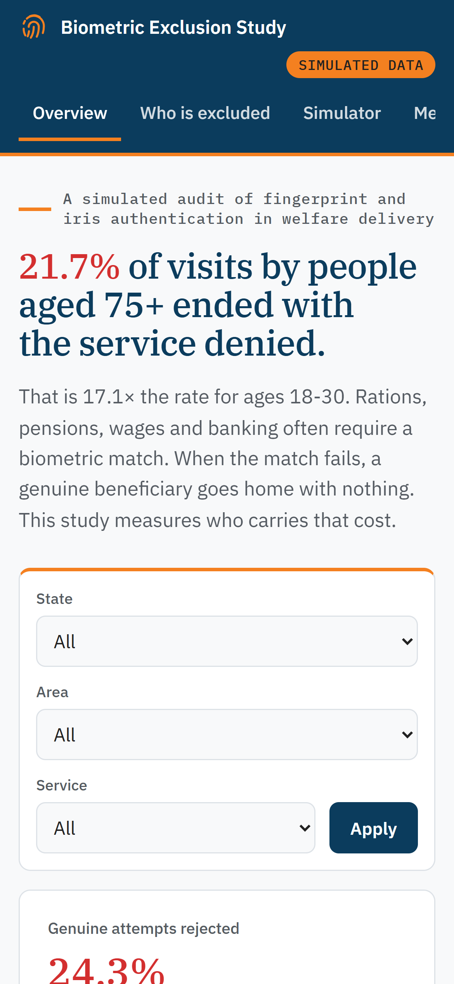
UCS421 · ETHICS AND RISK MITIGATION IN AI
Who gets turned away when the fingerprint fails?
Aadhaar biometric authentication failures in India's welfare delivery
PRESENTED BY · GROUP 7 · CLASS 3C4
Shambhvi Sharma
1024030552
Gurleen Kaur
1024030560
Raj Kumar
1024031132
Shivam Raj
1024031140
Mehakdeep Kaur
1024031162
Notes:
Introduce the question: when welfare depends on a fingerprint match, who carries the cost when the match fails? Stress at once that every number in this talk comes from simulated data, not real UIDAI records.

Slide 2




A failed match means a lost entitlement
THE PROBLEM
Rations, pensions, wages and banking increasingly require a fingerprint or iris match at the point of service. The check is there to stop impostors, but every false rejection lands on a genuine beneficiary.
PDS ration
Old-age pension
MGNREGA wages
AePS banking
Subsidised grain at the ration shop
Monthly support for older people
Pay for rural public works
Cash at village banking points
2.6%
of genuine visits denied
11.3%
of genuine visits denied
2.3%
of genuine visits denied
2.3%
of genuine visits denied
Notes:
Four services depend on authentication. In our simulation old-age pensions stand out: 11.3% of genuine visits end in denial, about five times the rate for MGNREGA wages, because pensioners are older.

Slide 3




A system can be bug-free and still unfair
WHY THIS IS AN ETHICS PROBLEM
Technical failure
A bug, a sensor fault, a wrong parameter. Fixed by debugging.
Fairness
Accountability
Works on average (3.3% of visits denied) but not for everyone: 21.7% for people aged 75+.
When a pensioner is turned away, who answers? “The machine said no” is not an answer.
Ethical failure
Discrimination, unfair risk exposure, no accountability. It can happen with no bug at all.
Transparency
Privacy
Compliance asks: are we following the rules?
Ethics asks: should we, even if it is allowed?
A denied person is not told why: poor capture, a mismatch or a network timeout?
Fingerprints and iris scans are sensitive personal data. Our study uses none.
Notes:
Unit 1 frames this. Aadhaar authentication has no bug: it applies one threshold to everyone, exactly as designed. That is why this is an ethical failure, not a technical one. Like the campus face-recognition case in Unit 1, the system works well on average but repeatedly fails some users. Compliance asks whether rules are followed; ethics asks whether the outcome is acceptable. The four core principles each apply: fairness, accountability, transparency and privacy.

Slide 4








We simulated 7,858 attempts, one visit at a time
OUR APPROACH
2,000
6,000
7,858
invented beneficiaries
visits to a service point
authentication attempts
01 Scan
02 Match
03 Retry
04 Decide
Quality scored 0 to 100; below 40 is rejected.
Compared with the stored template; the score must clear 0.60.
Up to three attempts are allowed per visit.
If every attempt fails, the service is denied.
Privacy by design. No real Aadhaar numbers or biometrics are used. Every bias is a documented assumption in a seeded generator, so we can check that fairness tests find it.
Notes:
Real authentication logs with biometric scores are not public, and using them would raise privacy and legal issues. A seeded generator gives us a reproducible dataset where every bias is a known, documented mechanism. Walk through one visit: scan, match against the template, retry up to three times, and only if all fail is the service denied.

Slide 5
The oldest are turned away 17 times more often
FINDING 1 · AGE
Share of genuine visits denied, by age group
21.7%
of visits by people aged 75+ end with the service denied, against 1.3% for ages 18‑30.
17.1× the youngest group's rate
p < 0.001 chi-square test
Fails the four-fifths rule
Notes:
This is the central finding. People aged 75 and over are denied on 21.7% of genuine visits, 17.1 times the rate for ages 18–30. The gap is highly significant and fails the four-fifths fairness rule. The likely mechanism is worn fingerprint ridges with age.

Slide 6
Strict on impostors, costly for genuine users
FINDING 2 · THE TRADE-OFF
About 1 in 4 genuine attempts is rejected
0.6%
False acceptance rate: impostor attempts the system wrongly let through.
24.3%
159
False rejection rate: genuine attempts the system wrongly refused.
of 2,000 genuine beneficiaries were turned away on at least one visit.
Notes:
The system is tuned to keep impostors out: only 0.6% get through. The price is a false rejection rate of 24.3%. Strictness is a policy choice, and its cost falls on the people the scheme is meant to serve.

Slide 7
Four gaps, each statistically tested
FINDING 3 · FAIRNESS TESTS
AGE
OCCUPATION
AREA
SERVICE
17.1×
54.4×
3.6×
5.0×
75+ vs 18–30
21.7% vs 1.3% denied
Farmer vs office worker
5.8% vs 0.1%* denied
Remote vs urban
6.2% vs 1.7% denied
Pension vs MGNREGA
11.3% vs 2.3% denied
p < 0.001
p < 0.001
p < 0.001
p < 0.001
Control check · Gender: 1.0×, 3.3% vs 3.3%, p = 1.00 (not significant). The generator has no gender effect, and the method finds none: it does not invent bias.
*Office workers are almost never denied, which inflates this ratio.
Notes:
Each gap is tested with a chi-square test and the adapted four-fifths rule. Age, occupation, area and service all show significant gaps. Gender is our control: the simulation has no gender effect, and the analysis correctly finds none.

Slide 8
Capture quality decides the outcome
FINDING 4 · CAUSES
Failure rate of genuine attempts, by capture quality
78%
of failures are biometric, not network or device
Biometric mismatch
899
Poor quality capture
793
Network timeout
324
Device error
151
Notes:
Below a capture quality of about 40, most genuine attempts fail; above 60 almost all succeed. 78% of failures are biometric: the body, not the network, is blamed. That points at worn fingerprints from age and manual work.

Slide 9
Where poor devices go, denials follow
FINDING 5 · INFRASTRUCTURE
Share of genuine visits denied
20×
Remote with a low-quality device: 9.9% denied. Urban with a high-quality device: 0.5%.
High device
Medium device
Low device
Urban
0.5%
2.0%
6.1%
Rural
0.4%
2.5%
8.7%
It is the device, not the place
With device and network held constant, living in a remote area does not raise the odds of failure (0.85×). Remote areas simply get worse scanners.
Remote
2.6%
1.9%
9.9%
Notes:
This is the key policy slide. Denial concentrates where low-quality devices are deployed, which is mostly in rural and remote areas. Once device quality is in the model, area itself stops mattering: the geographic gap is an infrastructure gap.

Slide 10



What raises the odds of failure, all else equal
FINDING 6 · WHAT DRIVES FAILURE
Odds ratio of a failed first attempt (1.0 = no effect)
7.5× Age
for people 75 and over
4–5× Manual work
worn fingerprint ridges
4.3× Device
low-quality scanners
Notes:
A logistic regression on 5,884 genuine first attempts separates the factors. Age 75+ multiplies the odds of failure by 7.5, construction work by 5.5 and a low-quality device by 4.3, each holding everything else constant.

Slide 11

Trying again does not fix it
FINDING 7 · RETRIES
Success rate of genuine attempts
31
people were denied on two or more visits.
The cause, a worn fingerprint or a poor scanner, is still there on the next try. That is systematic exclusion, not bad luck.
Notes:
'Just try again' is not a fix. Success falls from 79.8% on the first attempt to 55.6% on the third, because people who reach a third attempt are those with the underlying problem.

Slide 12
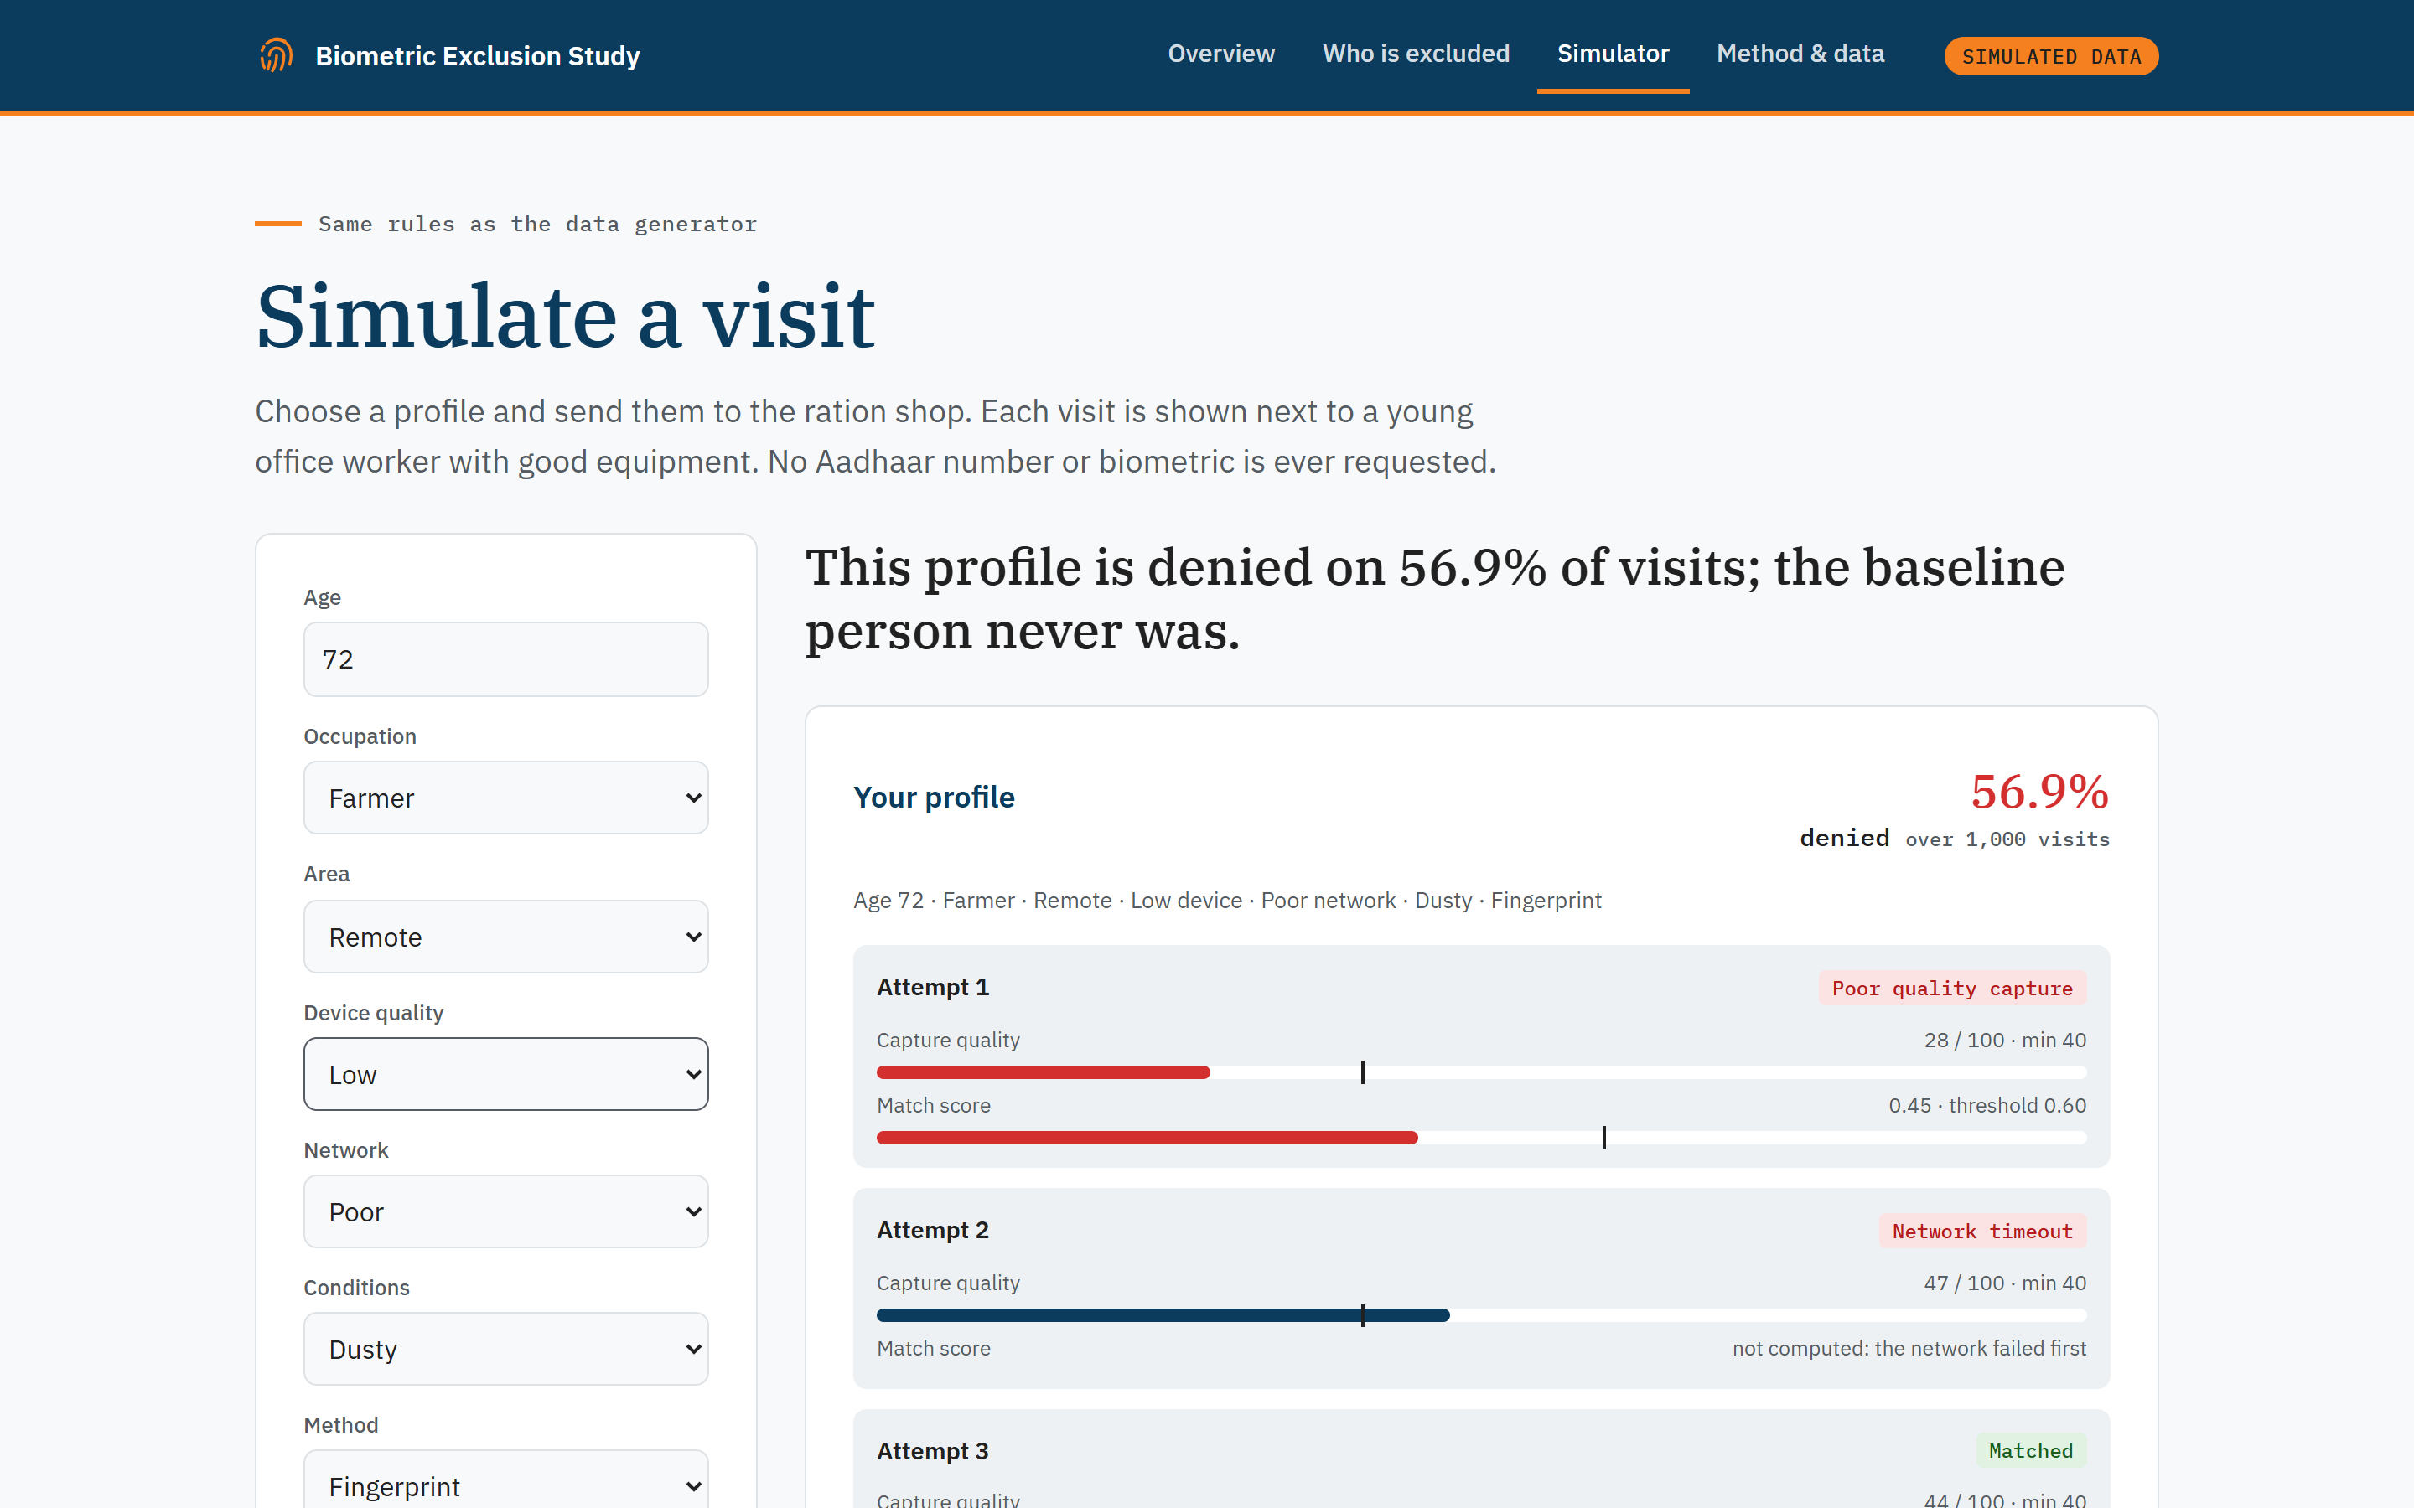
The simulator: same rules, different lives
LIVE DEMO
56.9%
Farmer, 72, remote area, low-quality scanner, poor network, dusty conditions
0.0%
Office worker, 25, urban area, high-quality scanner, good network
Share of visits denied, estimated over 1,000 simulated visits each.
Notes:
Demo the simulator live if time allows. The same scheme, the same rules: one person is turned away on more than half of visits, the other essentially never.

Slide 13




Where bias enters the authentication pipeline
SOURCES OF BIAS
1. Collect
2. Set the objective
3. Deploy
4. People feel it
5. Feedback
Measurement bias
Evaluation bias
Deployment bias
Disparate impact
Hidden exclusion
Scanners capture worn fingers poorly: manual work costs 12 to 20 quality points.
One threshold (0.60) tuned for security: FAR 0.6%, but FRR 24.3%.
Remote areas are given Low devices on 57% of visits; cities on 12%.
Denied: 21.7% of visits for 75+, 5.8% for farmers, 0.1% for office workers.
People who give up after repeated denials leave no trace in the logs.
feedback loop: the data never shows who stopped coming
Measure bias. Subgroup denial rates, the four-fifths rule, chi-square and odds ratios: this project.
Remove bias. Better devices, fallbacks, exemptions and public audits: our recommendations.
Notes:
Unit 2 shows bias entering at every stage of an ML pipeline. Here: measurement bias, because sensors capture worn or dusty fingers poorly; evaluation bias, because one threshold is tuned for security, not for equal error rates; deployment bias, because remote areas get worse scanners; the result is disparate impact on the elderly and manual workers; and a feedback loop, because people who give up never appear in the data. Unit 2's answer is to measure bias, then remove it. This project does the measuring; the recommendations do the removing.

Slide 14
Biometric data is sensitive: who is responsible?
PRIVACY AND GOVERNANCE
DPDP ACT ROLES (OUR MAPPING)
PRIVACY IMPACT ASSESSMENT, APPLIED
Data Principal
The beneficiary whose fingerprint is scanned
Identify data
Fingerprints, iris and the Aadhaar number: sensitive and directly identifying.
1
Data Fiduciary
UIDAI and the department running the scheme
Assess risk
Exclusion of the elderly and manual workers, the most vulnerable users.
2
Data Processor
Authentication agencies and device operators
Mitigate harm
Fallbacks, better devices, offline mode and exemptions.
RIGHTS THAT MUST WORK IN PRACTICE
3
Information
Correction
Grievance redressal
Nominee
Document decisions
Publish denial rates and the four-fifths audit, every year.
A pensioner denied at the ration shop needs redressal on the spot, not a form to file later.
4
Our project, privacy by design: synthetic data only · nothing personal collected or stored · documented assumptions · 46 tests
Notes:
Unit 3 classes biometric data as sensitive personal data. Under the DPDP Act's roles, the beneficiary is the data principal, UIDAI and the scheme's department act as data fiduciaries, and authentication agencies and device operators as processors (our mapping). The Act gives rights to information, correction, grievance redressal and a nominee; grievance redressal matters most for someone denied a ration. Some state functions can be exempt under the Act, which is exactly where ethics must go beyond compliance. We applied the four-step Privacy Impact Assessment, and our own project follows privacy by design: synthetic data, no personal data stored.

Slide 15





RISK MITIGATION, PRINCIPLE BY PRINCIPLE
Fix the system, not the fingerprint
ACCOUNTABILITY · FAIRNESS
Fallback authentication
OTP, iris or a documented manual override.
FAIRNESS
Better devices first
Replace low-quality scanners in rural and remote areas.
FAIRNESS · PRIVACY
Offline (edge) mode
Authenticate locally when the network fails; less data in transit.
FAIRNESS
Exemptions
Alternative proof for people aged 75+ and manual workers.
TRANSPARENCY · ACCOUNTABILITY
Grievance redressal
On-the-spot help and a stated reason for every denial.
TRANSPARENCY · ACCOUNTABILITY
Public harm audits
Publish denial rates by group with the four-fifths check.
Thank you. Ethical failures can happen without bugs; responsible AI is good engineering. Questions?
Notes:
Each recommendation maps to a principle from Unit 1 and the risks from Units 2 and 3: fallbacks and redressal restore accountability, better devices and exemptions address fairness, offline edge authentication cuts network failures and data in transit, and public harm audits make the system transparent. Close with Unit 1's takeaway: ethical failures can occur without bugs. Then take questions.

