Slide 1
ENGI 301 One-Handed Piano Project Proposal
10/01/2023
Shannon McGill

Slide 2
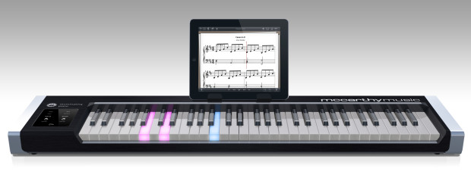
Background Information
My one-handed piano will teach beginner pianists how to play simple songs through memorization and repetition of a light sequence.
Lights corresponding to a given key will illuminate in a given sequence.
Users will press the correct buttons in the correct order to play a simple song.
Why? I love memorization games, and I have always wanted to learn to play the piano. This is a perfect combination of the two!
My project will be a (much) simplified version of this piano that requires you to memorize the light sequence to learn the song!

Slide 3
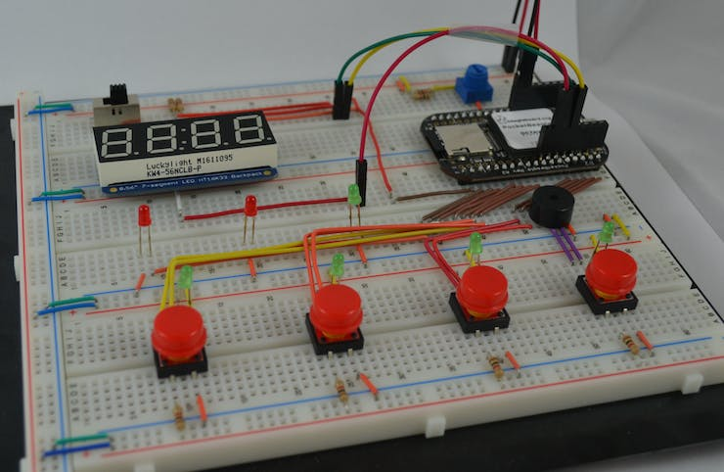
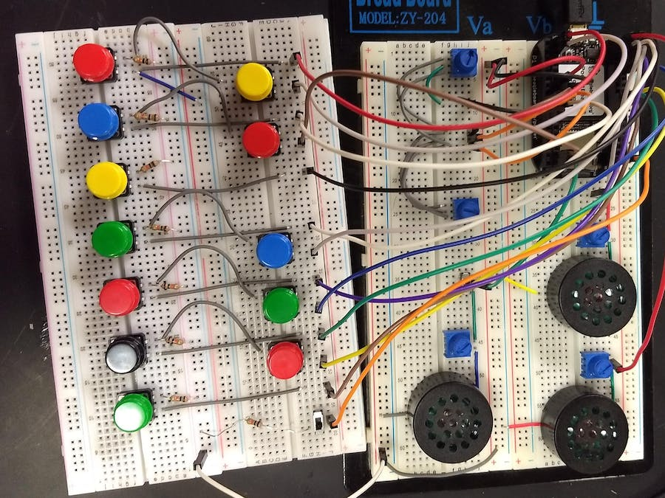
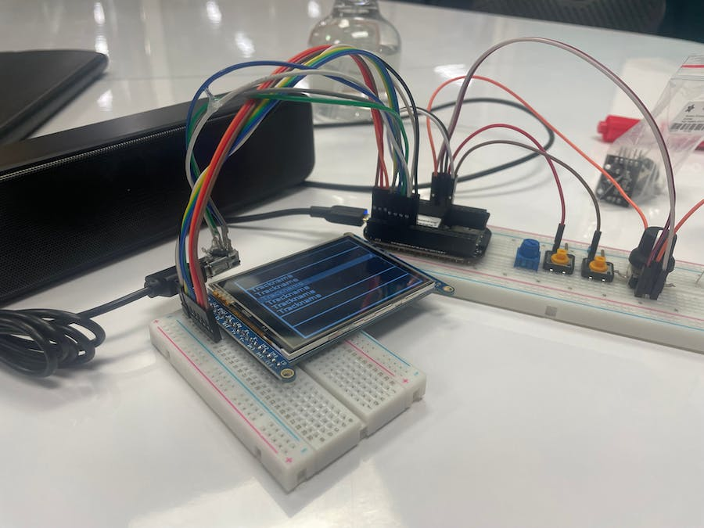
Background Information
Existing Projects Leveraged (Hyperlinked)
Whac-a-Mole Game with PocketBeagle shows how to illuminate lights in a certain order.
PocketBeagle Synthesizer will help me in learning how to sync buttons with specific notes.
Music Box uses USB speakers to play music and includes the LCD screen I plan to use.
My project will combine aspects of the above projects to display lights in a given sequence that will correspond to the buttons to press to play a song on my piano.
Whac-a-Mole Game with PocketBeagle
PocketBeagle Synthesizer
Music Box

Slide 4
System Block Diagram
Buzzer
Product ID: 1536
USB Speaker
LLR050A
PWM1A
USB1
Resistive Touch Screen Controller
Product ID: 5423
PocketBeagle
I2C1
Arcade Buttons
ASIN: B01N11BDX9
5 GPIO.IN (P1.26, P1.28, P1.30, P1.32, P1.34)
LCD Touchscreen
ILI9341
SPI1

Slide 5
Power Block Diagram
Buzzer
Product ID: 1536
3.3 V, max 5 mA
USB Speaker
LLR050A
PWM1A
5V (not from PocketBeagle), current unknown
USB1
Resistive Touch Screen Controller
Product ID: 5423
3.3 V, max 50 mA
PocketBeagle
I2C1
Arcade Buttons
ASIN: B01N11BDX9
5V, 5-10 mA
5 GPIO.IN (P1.26, P1.28, P1.30, P1.32, P1.34)
3.3 V, max 150 mA
LCD Touchscreen
ILI9341
SPI1

Slide 6
Components / Budget
Component (Components to Purchase are Hyperlinked!) | Need to Buy | Cost
Arcade LED Buttons | Yes | $11.88
Transistors for LEDs* | Yes | TBD
Resistors | No | N/A
USB Speaker | Yes | $15.98 (On Sale!)
USB Adapter | No | N/A
SPI Screen | Yes | $29.95
Resistive Touch Screen Controller | Yes | $4.95
Buzzer | No | N/A
*Professor Welsh will choose which transistors to buy and I will update this list accordingly.

