Slide 1
ENGI 301 One-Handed Piano Project Proposal
09/25/2023
Shannon McGill

Slide 2
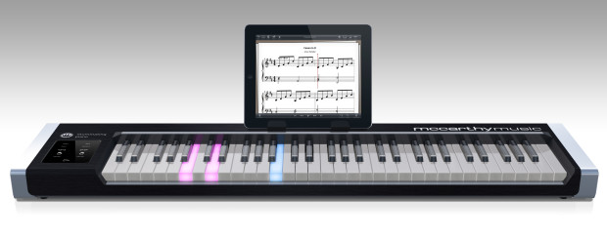
Background Information
One-handed piano will teach beginner pianists how to play simple songs through memorization and repetition of a light sequence
Lights corresponding to a given key will illuminate in a given sequence
Users will press the correct buttons in the correct order to play a simple song
Why? I love memorization games, and I have always wanted to learn to play the piano. This is a perfect combination of the two!
My project will be a (much) simplified version of this piano that requires you to memorize the light sequence to learn the song!

Slide 3
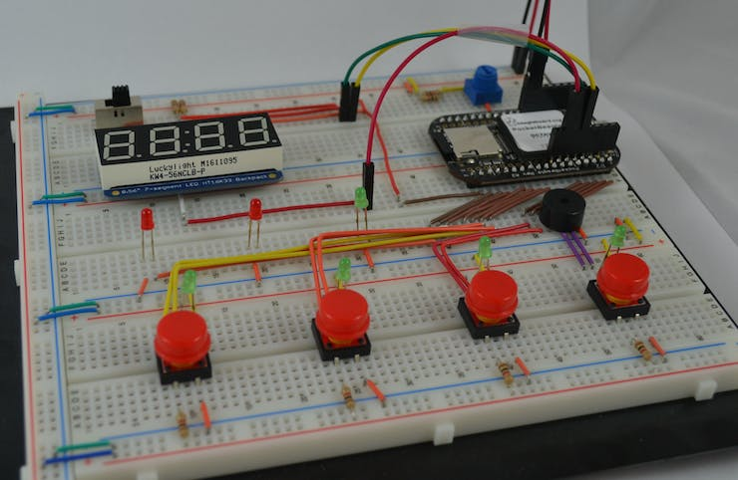
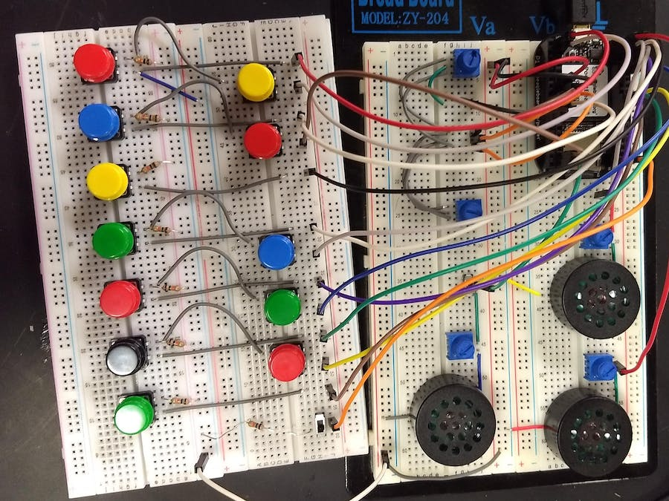
Background Information
Existing Projects Leveraged (Hyperlinked)
Whac-a-Mole Game with PocketBeagle will help me in getting the lights to illuminate in a certain order
PocketBeagle Synthesizer will help me in learning how to sync buttons with specific notes.
My project will combine aspects of both of the above projects to display lights in a given sequence that will correspond to the buttons to press to play a song on my piano.
Whac-a-Mole Game with PocketBeagle
PocketBeagle Synthesizer

Slide 4
System Block Diagram
Questions
Why does the speaker have to be PWM? Is this due to sound being a modulating signal?
Can the switch be a GPIO input? I wasn’t sure how to figure that out.
Speaker
PRT-20660
PWM
Slide Power Switch
COM-00102
1 GPIO?
PocketBeagle
LEDs
5 GPIOs
5 GPIOs
Buttons

Slide 5
Power Block Diagram
Questions
When do you use SYS 3.3 V power versus GPIO?
Can you back calculate current from a power rating and voltage?
Are the arrows directed the correct way (especially for the buttons)?
Speaker
PRT-20660
3.3 V, max current 151 mA
PWM
Slide Power Switch
COM-00102
3.3 V, max current 200 mA
GPIO_IN
PocketBeagle
GPIO_IN
3.3 V, max current 20 mA
LEDs
3.3 V, max current 100 mA
Buttons
GPIO_IN

Slide 6
Components / Budget
Component | Need to Buy | Cost
LEDs, 5 different colors | No | N/A
Buttons, 5 different colors | No | N/A
Resistors, 10 | No | N/A
Slide Power Switch | Yes | $1.60
Speaker | Yes | $2.95
Components to Purchase are Hyperlinked!
Note: The slide switch will be to change between ”learn” and “practice” mode. “Learn” mode will use the LED light sequence to teach the user the song, while “practice” mode will allow the user to just play the keys as they want.
Note: If I need to increase the complexity of my project, one idea I have is to add a potentiometer to vary how long the LEDs are illuminating. This will allow users to modulate how difficult memorization of the light sequence is.

