Slide 1
ENGI 301
One-Handed Piano
Project Proposal
11/14/2023
Shannon McGill

Slide 2
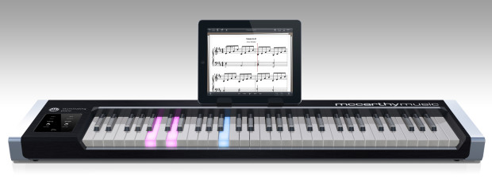
Background Information
My one-handed piano will teach beginner pianists how to play simple songs through memorization and repetition of a light sequence.
  Lights corresponding to a given key will illuminate in a given sequence.
  Users will press the correct buttons in the correct order to play a simple song.
  Why? I love memorization games, and I have always wanted to learn to play the piano. This is a perfect combination of the two!
My project will be a (much) simplified version of this piano that requires you to memorize the light sequence to learn the song!

Slide 3
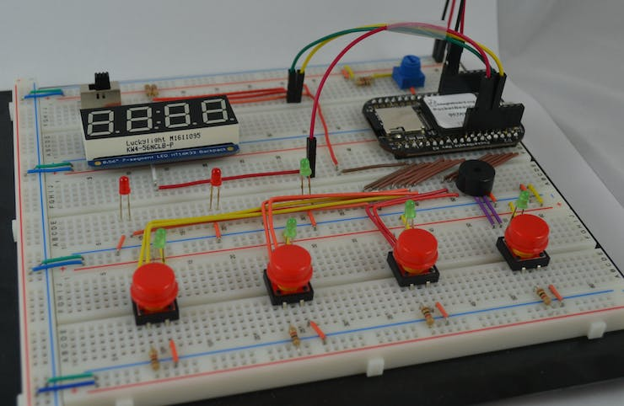
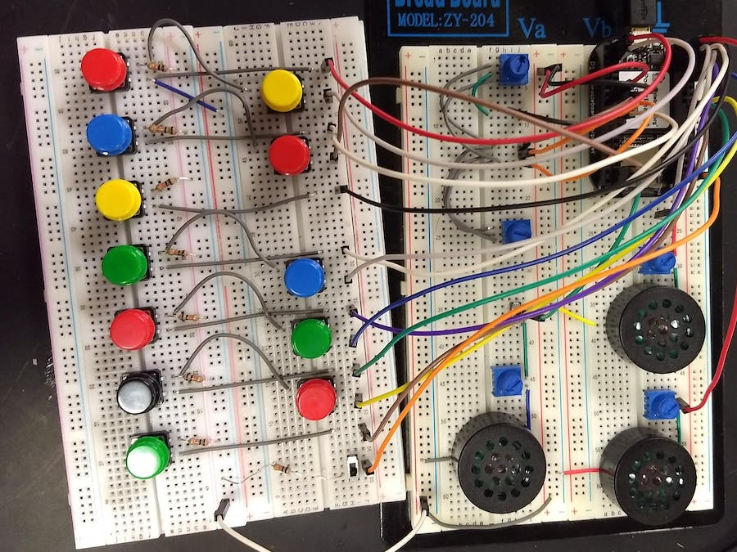
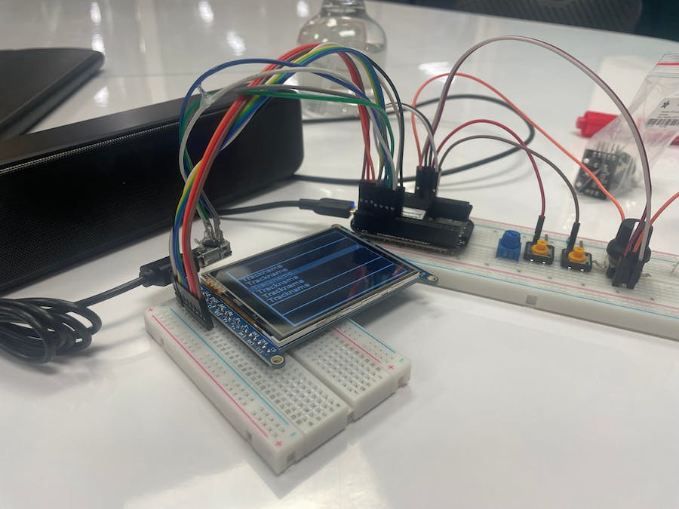
Background Information
Existing Projects Leveraged (Hyperlinked)
  Whac-a-Mole Game with PocketBeagle shows how to illuminate lights in a certain order.
  PocketBeagle Synthesizer will help me in learning how to sync buttons with specific notes.
  Music Box uses USB speakers to play music and includes the LCD screen I plan to use.
My project will combine aspects of the above projects to display lights in a given sequence that will correspond to the buttons to press to play a song on my piano.
Whac-a-Mole Game with PocketBeagle
PocketBeagle Synthesizer
Music Box

Slide 4
System Block Diagram
10 GPIO (P2.1, P2.3, P2.5, P2.7, P2.9 for LEDs, P2.2, P2.4, P2.6, P2.8, P2.10 for buttons)
USB Speaker
LLR050A
USB1 (P1.7, P1.9, P1.11, P1.13)
Arcade Buttons
ASIN: B01N11BDX9
PocketBeagle
SPI1, including power, ground, and 2 GPIO (P2.17, P2.19, P2.21, P2.23, P2.25, P2.27, P2.29, P2.31)
Buzzer
Product ID: 1536
LCD Touchscreen
ILI9341
PWM1A (P 1.36)

Slide 5
Power Block Diagram
10 GPIO (P2.1, P2.3, P2.5, P2.7, P2.9 for LEDs, P2.2, P2.4, P2.6, P2.8, P2.10 for buttons)
USB1 (P1.7, P1.9, P1.11, P1.13)
5V,
5-10 mA
Arcade Buttons
ASIN: B01N11BDX9
USB Speaker
LLR050A
5V (not from PocketBeagle), current
unknown
PocketBeagle
SPI1, including power, ground, and 2 GPIO (P2.17, P2.19, P2.21, P2.23, P2.25, P2.27, P2.29, P2.31)
Buzzer
Product ID: 1536
3.3 V,
max 5 mA
LCD Touchscreen
ILI9341
PWM1A (P 1.36)
3.3 V,
max 150 mA

Slide 6
Components / Budget
Component (Components to Purchase are Hyperlinked!) | Need to Buy | Cost
Arcade LED Buttons | Yes | $11.88
NPN Transistors for LEDs | Yes | TBD*
Resistors (1 kOhm) | No | N/A
USB Speaker | Yes | $15.98 (On Sale!)
USB Adapter | No | N/A
SPI Screen | Yes | $29.95
Buzzer | No | N/A
*Professor Welsh found and purchased the transistors.

