Slide 1
ENGI 301 PCB Project
Shannon McGill
Due 12/12/2023 @ 11:59pm

Slide 2
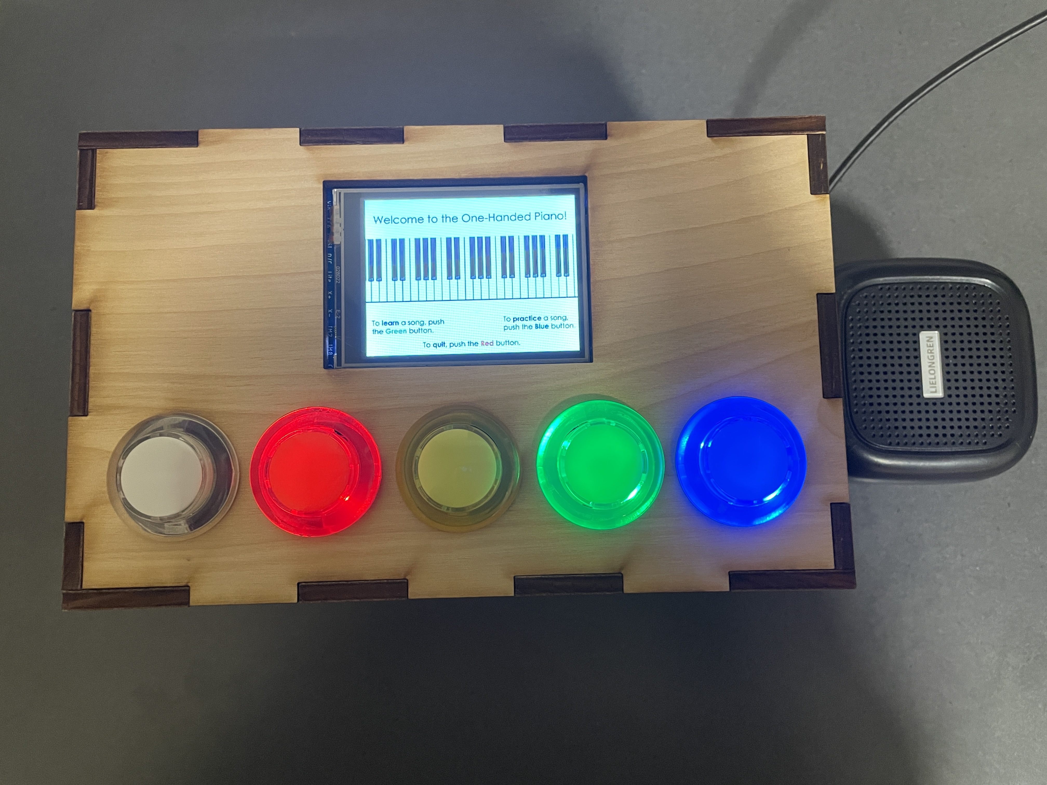
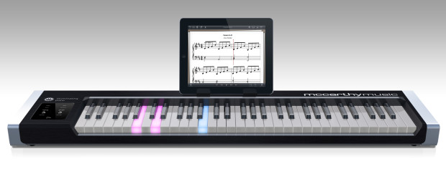
Background Information
Create a PCB for a “One-Handed Piano”
Hardware:
Five Arcade Buttons (Keys)
SPI Display Screen (Game Interface)
USB Adapter (Speaker)
Buzzer (Incorrect Notes)
Five Transistors
Fifteen Resistors

Slide 3
System Block Diagram – “One-Handed Piano”
10 GPIO (P2.1, P2.3, P2.5, P2.7, P2.9 for LEDs, P2.2, P2.4, P2.6, P2.8, P2.10 for buttons)
USB Speaker
LLR050A
USB1 (P1.7, P1.9, P1.11, P1.13)
Arcade Buttons
ASIN: B01N11BDX9
Note: LED is wired as a transistor-controlled LED, and the button is wired in the active high configuration. They are both powered by 5 V.
PocketBeagle
SPI1, including power, ground, and 2 GPIO (P2.17, P2.19, P2.21, P2.23, P2.25, P2.27, P2.29, P2.31)
Buzzer
Product ID: 1536
LCD Touchscreen
ILI9341
PWM1A (P 1.36)

Slide 4
Mechanical Drawing
3.3”
SPI Screen
microUSB
Pocket Beagle
USB Adapter
2.6”
Buzzer
FRONT
BACK
Note: The colored boxes represent the colored buttons and their associated resistors and transistor.

