Slide 1
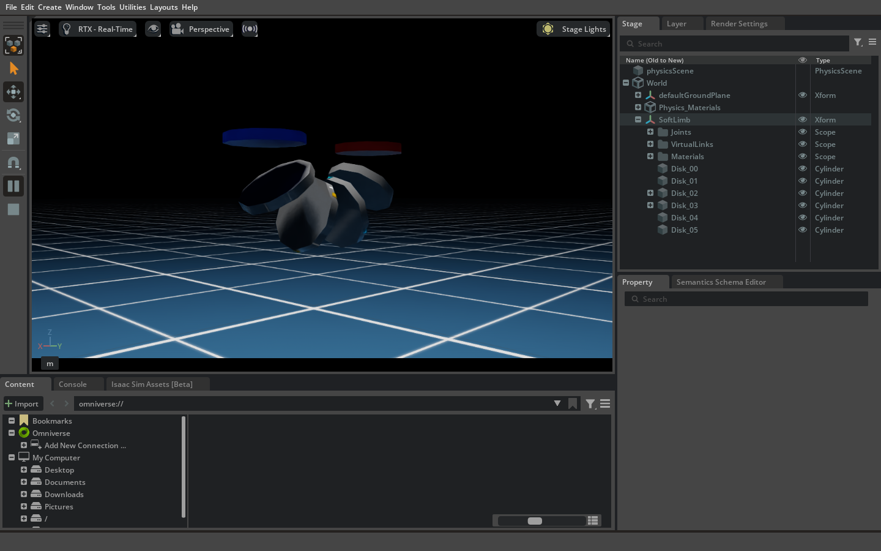
OVERVIEW
Soft Continuum Limb: Research Progress Update
Progress after successful single-module position control
Six-disc constant-curvature simulation • hybrid torque control • virtual strain sensing • Wheatstone-bridge output • RViz reconstruction
Current verified endpoint
1.0 N·m → 179.9999°
September 2026
Soft continuum limb research progress • 01
ETID / MSET research

Slide 2
MILESTONE
Starting Point and Scope of This Update
✓
6 discs
180°
Single-module position control established
Current reduced-order limb architecture
Active maximum bend in both interfaces
Work completed after the baseline milestone
●
Converted the twelve-disc normalization logic to a six-disc, five-interval model.
●
Synchronized all physical intervals so the limb assumes one curve during motion.
●
Added torque-commanded admittance while preserving position-control operation.
●
Added two rings of three pose-derived virtual strain gauges and bridge voltages.
●
Published robot_description and joint states for sensor-driven RViz visualization.
●
Added reproducible regression tests and a continuously updated research record.
Soft continuum limb research progress • 02
ETID / MSET research

Slide 3
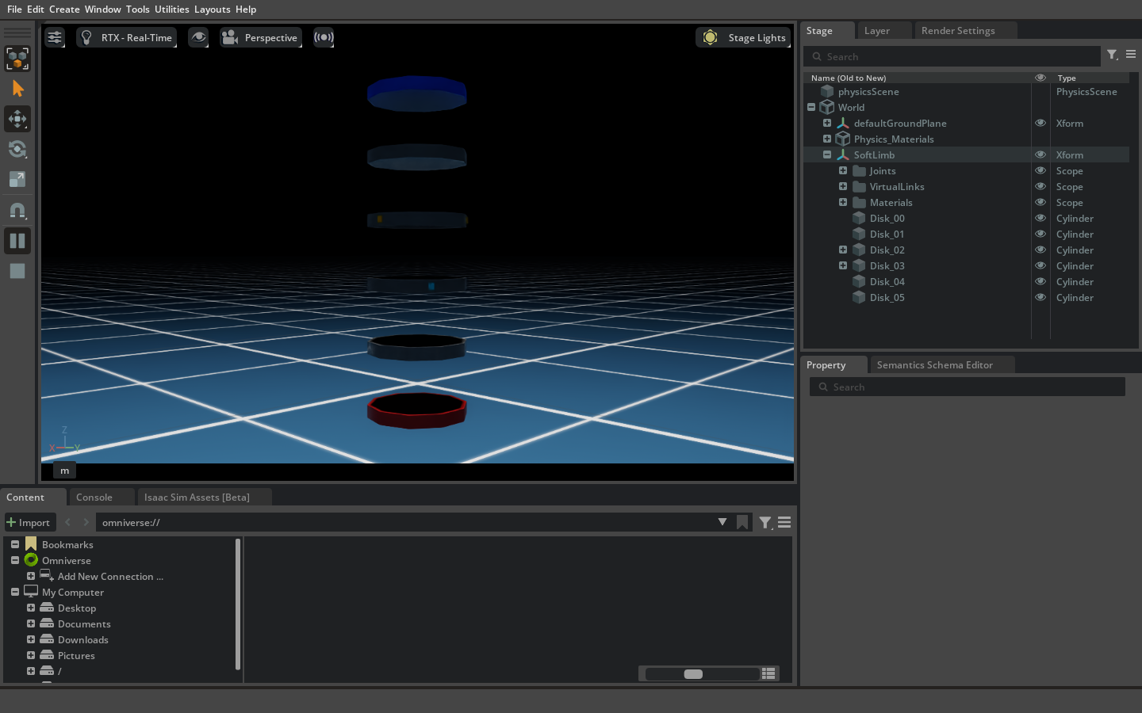
SIMULATION
Current Six-Disc Working Architecture
Working configuration
●
Six physical discs: Disk_00 through Disk_05
●
Five physical bending intervals
●
Hanging base with active gravity compensation
●
Direct runtime D6 joint per interval
●
240 Hz physics and 60 Hz rendering
●
Overdamped position drives: stiffness 6400, damping 240
●
Twist locked; bend direction controlled by θ
Captured from the current Isaac Sim working launch.
Soft continuum limb research progress • 03
ETID / MSET research

Slide 4
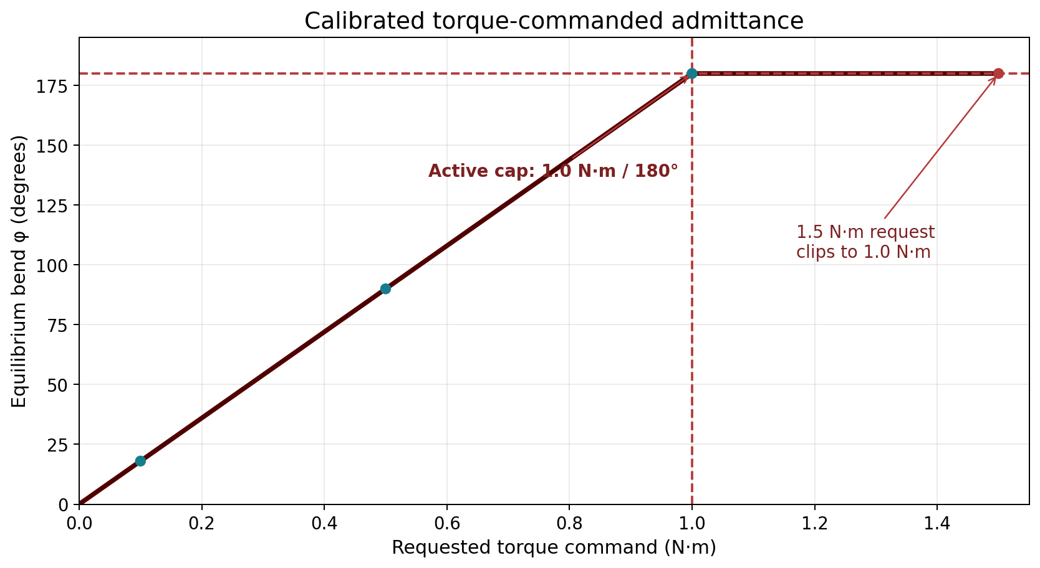
CONTROL
From Position Control to Hybrid Torque Control
Implemented control law
φeq = 180° · τc / 1.0 N·m
●
0.1 N·m → 18°
●
0.5 N·m → 90°
●
1.0 N·m → 180°
●
Commands beyond ±1.0 N·m are clipped
●
2.0 N·m/s command slew limit
●
Position commands are ignored while nonzero torque is active
This is calibrated torque-commanded admittance—not raw open-loop torque and not a physical moment–curvature calibration.
Soft continuum limb research progress • 04
ETID / MSET research

Slide 5
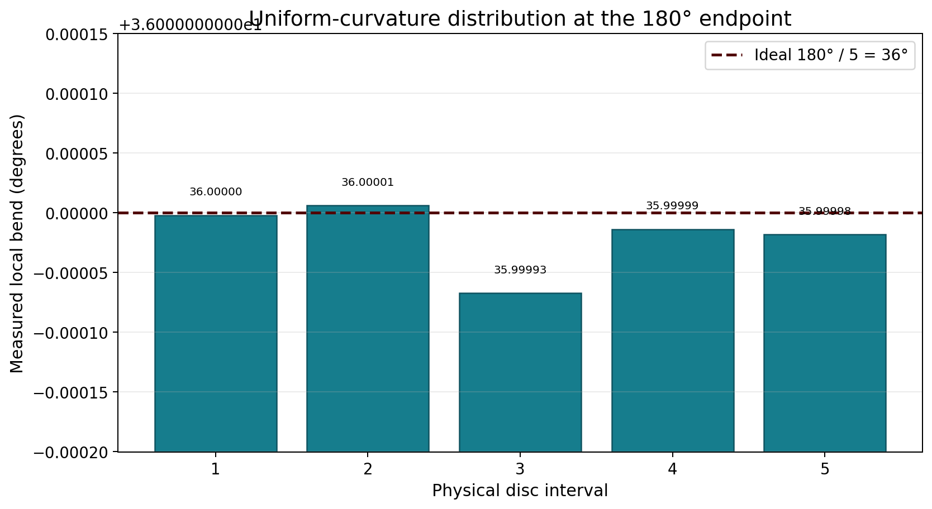
VALIDATION
Constant-Curvature Motion Is Enforced Across the Limb
≈36° each
0.0001°
Five local rotations at the 180° endpoint
Measured torque-mapping tracking error
The controller distributes one total bend uniformly; synchronized target slew prevents the former segment-by-segment transient.
Soft continuum limb research progress • 05
ETID / MSET research

Slide 6
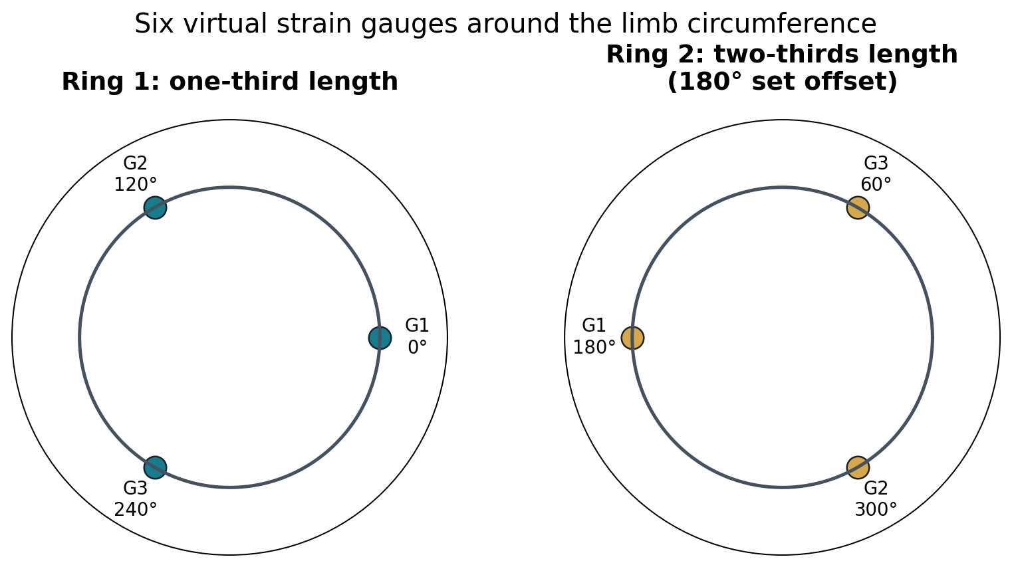
SENSING
Six Virtual Strain Gauges
Placement
●
Ring 1 at one-third length: 0°, 120°, 240°
●
Ring 2 at two-thirds length: 180°, 300°, 60°
●
Second ring uses the requested 180° set offset
●
Readings derive from live disc poses—even during manual dragging
Implemented surface-strain model
ε(α) = r [−κx sin(α) + κy cos(α)]
The readings are kinematic, pose-derived estimates. Physical gauge bonding, material hysteresis, temperature drift, and calibration remain future work.
Soft continuum limb research progress • 06
ETID / MSET research

Slide 7
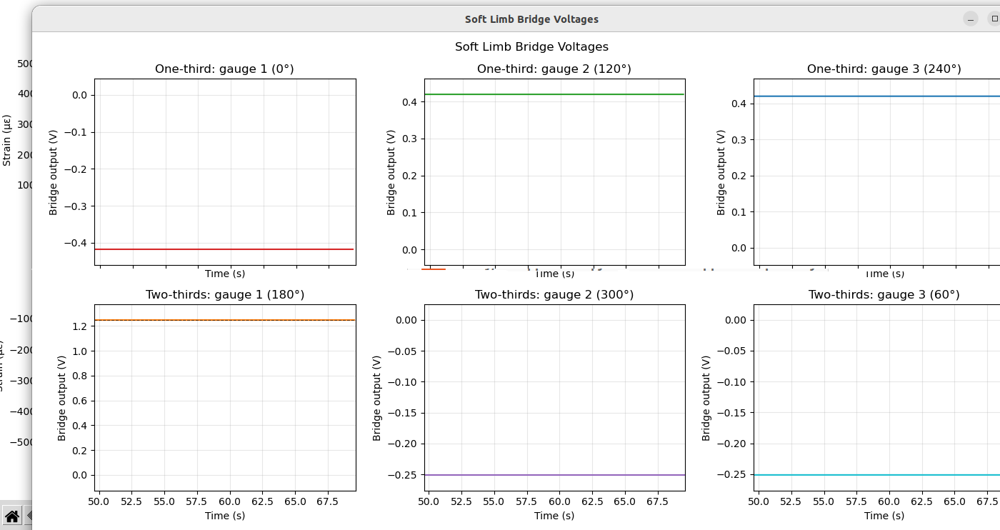
RESULTS
Live Six-Channel Strain Response
Acquisition
●
Captured from live ROS topics
●
Torque stepped through 0, 0.5, and 1.0 N·m
●
Two stations × three circumferential gauges
●
Opposing signs distinguish tension and compression
●
Signals remain available without a control command
Simulated, pose-derived strain; not yet hardware validated.
Soft continuum limb research progress • 07
ETID / MSET research

Slide 8
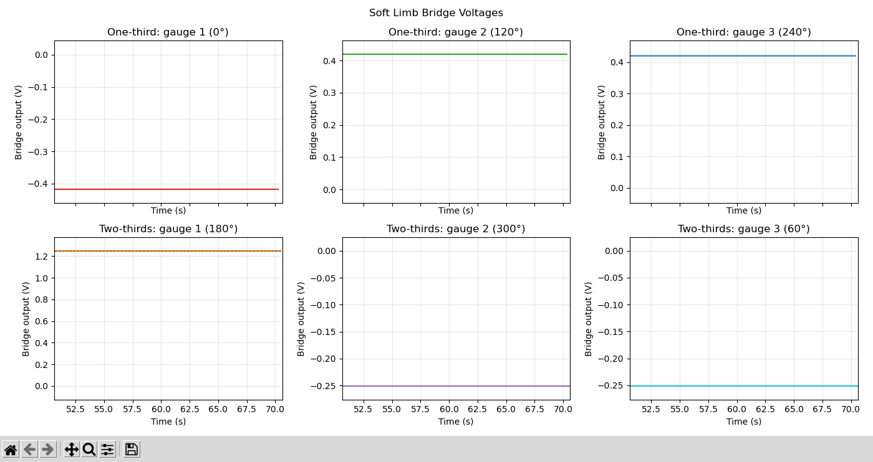
INSTRUMENTATION
Wheatstone-Bridge Voltage Layer
Nominal bridge model
●
350 Ω foil gauge
●
Gauge factor GF = 2.0
●
Quarter-bridge topology
●
Excitation Vexc = 2.5 V
●
Validity flags on separate ROS topics
●
Non-finite model regions displayed at a marked 1.25 V boundary
The voltage layer supports DAQ planning; it does not establish a purchased sensor’s survivability or experimental accuracy.
Soft continuum limb research progress • 08
ETID / MSET research

Slide 9
INTEGRATION
ROS 2 and RViz Visualization Pipeline
Isaac Sim
six-disc limb
→
Live disc poses
and commands
→
Six strain +
bridge channels
→
Shape
reconstruction
→
RViz RobotModel
and TF
●
robot_description is published at simulator launch.
●
Joint states reconstruct the sensed limb rather than displaying a second physical Isaac limb.
●
A static map → soft_limb_disk_00 transform supplies the RViz fixed frame.
Soft continuum limb research progress • 09
ETID / MSET research

Slide 10
EVIDENCE
Verification Summary
179.9999°
PASS
≈36°
0.0001°
1.0 N·m endpoint
1.5 N·m request clipped to 1.0 N·m
Every physical interval
Torque mapping error
Additional verified behavior
Research interpretation
●
Position control still reaches the 180° endpoint.
These results validate the implemented software mapping in unloaded, single-axis simulation. They do not yet validate material behavior, payload response, physical torque requirements, or real strain gauges.
●
First-step X/Y targets are identical across all five physical intervals.
●
The sixth disc is treated as the final disc—not as a midpoint from the old twelve-disc model.
●
Syntax, topology, bridge-model, ROS build, Isaac regression, and LaTeX builds pass.
Soft continuum limb research progress • 10
ETID / MSET research

Slide 11
LATEST UPDATE
What Changed in the Latest Iteration
Previous development state
Current active working state
●
Torque range temporarily extended to 1.5 N·m
●
Maximum bend restored to ±180°
●
Accumulated bend measurement demonstrated 270°
●
Torque command capped at ±1.0 N·m
●
Useful as historical topology evidence
●
Over-limit commands clamp safely and visibly
●
Verifier checks requested vs. applied torque
●
Outside the intended active research range
●
README, validation log, and research document synchronized
Decision: retain the 270° result only as historical pre-cap evidence; use 180° as the active experimental boundary.
Soft continuum limb research progress • 11
ETID / MSET research

Slide 12
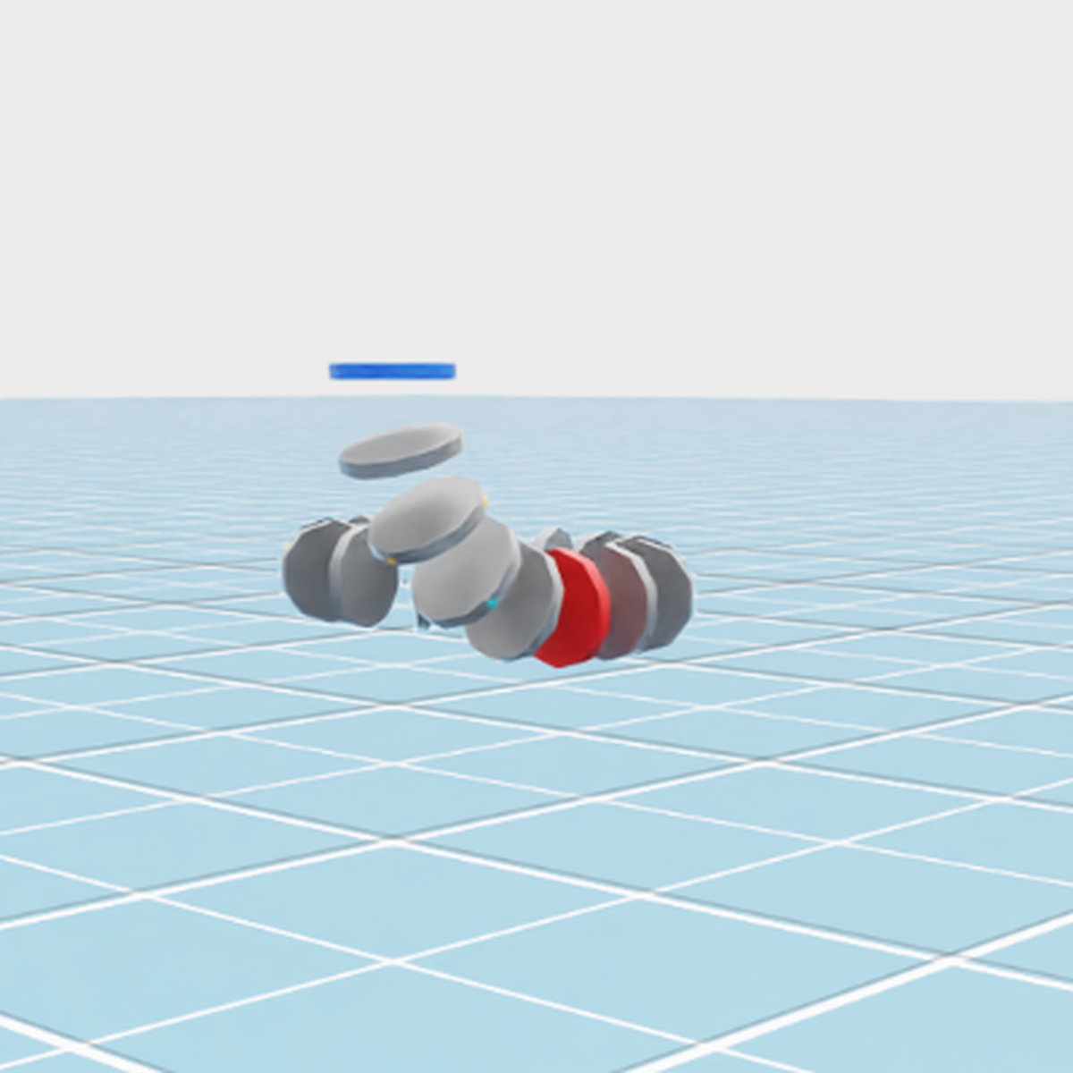
SOFT_3_WORKING
Third Objective: Three Modules in Series
soft_3_working architecture
●
Three serial six-disc modules: 18 physical discs
●
Five actuated intervals per module: 15 total
●
Two fixed connectors transmit pose between modules
●
The first disc is fixed in air; the chain hangs under gravity
●
Three independent φ-torque commands
●
Three independent θ bending directions
●
Same synchronized constant-curvature target inside every module
●
Source, launch, control, plotting, verification, and USD files use the soft_3_working name
Live Isaac Sim capture using the Grey Studio light rig; overlapping discs reflect the commanded compound three-dimensional pose.
Soft continuum limb research progress • 12
ETID / MSET research

Slide 13
VALIDATION
Independent Three-Module Control: Verified
90.0047°
134.9999°
179.9999°
Module 1: 0.50 N·m, θ = 0°
Module 2: 0.75 N·m, θ = 90°
Module 3: 1.00 N·m, θ = −90°
12-second headless regression
Research boundary
●
All five first-step interval targets matched within each module.
This validates independent software commands, synchronized interval targets, connector rigidity, and numerical stability. It does not calibrate physical torque, material response, or payload capacity.
●
Final-second ranges: 0.0001642°, 0.0000568°, 0.0000713°.
●
Connector residual bends: 0.0000672° and 0.0000394°.
●
Detected all 18 gauge publishers.
●
Overall verifier result: PASS.
Soft continuum limb research progress • 13
ETID / MSET research

Slide 14
LINKED BRANCH
Minimum-Energy Horizontal Tip Circle
212.34 mm
0.71 mm
0.1254 N·m
measured mean radius
height peak-to-peak
maximum module command
Constrained constant-curvature solution
Research boundary
●
Minimizes 0.5 Σ wᵢτᵢ² subject to requested tip radius and height.
Energy is a normalized squared-command/elastic proxy. It is not electrical consumption, actuator work, or calibrated mechanical energy in joules.
●
All 15 bending intervals and both rigid connector spans are modeled.
●
Optimized torques stay constant while the common bending plane rotates.
●
Default radius: 212.5 mm = half of the 425 mm modeled limb length.
●
Path height is 0.40 m; the 54 s period preserves the prior tip speed.
●
Full revolution passed: 0.76 mm radial and 0.71 mm height variation.
Soft continuum limb research progress • 14
ETID / MSET research

Slide 15
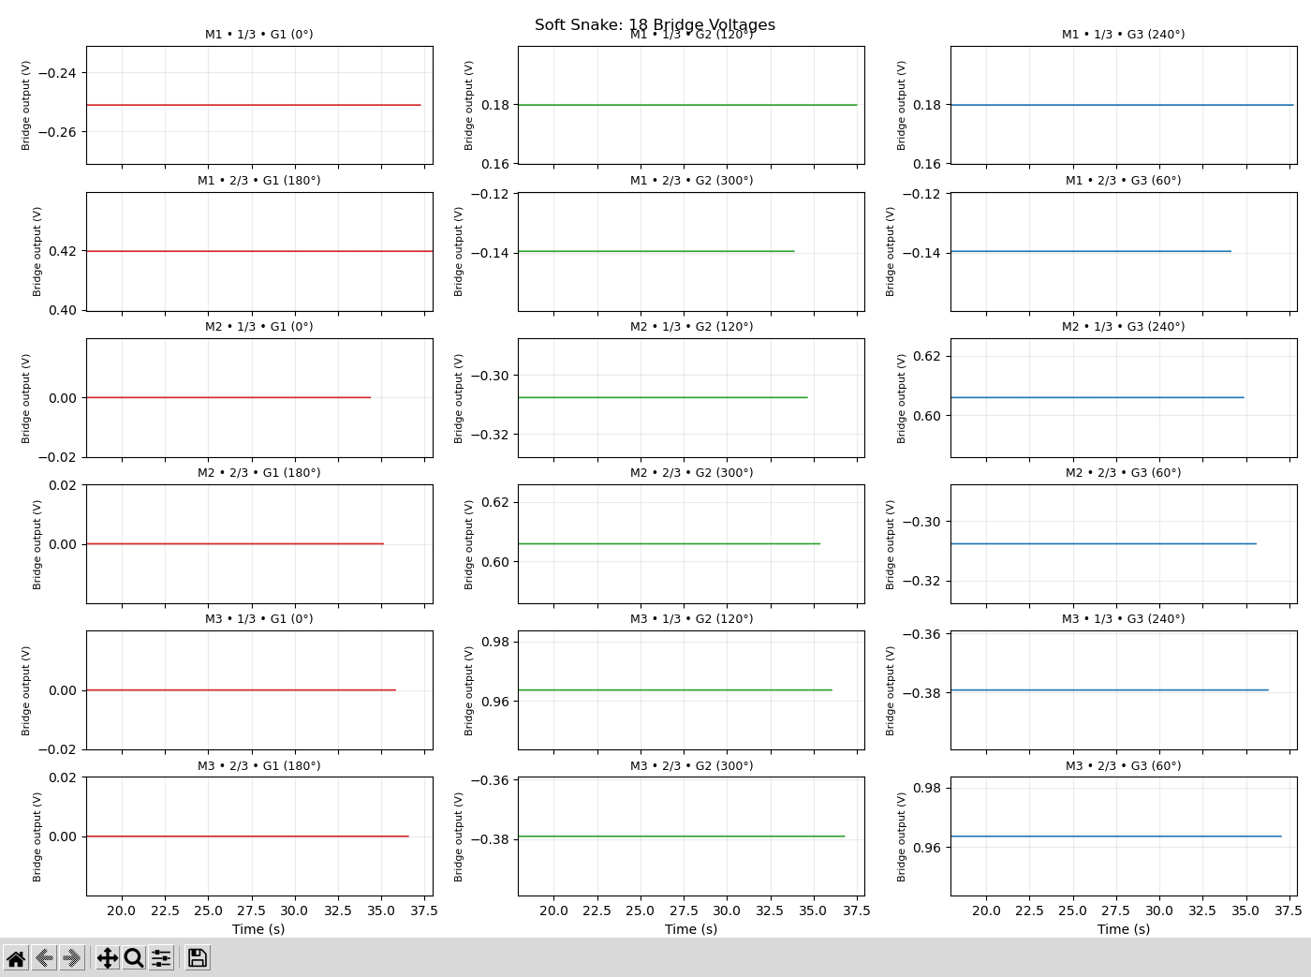
SENSING
Eighteen-Channel Bridge-Voltage Instrumentation
Repeated sensing layout
●
Six gauges per module
●
Two axial stations
●
Three gauges per ring
●
18 bridge-voltage channels
●
18 validity flags
●
Quarter bridge: 350 Ω, GF 2.0, 2.5 V excitation
●
All 18 voltage graphs open automatically with the simulation launch
●
Pose-derived readings remain available without a command
Live voltage graph captured from /soft_snake/module_N/sensors/... topics.
Soft continuum limb research progress • 15
ETID / MSET research

Slide 16
FORWARD PLAN
Next Research Steps
01
Physical gauge selection
Choose a commercial gauge, substrate, adhesive, and temperature compensation strategy.
02
Bench calibration
Measure real strain and bridge voltage against known curvature and loading.
03
Independent shape validation
Compare reconstructed curvature with motion capture or vision—not the same pose source.
04
Loaded and directional trials
Repeat across θ, negative torque, payloads, disturbances, and repeated cycles.
05
Uncertainty and statistics
Report repeatability, hysteresis, drift, confidence intervals, and failure limits.
Soft continuum limb research progress • 16
ETID / MSET research

Slide 17
CONCLUSION
Current Outcome
A reproducible six-disc research platform now connects
CONTROL
Position + torque admittance + minimum-energy circle
SHAPE
Synchronized five-interval constant-curvature target
SENSING
Six pose-derived strain channels + bridge voltages
VISUALIZATION
Isaac Sim + sensor-driven RViz reconstruction
EVIDENCE
Automated tests and research documentation
Active boundary: ±1.0 N·m and ±180° • Next milestone: physical sensor calibration
Soft continuum limb research progress • 17
ETID / MSET research

