Slide 1
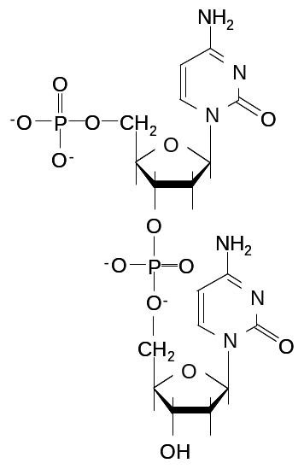
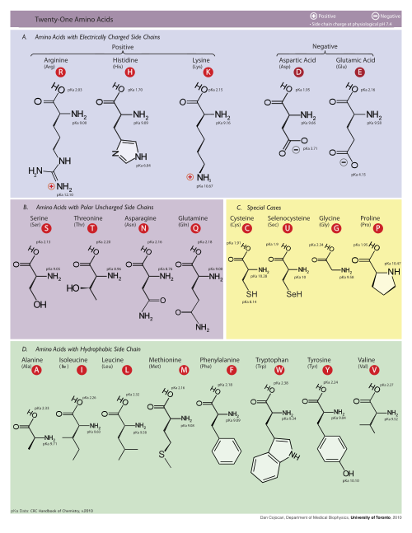

Genetic Codes
Base
NH
NH
2
phosphate
2
N
O
N
O
N
N
O
O
O
O
P
P
CH
O
CH
-
O
-
2
2
O
O
O
O
-
-
OH
OH
OH
OH
Sugar
Nucleotide
UUU
Phe
F
UCU
Ser
S
UAU
Tyr
Y
UGU
Cys
C
UUC
Phe
F
UCC
Ser
S
UAC
Tyr
Y
UGC
Cys
C
UUA
Leu
L
UCA
Ser
S
UAA
Ochre
Stop
UGA
Opal
Stop
UUG
Leu
L
UCG
Ser
S
UAG
Amber
Stop
UGG
Trp
W
CUU
Leu
L
CCU
Pro
P
CAU
His
H
CGU
Arg
R
CUC
Leu
L
CCC
Pro
P
CAC
His
H
CGC
Arg
R
CUA
Leu
L
CCA
Pro
P
CAA
Gln
Q
CGA
Arg
R
CUG
Leu
L
CCG
Pro
P
CAG
Gln
Q
CGG
Arg
R
AUU
Ile
I
ACU
Thr
T
AAU
Asn
N
AGU
Ser
S
AUC
Ile
I
ACC
Thr
T
AAC
Asn
N
AGC
Ser
S
AUA
Ile
I
ACA
Thr
T
AAA
Lys
K
AGA
Arg
R
AUG
Met
M
ACG
Thr
T
AAG
Lys
K
AGG
Arg
R
GUU
Val
V
GCU
Ala
A
GAU
Asp
D
GGU
Gly
G
GUC
Val
V
GCC
Ala
A
GAC
Asp
D
GGC
Gly
G
GUA
Val
V
GCA
Ala
A
GAA
Glu
E
GGA
Gly
G
GUG
Val
V
GCG
Ala
A
GAG
Glu
E
GGG
Gly
G

