Slide 1
Nashimoto M et al (2001) J Theor Biol 209:181-187
The RNA/Protein Symmetry Hypothesis: Experimental Support for Reverse
Translation of Primitive Proteins
Journal Club
Rintaro Saito

Slide 2
Old articles in Journal of Theoretical Biology is still worth reading?
J. Theor. Biol.
Impact factor: 2.574
Cited Half-life: >10.0
Science
Impact factor: 29.747
Cited Half-life: 8.8
Nature
Impact factor: 34.480
Cited Half-life: 8.9
http://admin-apps.isiknowledge.com/JCR

Slide 3
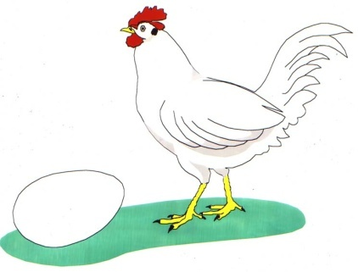
RNA first? Protein first?
RNA first
  RNA not only carries genetic information but also can function as catalyst
  Ribozyme, miRNA, other types of non-coding RNAs
  RNA world
Protein first
  Protein-like substances (“protenoids”) can be easily formed by thermal polymerization of amino acids (Fox, 1988).
  Appropriate for the primitive metabolism (Dyson, 1985)

Slide 4
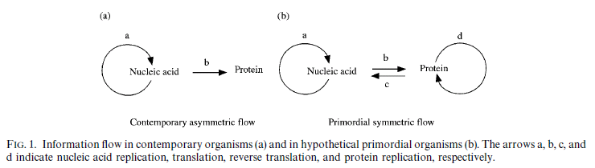
Third hypothesis:
RNA/Protein Symmetry Hypothesis
Both nucleic acids and proteins have coevolved from the very beginning?

Slide 5
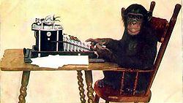
What is the advantage of this hypothesis?
RNA first
  Lives with only RNAs → Genetic codes which encode advantageous protein must emerge.
  Wait until a monkey types Hamlet by coincidence.
Symmetric
  RNA and protein evolved together … No need to search for enormous RNA sequence space to create functional protein.
Mechanism for reverse translation is necessary

Slide 6
How does the reverse translation occur?
rtRNA
Pre-mRNA
AGG
rtRNA
Pre-mRNA
UGA
UAG
UGG
AGG
AGG
UGA
UAG
5’
Phe
Ile
Arg
ACC
3’
Phe
Ile
UGG
Primitive protein
C
ACC
Primitive protein
C
3’
Pre-mRNA
Pre-mRNA
UGA
UAG
AGG
UGA
UAG
Phe
Ile
Arg
ACC
Primitive protein
C
3’
Phe
Ile
ACC
rtRNA
Pre-mRNA
Primitive protein
C
3’
AGG
UGA
UAG
Phe
Ile
Arg
UGG
ACC
UGG
Primitive protein
C
3’
Arg

Slide 7
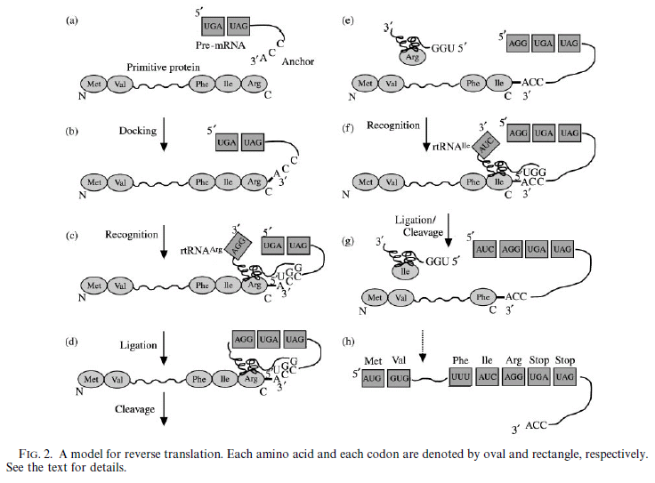
The Model

Slide 8
Can we do reverse translation experimentally?
rtRNA
3’
5’
3’
Pre-mRNA
AGG
GAGUUCCC
CUCAAGGG
5’
Arg binding
domain
3’
5’
3’
AGG
GAGUUCCC
||||||||
CUCAAGGG
5’
Arg binding
domain
5’
3’
3’
AGG
GAGUUCCC
CUCAAGGG
5’
Arg binding
domain

Slide 9
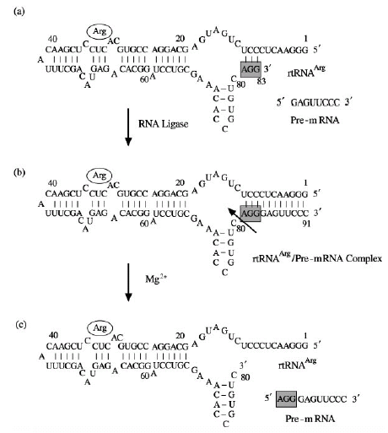
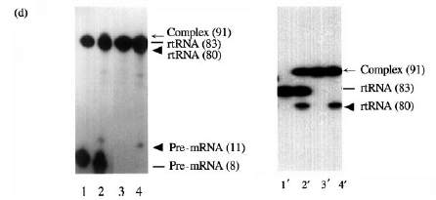
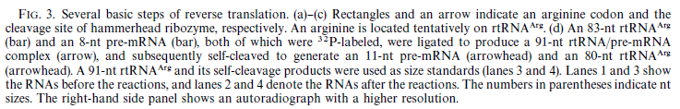
Some of the steps necessary for reverse translation can be done experimentally
Arginine-binding domain
(Connell et al. 1993)
rtRNA synthesized by T7 RNA polymerase
83 bases
Pre-mRNA synthesized by DNA/RNA synthesizer
8 bases
After reaction
Hammerhead ribozyme domain
(Symons,1992)
91 bases
T4 RNA ligase
Self-cleavage reaction
Autoradiograph
Lane 1→ 2: (a) → (b), (c)
Lane 3→ 4: (b) → (c)
80 bases
11 bases

Slide 10
Additional necessary steps
Joining the C-terminal residue of a protein to the 3’-end nucleotide of a pre-mRNA
Cleavage of the C-terminal amino acid and rejoin a newly generated C-terminal residue to the 3’-end nucleotide
Regeneration of a codon sequence of each rtRNA

