Slide 1
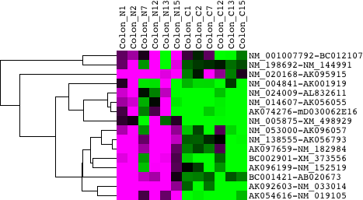

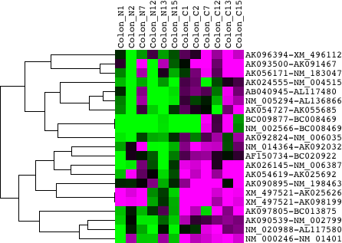

(Fig. 1)
(a)
Protein-coding
- Protein-coding
Protein-coding
- Non-coding
Normal
Cancer
(b)
Protein-coding
- Protein-coding
Protein-coding
- Non-coding
Normal
Cancer
Sense / Antisense = 3
Sense / Antisense = 1
Sense / Antisense = 1/3

