Slide 1
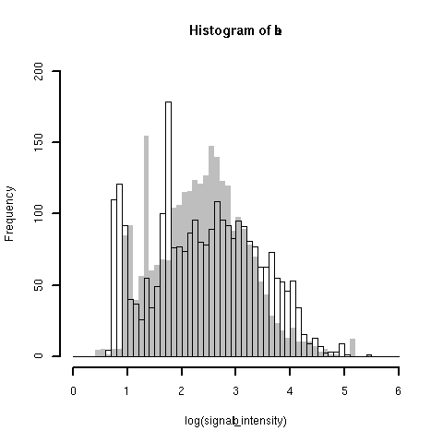
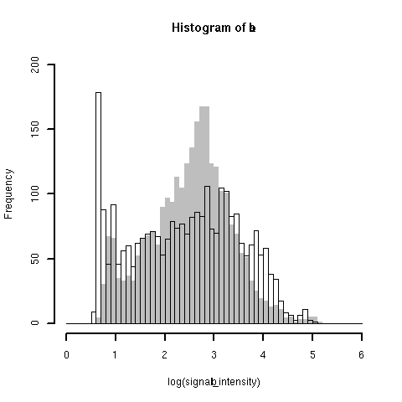
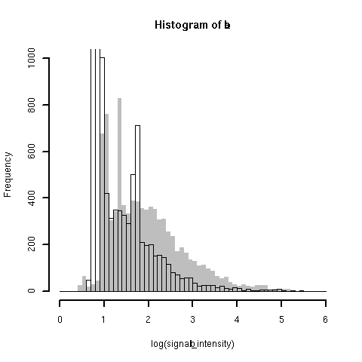
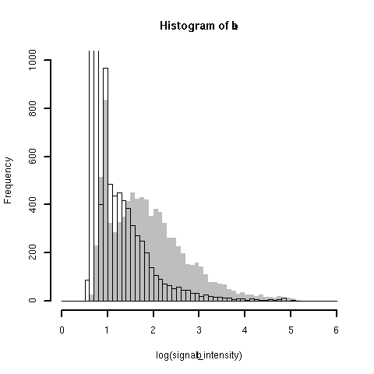
(Fig. 2)
Sense probes, Normal
Sense probes, Cancer
Oligo dT
Random
Frequency
Frequency
log₁₀(Signal Intensity)
log₁₀(Signal Intensity)
AFAS probes, Normal
AFAS probes, Cancer
Frequency
Frequency
log₁₀(Signal Intensity)
log₁₀(Signal Intensity)

