Slide 1
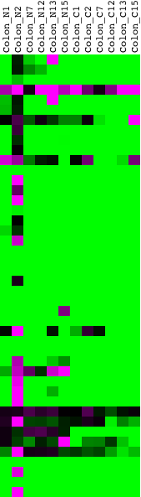
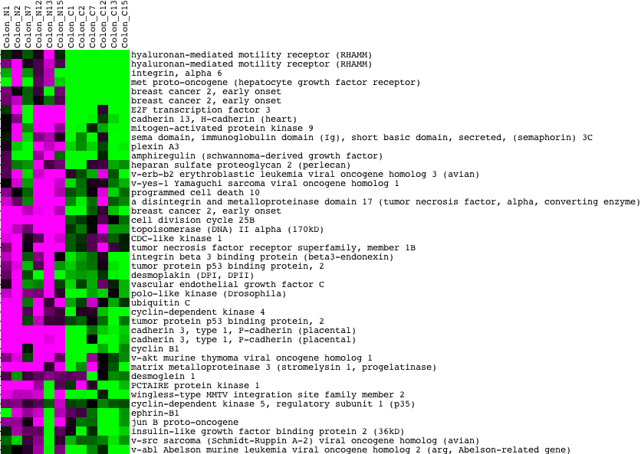
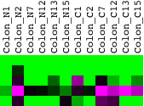
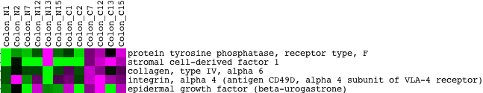
(Fig. 3)
(a)
Oligo-dT
Random
Normal
Cancer
Normal
Cancer
(b)
Oligo-dT
Random
Normal
Cancer
Normal
Cancer
Sense / AFAS = 3
Sense / AFAS = 1
Sense / AFAS = 1/3

