Slide 1
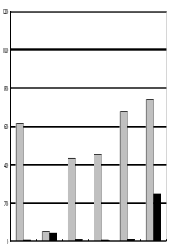
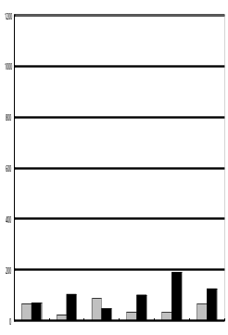
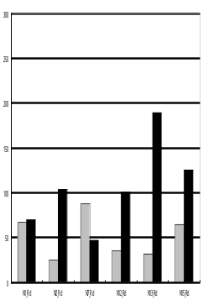
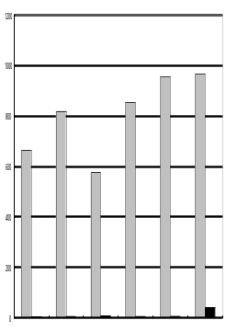
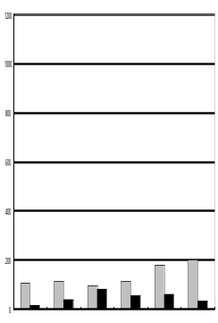
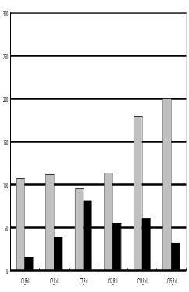
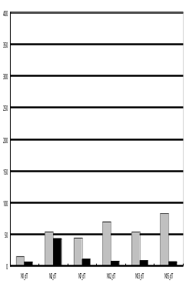
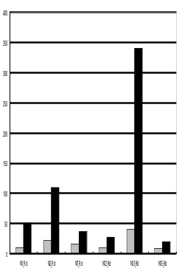
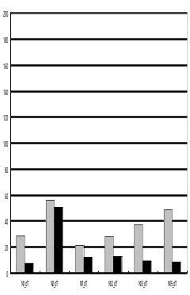
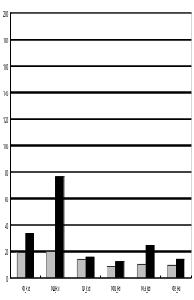
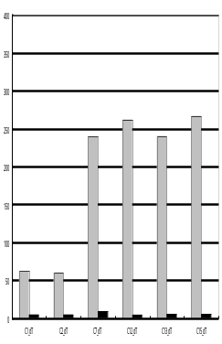
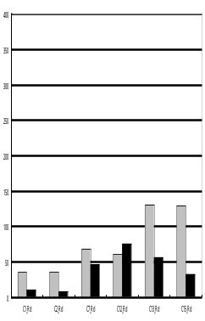
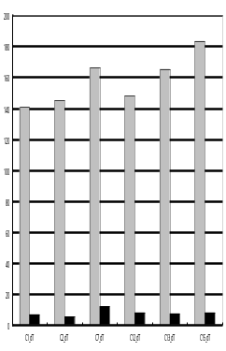
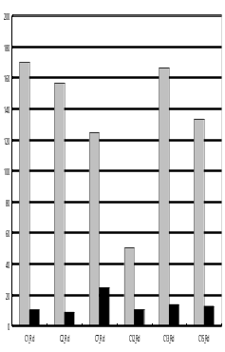
(Fig.5a)
L31951-03: mitogen-activated protein kinase 9
Signal Intensities
Signal Intensities
Signal Intensities
1200
1200
300
Normal
200
600
600
100
0
N15
0
N15
0
N1
N2
N12
N1
N2
N12
N15
N7
N13
N7
N13
N1
N2
N7
N12
N13
Signal Intensities
Signal Intensities
Signal Intensities
1200
1200
300
Cancer
200
600
600
100
0
0
0
C1
C2
C7
C12
C13
C1
C2
C12
C1
C2
C12
C15
C7
C13
C7
C13
Oligo-dT
Random
C15
C15
U43746-02: breast cancer 2, early onset
U29343-04: hyaluronan-mediated
motility receptor (RHAMM)
Signal Intensities
Signal Intensities
Signal Intensities
Signal Intensities
400
400
200
200
300
300
Normal
Normal
200
200
100
100
100
100
0
0
N1
N2
N7
N12
N13
N1
N2
N7
N12
N13
N1
N2
N7
N12
N13
N1
N2
N7
N12
N13
N15
N15
N15
N15
Signal Intensities
Signal Intensities
Signal Intensities
Signal Intensities
400
400
200
200
300
300
Cancer
Cancer
100
200
200
100
100
100
0
0
C7
C13
C15
C7
C13
C1
C2
C7
C12
C13
C15
C1
C2
C7
C12
C13
C15
C1
C2
C12
C1
C2
C12
C15
Oligo-dT
Random
Oligo-dT
Random

