Slide 1
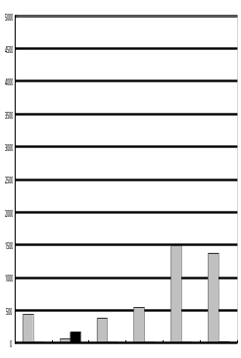
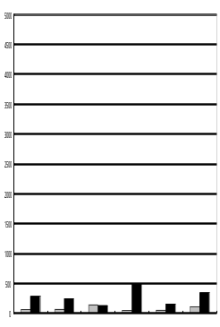
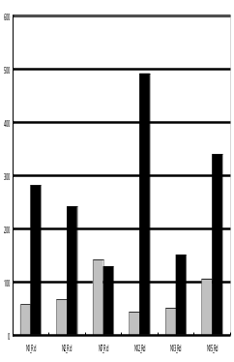
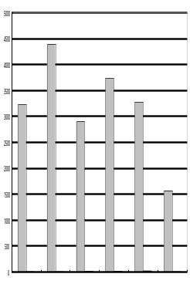
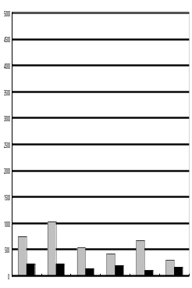
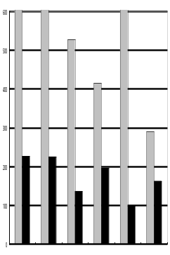
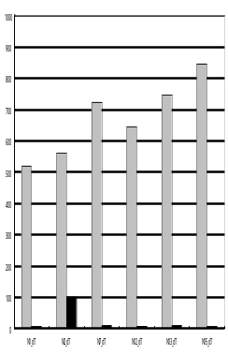
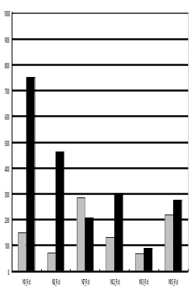
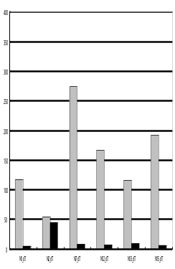
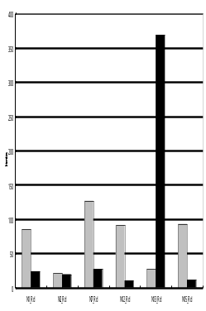
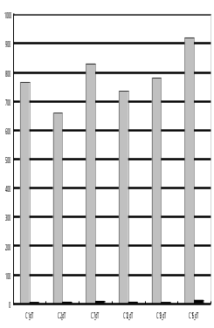
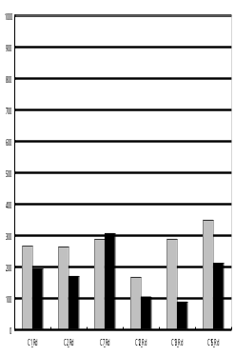
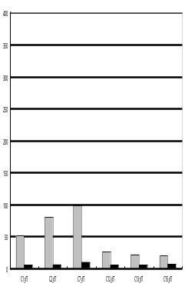
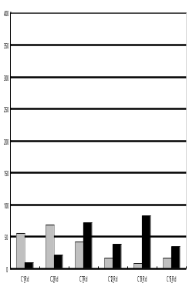
(Fig.5a cont.)
M25753-01: cyclin B1
Signal Intensities
Signal Intensities
Signal Intensities
5000
5000
600
500
Normal
400
2500
2500
300
200
100
0
0
0
N1
N7
N13
N1
N2
N7
N12
N13
0
N2
N12
N15
N15
N1
N2
N7
N12
N13
Oligo-dT
Random
N15
Signal Intensities
Signal Intensities
Signal Intensities
5000
5000
600
500
Cancer
400
2500
2500
300
200
100
0
0
0
C1
C2
C7
C12
C13
C15
C1
C2
C7
C12
C13
C15
C1
C2
C7
C12
C13
C15
Oligo-dT
Random
(Fig.5b)
U58334-02: tumor protein p53 binding protein, 2
U16752-04: stromal cell-derived factor 1
Signal Intensities
Signal Intensities
Signal Intensities
Signal Intensities
1000
1000
400
400
300
300
Normal
Normal
200
500
500
200
100
100
0
0
N1
N2
N12
N15
N1
N2
N12
N15
N7
N13
N2
N12
N1
N2
N12
N7
N13
N1
N7
N13
N15
N7
N13
N15
Signal Intensities
Signal Intensities
Signal Intensities
Signal Intensities
1000
1000
400
400
300
300
Cancer
Cancer
500
500
200
200
100
100
0
0
0
0
C1
C2
C7
C12
C13
C15
C1
C2
C7
C12
C13
C15
C1
C2
C7
C13
C15
C7
C13
C15
C12
C1
C2
C12
Oligo-dT
Random
Oligo-dT
Random

