Slide 1





(Supplemental figure 1)
dT
Random
Flag
A
A
C
D
E
B
F
(Protein-Coding / Non-Coding)
C
(Non-Coding / Non-Coding)
B
Normal
Cancer
Sense : Antisense = 3:1
Sense : Antisense = 1:1
D
E
Sense : Antisense = 1:3
F
(Protein-Coding / Protein-Coding)

Slide 2
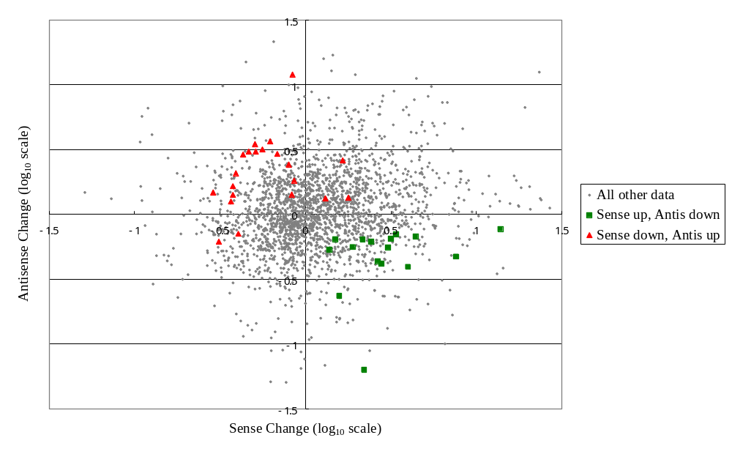
(Supplemental figure 2a)

Slide 3
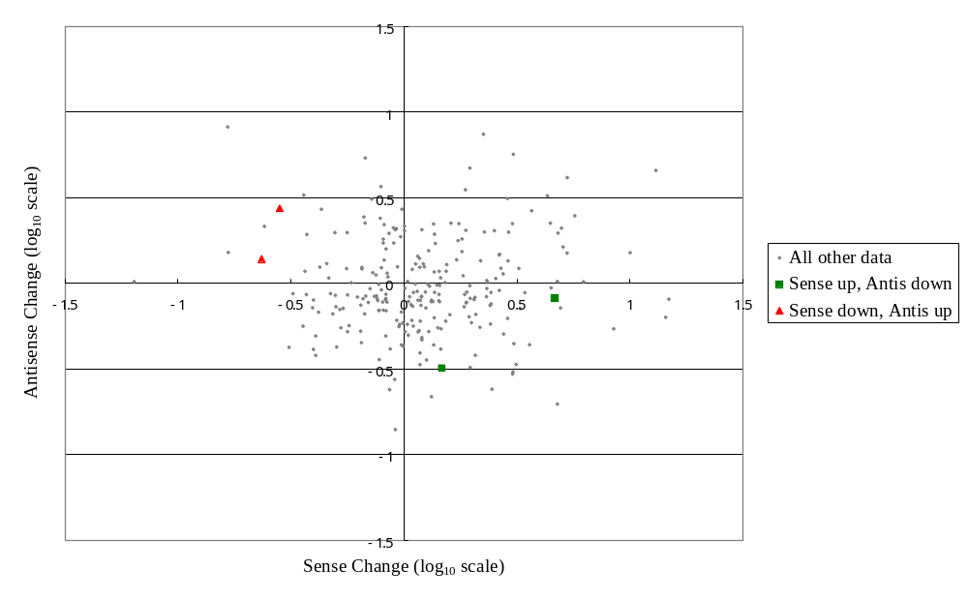
(Supplemental figure 2b)

Slide 4
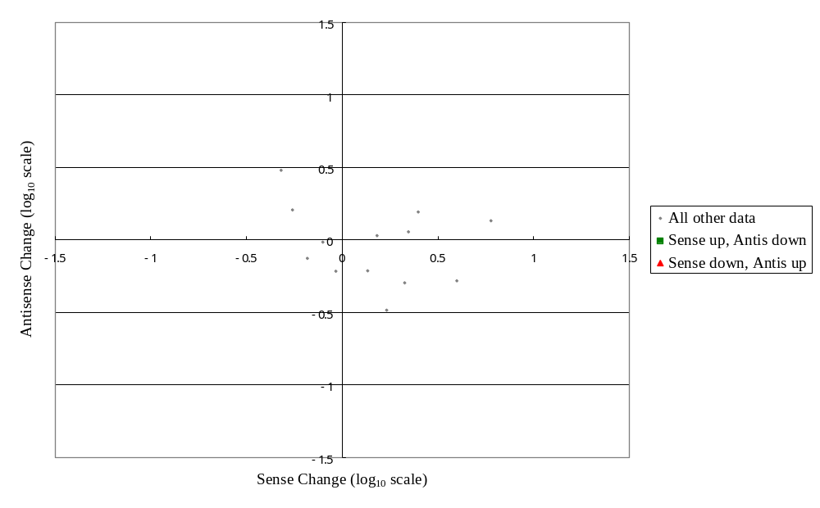
(Supplemental figure 2c)

Slide 5
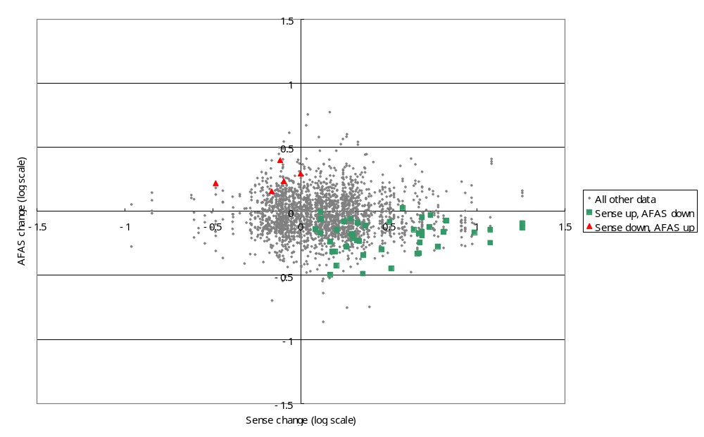
(Supplemental figure 3)

Slide 6





(Supplemental figure 4)
dT
Random
Flag
A
A
C
D
E
B
C
D
B
Sense : AFAS = 3:1
Sense : AFAS = 1:1
E
Normal
Cancer
Sense : AFAS = 1:3

Slide 7
(Supplemental figure 5)
Expressional intensity of sense gene
500
N
C
400
300
200
100
9613299
9547332
Truncated
Truncated
100
200
300
N
C
400
500
Expressional intensity of AFAS gene

Slide 8
(Supplemental figure 6)
4000
3500
Normal
Cancer
3000
2500
Average Intensity
2000
1500
1000
500
0
-1
-2
-3
-4
-5
5
4
3
2
1
Probe Position
500 bp
500 bp
500 bp
500 bp
Sense transcript
-1
-2
2
1

