Slide 1
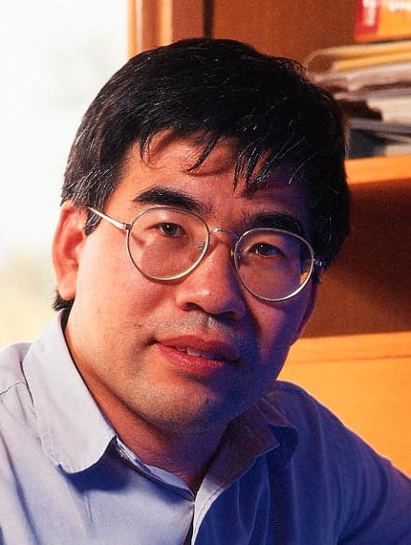
Louxin Zhang
Combination of TFs, neural cell development
http://www.math.nus.edu.sg/~matzlx/
  Phylogenetic
  Tree model

Slide 2
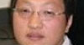
Peng-Liang Wang
Infrastructure management
Sitting at the corner

Slide 3
Alex Thomas
Rotating student.
Using Python, MatLab and R

Slide 4
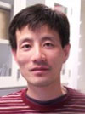
Fan Zhang
Doing ChIP-seq experiments for TFs
DNA damage
Cell cycle
Chin’s restaurant at Convoy St.

Slide 5
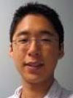
Dwight Kuo
Comparison of TF target genes for S. cerevisiae and S. pombe. Focused on cell cycle. Only slight amount of target genes are conserved between these two species. Doing both informatics and experiments including sequencing.
Collaborator: Jaehnig (ejaehnig@gmail.com), doing phosphorylations?
Lanosterol, ERG11

Slide 6
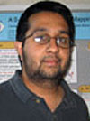
Rohith Srivas
~400 gene K.O.
150 tumor suppressors
(Yeast orthologs of human)
~400 gene K.O.
1536 druggable genes
(Yeast orthologs of human)
All kinases, phosphatases, TFs, DNA repair (Sourav et al.)
Rohith et al.
Genetic Interaction (wt = 1, K.O. mutant 0.9 x 0.7 = 0.63, expected colony size)
Using E-map, trying to draw genetic interactions
Oncogene (accelerator malfunction), Tumor Suppressors (brake malfunction)
Druggable gene … gene having known chemical which can inhibit the function of that gene
If genetic interaction counterpart for tumor suppressor exists, and is druggable, we can kill cell using corresponding chemical of that druggable gene.

Slide 7
Chia-Yu Ku
c2ku@ucsd.edu
PINK-I and NCSs (Neuron Stem Cells)
Supervisors are Trey and Louise
Neuron degenerative disease
PINK-1 (kinase) → neuron cell, mitochondrion disease → cell death → Parkinson disease
PINK-1 mutant → microarray

Slide 8
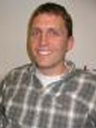
Mike Smoot
Cytoscape 2.8 → Cytoscape 3.0
Cleaup codes, easier to develop and maintain plugins, version control of plugins much easy
Uses SPRING and OSGI
Watch for SBGN
May 20th is retreat? (Watch announcements)
Recommendations for version control
  Git, github, redmine, google code, sourceforge, bitbucket

Slide 9
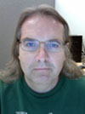
Johannes Rushcheinski
Otaku
System administrator, IP address assignments
Scala, functional programming

Slide 10
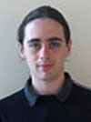
Gregory Hannum
Combination of Genotype → Phenotype associations
Mapping to pathways
Multi-test corrections necessary … Computational method to find biologically relevant associations
Have to consider Linkage disequilibrium (Close proximity on the genome)
Myers AJ et al. 2007
individuals
individuals
363 individuals
~300X markers
8560 expression data
Phenotype
(expression)
genotype
m₁
g₁

Slide 11
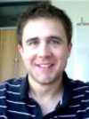
Janusz Dutkowski
PPI evolution → PPI prediction
  Protein evolution history
  Speciation history
Bayesian network, parameter estimation (loss of interaction, gain of interaction)
Cytoscape plugin (MODEVO)
Essential genes in local and global scale, neural networks to predict essentiality of genes based on gene-knockout inputs. Intermediate nodes are modules.

Slide 12
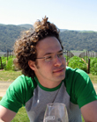
Matan Hofree

Slide 13
Rob
Uses Sweave (R, latex) to take a lab note. Labwiki (based on mediawiki) may be another choice.

Slide 14
Yu Zhon

Slide 15
Sanath
Rotating Student (Ms. Grade 1)
Computer Architecture

Slide 16
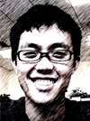

Menzies Chen
Epigenetics of single gene (KanMX) … How expression patterns of KanMX changes depending on genomic position where there is histone with specific modifications. Such strains (6,000 strains) are already available since there is yeast knockout collection; genes are knocked out by replacing the gene with KanMX. Right now, focusing on 91 KanMX positions and measuring their expression levels. The effect of each modification is different from what is known by literature, dealing thousands of genes by averaging them.
barcode
barcode
KanMX
Homologous recombination
Target gene
KanMX
Barcode identifies the knock-out strain. It can be used to hybridize with microarray probe.
→ Microarray which can analyze condition-specific lethality of genes.

Slide 17
One of the ultimate goal!?
Combinatorial TFs
Meso
Endo
Eeto
Adult tissues (Let’s try to predict which tissue computationally!)
Janusz is working on?

Slide 18
Meetings
Rob DeConde is lab meeting organizer (11:00 Wednesday, Ground S.E. Corner). Each presentation is 30 min.
Journal club. Monday 15:00 at the fourth floor, close to the office.

Slide 19
Members
Janusz (I)
Fan Zhang (E)
Mike (I)
Rohith (I+E)
Kate (Kathelicon)
Matan Hofree (I)
Menzies Chen (E)
Koyel Mitra(E)
Greg Hannun (I, GWAS + network)
Johannes

Slide 20
Infrastructure
X11
ssh –Y grenache.ucsd.edu
ssh –Y durif
rdesktop -a 24 -f sauterne
If you do not have network disk (Z:) yet, you can add one yourself. My computer-->tools--> map network driver --> click browser button and pick madeira, you could choose your loginID. Z disk will appear as network drive, not as a hard drive. Also you can go directly from the network.

Slide 21
Infrastructure (Ubuntu)
sudu apt-get < package-name >
Ctrl-Alt+F1, F7 command line

