Slide 1
Reconstruction of Functional Classifications according to Molecular Interactions
Rintaro Saito
UCSD

Slide 2
Functional Classifications
Functional Classification of Proteins in E. coli (Genobase)
Amino acid metabolism
Biosynthesis of cofacters …
Cell envelope
Celluler process
Central intermediary metabolism
Energy metabolism
Fatty acid/Phospholipid metabolism
Nucleotide metabolism
Other categories
Regulatory functions
Replication
Transcription
Translation
Transport/binding protein
Hypothetical

Slide 3
Can we define protein functions mathematically?
Current functional classification scheme (GO, GenoBase, etc) is not objective
・ No strict criteria
・ Proteins with multiple functions
・ Does the classification indeed reflects what is going on in the cell?
X
Cell division
(Function of X is signal transduction? Transcription? Cell division?)
Molecular interactions are more objective; Molecule A and B interact to share the same function.
Development of mathematical scheme which estimates the function of proteins according to molecular interaction network by also using current classification scheme

Slide 4
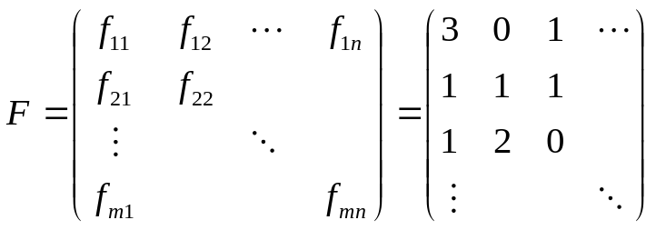
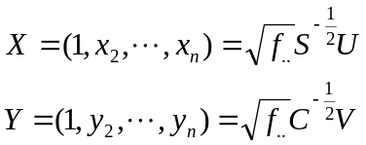

Mathematical Scheme
translation
Correspondence Analysis (CA)
translation
B
cell cycle
transcription
A
transcription
C
cell cycle
A
B
cell cycle
Reduction of Dimension
Both proteins and functions are mapped to the same field
Similar elements are mapped to similar positions
C
cell cycle
cell cycle
translation
transcription
Matrix
creation
Relationships between protein and function
Cell cycle
Transcription
Translation
A
Calculate
B
Plot (x₂, x₃) for each gene,
Plot (y₂,y₃) for each function
C
Where U,V are SVD of H

Slide 5
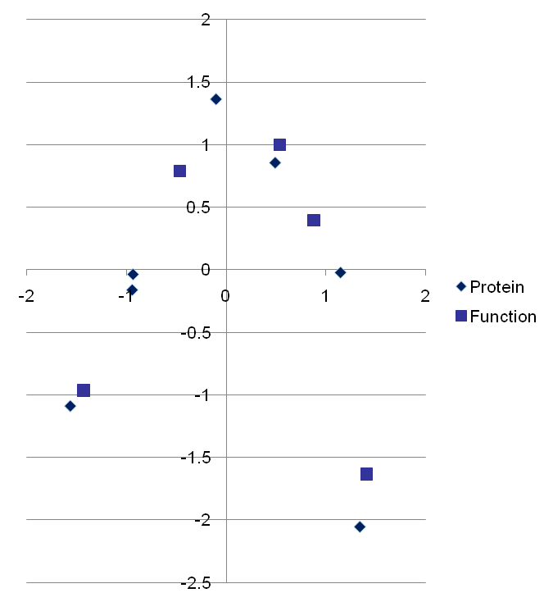
Idea of Correspondence Analysis
 | Function A | Function B | Function C | Function D | Function E
Protein 1 | 23 | 2 | 2 | 43 | 3
Protein 2 | 22 | 3 | 23 | 5 | 34
Protein 3 | 3 | 4 | 32 | 4 | 2
Protein 4 | 23 | 4 | 6 | 21 | 23
Protein 5 | 3 | 23 | 3 | 23 | 3
Protein 6 | 5 | 23 | 2 | 23 | 3
Protein 7 | 1 | 41 | 1 | 9 | 3
1
A
D
4
E
6
5
2
 | Function C | Function E | Function A | Function D | Function B
Protein 3 | 32 | 2 | 3 | 4 | 4
Protein 2 | 23 | 34 | 22 | 5 | 3
Protein 4 | 6 | 23 | 23 | 21 | 4
Protein 1 | 2 | 3 | 23 | 43 | 2
Protein 6 | 2 | 3 | 5 | 23 | 23
Protein 5 | 3 | 3 | 3 | 23 | 23
Protein 7 | 1 | 3 | 1 | 9 | 41
B
7
C
3

Slide 6
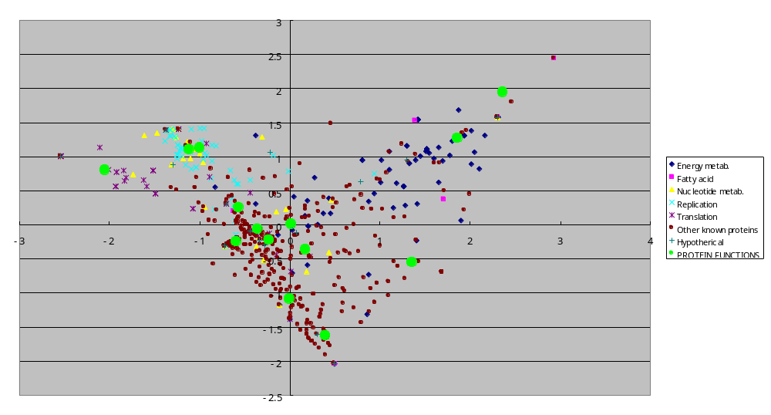
Yeast PPIs Reported in the Literature
Cell envelope
Nucleotide metabolism
Other categories
Fatty acid
Phospholipid metabolism
Replication
Energy metabolism
Translation
Regulatory
functions
Transcription
Biosynthesis
of cofactors
Cellular process
Amino acid
metabolism
Central intermediary
metabolism
Transport binding
protein

Slide 7
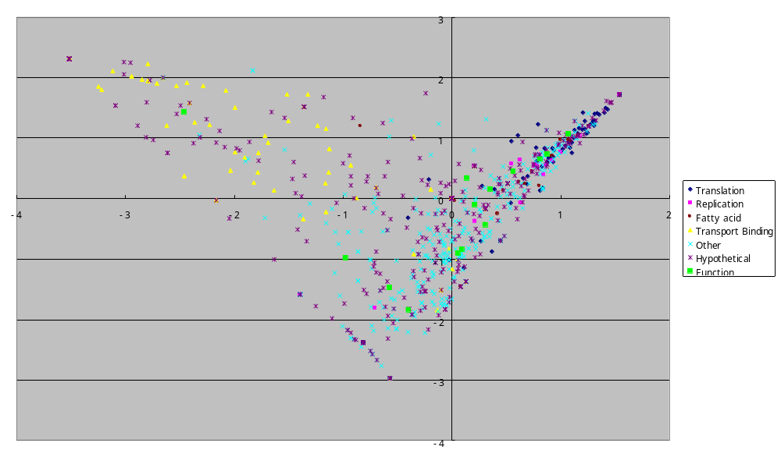
E. coli PPIs reported stored in public database
Transport Binding Protein
Translation
Replication
Fatty acid / Phospholipid metabolism

Slide 8
Interaction information can be shown easily in the plots
translation
A
B
transcription
cell cycle
C
PPIs
D
Genetic Interactions

Slide 9
Summary of CA
Reduction of dimensions like PCA
It maps both row elements and column elements to the same map (provided that coefficient of determination is sufficiently high).
We can visualize not only relationships between proteins but also relationships between proteins and functions, and between functions themselves.

Slide 10
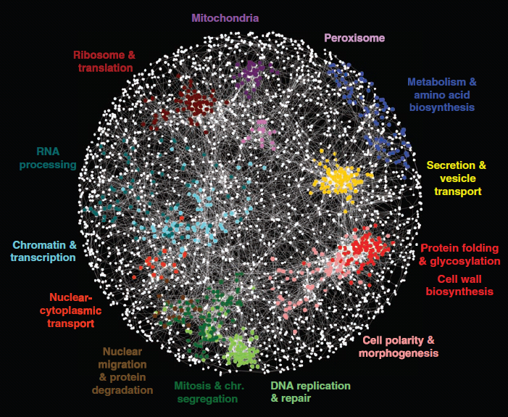
Application
Why ball shape?
What is the logical reason?
Costanzo M et al.(2010)
More objective ways to layout nodes in interaction network
Standard layout algorithm? Implement as Cytoscape Plug-in?

Slide 11
Possible analysis using this method
Characterization of functional organizations in the cell based on interaction type (PPI, PDI, Genetic int.)
Functional prediction of uncharacterized proteins
Discovery / creation of novel functional category
Analyses of dynamic changes of the organizations among multiple conditions (i.e. with / without DNA damages, some group of functions work tightly in specific condition)
Additional ideas to demonstrate that it is not just a toy!

Slide 12
Previous bioinformatics works using CA
Fellenberg K, Hauser NC, Brors B, Neutzner A, Hoheisel JD, Vingron M (2001) Correspondence analysis applied to microarray data. Proc Natl Acad Sci U S A. 2001 Sep 11;98(19):10781-6.
Busold CH, Winter S, Hauser N, Bauer A, Dippon J, Hoheisel JD, Fellenberg K (2005) Integration of GO annotations in Correspondence Analysis: facilitating the interpretation of microarray data. Bioinformatics. 2005 May 15;21(10):2424-9
Rausell A, Juan D, Pazos F, Valencia A.(2010) Protein interactions and ligand binding: from protein subfamilies to functional specificity. Proc Natl Acad Sci U S A. 107(5):1995-2000

Slide 13
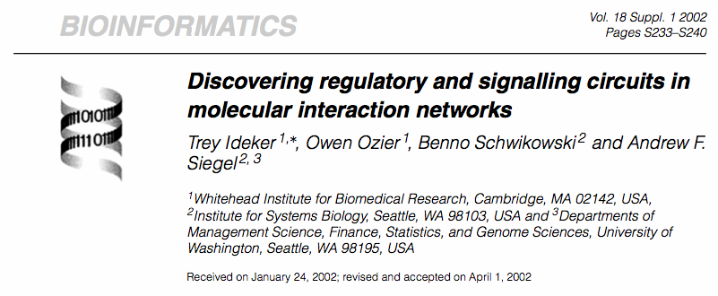
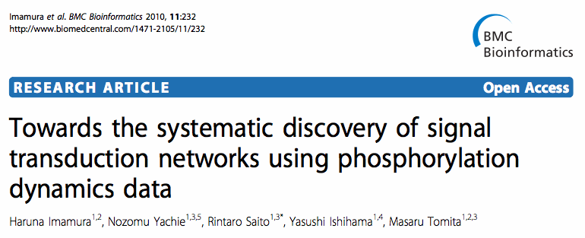
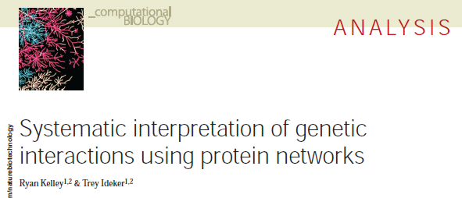
Brainstorming (1)
Integration of these data may be efficient to detect novel signal transduction pathways
Genetic Interactions
Phosphorylation networks
Phylogenetic profiling

Slide 14
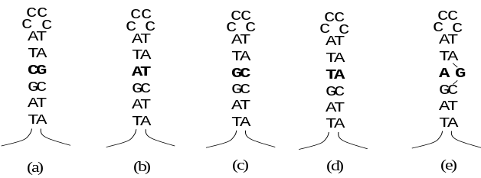
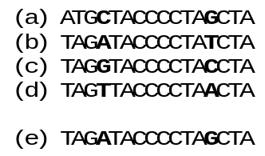
Brainstorming (2)
Which are the important functions or pathways?
Previous researches focused on mutual information between nodes
Mutual information of edges among multiple cellular conditions or multiple species
Species A
Species B
Species C
Species D

Slide 15
Additional issues to discuss
National Resource for Network Biology (P41)
Collaboration with other groups
  Chance to learning a lot of biology and getting idea

