Slide 1
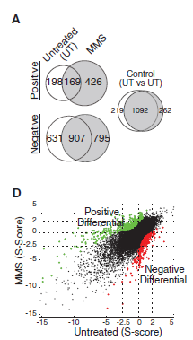
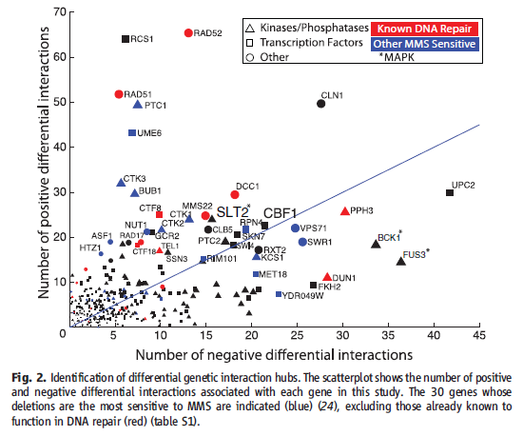
General genetic interactions vs condition specific interactions
What is the difference between general genetic interactions and condition specific interactions?
Can we discriminate general and condition-specific using the following data?
  Gene expression data (Roguev, A et al. 2008)
  Phylogenetic data
  Length of proteins, types of protein motifs
  Overlap with PPI, PDI or phosphorylation data
Bandyopadhyay S et al. 2010
Notes:
As more basic analysis, differences between essential proteins, non-essential proteins, synthetic lethal proteins

Slide 2
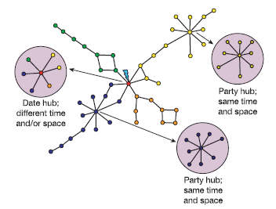
Characterization of hubs
Work by Han … No guarantee that they really interact even when the expression patterns are correlated
Genetic interactions … guaranteed to interact at specific condition (advantage of using data of Bandyopadhyay S et al. 2010).
Overlap between PPI hub and genetic interaction hub
Do genetic interaction hubs show similar tendencies to those of PPI hubs?
Han JD et al. Nature 2004

Slide 3
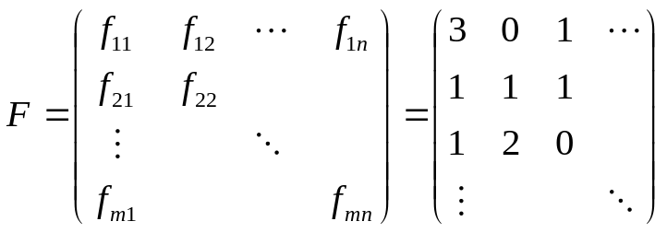
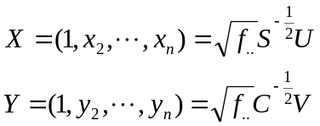

Mathematical Scheme
translation
Correspondence Analysis (CA)
translation
B
cell cycle
transcription
A
transcription
C
cell cycle
A
B
cell cycle
Reduction of Dimension
Both proteins and functions are mapped to the same field
Similar elements are mapped to similar positions
C
cell cycle
cell cycle
translation
transcription
Matrix
creation
Relationships between protein and function
Cell cycle
Transcription
Translation
A
Calculate
B
Plot (x₂, x₃) for each gene,
Plot (y₂,y₃) for each function
C
Where U,V are SVD of H

Slide 4
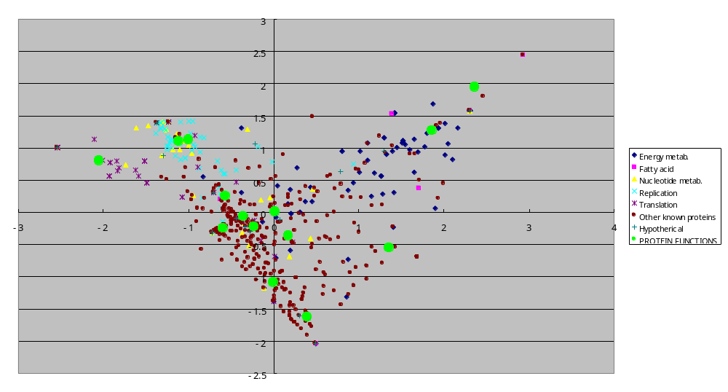
Yeast PPIs Reported in the Literature
Cell envelope
Nucleotide metabolism
Other categories
Fatty acid
Phospholipid metabolism
Replication
Energy metabolism
Translation
Regulatory
functions
Transcription
Biosynthesis
of cofactors
Cellular process
Amino acid
metabolism
Central intermediary
metabolism
Transport binding
protein

Slide 5
Interaction information can be shown easily in the plots
translation
A
B
transcription
cell cycle
C
PPIs
D
Genetic Interactions

Slide 6
Summary of CA
Reduction of dimensions like PCA
It maps both row elements and column elements to the same map (provided that coefficient of determination is sufficiently high).
We can visualize not only relationships between proteins but also relationships between proteins and functions, and between functions themselves.

Slide 7
Possible analysis using this method
Characterization of functional organizations in the cell based on interaction type (PPI, PDI, Genetic int.)
Functional prediction of uncharacterized proteins
Discovery / creation of novel functional category
Analyses of dynamic changes of the organizations among multiple conditions (i.e. with / without DNA damages, some group of functions work tightly in specific condition)
Additional ideas to demonstrate that it is not just a toy!

Slide 8
Previous bioinformatics works using CA
Fellenberg K, Hauser NC, Brors B, Neutzner A, Hoheisel JD, Vingron M (2001) Correspondence analysis applied to microarray data. Proc Natl Acad Sci U S A. 2001 Sep 11;98(19):10781-6.
Busold CH, Winter S, Hauser N, Bauer A, Dippon J, Hoheisel JD, Fellenberg K (2005) Integration of GO annotations in Correspondence Analysis: facilitating the interpretation of microarray data. Bioinformatics. 2005 May 15;21(10):2424-9
Rausell A, Juan D, Pazos F, Valencia A.(2010) Protein interactions and ligand binding: from protein subfamilies to functional specificity. Proc Natl Acad Sci U S A. 107(5):1995-2000

Slide 9
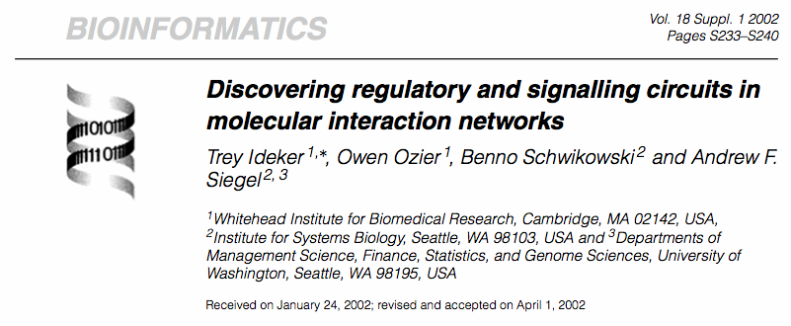
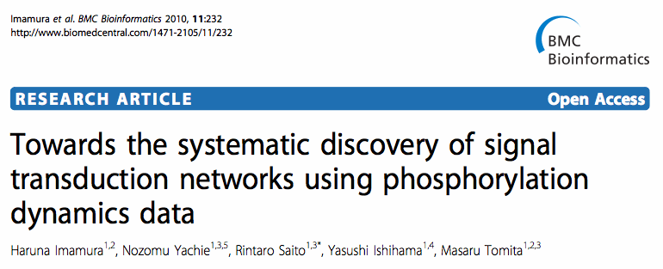
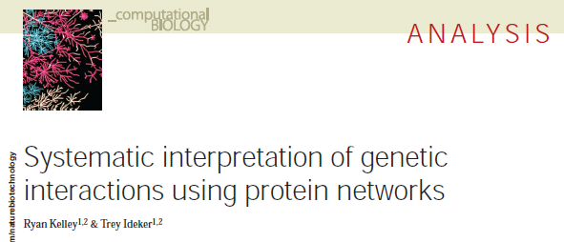
Brainstorming (1)
Integration of these data may be efficient to detect novel signal transduction pathways
Genetic Interactions
Phosphorylation networks
Phylogenetic profiling

Slide 10
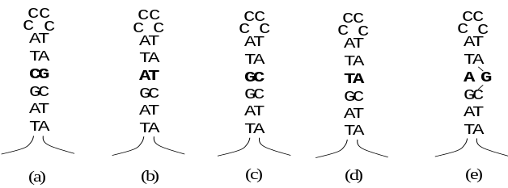
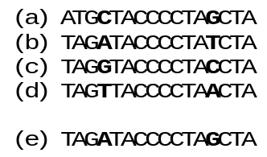
Brainstorming (2)
Which are the important functions or pathways?
Previous researches focused on mutual information between nodes
Mutual information of edges among multiple cellular conditions or multiple species
Species A
Species B
Species C
Species D

Slide 11
Additional issues to discuss
National Resource for Network Biology (P41)
Collaboration with other groups
  Chance to learning a lot of biology and getting idea

