Slide 1
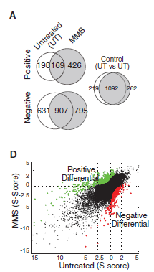
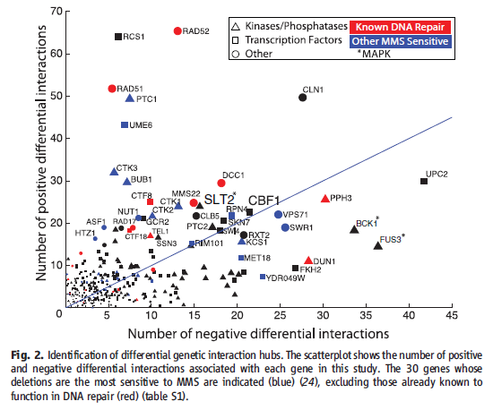
General genetic interactions vs condition specific interactions
What is the difference between general genetic interactions and condition specific interactions?
Can we discriminate general and condition-specific using the following data?
  Gene expression data (Roguev, A et al. 2008)
  Phylogenetic data
  Length of proteins, types of protein motifs
  Overlap with PPI, PDI or phosphorylation data
Bandyopadhyay S et al. 2010
Notes:
As more basic analysis, differences between essential proteins, non-essential proteins, synthetic lethal proteins

Slide 2
Specificity of edges
Functional assignments to the edges (1)
Make edge the key player instead of node.
Functional assignment to edge may be more appropriate especially for the cases where there are many interacting partners
A lot of methods have been developed to predict protein functions based on biological network, few method has been developed to predict function of interaction, probably because validation is difficult.
A
B?
A,B,C,D
B
C?
C
C,D

Slide 3
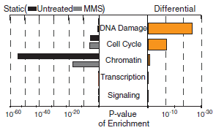
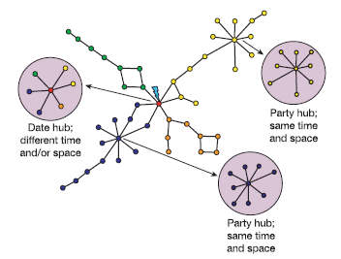
Specificity of edges
Functional assignments to the edges (2)
Predict functions of the interactions using annotation of the proteins.
Use genome-wide genetic interaction data (Costanzo et al. 2010)
Test prediction of DNA-damage using Bandyopadhyay S et al. 2010. Test enrichment.
Both ambiguity and accuracy must be tested.
Genome-wide prediction will be conducted.
May be efficient for date hubs?
A
B?
A,B,C,D
B
C?
C
C,D
Han JD et al. Nature 2004

Slide 4
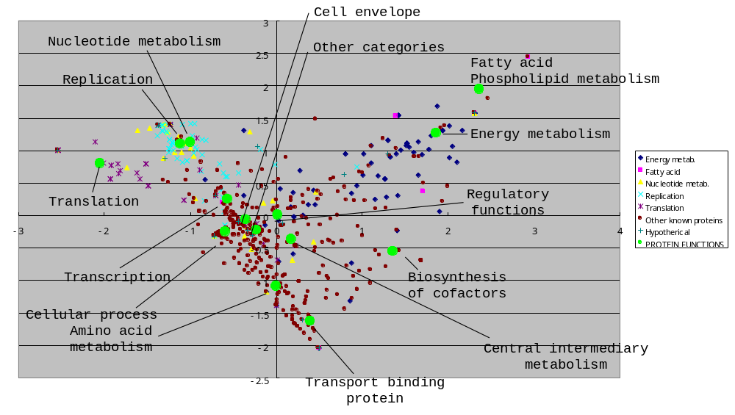
Protein functional analysis using correspondence analysis
Complementary with GO … Protein annotations shown in the plot can be GO
Main point?
  Functional prediction (A lot starting from Schwikowski B et al. 2000)
  Interaction layout (Some regions will be messed)
Good story for this work may be necessary

Slide 5

Integration of genetic interaction data with phosphorylation data
Available phosphoproteome data
  Breitkreutz et al. 2010
  Fiedler et al. 2009 (Genetic interactions)
  Ptacek et al. 2005
We must think network topology which are likely to occur and biologically justified.

Slide 6
Correlation of edges among multiple cellular conditions or multiple species
Species A
Species B
Species C
Species D
BioGrid and InParanoid will be used.
Problems
  Non-interactions (Not tested or no interaction?)

Slide 7
Collaboration with Kumar
(NIH DP3)
Type 1 diabetes + Chronic Kidney Disease → Mortal
Brownlee’s hypothesis
Caloric excess → excess superoxide → cell dysfunction
Kumar’s hypothesis
Caloric excess → decrease in mitochondria DNA (also superoxide will be decreased) → cell danger → immune response → effect on metabolism → diabetes
Metabolomics … urine metabolomes
Epigenetics … genome-wide methylation patterns
Systems Biology … network analyses and genomic analyses of methylated regions

