Slide 1
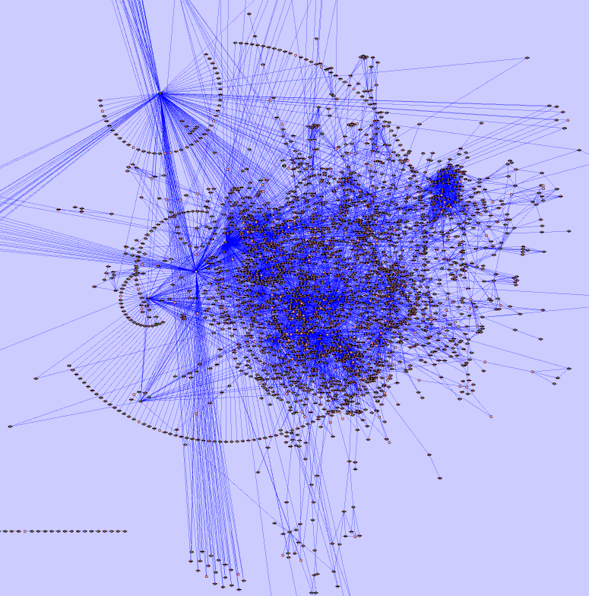
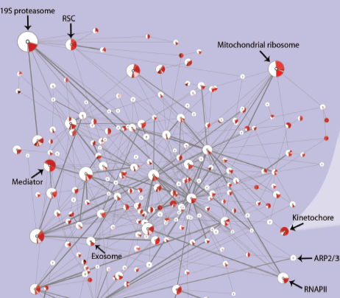
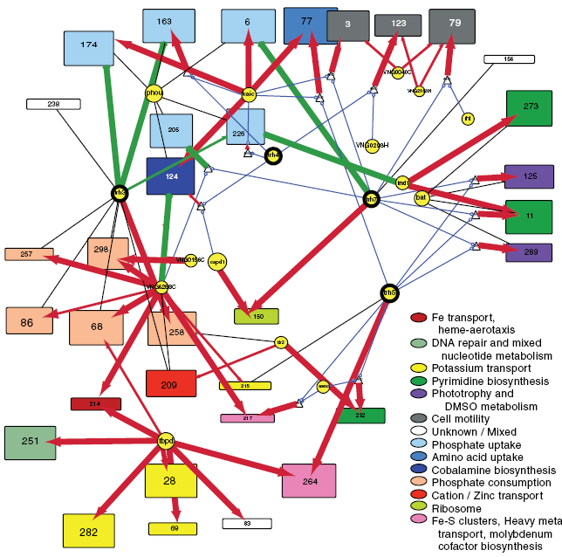
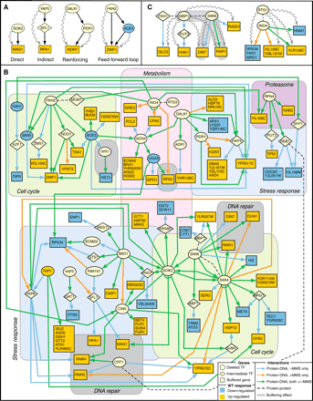
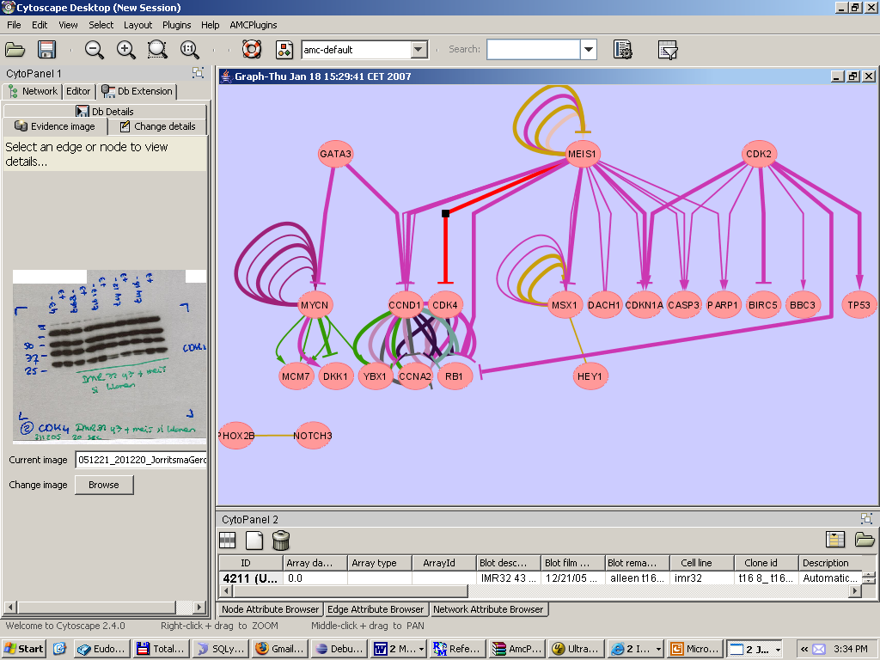
6-9 November 2007
AMC, Amsterdam
8 November: Public Symposium
Network-Based Approaches to Biological Data Integration and Analysis
Confirmed speakers
Leroy Hood; ISB
Ewan Birney; EBI
Chris Sander; MSKCC
Further details follow
www.cytoscape.org
Email: p.molenaar@amc.uva.nl
Department of Human Genetics, AMC

