Slide 1
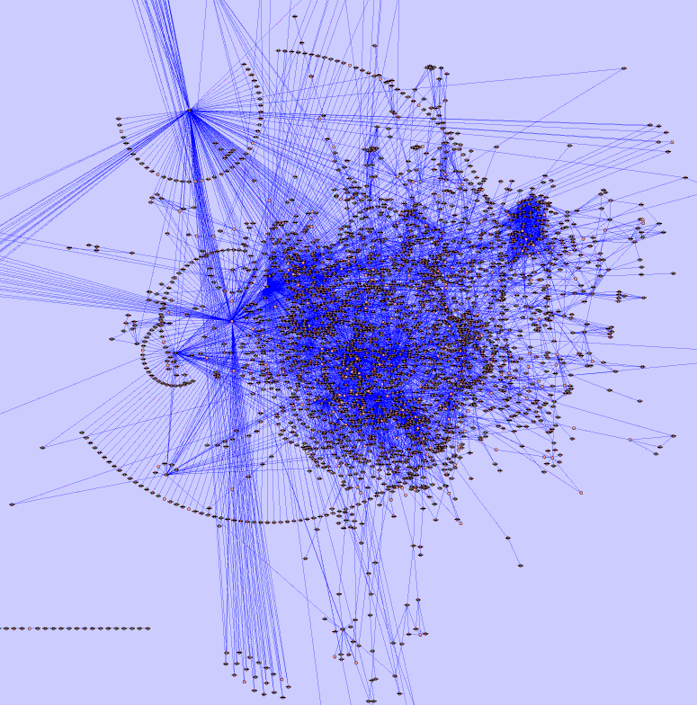
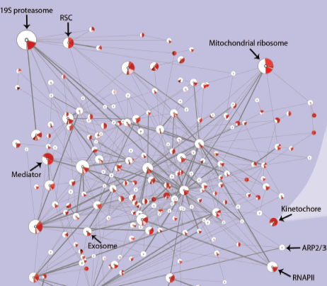
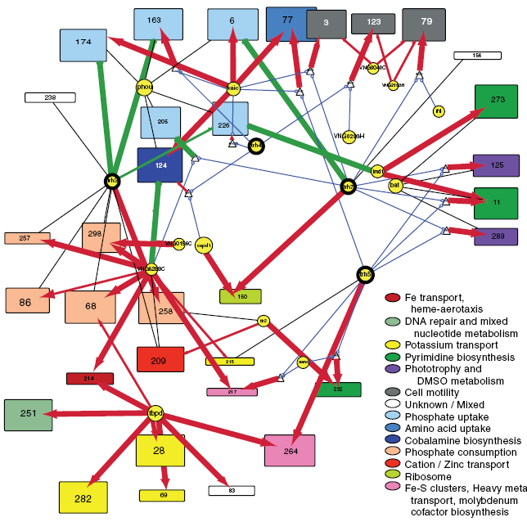
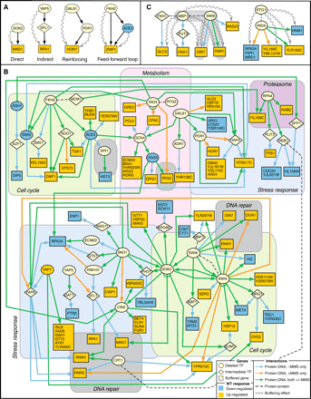
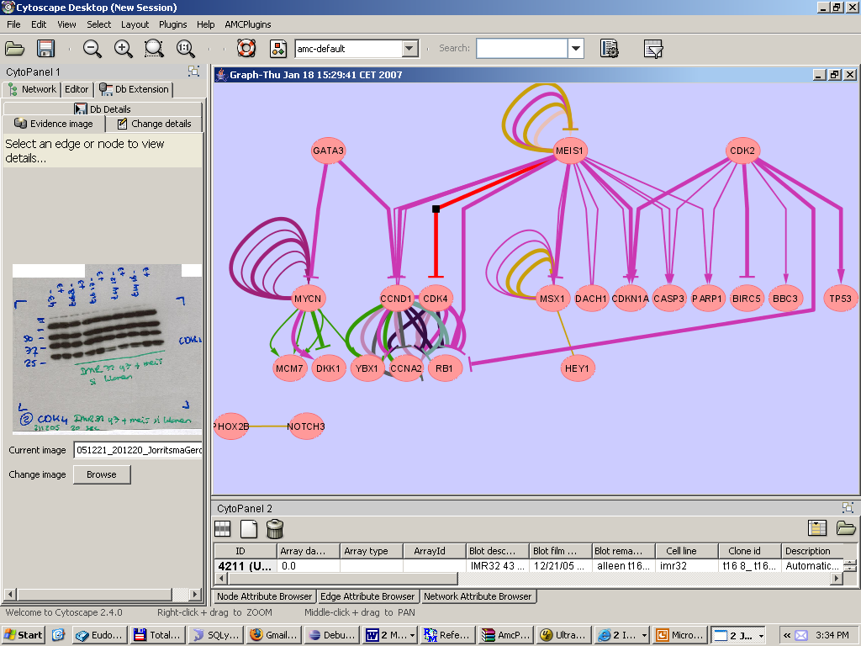
6-9 November 2007
AMC, Amsterdam
8 November: Public Symposium
Integrative Bioinformatics:
At the cutting edge of network analysis and biological data integration
Leroy Hood; ISB
Ewan Birney; EBI
Chris Sander; MSKCC
Rogier Versteeg; AMC
Peter Sorger; Harvard
Trey Ideker; UCSD
Benno Schwikowski; Inst.Louis Pasteur
Andrew Hopkins; Pfizer R&D
www.cytoscape.org/retreat2007
Email: cytoretreat@cytoscape.org
Department of Human Genetics, AMC

