Slide 1
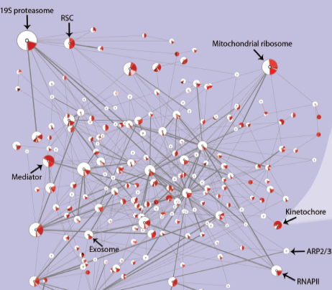
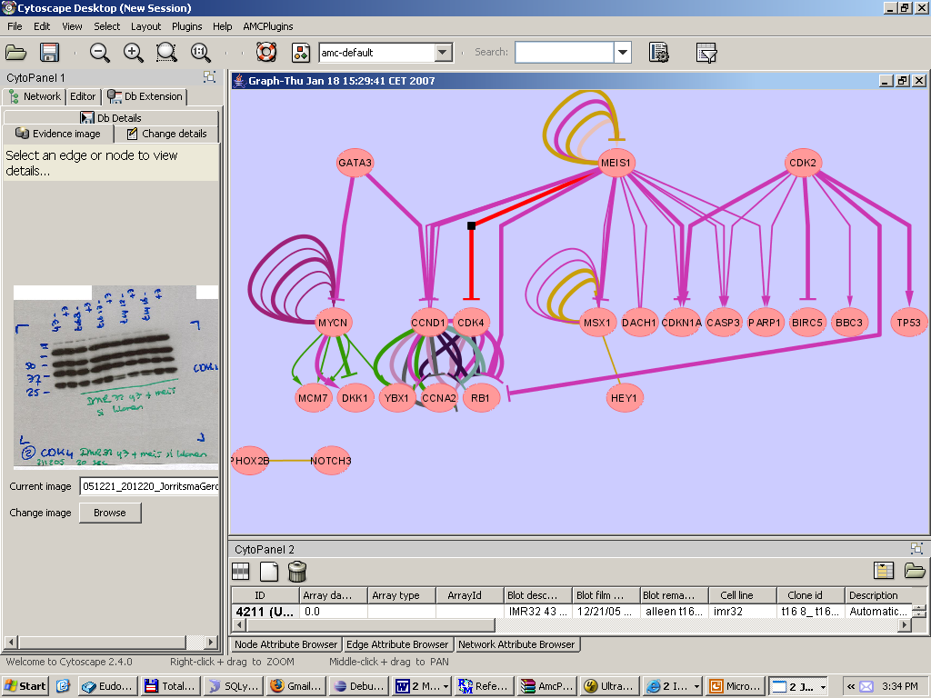
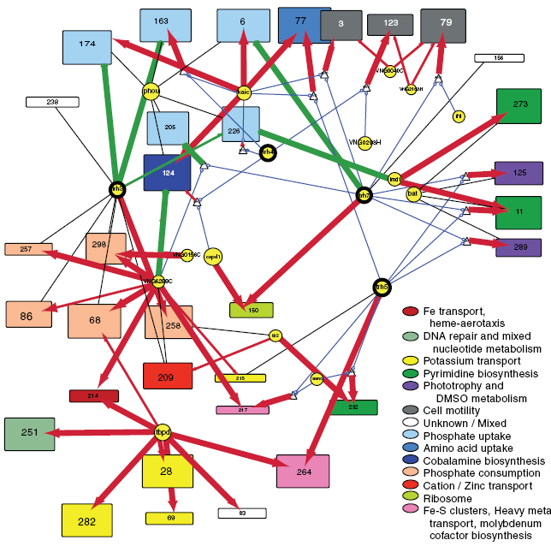
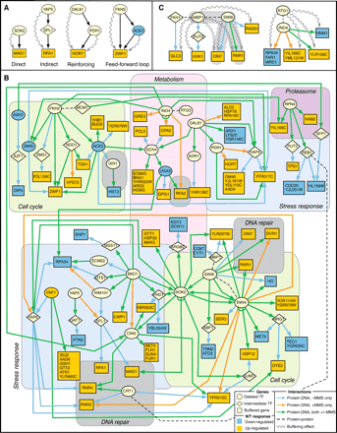
8 November: Symposium
Integrative Bioinformatics:
At the cutting edge of network analysis and biological data integration
www.cytoscape.org/retreat2007
Email: cytoretreat@cytoscape.org
Department of Human Genetics, AMC

