Slide 1

Overview
Introduction
Biological network data
Text mining
Gene Ontology
Expression data basics
Expression, text mining, and GO
Modules and complexes
Domains and conclusion

Slide 2
Domain Interaction networks
Protein domain basics
Applications of domain interaction networks
Inferring domain interaction networks
Domain interaction networks in Cytoscape.

Slide 3
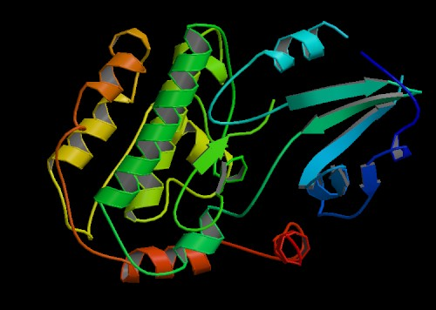
Facts about protein structure
Protein structures are built from domains.
Domain composition implies protein function.

Slide 4
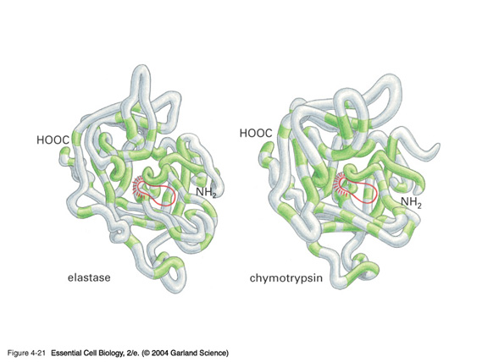
Protein domains come in families

Slide 5
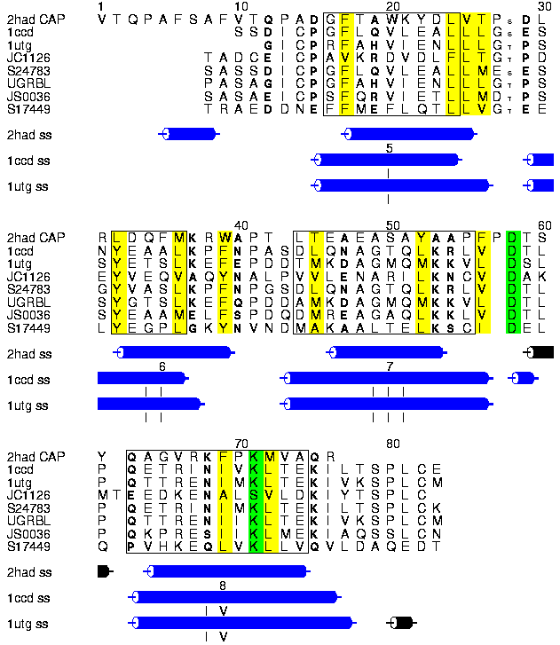
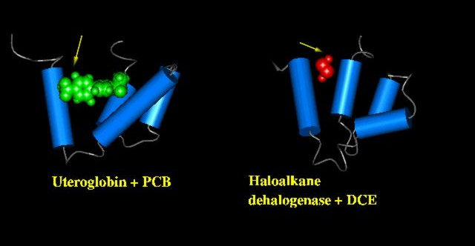
Domains can be recognized through sequence similarity
Source: http://www.sbg.bio.ic.ac.uk/ people/rob/sf/sf.html

Slide 6
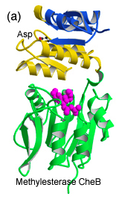
Interactions are often domain-specific
Source: http://faculty.umdnj.edu/ cabm/faculty_stock.asp

Slide 7
Why study protein domain interactions?
A putative protein-protein interaction is more reliable if the proteins have domains that might interact.
If something disrupts the protein sequence, it might disrupt the domain, and thus the network
  Genetic or somatic mutations
  Splice variation

Slide 8
Exon
Intron
Exon
Intron
Exon
Intron
Exon
DNA
Transcription
Pre-mRNA
Splicing
mRNA
Translation
Protein

Slide 9
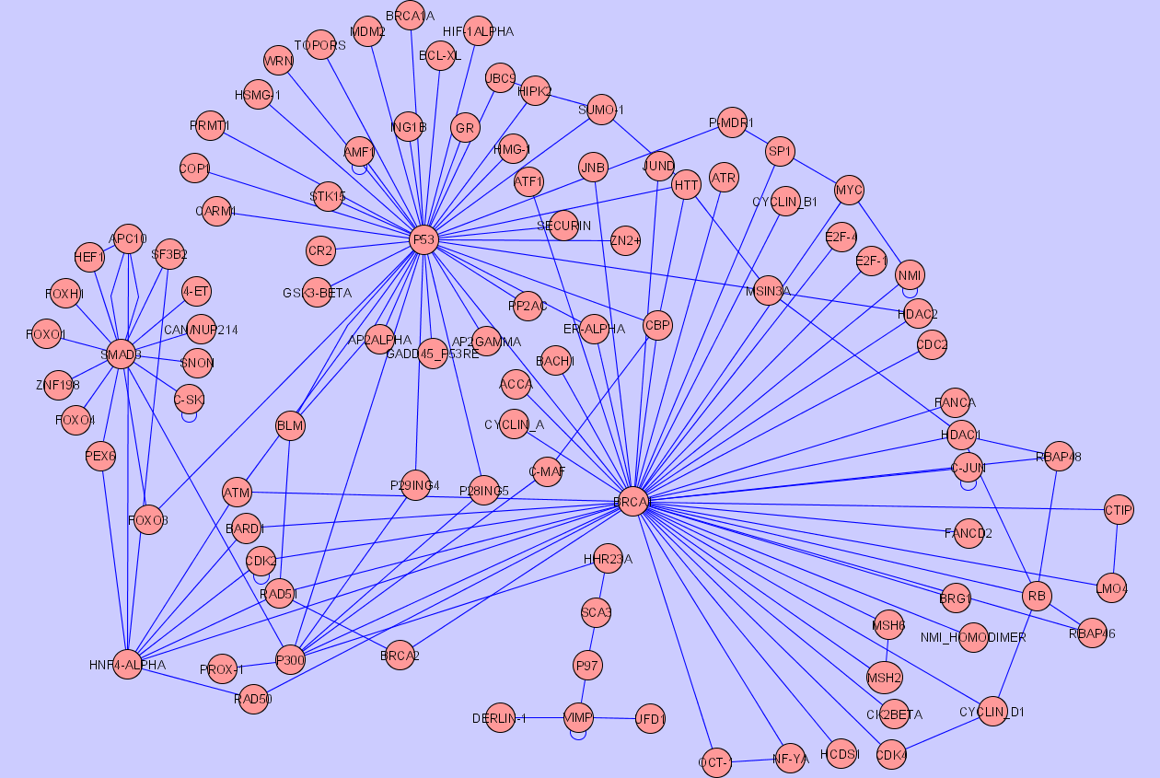
Single Protein-Protein Interaction

Slide 10
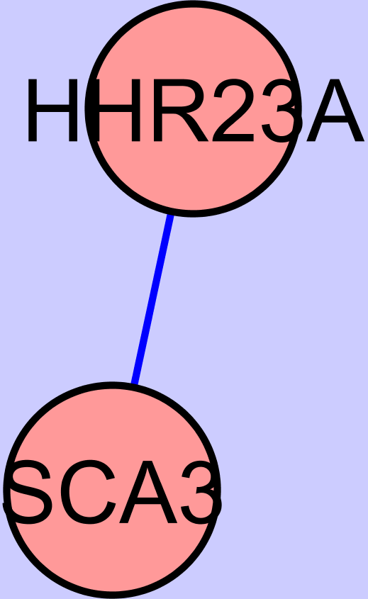
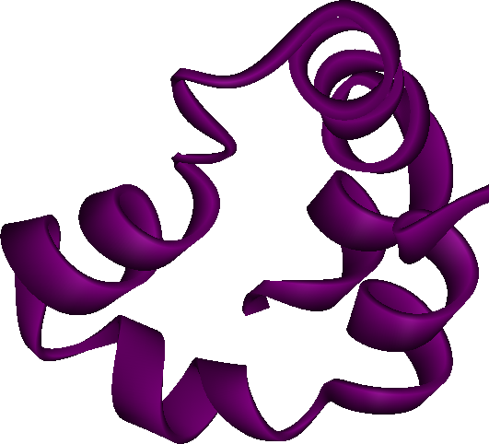
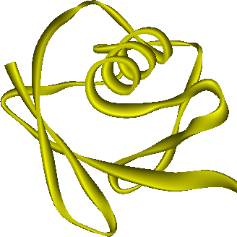
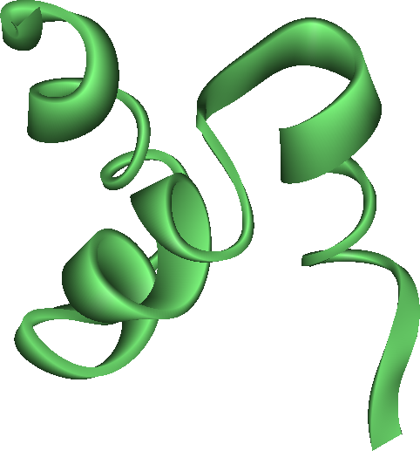
Structural Protein Domain Architecture
UBL
UBA
XPC
UBA

Slide 11
Which part of the proteins interact?
Protein structure: which domain structures are complementary?
Domain co-occurrence: which domains tend to appear in the same proteins?
Rosetta stone: are any domains fused in other proteins?
Yeast two-hybrid domain interactions: coming soon.

Slide 12
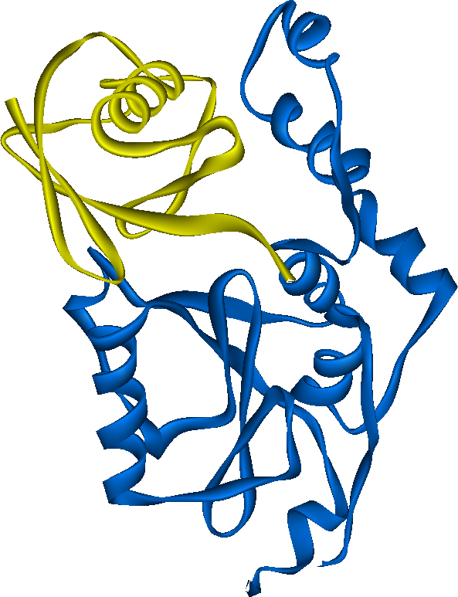


Which part of these proteins interact?
UBL
UBA
XPC
UBA
!
Josephin
UIM
UIM
Databases such as InterDom provide putative interactions of Pfam domains

Slide 13
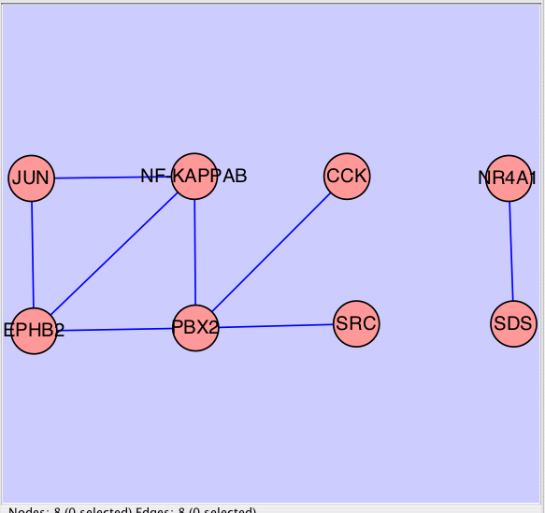
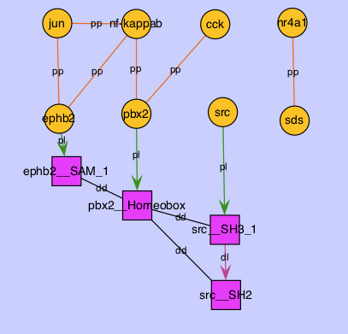
Domain interaction networks

Slide 14
For this hands-on session
Explore usage of the Cytoscape Domain Network builder plugin
Fill out your evaluation sheets.

