Slide 1
CyGroups and CyGroupViewers
John "Scooter" Morris, Ph.D.
UCSF

Slide 2
Outline
CyGroups
CyGroupViewers
CyGroupManager

Slide 3
Description
A CyGroup is a collection of CyNodes
  A CyGroup is represented by a CyNode
  CyGroups include a list of internal CyEdges
  CyGroups include a list of external CyEdges
CyNodes include the list of CyGroups they are a member of
CyNodes have a method to see if they represent a CyGroup
CyGroups are part of the core
CyGroups have no visual representation

Slide 4
CyGroupViewer
CyGroupViewer Interface
  Classes implementing CyGroupViewer provide the visual representation
  Generally implemented as part of a plugin

Slide 5
CyGroupManager
The CyGroupManager is a static class that provides an interface to the CyGroups mechanism
  CyGroup creation
  CyGroupViewer registration
  Notification of group creation, changes, and removal
  Ability to set or change the CyGroupViewer for a CyGroup

Slide 6
Overview
Cytoscape Core
CyGroupManager
groupList
Is a group
Plugins
CyNode
Is represented by
CyGroup
Viewer
CyGroupViewer
Is in
Group List
CyNode
CyEdge
Contains
CyEdge
CyEdge
Nodes
CyEdge
CyEdge
CyEdge
Contains
CyEdge
Inner Edges
CyEdge
CyEdge
CyEdge
Contains
CyEdge
Outer Edges

Slide 7
Using CyGroupManager

Slide 8
Implementing a CyGroupViewer

Slide 9
Tools & Samples
groupToolPlugin
  Interface to group mechanism
  Can list groups, create groups, change group viewers, etc.
  Source: /csplugins/ucsf/scooter/groupTool
namedSelectionPlugin
  JTree interface to groups
  Source: /csplugins/ucsf/scooter/namedSelection
metaNodePlugin2
  Expand/contract interface to group
  Source: /csplugins/ucsf/scooter/metaNodePlugin2
sampleGroupViewer

Slide 10
Demo
groupTool
sampleGroupViewer
namedSelection
metaNodes

Slide 11
SampleGroupViewer
Simple example plugin
Displays list of groups in CytoPanel 1
Click on group to select all nodes part of that group

Slide 12
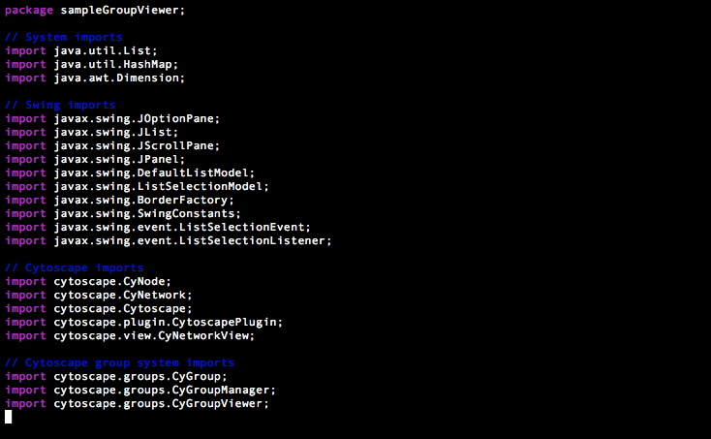
sampleGroupViewer
Preamble

Slide 13
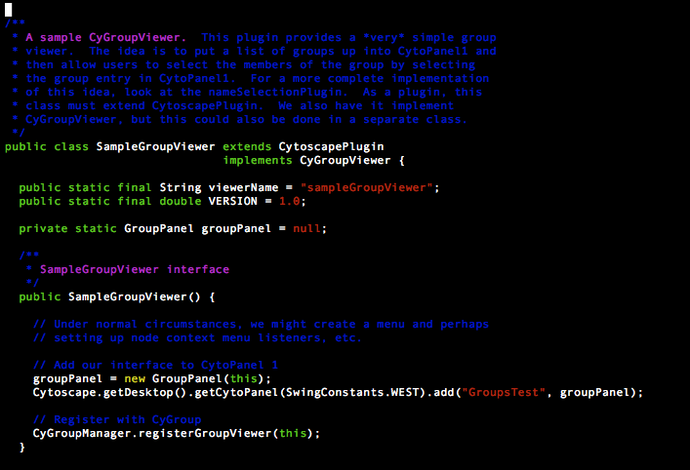
sampleGroupViewer
Plugin interface

Slide 14
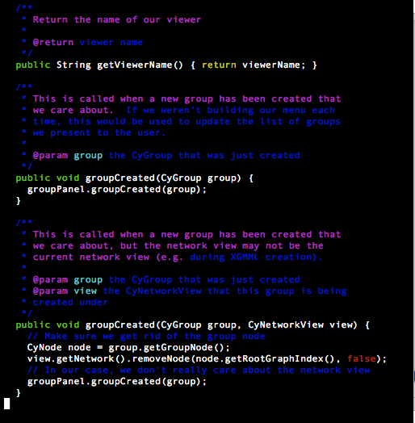
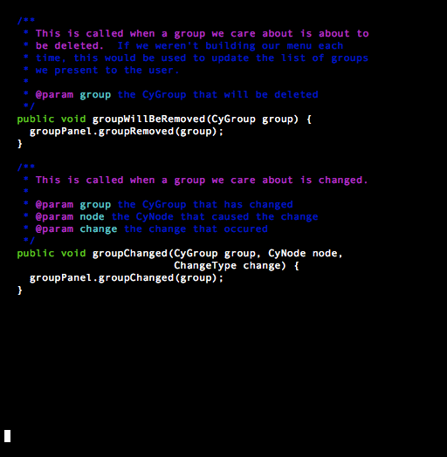
sampleGroupViewer
CyGroupViewer interface

Slide 15
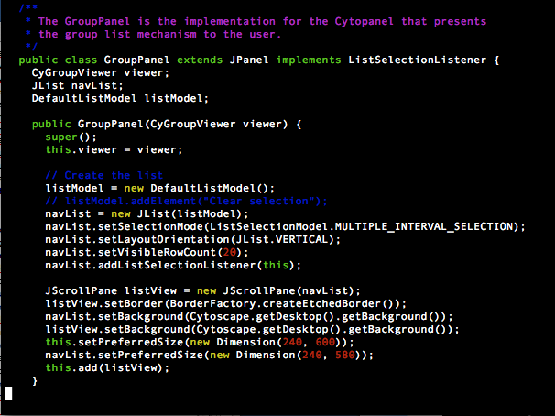
sampleGroupViewer
UI creation

Slide 16
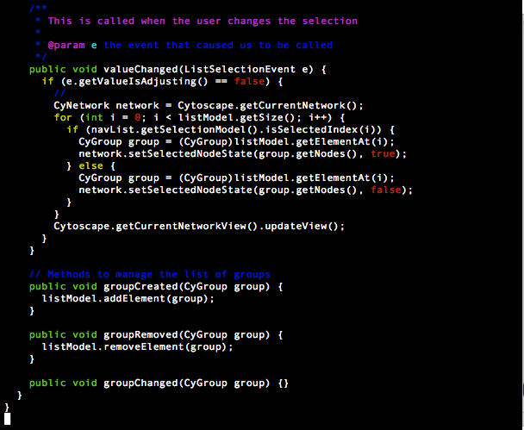
sampleGroupViewer
UI interaction

Slide 17
Questions
Thanks!

