Slide 1
Second Meeting on
P41 Collaboration
Rintaro Saito
University of California, San Diego
School of Medicine
Departments of Medicine and Bioengineering
Feb. 21, 2011

Slide 2
We are good at…
Network visualization
Network analysis
  Integration of various network data (PPI, PDI, genetic interactions, etc.)
  Integration of other types of data (expression data, etc.) onto the network
  Finding enriched functions (GO) in specific region of the network
  (Diagnosis of phenotype according to the expression data integrated with network; Chuang HY et al. 2007

Slide 3
What types of collaboration do we accept?
Which one belongs to P41 collaboration?
General Bioinformatic Request / Simple data processing
  Ex.1 How to analyze expression data
  Ex.2 Please compare my expression data with other expression data
  Ex.3 Please collect publicly available PPIs
Cytoscape training → Introduce tutorials, etc.
  How to do specific procedure in Cytoscape
  One wants to learn how to use Cytoscape
Development of tools (ex. Plug-ins) → Basically we should help them to develop plug-ins, instead of developing by us.
Scientific research collaboration
Data provider → Integration of data into cytoscape
For collaboration, we should focus on network analyses.

Slide 4





Collaboration Starting Workflow
Rintaro will check information and process appropriately
Discard if low quality
If unrelated to network biology
Collaboration request
General bioinfo / data processing
Web form input
Request type
  General bioinfo / data processing
  Cytoscape training
  Development of tools (ex. Plug-ins)
  Scientific research collaboration
  Data provider
Contact info
Research proposal
Publications
Development of tools
Scientific research collaboration
Data provider
Simple consultation by E-Mail, giving some options of what they can do (Rintaro & some graduate students?)
Cytoscape training
Discussion in regular meeting
Recommendation of using Web tutorial, Quick start guide.
Providing Cytoscape retreat information
Discard if proposal is not appropriate for collaboration or no available human resource.
Work member assignment
Researchers, Cytoscape team, Post-docs, graduate students

Slide 5
Can we define our task according to collaborator’s proposal?
Well-defined by the proposal per se.
We can define easily according to the proposal
Difficult to define
  Reject the collaboration
  Give them some possible options of what kind of bioinformatic analysis they should do so that they can further make appropriate proposal
  Try to figure out what we can do

Slide 6
Is our task well-defined?
Simple data processing → Well defined
Cytoscape training → Defined
Development of tools (ex. Plug-ins) → Defined
Scientific research collaboration → Case by case
Data provider → ?

Slide 7
Web Page Preparation
Institute
Department
Family Name
Given Name
Phone / FAX
E-Mail
Position
Research field
Applicant’s Web page
Pubmed IDs of Applicant’s publications
Collaboration Type
One page proposal
Etc.
Thank you for your application. We will consider your application for collaboration and respond to you within few weeks.
risaito@ucsd.edu
(Ask Alex at Gladstone Institute for making Web page)

Slide 8

Actual Request #1 (1) Yates lab, The Scripps Research Institute
MS protein expression screen in Alzheimer‘s Disease mouse models
Alzheimer's disease
Wild type
For protein measurement, N¹⁴ is used for subject mouse and N¹⁵ is used for reference mouse. Log N¹⁴ / log N¹⁵ denotes relative abundance of corresponding protein.
Final value is AD/WT
Uses PDAPP as mouse model, N5 as second mouse
Dealing with ~18,000 proteins per data set
ANOVA P-values and log2 fold changes are major values used for the analyses (more than two-fold changes and p-value 0.05 or less)
Pre 3 month
Pre 3 month
Hippocampus
Cortex
Cerebellum (Ctrl)
Hippocampus
Cortex
Cerebellum (Ctrl)
Post 12 month
Post 12 month
Hippocampus
Cortex
Cerebellum (Ctrl)
Hippocampus
Cortex
Cerebellum (Ctrl)
First step is to find proteins whose abundances are altered in hippocampus or cortex, but no alteration in cerebellum.
Find candidate proteins which show alteration in protein abundance at statistically significant level
Map altered proteins onto protein-protein interaction network (Cytoscape)
Post-doc or researcher should be assigned?
Help them how to use cytoscape

Slide 9
Actual Request #1 (2) Yates lab, The Scripps Research Institute
MS protein expression screen in Alzheimer‘s Disease mouse models
Yates Lab has Informatics support but they require some guidance and direction.
AD project is Jeff’s (Yates lab) main Post Doc project and expect major publication in 2011-12

Slide 10
Actual Request #2 Dr. Michael Karin’s lab, UCSD
Microarray Data Analysis → Network?
Mouse cancer
DEN
3 month
8 month
to liver
15 days
HIC
Determined according to aggregated cells
Cancer cell
Microarray data for 4 types of cells
Overexpression of Ikkb in intestine
Ikkb^{ee}
NF-kappaB pathway
2 month old mouse
Microarray data for 2 wild types, 2 overexpressed (ee)
Show options what they can and we can do?

Slide 11
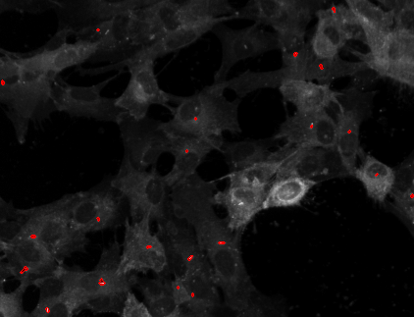
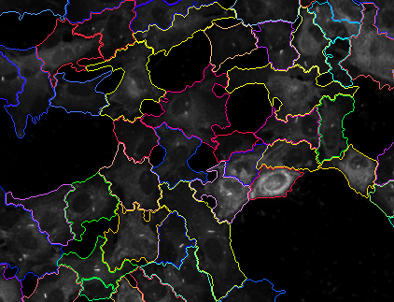
Actual Request #3 Dr. Joseph Gleeson’s lab at UCSD
Elucidating miRNA network underlying Ciliome
miRNAs
Ciliogenesis faciliating miRNAs
(26)
miRNA transfection
Prediction of target mRNAs, assessment of enriched GOs
Control (25)
In vitro ciliogenesis model:
htRPE cell (Serum starvetion induces ciliogenesis in hRPE cells)
Ciliogenesis inhibitory miRNAs
(55)

Slide 12
Actual Request #4 (1) Dr. Kumar Sharma’s lab, UCSD
Metabolome Analyses of Diabetic Kidney Disease
Excess glucose in
type 1 diabetic patient
m
m
PGC1α
CpG
mitogenesis
AMPK pathway
m
m
beclin 1
CpG
autophage
Aim 2:
Urine epigenetic profiles
Renal tubular epithelial cell
Urine
Metabolites in urine
Diabetic kidney disease
(Reduction of eGFR)
Mitochondrial depletion
Aim 1:
Urine metabolic profiles
Down-regulated / inhibited

Slide 13
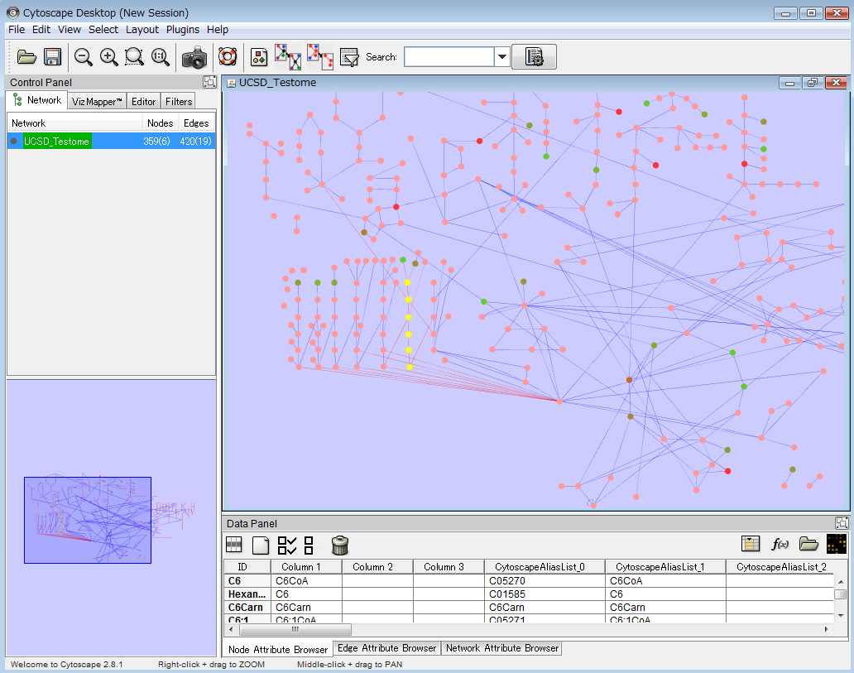
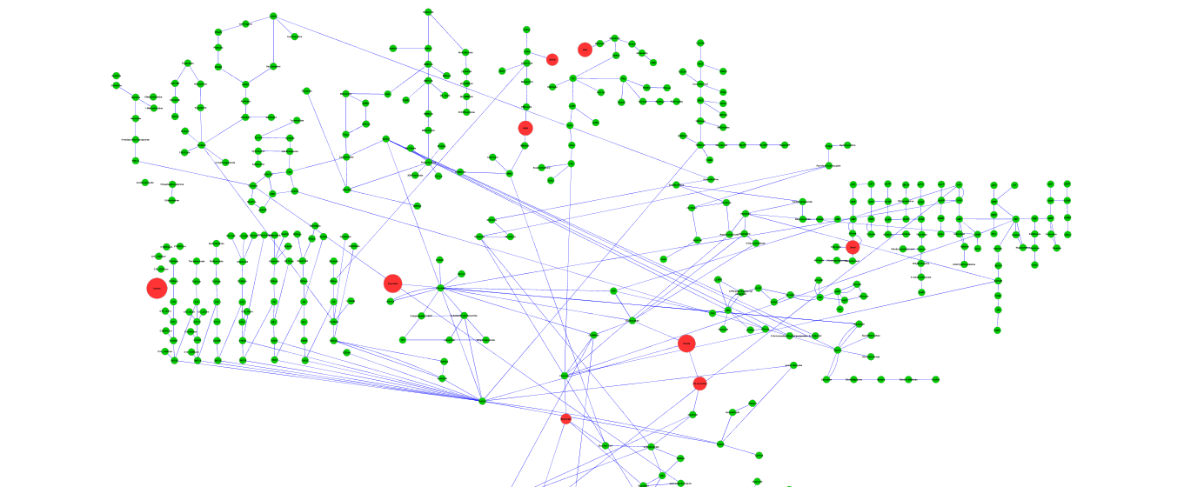
Actual Request #4(2) Dr. Kumar Sharma’s lab, UCSD
Metabolome Analyses of Diabetic Kidney Disease
They have good skill to manipulate Cytoscape.
They have manually constructed human metabolic pathways of their interest. Only biochemist can modify it.
Integration with publicly available data (especially high-throughput data) will just mess up the pathway.
Appearance of the network may be improved. → can be consulted.

