Slide 1
Functional screen for miRNAs regulating ciliogenesis
miRNA library screen
Assay: monitoring cilia and cell cycle status
Smo-EGFP: cilium marker
(reference: Nature 2005, 437, 1018-1021)
mCherry-Geminin(1-110): S-G2-M marker
(reference: Cell 2008, 132, 487-498)
Cell line: hTERT-RPE-SEMG#1
hTERT-RPE cells stably expressing Smo-GFP and mCherry-Geminin
miRNA libraries:
Ambion pre-miRNA library (858 miRNAs)
Anti-miRNA library (887 miRNAs)

Slide 2
Protocols
A. Serum Starvation
Transfection (Cell seeding 2000 cells)
48h culture with 10 % FBS
Medium Change
24h Serum Starvation (0.5% FBS)
Fixation and Imaging
B. Without Serum Starvation
Reverse Transfection (Cell seeding: 1000 cells)
72h culture with 10 % FBS
Fixation and Imaging
SERUM STARVETION INDUCES CILIOGENESIS in hRPE cells

Slide 3
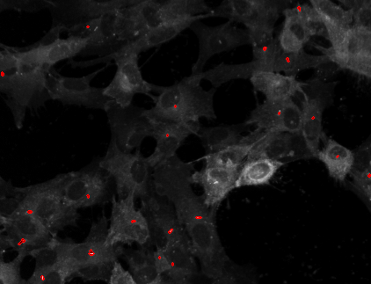
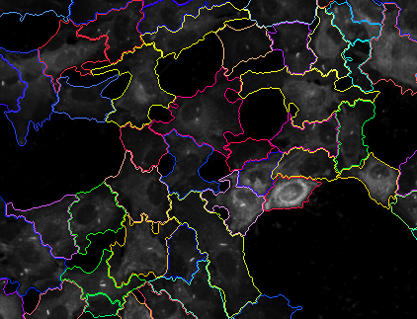
Example of Cilia Detection

Slide 4

Functional screen for miRNAs regulating ciliogenesis:
results
37±3% of serum starved cells transfected with control miRNA have one cilium
% ciliated cells
0
10
20
30
40
50
60
70
80
90
100
miRNA ID
Hit classification: positive regulator (facilitate ciliogenesis) avg + 3sd
negative regulator (inhibit ciliogenesis) avg - 3sd

Slide 5
Pre-miRNA screen results
55 miRNAs negatively regulate ciliogenesis
26 miRNAs positively regulate ciliogenesis
25 miRNAs used as “control” since have absolutely no effect on ciliogenesis
Prediction of miRNAs targets:
Targets of “negative miRNAs”: total of 5782 mRNAs, some of these are predicted to be
targeted by more than one miRNA present in our list (up to 21 times).
Targets of control miRNAs: total of 4132 mRNAs, some of these are predicted to be targetd
by more than one miRNA persent in the list (up to 10 times)

Slide 6
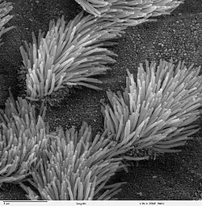
Actual Request #3 Dr. Joseph Gleeson’s lab at UCSD
Elucidating miRNA network underlying Ciliome
miRNAs
Ciliogenesis faciliating miRNAs
miRNA transfection
Prediction of target mRNAs, assessment of enriched GOs
Control
In vitro ciliogenesis model:
htRPE cell
Ciliogenesis inhibitory miRNAs

