Slide 1
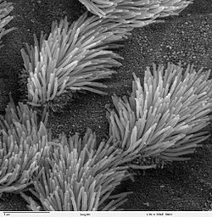
Actual Request #3 Dr. Joseph Gleeson’s lab at UCSD
Elucidating miRNA network underlying Ciliome
miRNAs
Ciliogenesis faciliating miRNAs
miRNA transfection
Prediction of target mRNAs, assessment of enriched GOs
Control
In vitro ciliogenesis model:
htRPE cell
Ciliogenesis inhibitory miRNAs

