Slide 1
Working (and writing) with CyLayoutsAlgorithms
John "Scooter" Morris, Ph.D.
UCSF

Slide 2
Outline
CyLayoutAlgorithm Interface
Tunables and LayoutProperties
AbstractLayout
Example

Slide 3
CyLayoutAlgorithm
Interface to all Cytoscape layout algorithms
  Provides methods to query layout capabilities:
    Ability to only work on selected nodes
    Ability to use node attributes in layout
    Ability to use edge attributes in layout
  Methods to handle settings
    Get a JPanel to provide for user input
    Update and revert settings
  Methods to lock and unlock nodes
  doLayout methods
    Main calls to execute layouts

Slide 4
Tunables
History
  Needed to expose layout parameters
  Lots of code needed to create JPanel for each layout
    Also needed to provide mechanism to save parameters
  I’m lazy
  Tunables and LayoutProperties did what I needed
    With less work

Slide 5
Tunables
Encapsulated variables
  Typed
    Boolean, Integer, Double, String, Node Attribute, Edge Attribute, List
  Includes metadata
    Name
    Description
    Value
    Bounds

Slide 6
LayoutProperties
Stores the list of Tunables for a layout algorithm
Responsible for saving and restoring properties
Creates default JPanel to provide UI for Settings dialog

Slide 7
AbstractLayout
Recommended approach:
  Extend AbstractLayout
  Override construct:
    construct is called by AbstractLayout to perform the layout
  Override appropriate “supports” routines
    supportsSelectedOnly, supportsNodeAttributes, supportsEdgeAttributes
  Provide all settings through Tunables added to a LayoutProperties object
  Override “update” routines to interface to your LayoutProperties
  If algorithm is long running, use taskManager provided by AbstractLayout

Slide 8
ExampleLayout
Demo

Slide 9
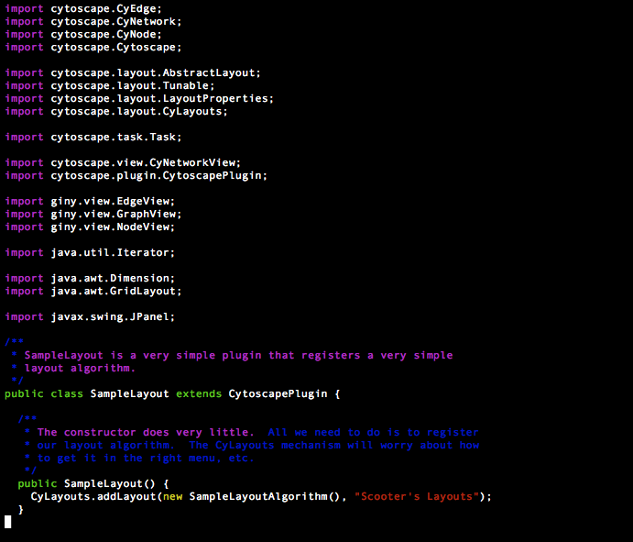
ExampleLayout
Preamble & Registration

Slide 10
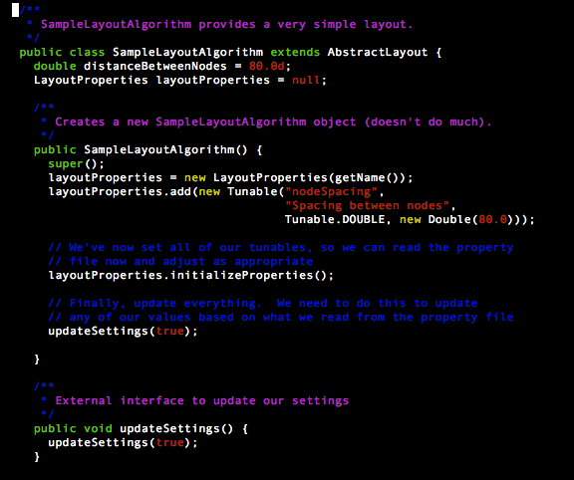
ExampleLayout
CyLayout Interface1

Slide 11
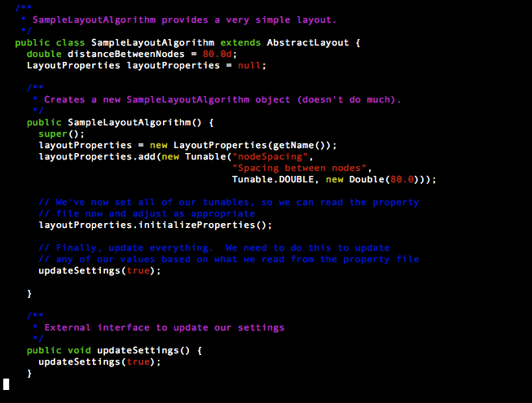
ExampleLayout
CyLayout Interface 2

Slide 12
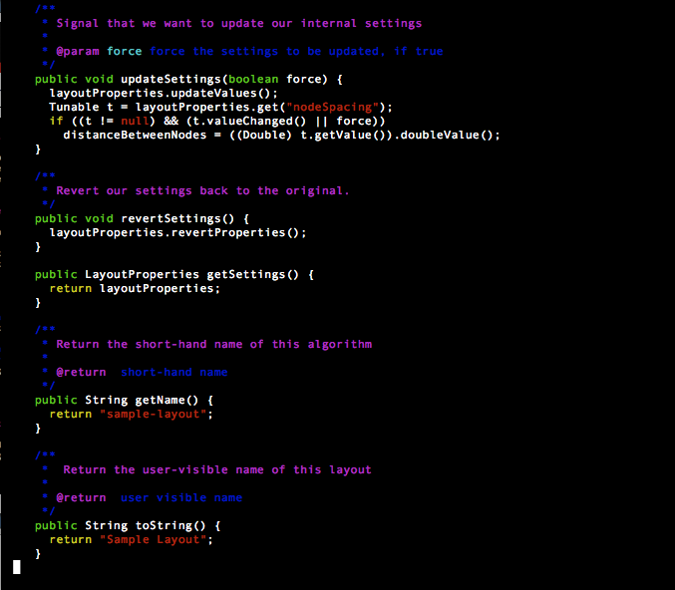
ExampleLayout
CyLayout Interface 3

Slide 13
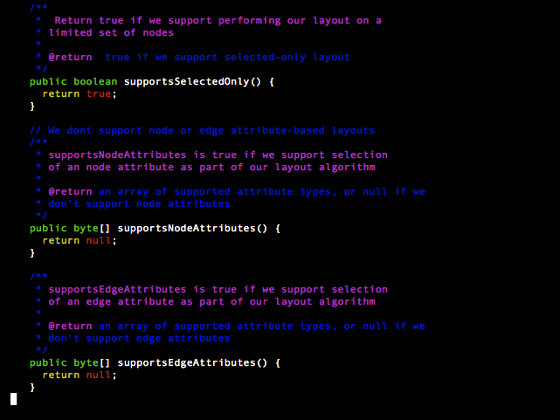
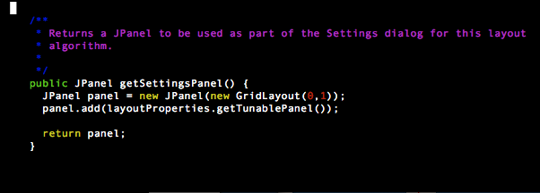
ExampleLayout
CyLayout Interface 4

Slide 14
ExampleLayout
CyLayout Interface 5

Slide 15
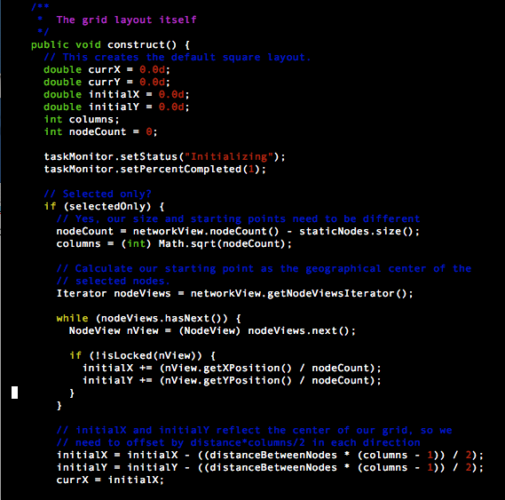
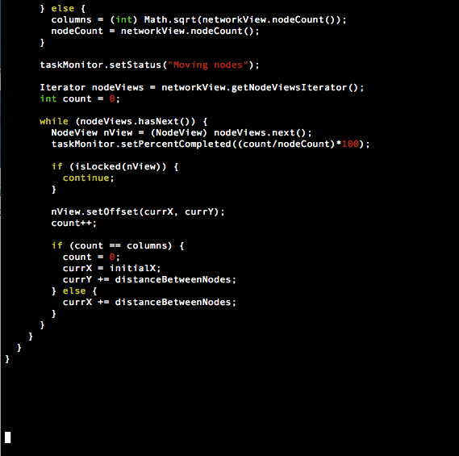
ExmapleLayout
Layout algorithm

Slide 16
Available Layouts
Cytoscape Layouts
  Group Attributes Layout [attributes-layout]
    Partitions based on node attributes
  Inverted Self-Organizing Map Layout [isom]
    ISOM layout from the JUNG project
  Edge-weighted Force directed (BioLayout) [fruchterman-rheingold]
    Classical Fruchterman-Rheingold algorithm with support for numerical edge weights
  Degree Sorted Circle Layout [degree-circle]
    Place nodes on a circle where the location on the circle depends on the degree of the node
  Grid Layout [grid]
    Simple grid, part of core
  Attribute Circle Layout [attribute-circle]
    Place nodes on a circle based on selected node attribute

Slide 17
Available Layouts
Cytoscape Layouts (cont)
  Attribute Circle Layout [attribute-circle]
    Place nodes on a circle based on selected node attribute
  Circular Layout [circle]
    Place nodes on a circule
  Force-Directed Layout [force-directed]
    Edge weighted, force directed algorithm from prefuse project
  Edge-weighted Spring Embedded [kamada-kawai]
    Kamada-Kawai algorithm with support for numercial edge weights
  Spring Embedded [kamada-kawai-noweight]
    Kamada-Kawai algorithm with no edge weight support
  Hierarchical Layout [hierachical]
    Hierarchical layout

Slide 18
Available Layouts
JGraph
  Simulated Annealing Layout [jgraph-annealing]
  MOEN Layout [jgraph-moen]
  Circle Layout [jgraph-circle]
  Radial Tree Layout [jgraph-radial-tree]
  GEM Layout [jgraph-gem]
  Spring Embedded Layout [jgraph-spring]
  Sugiyama Layout [jgraph-sugiyama]
  Tree Layout [jgraph-tree]

Slide 19
Available Layouts
yFiles
  Not available through CyLayouts mechanism

Slide 20
Questions
Thanks!

