Slide 1



C
C
C
A
B
A
B
A
B
C
C
A
B
A
B
Topological analysis of network structure
(Saito R et al. 2003)
Extraction of interacting domain (Miyamoto-Sato et al. 2005)
- Integration of
various data (Saito et al. 2004),
- Platform construction (Negishi et al. 2007)
Expression level
A
B
Gene & Protein expression patterns
Comparative analyses
among species
P
P
Regulatory Protein
Signaling
Pathway
Protein phosphorylation analysis
(Yachie et al. 2009)

Slide 2
Expressional analyses of non-coding regions and pseudogene regions
(Numata et al. 2003, Yano, Saito et al. 2004, Yachie et al. 2006)
 
# #
#
##
AAAAA
Genomic structure of sense-antisense transcription units (Numata et al. 2007)
Tissue A
Tissue B
100
Expression level
Expressional analyses of sense-antisense transcripts (Okada et al. 2008, Numata et al. 2009)
50
0
Characterization of nucleosomes
(Ogawa et al. 2010)

Slide 3


癌を裏で操っている遺伝子の予測
癌患者
100
遺伝子
発現解析
50
0
表
裏
正常細胞
癌細胞
コンピュータを用いた
情報処理・統計解析

Slide 4
100
Expression level
50
0

Slide 5
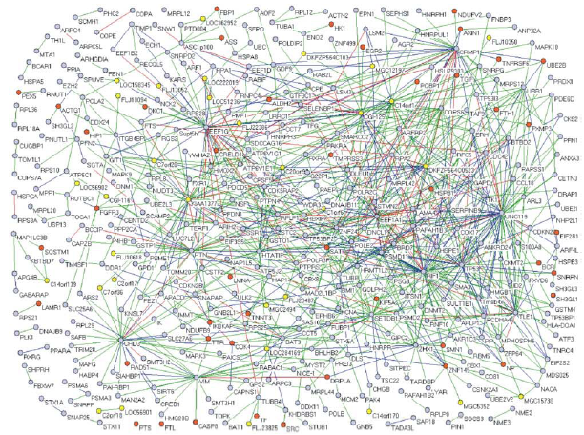
Extraction of functional units
Figure published from Vidal’s lab
Extraction of regulatory networks
Protein which are related to disease

Slide 6
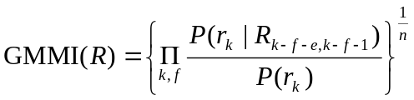
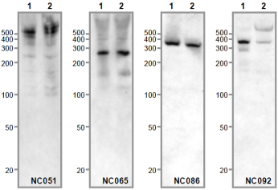
Genomic Sequence
Analysis of Transcription Signals
Start Sites
Term Sites
GMMI (Gapped Markov Model Index)
Characterizes given sequences using formula based on Markov Model.
Predicted Transcription Unit
Elimination of predicted TUs which potentially encode protein using GMMI
Input
Non-coding RNA Candidates
Validation by Experiments
Protein Coding Potential

Slide 7
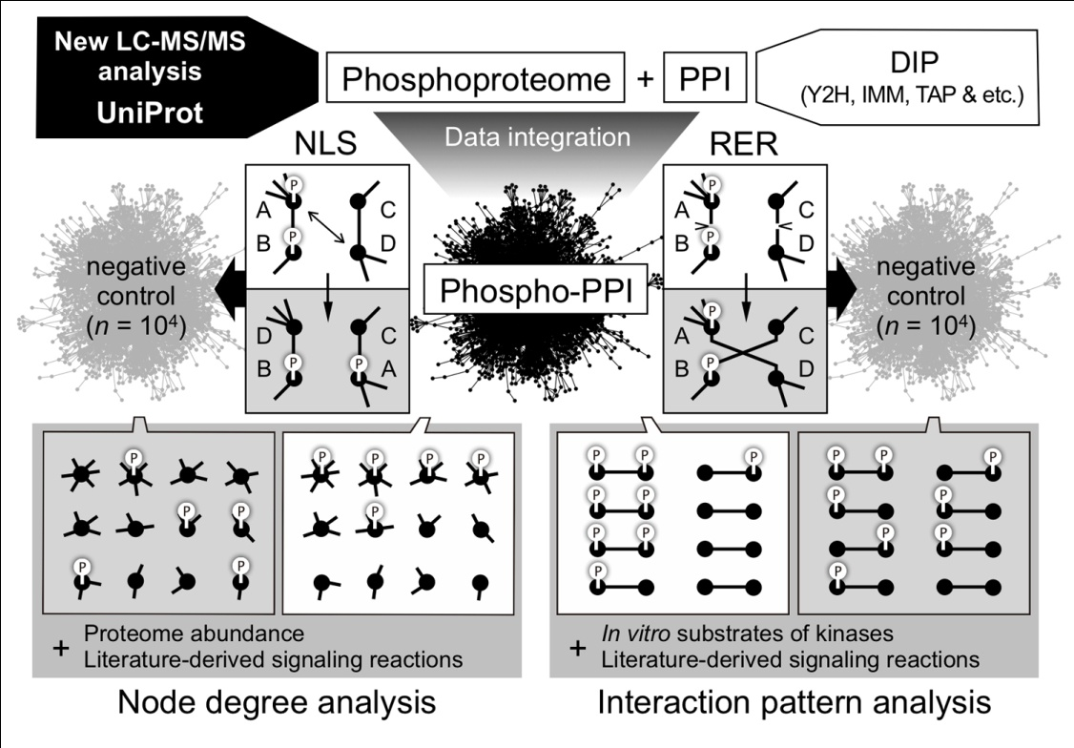
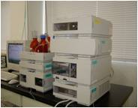
Analysis of Phosphorylation Network
P
Regulatory Protein
Signaling Pathway
Collection of phosphorylation data
(Yachie et al. 2009)

Slide 8
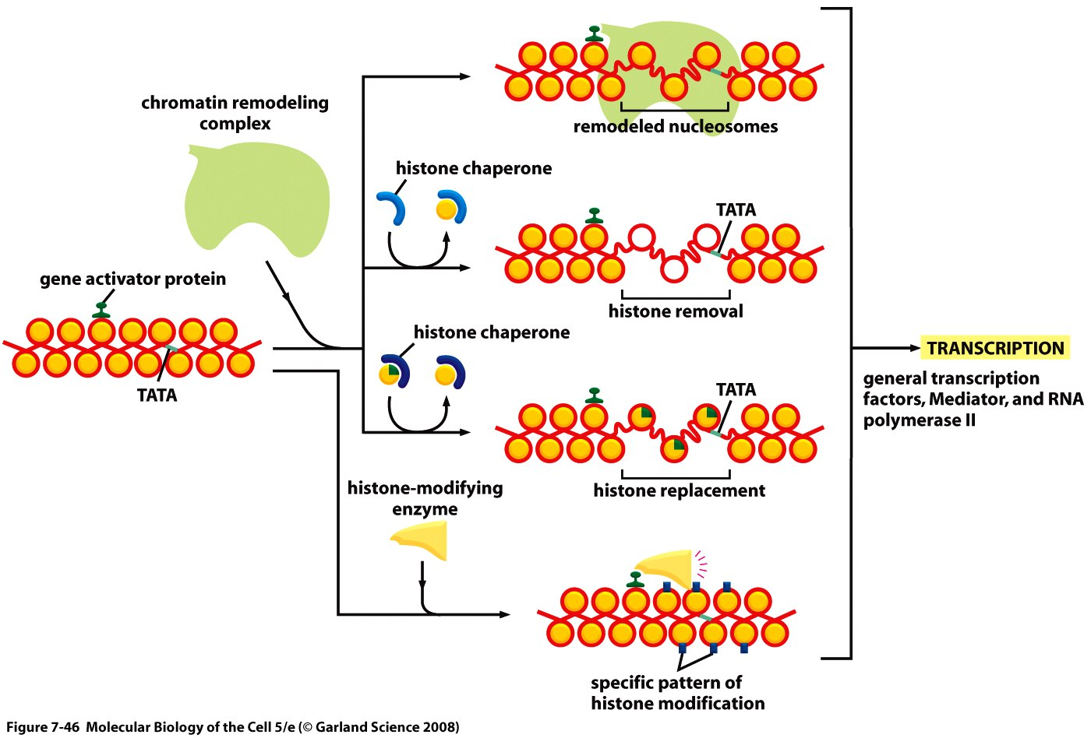
Transcriptional Regulation

Slide 9
_x0016_
_x0016_
_x0016_
_x0016_
_x0016_
_x0016_

