Slide 1
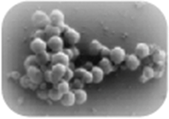
(a)
(b)
(c)
(d)
g
c
g
tccctagcat
agggatcgtacg
t
c
<200
cagtagct
gtcatcgag
t
c
a
t
gtacgtacatg
catgcatgtactg
t
a
t
cagtagc
gtcatcga
<10
<500

