Slide 1
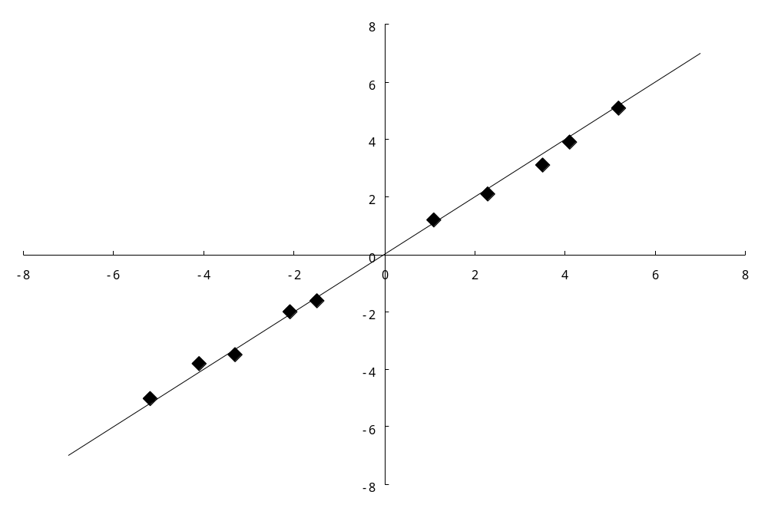
x₂
x₂=x₁
x₁
x₁ | x₂
-5.2 | -5.1
-4.1 | -3.8
-3.3 | -3.5
-2.1 | -2.4
-1.5 | -1.6
1.1 | 1.2
2.3 | 2.1
3.5 | 3.1
4.1 | 3.9
5.2 | 5.1

