Slide 1
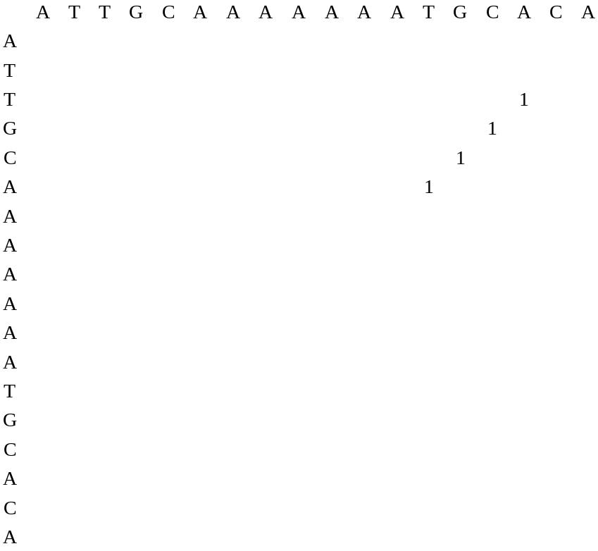
A
10
A
A
A
A
A
A
A
A
A
(a)
(b)
T
A
A
A
G
C
A
C
G
T
T
G
C
A
C
G
5
15
T
A
T
C
A
A T
C A
(c)
(d)
{ (3,16), (4,15), (5,14),(6,13) }
A

