Slide 1
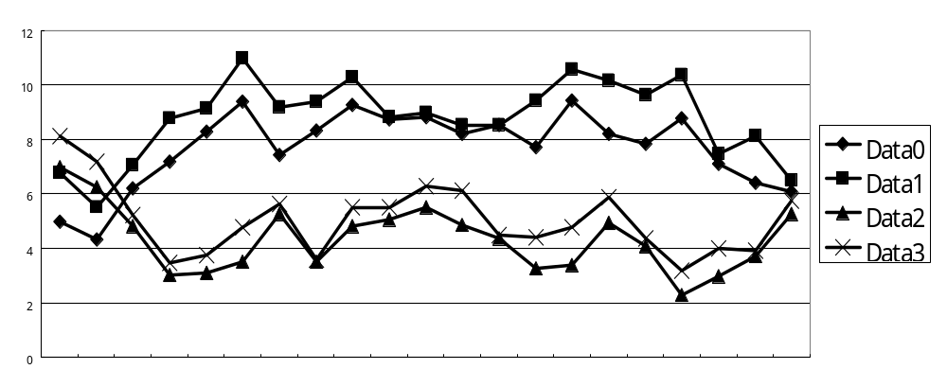
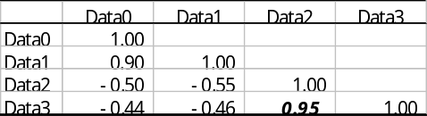
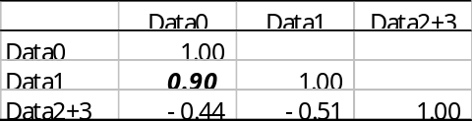
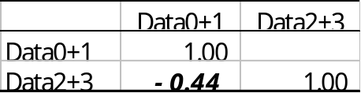
Step 1
Data0
Data1
Data2
Data3
Step 2
Data0
Data1
Data2
Data3
Step 3
Data0
Data1
Data2
Data3

