Slide 1
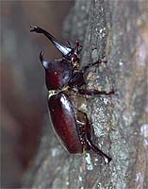
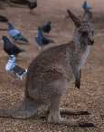
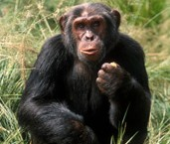

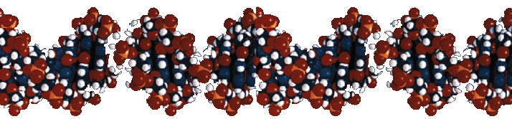
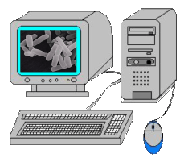
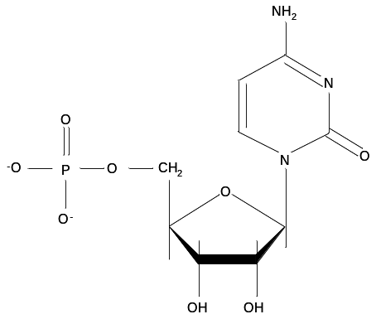
Decryption of DNA by Bioinformatics
ggagctgcagcccgaccgcggggaggacgccatcgccgcctgcttcctcatcaactgcct
ctacgagcagaacttcgtgtgcaagttcgcgcccagggagggcttcatcaactacctcac
gagggaagtgtaccgctcctaccgccagctgcggacccagggctttggagggtctgggat
ccccaaggcctgggcaggcatagacttgaaggtacaaccccaggaacccctggtgctgaa
ggatgtggaaaacacagattggcgcctactgcggggtgacacggatgtcagggtagagag
gaaagacccaaaccaggtggaactgtggggactcaaggaaggcacctacctgttccagct
gacagtgactagctcagaccacccagaggacacggccaacgtcacagtcactgtgctgtc
caccaagcagacagaagactactgcctcgcatccaacaaggtgggtcgctgccggggctc
tttcccacgctggtactatgaccccacggagcagatctgcaagagtttcgtttatggagg
ctgcttgggcaacaagaacaactaccttcgggaagaagagtgcattctagcctgtcgggg
tgtgcaaggcccctccatggaaaggcgccatccagtgtgctctggcacctgtcagcccac
ccagttccgctgcagcaatggctgctgcatcgacagtttcctggagtgtgacgacacccc
caactgccccgacgcctccgacgaggctgcctgtgaaaaatacacgagtggctttgacga
gctccagcgcatccatttccccagtgacaaagggcactgcgtggacctgccagacacagg
actctgcaaggagagcatcccgcgctggtactacaaccccttcagcgaacactgcgcccg
ctttacctatggtggttgttatggcaacaagaacaactttgaggaagagcagcagtgcct
cgagtcttgtcgcggcatctccaagaaggatgtgtttggcctgaggcgggaaatccccat
ggagctgcagcccgaccgcggggaggacgccatcgccgcctgcttcctcatcaactgcct
ctacgagcagaacttcgtgtgcaagttcgcgcccagggagggcttcatcaactacctcac
gagggaagtgtaccgctcctaccgccagctgcggacccagggctttggagggtctgggat
Information of any life is encoded in DNA
Computational Analysis

Slide 2
NH₂
N
O
N
O
⁻O
P
O
CH₂
O
O⁻
OH
OH

