Slide 1
ISO Master Execution Flow
X
First Screen
X.1
Open Image
X
0
Image Open
X, X.1
1
Quit Confirm
0
2
Save Boot Record
0
3
Load Boot Record
0
4
View/Edit Text
0

Slide 2
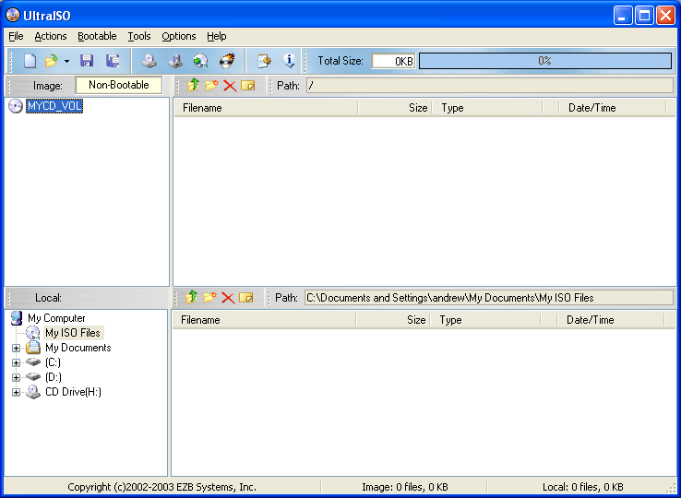
First Screen
Back (Flow Diagram)

Slide 3
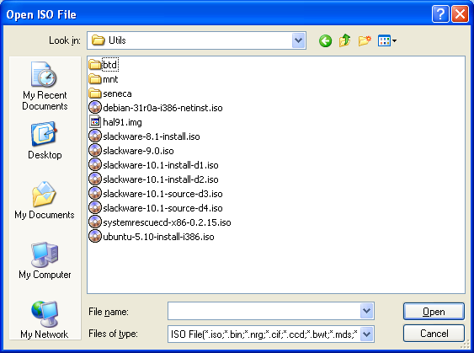
Open Image
Back (First Screen)

Slide 4
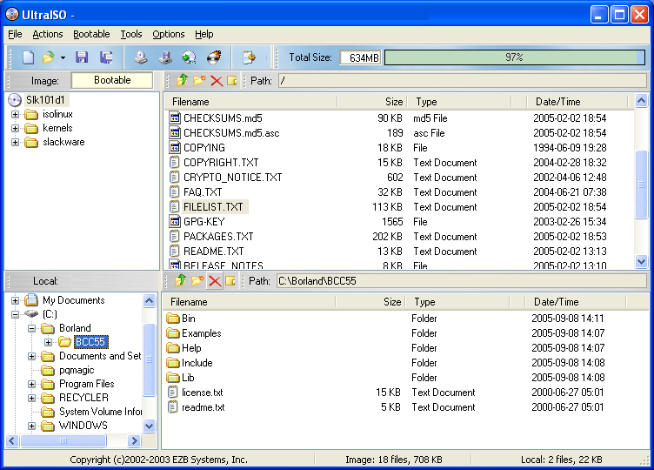
Image Open
(ready to add/remove/save/etc)
Back (Open Image)

Slide 5
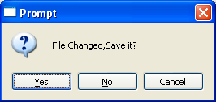
Quit Confirm
Back (Image Open)

Slide 6
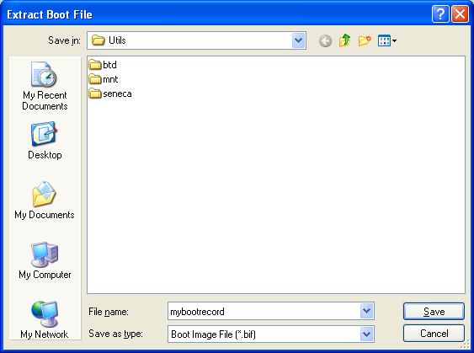
Save Boot Record
Back (Image Open)

Slide 7
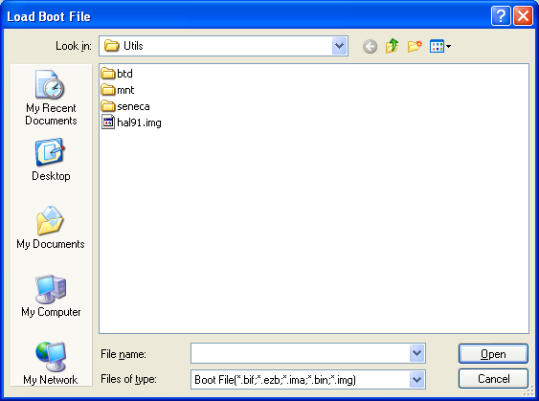
Load Boot Record
Back (Image Open)

Slide 8
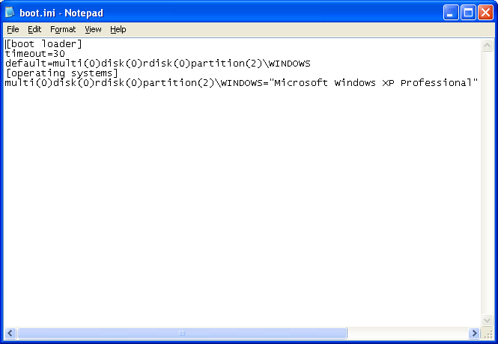
View/Edit Text
Back (Image Open)

