Slide 1
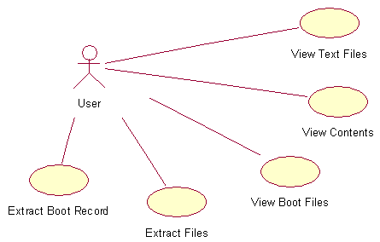
Use Case Diagram (read)

Slide 2
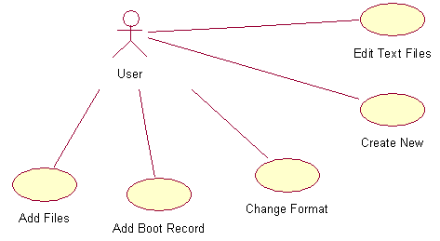
Use Case Diagram (write)

