Slide 1
Cypress FX3 firmware for INI Sensors
Luca Longinotti <luca.longinotti@uzh.ch>

Slide 2
Overview
  USB 3.0
  Cypress FX3
  FX3 SDK + Tools
  FX3 Firmware
  FX3 jAER integration

Slide 3
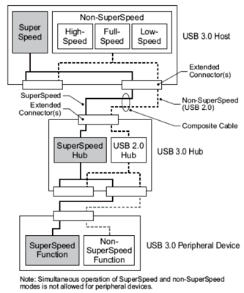
USB 3.0
  Since end of 2008, but spread started only 2011-2012
  More bandwidth: Super Speed 5Gbit/s
  Better power management: new power states (U0 to U3)
  New features: Bursts, Streams, …
    Asynchronous notifications
    Traffic only to target device
  Dual Bus Architecture: everything is supported!

Slide 4
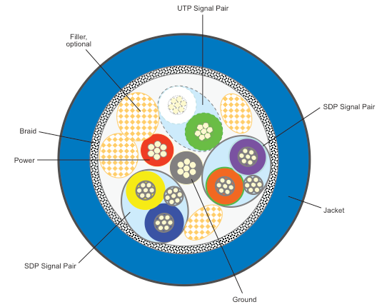
USB 3.0 (2)
  Electrically different, six new wires!
  Backwards compatible to USB 2.0
  by also having the old wiring
  XHCI (eXtensible Host Controller Interface)
  Drivers from Host Controller vendors for Windows 7, (XP)
  Integrated driver starting with Windows 8
  Linux >= 2.6.31, Mac OS X >= 10.8

Slide 5
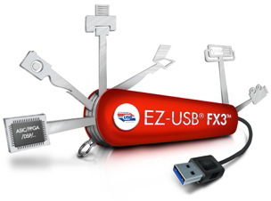
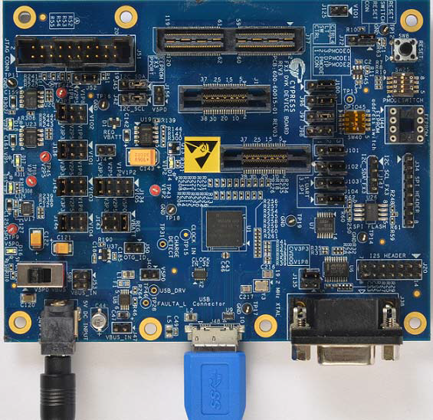
Cypress FX3
  Supports USB 3.0
  Up to 32 endpoints (16 IN, 16 OUT)
  32-bit, 200 MHz ARM CPU, 512 KB SRAM
  Boot from USB, I2C, SPI, GPIF2 ( + support for I2S, UART)
  GPIF2: 100 MHz operation, 8/16/32-bit data bus
  DMA-Engine
  ThreadX RTOS

Slide 6
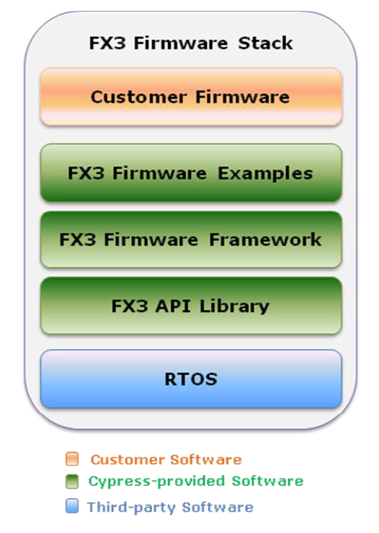
FX3 SDK + Tools
  Eclipse + GCC for ARM-based !!!
  Various tools: GPIF2 Designer, ControlCenter
  Easy install & automatic updates
  Lots of examples
  Good documentation
  Well defined API Library

Slide 7
FX3 SDK + Tools: API Library
FX2:
EP0BUF[0] = SETUPDAT[1];
EP0BUF[1]= TIMESTAMP_MASTER; // PC1 (Port C Pin 1)
EP0BCH = 0;
EP0BCL = 2;
EP0CS |= bmHSNAK;
FX3:
uint8_t Buffer[2];
Buffer[0] = bRequest;
CyU3PGpioGetValue(GPIO_ID, &Buffer[1]); // GPIO Pin
CyU3PUsbSendEP0Data(2, &Buffer);

Slide 8
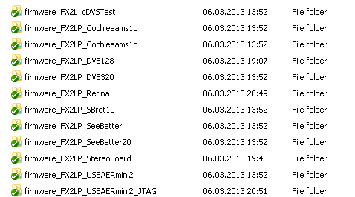
FX3 Firmware: FX2 Analysis
  FX2 firmware: heavy fragmentation!
    Different names, ports, …
    But everyone kinda does the same!

Slide 9
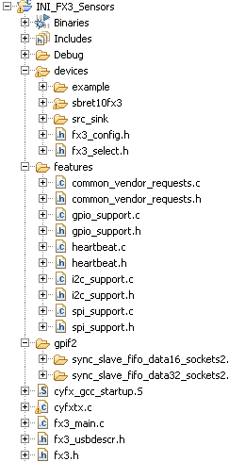
FX3 Firmware: Framework
  Solution: one framework, common core,
  additional features as options
    → Configurations for each device!
#define GPIF_32BIT_SUPPORT_ENABLED 0
#define I2C_SUPPORT_ENABLED 1
#define SPI_SUPPORT_ENABLED 1
#define GPIO_SUPPORT_ENABLED 1
gpioConfig_DeviceSpecific_Type cfg[] = {
{ 26, 'I'}, // GPIO 26 is an IN
{ 27, 'P'}, // GPIO 27 is an IN, and
will interrupt on POS_EDGE ('N' NEG_EDGE,
'B' BOTH_EDGES, 'L' LOW, 'H' HIGH)
{ 28, 'O'}, // GPIO 28 is an OUT
{ 45, 'E'} // GPIO 45 is a LED
};

Slide 10
FX3 Firmware: Features
  Core: 16-bit GPIF Slave FIFO interface (Data EP2),
  USB debugging (Status EP1), default Vendor Requests (Control EP0),
  Heartbeat functionality (status messages, flashing LEDs, ...)
  Optional:
    32-bit GPIF Slave FIFO interface
    MS Feature Descriptor (WCID, WinUSB)
    I2C support (EEPROM access or commands)
    SPI support (Flash access or commands)
    GPIO (configurable pins, IN/OUT, debug LED, …)
    Device-specific initialization (load data from flash, ...)
    DMA callbacks for Data EP2 to process/manipulate data

Slide 11
FX3 Firmware: Features (2)
  Implemented default Vendor Requests:
VR_TEST VR_LOG_LEVEL
VR_FX3_RESET VR_STATUS
VR_SUPPORTED (ON, OFF, TOGGLE, TIMED, RECURRING)
VR_GPIO_GET VR_GPIO_SET
VR_I2C_CONFIG VR_I2C_TRANSFER
VR_SPI_CONFIG VR_SPI_CMD
VR_SPI_TRANSFER VR_SPI_ERASE
  Can define device-specific Vendor Requests (override default)
CyBool_t CyFxHandleCustomVR_DeviceSpecific(
uint8_t bDirection, uint8_t bRequest,
uint16_t wValue, uint16_t wIndex,
uint16_t wLength);

Slide 12
FX3 Firmware: Devices
  Example (based on dev-kit, general testing):
    SPI Flash (4 Mbit), GPIO toggle, static S/N setting
  Src_Sink (based on dev-kit, transfer testing):
    SPI Flash (4 Mbit), DMA overrides, MS Feature Descriptor
  SBRet10FX3 (based on data-sheets for new board):
    SPI Flash (8 Mbit), SPI FPGA (Lattice ECP3-17), I2C (IMU access),
    GPIO (controls, LED), S/N setting from Flash (init),
    FPGA configuration from Flash (init), FPGA configuration while
    running (vendor requests), MS Feature Descriptor

Slide 13
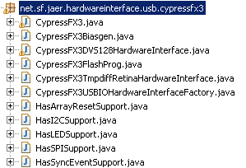
FX3 jAER integration
  PROOF OF CONCEPT ONLY, soon to be deprecated!
  New HardwareInterface package: cypressfx3
  New Chip package: retina3
  Code clean-up, re-factoring
  Uses Thesycon USBIO library for easy USB communication
    v 2.71.0 (14.11.2012) used
    “The USBIO driver is designed to support
    USB 3.0 devices with super speed“
    (Thesycon Manual v 2.71.0)

Slide 14

Done!
  Thanks for your attention!
  Any questions?

