Slide 1
f <- function () {
print ("Interactive console with syntax highlighting")
}
f ()
## define a S4 generic function and some methods
combo <- function(x, y) c(x, y)
setGeneric("combo")
setMethod("combo", c("numeric", "numeric"), function(x, y) x+y)

Slide 2
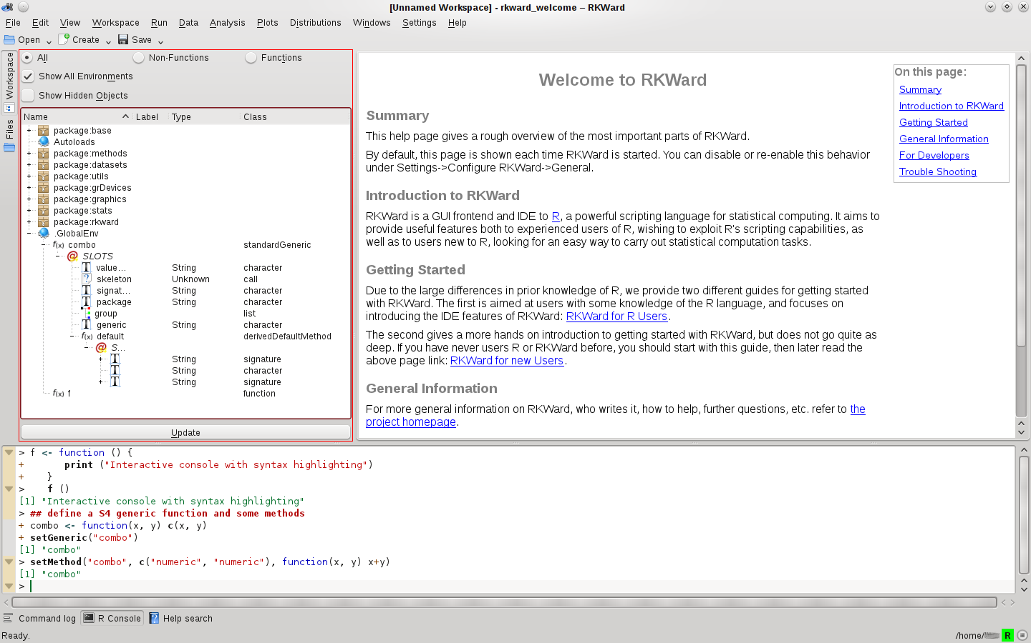
A
B
C
D
E

Slide 3
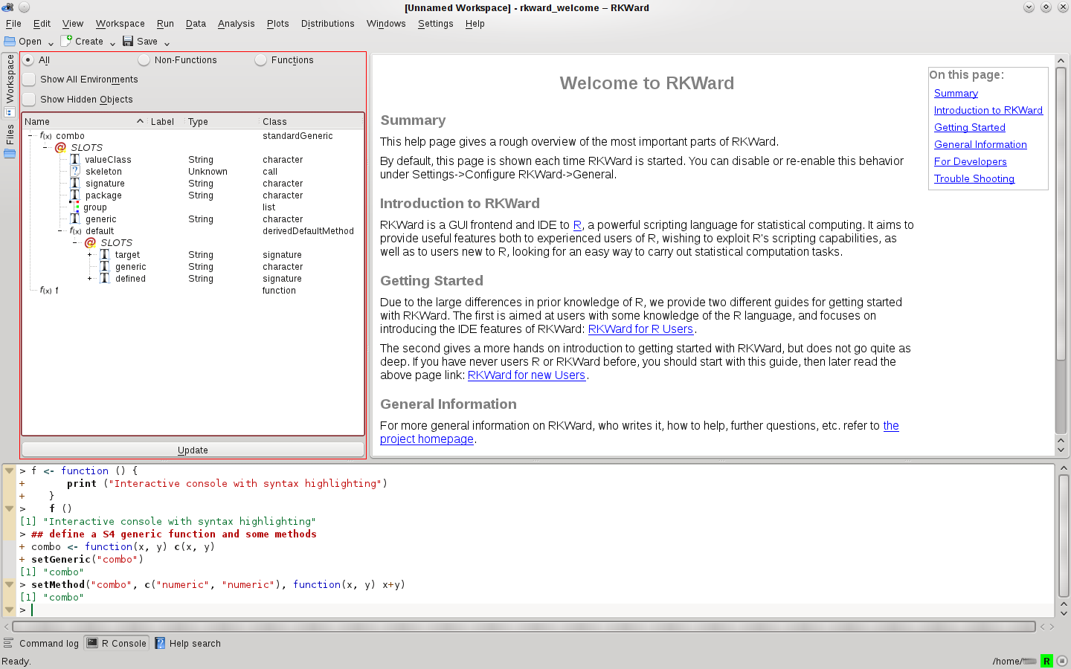
A
B
C
D
E

Slide 4
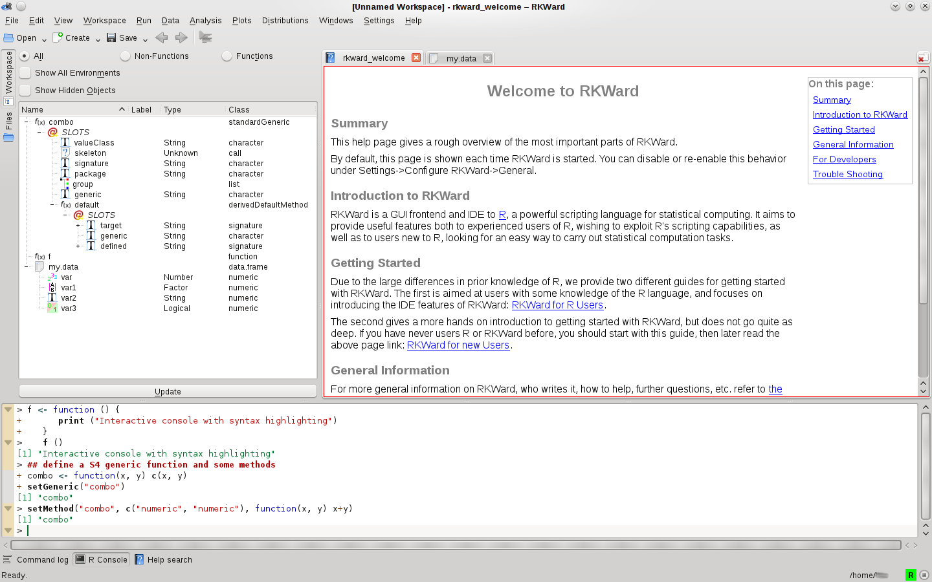
A
B
C
D
E

Slide 5
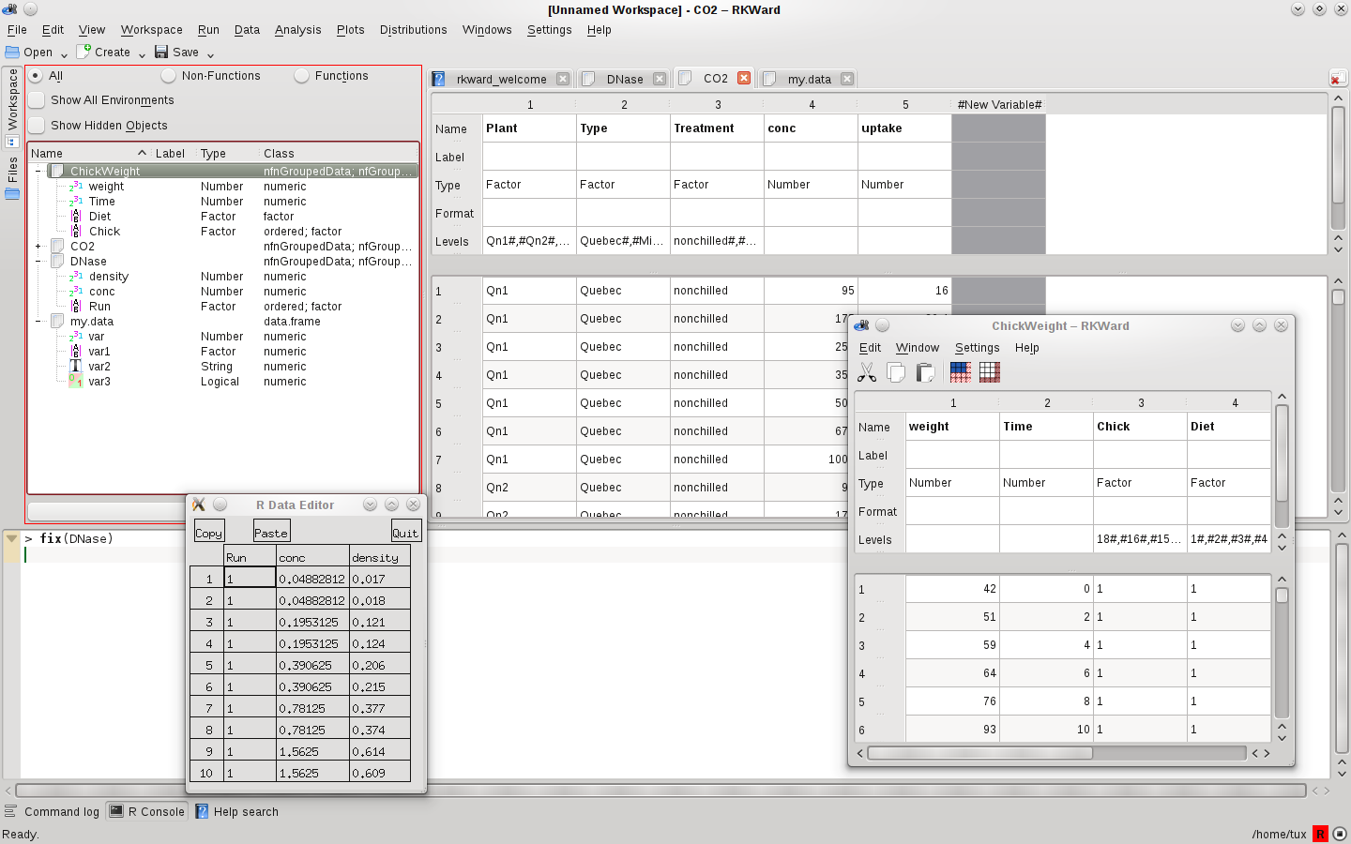
A
B
C

Slide 6
A
B

