Slide 1
meetchewthere
Lab Usability Study

Slide 2
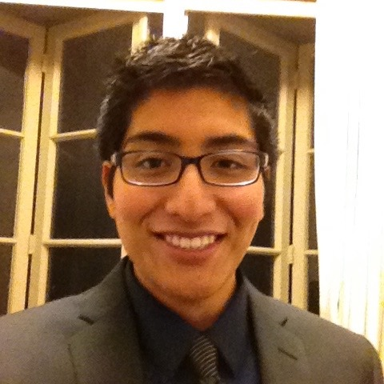


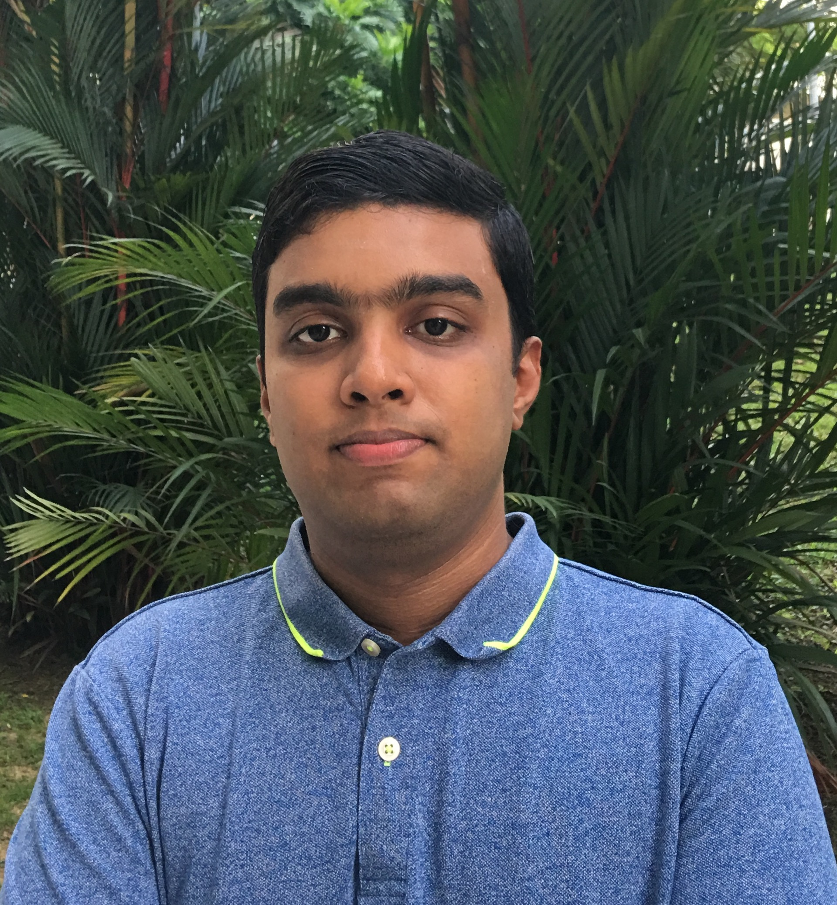
The Team
Michael
Cruz Doshi
Bronwyn
Early
Alejandrina
Gonzalez Reyes
Senthilnathan Viswanathan

Slide 3
Problem: Individuals with eating restrictions have limited choice in restaurants, but still want to be able to eat out with friends
Solution: Easy searching based on your restrictions, easy sharing to your friends

Slide 4
UI Changes

Slide 5
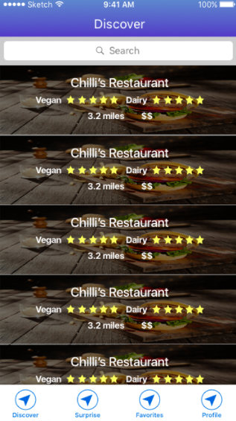
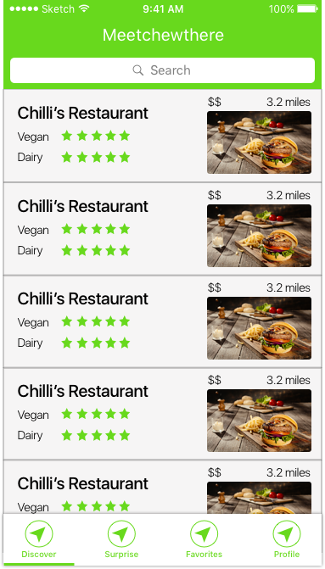
Discover
+
Search

Slide 6
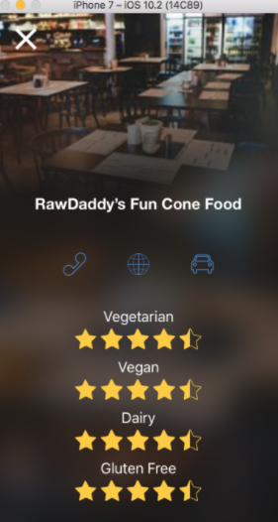
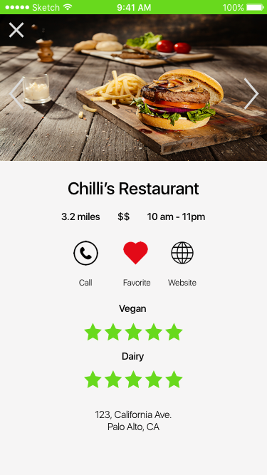
Restaurant
Page

Slide 7
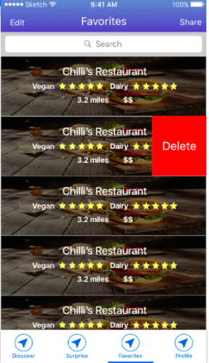
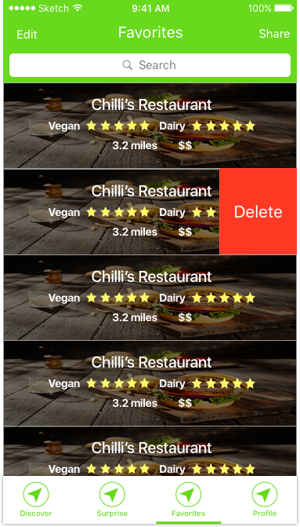
Favorites

Slide 8
Demo

Slide 9
Task 1
Find Food
Locate restaurants that fit your dietary restrictions

Slide 10
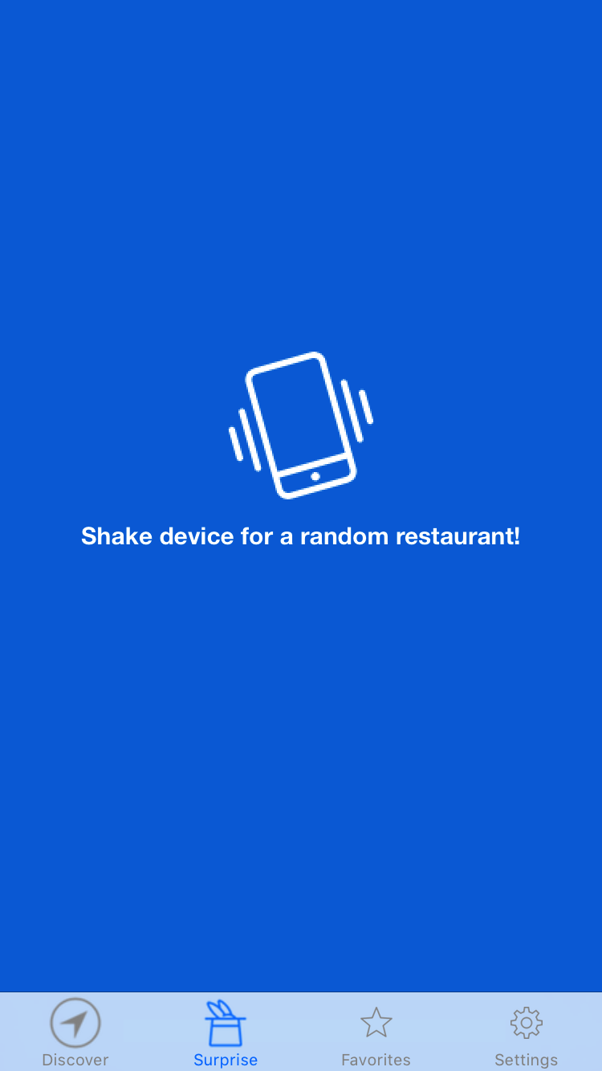
Task 2
Explore New Places To Eat
Shake and be surprised!
Search functionality

Slide 11
Task 3
Share With Friends
Share your options with a group

Slide 12
Unimplemented / Future Work
Filtering
Not the biggest priority - task already achievable
Adding favorites
Customizable Profile
Time
User inputed ratings and reviews
Time

Slide 13
Questions?

