Slide 1
REMOTE MEDICARE
By Team Pied Piper
Bridging the gap between doctors and patients
Demo Link:
https://www.youtube.com/watch?v=wi7NKEVaBFo

Slide 2
Brief Idea:
Social distancing is best enforced when people stay in their homes. But to visit a doctor, they have no choice but to step out.
We are building a platform that allows Doctors to virtually communicate with their Patients.

Slide 3
TECH STACK
React JS
Flask
Agora SDK
Express JS
Tensorflow/keras
Librosa
Open Source Frontend Javascript Library
Lightweight Web Framework of Python to deploy on the go
Real-Time Engagement Platform for Developers
Backend Web Application Framework for Node.js
Machine learning framework, rescuing developers from complex backprop
Library for audio analysis in python

Slide 4
Innovation
In our platform, users can find out whether they have Covid-19 just by recording Audio of their Cough. This is more beneficial than using x-rays as people don’t have to leave their house.
We’ve made Chatbots that can help Doctors in knowing about the health and basic symptoms(if disease is present) of patient.
Disease prediction will help doctors in knowing the disease based on the symptoms.
In 2020, 50% of the internet searches were voice based. So we built a personal voice based assistant to help the user in submitting data.

Slide 5
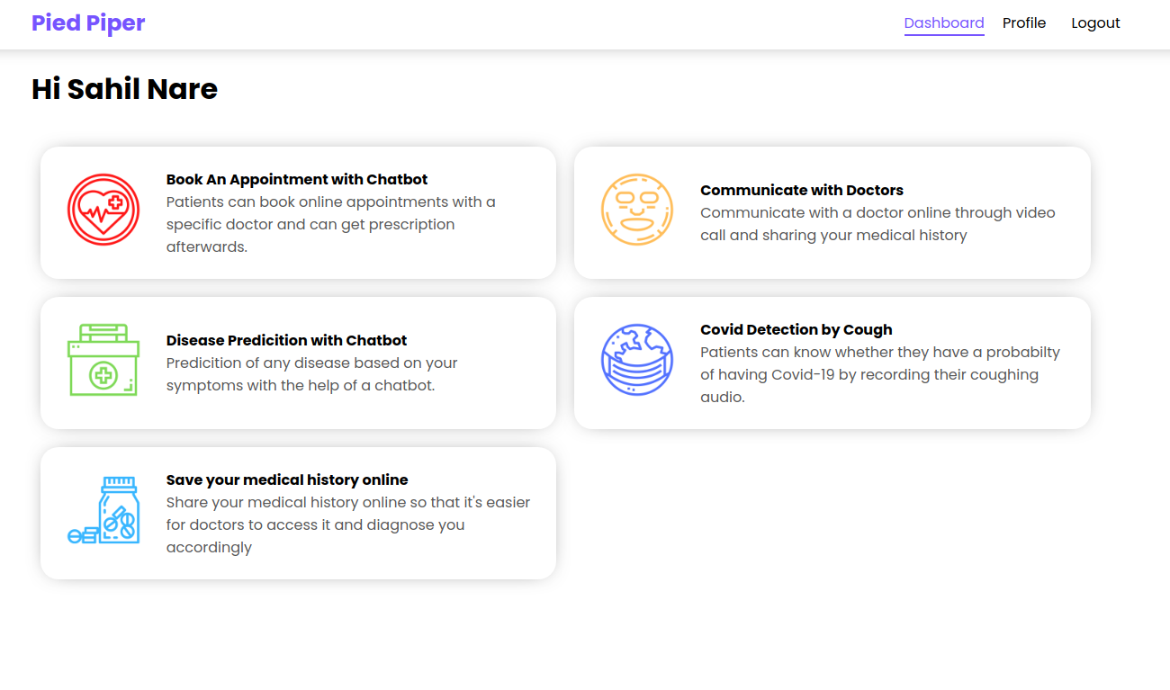

Slide 6
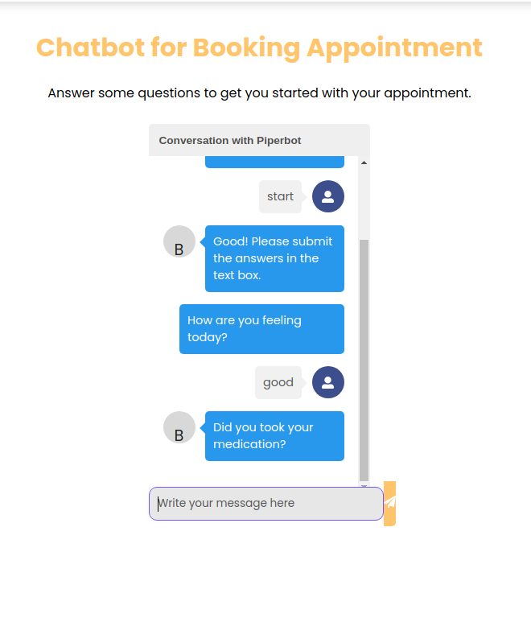

Slide 7
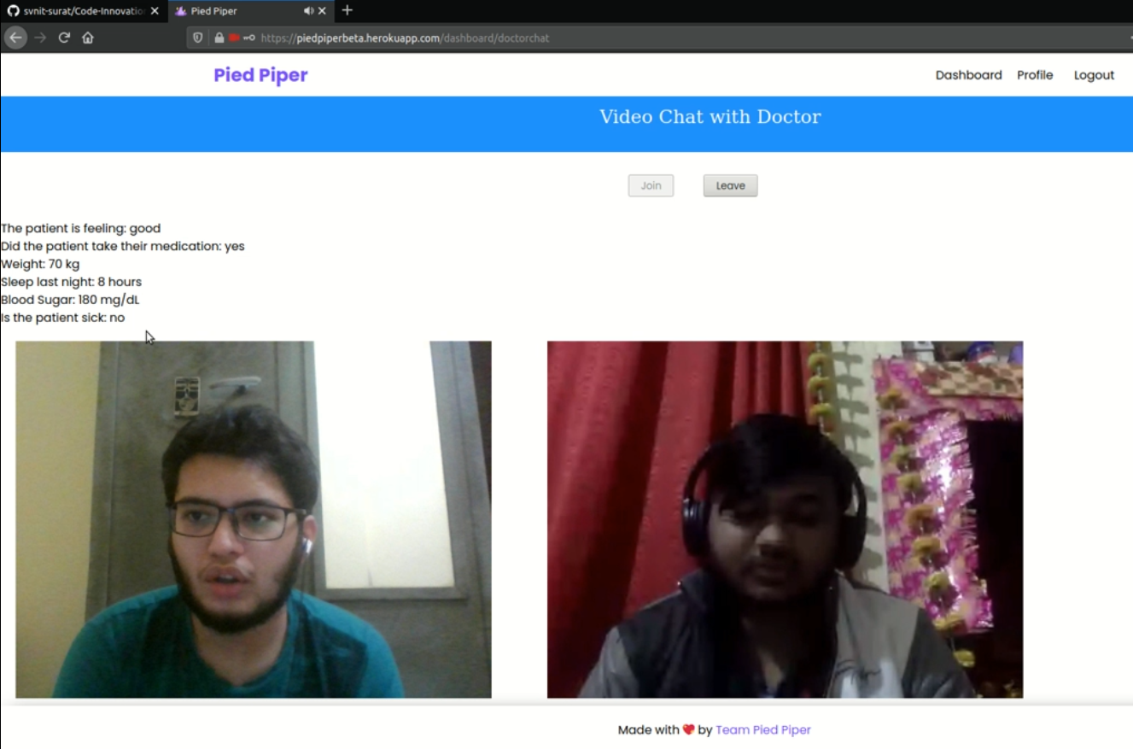

Slide 8
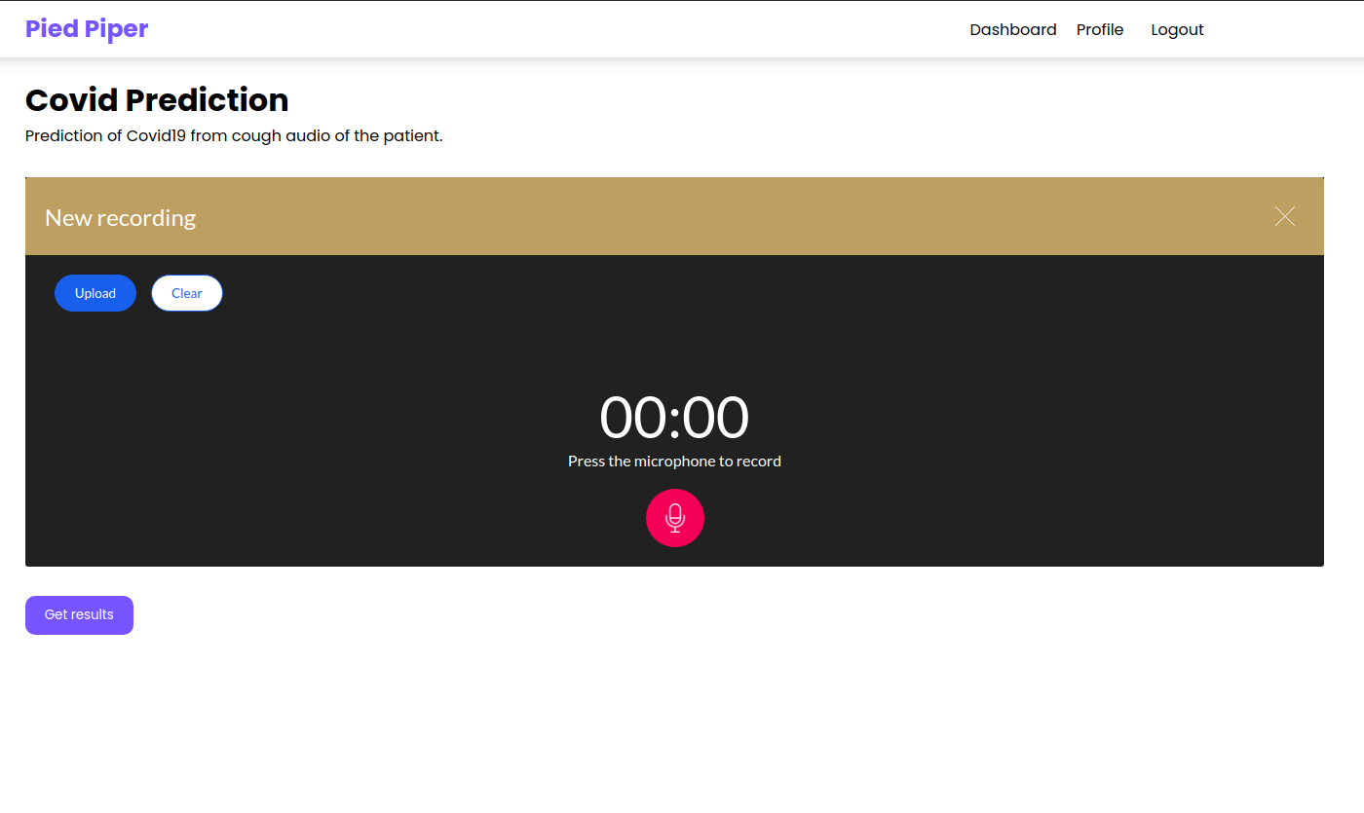

Slide 9
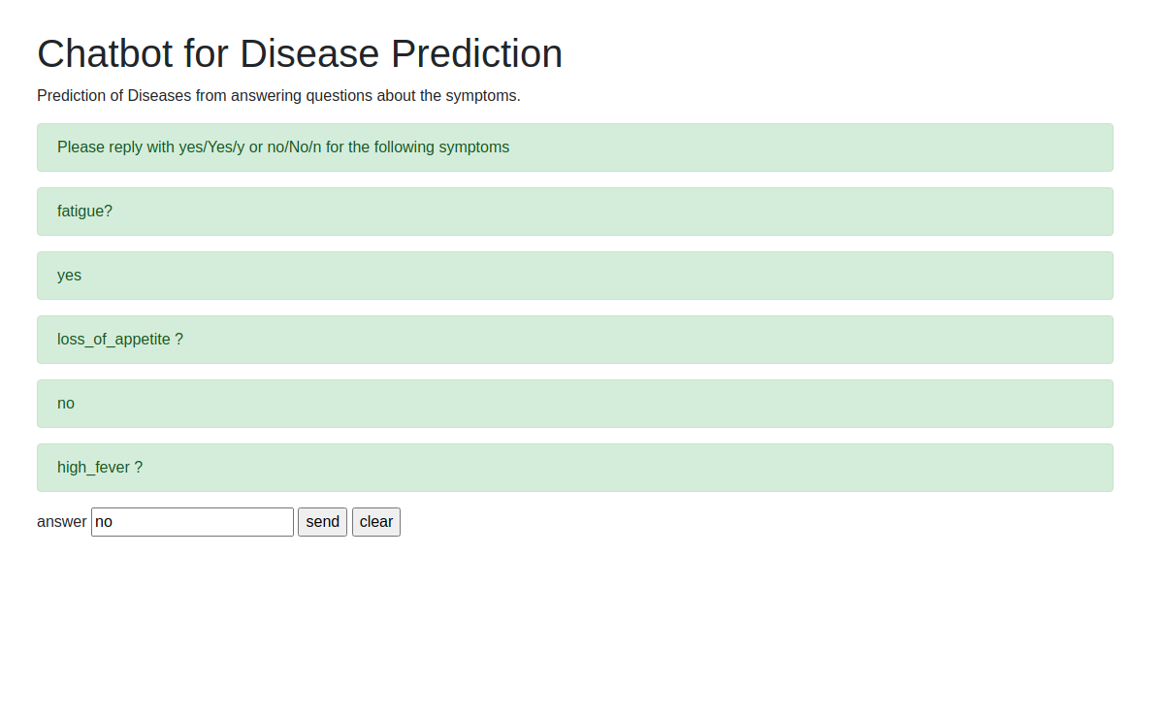

Slide 10
SCALABILITY
—Chatbots
—Video Chat
—Covid Audio Predictor
—Database
The Chatbots mostly work on client side, and the rest will need more servers
We used Agora SDk for video chat so their tech can help us scale faster
The Covid Predictor needs more servers to handle the traffic and heavy load of ML
NoSQL databases and cloud servers can be used to store the patients’ data

Slide 11
More things to ...
Nails Based Disease Prediction
Ear Based Person Identification
Blockchain

Slide 12
THANK YOU!!

