Slide 1






AsteriX By Dedsec

Slide 2
Index
Gaming Industry
Screen Time
Health Problems
Well, What Can We Do?
Discord
Bot Commands

Slide 3

Gaming Industry
As you can see there has been a rapid growth in the gaming industry over multiple platforms in the recent years which has led to...

Slide 4
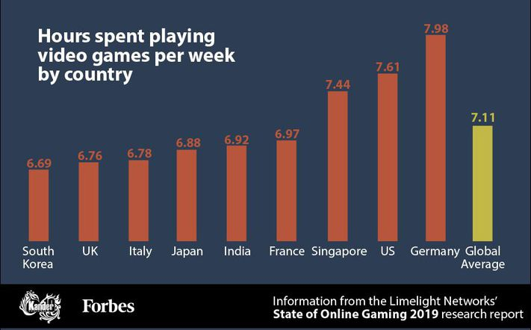
Screen Time
Excessive increase in screen time due to video games which has led to...

Slide 5
Health Problems such as:
Backache due to Bad Posture
Improper and Untimely consumption of food and water
Poor Vision
Insomnia

Slide 6

If only there was someone who could help you change your habits by reminding you to do things such as drink water, sit straight and sleep on time? Don't worry, we have someone for you Meet AsteriX He is a bot on Discord.
Well, What can we do?
Beep Boop Bop

Slide 7

Discord lets friends communicate directly via voice, video, or text, and join servers where larger communities can interact together. Gaming is definitely Discord's focus.
Have you heard of Discord?
It has around 150 million active members and 300 million registered members!

Slide 8
Bot Commands
Command for Drinking Water: "*Water" Description: It will remind you to drink water in every 30 minutes.
Command for Sitting Straight: "*Sit" Description: It will remind you to sit straight in every 15 minutes.
Command for Sleeping on Time: "*Sleep(Number of minutes)" Description: It will remind you to go to sleep after the minutes you specify. For Ex: "*Sleep20" will remind you to sleep in 20 minutes.
Also all of these commands will remind you with a special note.

Slide 9
Thank you

