Slide 1
Speech to speech translation
Mukund K Roy
PhD Scholar, DoAI, SVNIT, Surat

Slide 2
introduction
Translates speech in language X into speech in language Y in real time.
Key Components:
Automatic Speech Recognition (ASR) – Converts speech to text.
Machine Translation (MT) – Translates text into the target language.
Text-to-Speech (TTS) – Converts translated text back to speech.

Slide 3
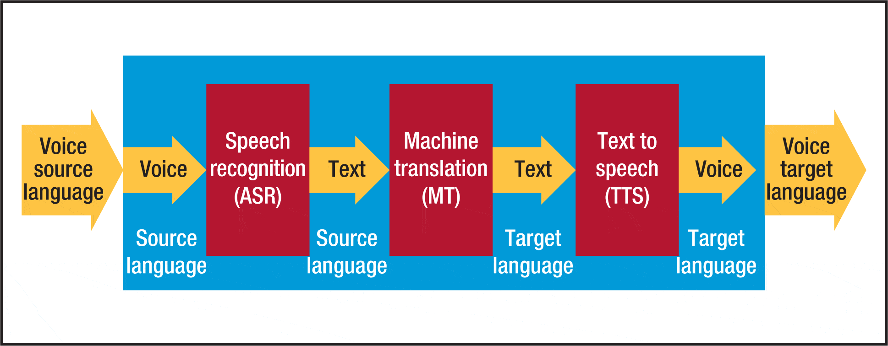
Speech to Speech Machine Translation - Pipeline

Slide 4
Approaches
Cascaded Approach
Pipeline: ASR → Text Translation (MT) → TTS
Used in applications like Google Translate and iTranslate.
Challenges: Error propagation from ASR to MT.
End-to-End Neural Approach
Uses Sequence-to-Sequence (Seq2Seq) models with Transformer-based architectures.
Avoids text conversion, directly maps speech to translated speech.
Example: Facebook’s SeamlessM4T, OpenAI’s Whisper-based models.
Challenges: Requires large-scale multilingual speech data.

Slide 5
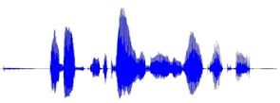
Cascaded SSMT Approach
ASR : Transcribing speech into text
MT : Translating text from language A to language B
TTS : Synthesizing speech from text
Automatic Speech Recognition (ASR)
Machine Translation (MT)
Text to Speech (TTS)
Speech Signal In language A
Text in language A
Text in Language B
Speech Signal In language B

Slide 6
Automatic speech recognition

Slide 7
Automatic Speech Recognition
ASR is the task of using algorithms and methodologies to enable translation of speech signals to text by computers.
Research has developed from 1960s to 2020s
Speech recognition technologies have wide scale use in education, software development, utilities, luxury, military, etc.
Well known examples: YouTube closed captioning, Voicemail transcription, Dictation Systems, etc

Slide 8
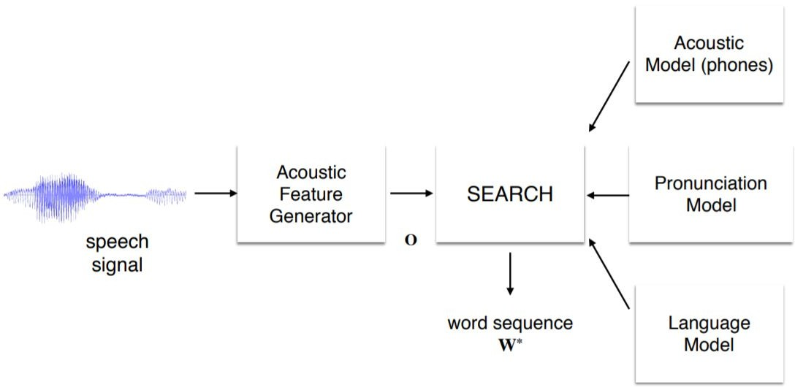
Automatic Speech Recognition

Slide 9
Automatic Speech Recognition
Audio Input:
Voice is captured as a waveform, sampled into digital data.
Feature Extraction:
Key acoustic features (pitch, tone) are isolated.
Acoustic Models:
Contains statistical representations of each of the distinct sounds that make up a word
44 phonemes in English, each phoneme has its own HMM
Lexicon Models:
Pronunciation models for speech recognizers; provides discriminating metric between pronunciations of the same word in different context
Eg, consider “ough” as in through, dough, cough, rough, bough, thorough, enough, etc
Language Models:
Predicting next word given a sequence of words
Used to calculate P(W) in previous expressions

Slide 10
ASR architectures
Wav2Vec 2.0 – Self-Supervised ASR
Developed by Facebook AI, it leverages self-supervised learning for ASR.
Architecture:
Feature Extractor: CNN-based model processes raw waveforms.
Transformer Encoder: Captures long-range dependencies in speech.
Contrastive Loss Pretraining: Learns representations from untranscribed speech.
Fine-Tuning with CTC Loss: Converts features into text.
Key Advantages:
Works with low-resource languages.
Reduces labeled data needs.
Outperforms supervised models in speech recognition.

Slide 11
ASR architectures
Conformer – CNN + Transformer Hybrid
Developed by Google, Conformer improves ASR by combining CNNs and Transformers.
Architecture:
Convolution Modules: Capture local features in speech.
Self-Attention Blocks: Learn global dependencies.
Feed-Forward Layers: Enhance model efficiency.
Uses RNN-T or CTC loss for end-to-end training.
Key Advantages:
Highly accurate on real-world speech.
Computationally efficient compared to pure Transformers.
Robust to noisy environments.

Slide 12
ASR architectures
Whisper – Large-Scale Multilingual ASR
OpenAI’s Whisper is a Transformer-based model trained on 680,000 hours of diverse multilingual and noisy speech data.
Architecture:
Encoder-Decoder Transformer: Processes speech directly into text.
Pretrained on diverse datasets: Makes it robust to accents, noise, and low-resource languages.
Zero-shot learning: Performs well on languages it wasn’t fine-tuned on.
Key Advantages:
Best for multilingual ASR & long-form transcription.
Robust to accents & background noise.
Supports speech translation tasks as well.

Slide 13
ASR architectures
RNN-T – Streaming ASR for Real-Time Applications
Recurrent Neural Network Transducer (RNN-T) is used in real-time speech applications like Google Assistant & Siri.
Architecture:
Encoder (LSTM/Conformer): Extracts speech features.
Prediction Network (RNN): Generates text in real-time.
Joint Network: Combines audio & previous predictions for smooth decoding.
Key Advantages:
Low latency: Ideal for real-time ASR.
Efficient & lightweight compared to Transformers.
Used in voice assistants & live transcription services.

Slide 14
Machine translation

Slide 15
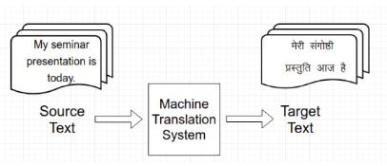
Introduction
Process of automatic conversion of text from one language to another
Preserve the meaning
Fluent output text
Reduces dependency on human translators.
Translates large volumes of text instantly.
Supports multiple languages simultaneously

Slide 16
MT approaches
Rule-Based Machine Translation (RBMT)
Uses linguistic rules, grammar, and dictionaries for translation.
Requires handcrafted rules for source and target languages.
Good for specific use cases with well-defined rules.
Requires extensive linguistic knowledge.
Poor performance for informal or unstructured text.
Example: AnglaBharti, Systran, Apertium.
Notes:
SMT Pros: ✔ Does not require handcrafted rules. ✔ Works well with large datasets.
SMT Cons: ✘ Struggles with syntax and grammar. ✘ Requires large datasets to improve quality.
NMT Pros: ✔ More natural and fluent translations. ✔ Can generalize well to new sentence structures.
NMT Cons: ✘ Requires significant computational power. ✘ Can produce unpredictable errors.

Slide 17
MT approaches
Statistical Machine Translation (SMT)
Learns from bilingual text corpora using statistical models.
Uses probability-based predictions for translation.
Does not require handcrafted rules.
Works well with large datasets.
Struggles with syntax and grammar.
Requires large datasets to improve quality.
Example: Google Translate (before 2016), Moses.
Notes:
NMT Pros: ✔ More natural and fluent translations. ✔ Can generalize well to new sentence structures.
NMT Cons: ✘ Requires significant computational power. ✘ Can produce unpredictable errors.

Slide 18
MT approaches
Neural Machine Translation (NMT)
Uses deep learning models (RNNs, Transformers) to generate translations.
Translates entire sentences rather than individual words or phrases.
More natural and fluent translations.
Can generalize well to new sentence structures.
Requires significant computational power.
Can produce unpredictable errors.
Example: Google Translate (after 2016), OpenNMT, MarianNMT. NLLB, IndicTrans
Notes:
NMT Pros: ✔ More natural and fluent translations. ✔ Can generalize well to new sentence structures.
NMT Cons: ✘ Requires significant computational power. ✘ Can produce unpredictable errors.

Slide 19
Text to speech synthesis

Slide 20
Introduction
Text-to-Speech (TTS) converts written text into spoken words using artificial voice generation.
Used in virtual assistants, screen readers, automated customer service, and AI-driven applications.
Key Components:
Text Processing:
Converts input text into a structured format (tokenization, normalization).
Linguistic Analysis:
Identifies phonemes, stress, intonation, and rhythm.
Speech Synthesis:
Generates human-like speech using various synthesis approaches.

Slide 21
TTS approaches
Concatenative TTS
Uses pre-recorded speech units (phonemes, syllables, words, phrases) stored in a database.
Assembles these units to form speech output.
High naturalness if well-recorded.
Low computational cost.
Limited flexibility (requires extensive recordings).
Cannot handle new words or expressions smoothly.
Example: Railway announcements, Early GPS navigation systems, IVR systems.

Slide 22
TTS approaches
Parametric TTS
Uses a statistical model like Hidden Markov Models to generate synthetic speech.
Relies on parameters like pitch, duration, and voice timbre instead of recorded units.
More flexible than concatenative TTS.
Can generate new words and phrases.
Sounds robotic and unnatural.
Requires fine-tuning of parameters.
Example: Festival, HTS (HMM-based TTS).

Slide 23
TTS approaches
Neural TTS (Deep Learning-Based TTS)
Uses deep learning models like WaveNet, Tacotron, and FastSpeech to generate highly natural speech.
Learns from large datasets and generates speech waveform directly.
High-quality, natural, and human-like speech.
Can mimic accents, emotions, and speaking styles.
Requires large datasets and high computational power.
Can be difficult to control precisely.
Example: Google’s WaveNet, Microsoft Azure TTS.

Slide 24
Thank you

