Slide 1
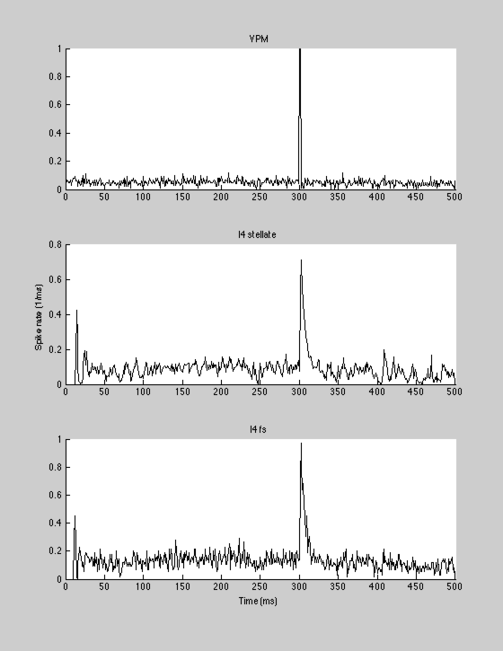
Intracortical circuit turned off
l4_l4_cp=0; %0.2; % connection probability
l4_l4_dge=0.01; % conductance in fraction change to reversal
l4_fs_cp=0; %0.5;
l4_fs_dge=0.01;
fs_l4_cp=0; % 0.5;
fs_l4_dgi=0.05;
fs_fs_cp=0;
fs_fs_dgi=0.01;
vpm_l4_cp=0.75;
vpm_l4_dge=0.03;
vpm_fs_cp=0.75;
vpm_fs_dge=0.04;

Slide 2
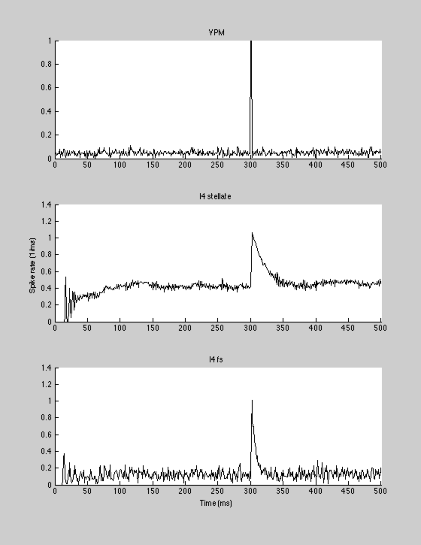
modest recurrent excitation
turned on
l4_l4_cp=0.2; %0.2; % connection probability
l4_l4_dge=0.01; % conductance in fraction change to reversal
l4_fs_cp=0; %0.5;
l4_fs_dge=0.01;
fs_l4_cp=0; % 0.5;
fs_l4_dgi=0.05;
fs_fs_cp=0;
fs_fs_dgi=0.01;
vpm_l4_cp=0.75;
vpm_l4_dge=0.03;
vpm_fs_cp=0.75;
vpm_fs_dge=0.04;

Slide 3

modest recurrent excitation
feedforwrd and feedback
inbitions
turned on
l4_l4_cp=0.2; %0.2; % connection probability
l4_l4_dge=0.005; % conductance in fraction change to reversal
l4_fs_cp=0.5; %0.5;
l4_fs_dge=0.005;
fs_l4_cp=0.5; % 0.5;
fs_l4_dgi=0.03;
fs_fs_cp=0;
fs_fs_dgi=0.01;
vpm_l4_cp=0.75;
vpm_l4_dge=0.03;
vpm_fs_cp=0.75;
vpm_fs_dge=0.04;

Slide 4
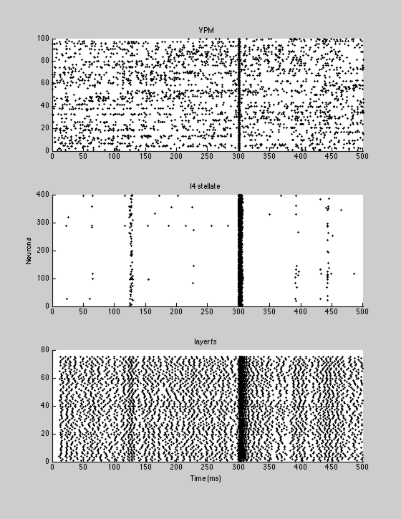
same as previous
raster

Slide 5
