Slide 1




Drug permeation through the data lenses
What MolMeDB and a meta-analysis of the literature reveal about the permeability numbers we collect
Karel Berka
Department of Physical Chemistry, Faculty of Science
Palacký University Olomouc
Notes:
Title. Two things in this talk: MolMeDB as a lens on molecule-membrane data, and what happens when you look through that lens at the whole permeability literature at once - the Storchmannova meta-analysis. Take-home in one line: permeability numbers are not interchangeable, and the database is what lets you see that.

Slide 2

THE PROPERTY
Permeability decides where a drug can go
log Perm, in cm·s⁻¹, sits underneath most of pharmacokinetics
1
Absorption
Gut uptake of oral drugs
2
Distribution
Crossing the blood–brain barrier
3
Elimination
Renal reabsorption in the tubule
4
Regulation
Input to BCS classification
5
Formulation
The liposome-formulability window
Notes:
Permeability is not a niche descriptor - it co-determines absorption, distribution and elimination, it feeds BCS classification, and it sets whether a molecule can be put in a liposome at all. The three coloured markers on the figure are the three barriers in the rows: blood-brain barrier in teal, intestinal wall in amber, renal tubule in green.

Slide 3
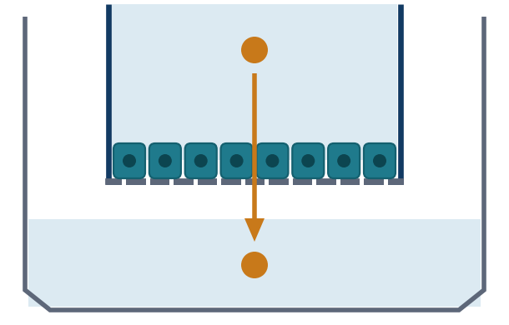
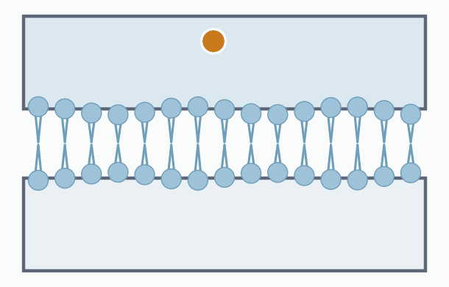
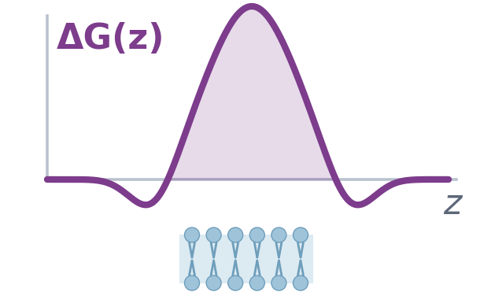
THE INSTRUMENTS
One property, three families of instrument
Each family answers a slightly different question — and that difference is the whole story
Cell-based
Membrane-based
In silico
CACO-2
MDCK
PAMPA (many variants)
BLM / liposomes
COSMOperm
PerMM
MD · QSAR · ML
Apparent permeability
Apparent or intrinsic
Intrinsic permeability
Notes:
Three families. Left: a transwell - a living cell monolayer on a porous filter, so the molecule crosses cells, transporters and all. Middle, animated: the same sandwich but the barrier is a bare artificial bilayer, and you can see the lipids splay as the molecule squeezes through. Right: no apparatus at all - a free-energy profile across the membrane, whose barrier height becomes the permeability. The bottom line of each card is the one that matters: cell assays give apparent permeability, calculations give intrinsic, and PAMPA gives whichever the authors happened to report.

Slide 4
SO WHY IS THIS HARD?
Comparing the numbers is the problem
Scattered
Under-reported
Thousands of papers, a dozen unit conventions
pH, temperature, direction and stirring missing
Conflated
Reused anyway
One word for two quantities, orders of magnitude apart
ML models are trained on pooled sets that mix them
Notes:
Four failure modes. None of them are anyone's fault individually - they are what happens when a field publishes for forty years without a shared deposition target. The fix has two halves: a database that keeps the context, and an honest look at what the pooled data actually support.

Slide 5

THE LENS
— Molecules on Membranes
Open and curated, built for molecule–membrane and molecule–transporter data
> 900,000
≈ 500,000
56
48
interactions
molecules
methods
membranes
2019: 1,200 molecules · 3,600 interactions
today: ≈ 500,000 molecules · > 900,000 interactions — a 250-fold growth
Manual curation, plus an automated ChEMBL data-mining workflow
In-house COSMOmic / COSMOperm baseline for every compound
Permeability, partitioning, positioning and free-energy profiles
http://molmedb.upol.cz
Juračka et al., Database 2019, baz078
Notes:
MolMeDB in one slide. The growth line: 3,600 interactions at publication in 2019, over 900,000 today - about 250-fold in six years, mostly from the automated ChEMBL mining workflow on top of manual curation. The point is not size for its own sake: every value carries its method, membrane and conditions with it, which is exactly what the second half of this talk needs.

Slide 6
UNDER THE HOOD
What travels with every value
The context is the data — a permeability without its conditions is not reusable
Molecule
System
Structure, SMILES, InChI
Charge form as its own entity
Links to PubChem, ChEMBL, PDB
Membrane model and composition
Biology- vs substance-based
Anatomical assignment
Measurement
Provenance
Method, from a 56-term taxonomy
pH, temperature, charge state
Value and standard deviation
Primary reference vs. source
DOI and PubMed identifiers
Substrate / inhibitor calls
Notes:
This is what makes the meta-analysis possible at all. Because method, membrane, pH, temperature and charge state are first-class fields, you can filter a comparable subset out of a heterogeneous pile. Note the provenance distinction: primary reference versus the database we mined it from.

Slide 7
INTEROPERABILITY
Making the lens machine-readable
MolMeDB RDF — the same data as a graph, queryable alongside the chemical web
Schema modelled on the PubChem and ChEMBL RDF schemas, with BAO, SIO and ChEBI terms
A MolMeDB vocabulary fills the gap where no ontology described membrane models
Public SPARQL endpoint at IDSM, with Sachem structural search built in
skos links to PubChem, ChEMBL, ChEBI, wwPDB and UniProt make federation routine
ONE QUERY, TWO DATABASES
“Give me the permeabilities of every drug that inhibits a human ABC transporter.”
One federated SPARQL query across MolMeDB and UniProt.
Martinát, Juračka, Galgonek & Berka, J. Cheminform. 2026, 18, 10.1186/s13321-026-01208-3
Notes:
Why RDF: membrane data only becomes useful in the context of transporters, targets and assays that live in other databases. We deliberately reused the PubChem and ChEMBL schemas so federation actually works. The one gap we had to fill ourselves was ontology terms for membrane models - there were none.

Slide 8
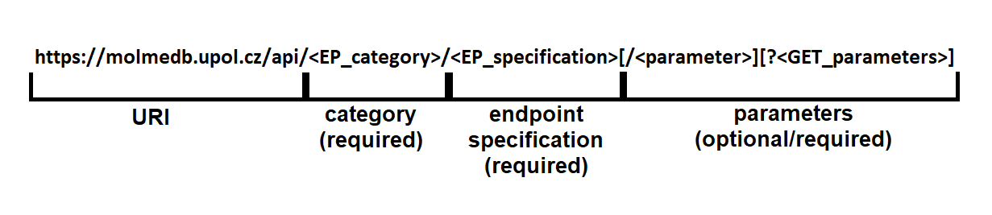
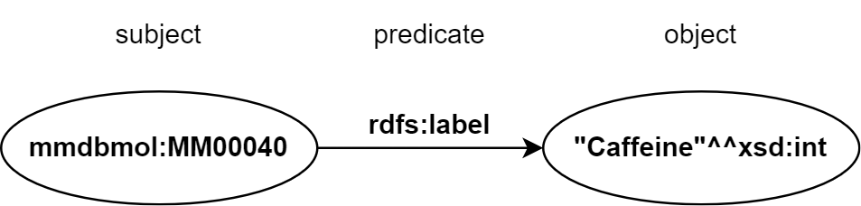
ACCESS
Programmatic access
Everything in MolMeDB is reachable without opening a browser
Classical REST API
RDF browsable via the SPARQL endpoint
https://idsm.elixir-czech.cz/sparql/endpoint/molmedb
Documentation: https://docs.molmedb.upol.cz
Notes:
Three ways in. A classical REST API whose URIs follow a fixed grammar - category, endpoint, parameters. The same data as RDF through the IDSM SPARQL endpoint, where every fact is a triple like this one: the MolMeDB identifier for caffeine, the predicate rdfs:label, the literal Caffeine. And full documentation at docs.molmedb.upol.cz.

Slide 9
PART TWO
Looking through the lens
Meta-analysis of permeability literature data shows possibilities and limitations of popular methods
Kateřina Storchmannová, Martin Balouch, Jakub Juračka, František Štěpánek, Karel Berka
Molecular Pharmaceutics 2025, 22, 1293–1304
Notes:
Part two. Katerina's paper. The question she asked was deliberately simple: if I take the public permeability data and treat it as one dataset - which is what everyone building an ML model implicitly does - what do I actually get?

Slide 10
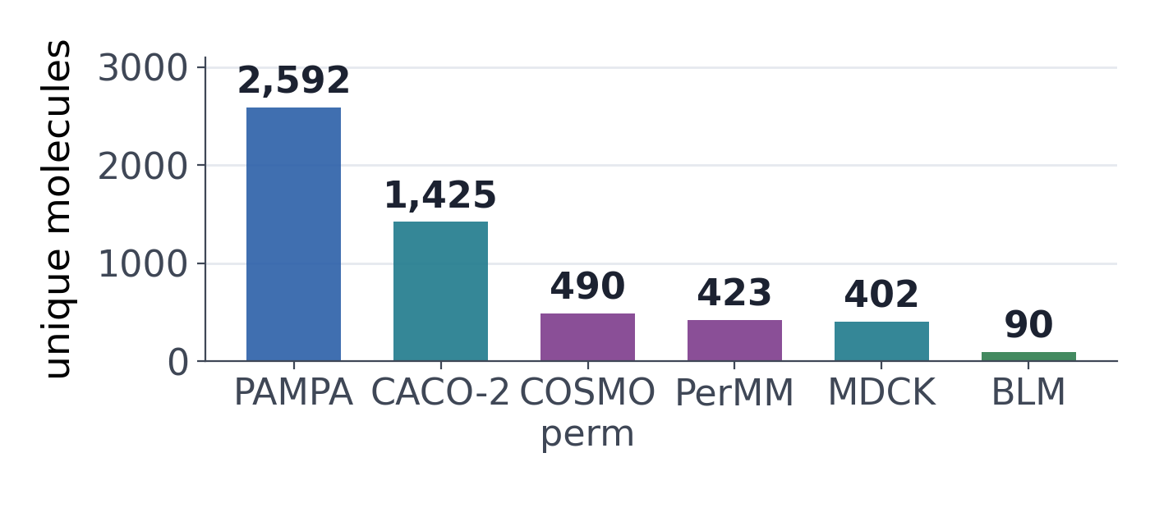
STUDY DESIGN
From 900,000 interactions to 5,483
Filters applied so that the remaining values answer the same physical question
Cell and intestinal membranes
Small molecules, ≤ 800 Da
pH 7.0–7.5, at 20–25 °C
Neutral for calculations
No amino acids
5,483 interactions 4,218 molecules
Four experimental and two computational methods
Data and KNIME workflows: WorkflowHub · Storchmannová et al., Mol. Pharm. 2025
Notes:
The funnel matters. Out of everything in MolMeDB, only about five and a half thousand measurements survive filters that make them physically comparable. Note the imbalance in the bar chart: PAMPA dominates, BLM has ninety molecules. That imbalance shapes everything that follows.

Slide 11
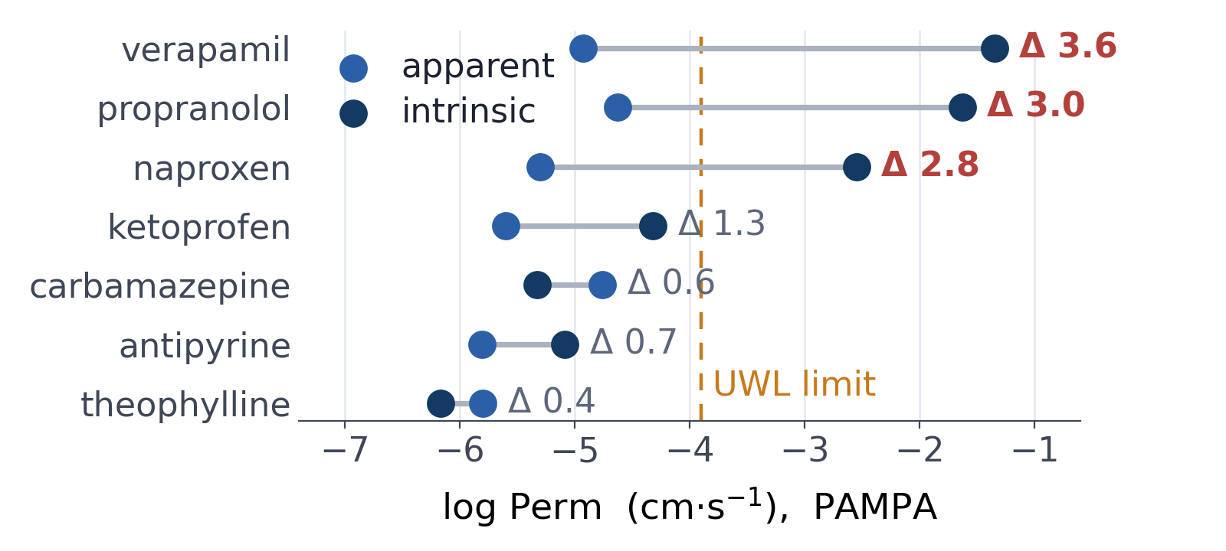
FINDING 1
The same method does not reproduce itself
PAMPA values for the seven best-covered molecules in the database
What you are seeing
Antipyrine repeats within 0.5 log
Others scatter by 2 log units
Two quantities, one label
Mean values per molecule, from Table 1 of Storchmannová et al., Mol. Pharm. 2025
Notes:
Start with repeatability, because if a method cannot reproduce itself there is no point comparing it to anything else. Verapamil: three point six log units apart depending on which quantity was reported. That is a factor of four thousand.

Slide 12
FINDING 2
Apparent is not intrinsic
Two resistances in series — and only one is a property of the molecule
1 / Papp = 1 / PUWL + 1 / ( f0 · P0 )
The water layer
One direction only
Often not stated
A stagnant film at the membrane surface caps transwell permeability near log Perm −3.9.
Intrinsic → apparent is arithmetic. The reverse fails near the diffusion limit.
Papers rarely say which is reported. We had to add intrinsic PAMPA to MolMeDB.
Notes:
The physics behind finding one. Apparent permeability is a series resistance: the water layer plus the membrane, weighted by the neutral fraction. When the membrane is fast, you are measuring the water - which is why at least forty percent of CACO-2 values sit at the ceiling.

Slide 13
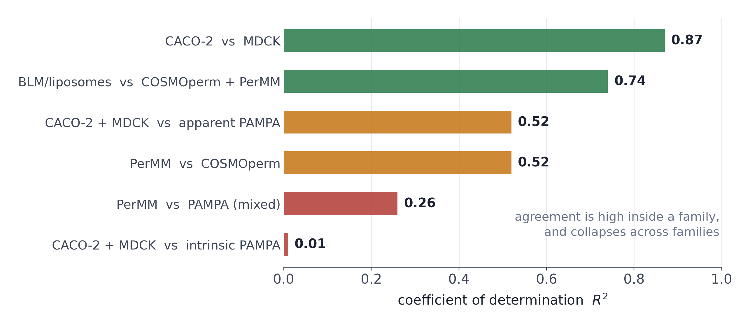
FINDING 3
Methods agree with their own kind
Pairwise coefficients of determination, for molecules measured by both
Two clusters
UWL-limited
CACO-2 · MDCK · apparent PAMPA
Membrane-limited
COSMOperm · PerMM · BLM
Figure 2 and Table 2 of Storchmannová et al., Mol. Pharm. 2025
Notes:
The headline result. Cell assay versus cell assay: R squared nought point eight seven. Cell assay versus intrinsic PAMPA: nought point zero one. Same molecules, same property name, no relationship whatsoever. The dividing line is not experimental versus computational - it is whether the unstirred water layer limits the measurement. Pool inside a cluster, never across: intrinsic PAMPA joins the membrane-limited group only to a lesser extent.

Slide 14
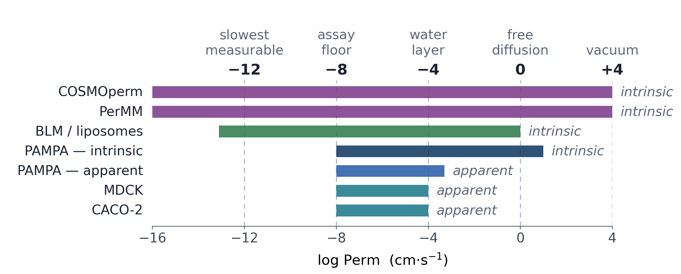
FINDING 4
A ruler for permeability coefficients
Five anchors, four log units apart — every method sees only a slice
Notes:
If you take one slide home, take this one. Minus twelve: the slowest permeation that still matters biologically - over the whole intestinal surface that is a quarter of a percent crossing in ten days. Minus eight: the floor of transwell assays. Minus four: the water layer, not the membrane. Zero: free diffusion in water. Plus four: a molecule in vacuum - the spherical chicken.

Slide 15
WHAT TO DO ABOUT IT
Three audiences, three asks
No new instruments needed — only that the context travels with the number
If you measure
If you reuse
If you curate
Say apparent or intrinsic
Report pH, temperature, stirring
Report uncertainty
Pool only inside one cluster
−4 measures water, not the molecule
Check the dynamic range
Method and conditions as fields
Primary reference vs. source
Publish FAIR — deposit in MolMeDB
Notes:
Practical asks. The middle column is the one that costs money if ignored - a machine-learning model trained across both clusters is fitting a mixture of a molecular property and an apparatus constant.

Slide 16
TAKE HOME
Permeability is one word for several different measurements.
Repeatability within one method spans up to 2 log units
Most of that spread is apparent vs. intrinsic
Two families: UWL-limited assays, and membrane-limited ones
The water layer caps transwell assays at log Perm ≈ −3.9
Only three molecules were measured by all six methods
A database that keeps method and conditions makes this visible
molmedb.upol.cz
MolMeDB · Juračka et al., Database 2019, baz078
MolMeDB RDF · Martinát et al., J. Cheminform. 2026, 18
Meta-analysis · Storchmannová et al., Mol. Pharm. 2025, 22, 1293–1304
Notes:
Take home. One word, several measurements. If you remember the two clusters and the minus three point nine ceiling, you will read permeability tables correctly for the rest of your career.

Slide 17



THANKS TO
Acknowledgements
MolMeDB team
External collaborators
Karel Berka — group lead
Jakub Juračka — development
Kateřina Storchmannová — curation
Aneta Juklová — data mining
Dominik Martinát — RDF
Václav Bazgier — IT support, hardware
IOCB Prague
Jakub Galgonek
UCT Prague
František Štěpánek · Martin Balouch
Université de Limoges
Gabin Fabre
Receptor.AI
Semen Yesylevskyy
Notes:
Thanks to the MolMeDB team in Olomouc and to our collaborators at IOCB, UCT Prague, Limoges, Receptor.AI and Solvay.

Slide 18


Thank you
for
your attention
molmedb.upol.cz

Slide 19

1^{st –} 5th February 2027, Olomouc
Registration will open soon

Slide 20
BACKUP
On-demand computation service
COSMOmic / COSMOperm run for you, inside MolMeDB
COSMOmic / COSMOperm
Lab section of MolMeDB
Input: SMILES
Membrane selection
Output: logPerm, logK, membrane affinity, penetration barrier
Available to registered members
11,000 calculations in the last two months
COSMOperm method: J. A. H. Schwöbel, A. Ebert, K. Bittermann, U. Huniar, K.-U. Goss, A. Klamt, J. Phys. Chem. B 124 (2020) 3343–3354
Notes:
Backup slide. You do not need a COSMO licence to get COSMOperm numbers: the lab section of MolMeDB runs them for registered members. Eleven thousand calculations in the last two months.

Slide 21
FINDING 5
The common ground is vanishingly small
160
molecules shared by PerMM and COSMOperm — and both are calculations
3
65
molecules shared by PerMM, COSMOperm and BLM
molecules measured by all six methods
90
molecules is the whole BLM dataset, yet it alone spans the range
hydrocortisone · salicylic acid · acetylsalicylic acid
UpSet analysis of the six methods · Figure 3 of Storchmannová et al., Mol. Pharm. 2025
Notes:
Hidden backup slide. Everyone assumes there is a shared benchmark set. There are three molecules. And the biggest overlap in the data is between two computational methods validated on the same experimental set.

